Slide 1
Wrap-up

Slide 2
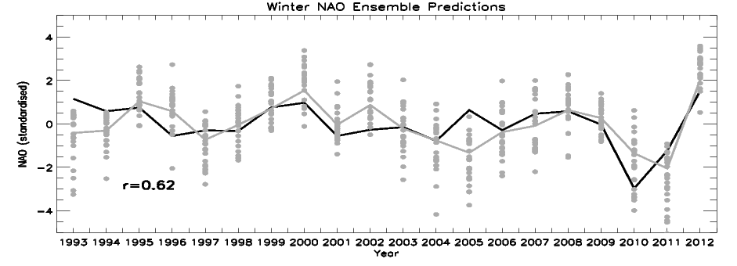
Predicting atmospheric circulation
DJF NAO Met Office operational seasonal forecasts with HadGEM3H N216L85O(0.25) with initial conditions from operational atmospheric analyses and NEMOVAR, 24 members, start date around the 1st of November (lagged method). Winter NAO correlation significant at the 98% confidence level.
A. Scaife (Met Office)

Slide 3
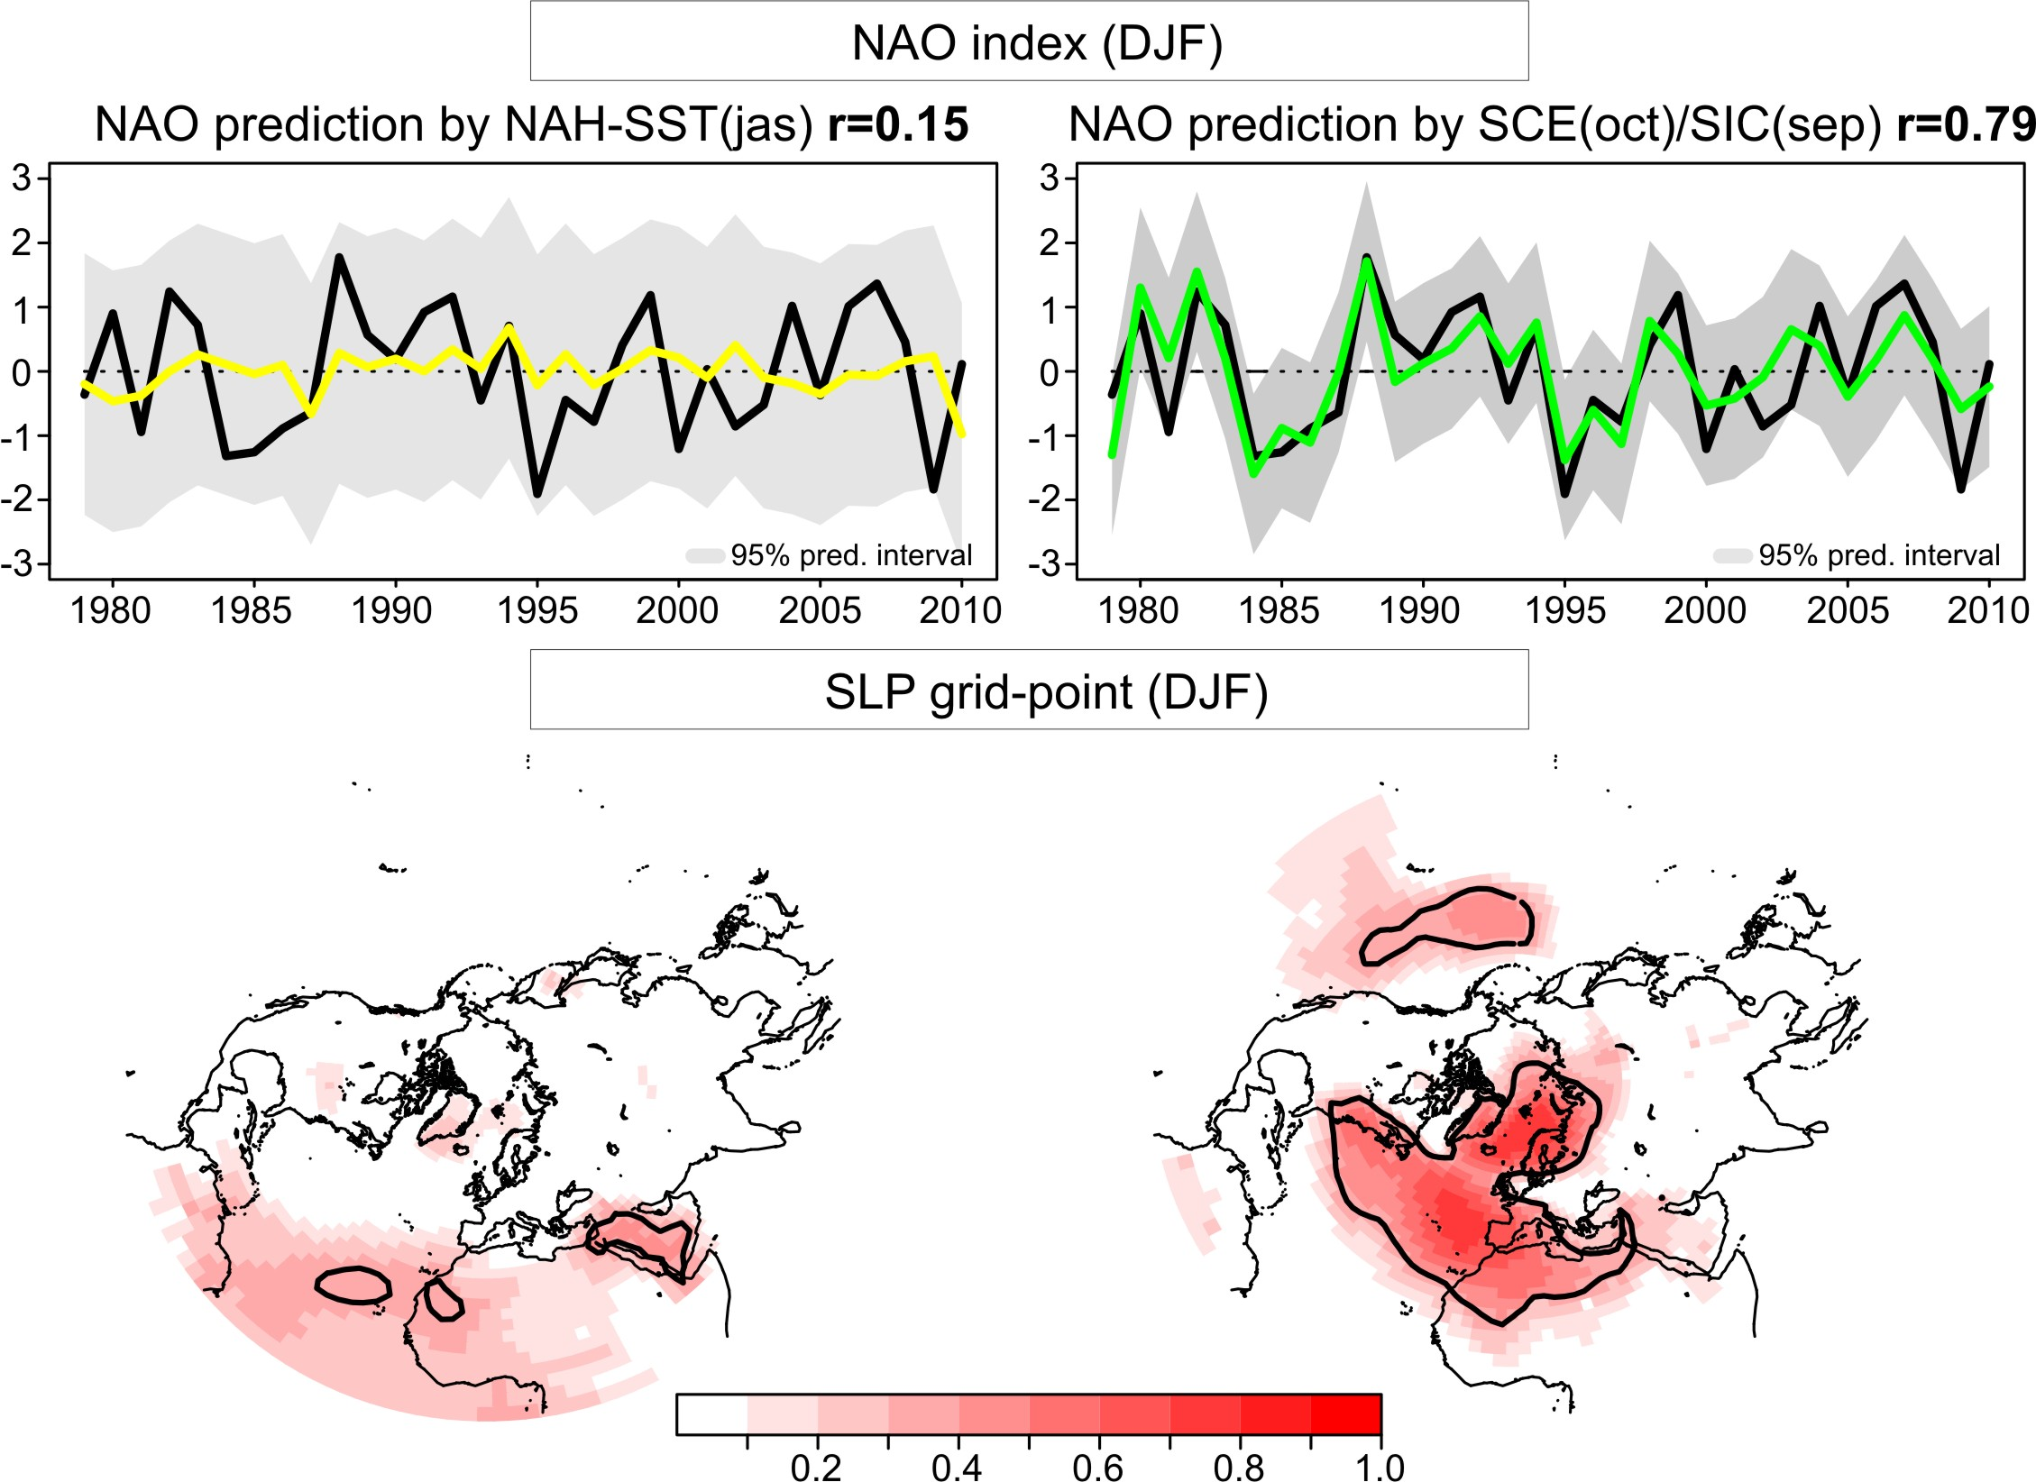
Predicting atmospheric circulation
DJF NAO seasonal forecasts using a multiple linear regression method (one-year-out crossvalidation) with the September sea-ice concentration over the Barents-Kara sea and the October snow cover over northern Siberia (one month lead time).
r=0.79
J. García-Serrano (IPSL)

Slide 4
Wrap-up
LRF training → 3 blocks:
  Monitoring and verification
    Need of standarized verification of prob. consensus outlook
    Need of monitoring info for verification

Slide 5
Example verification seasonal forecasts from GCMs: RPSS

Slide 6
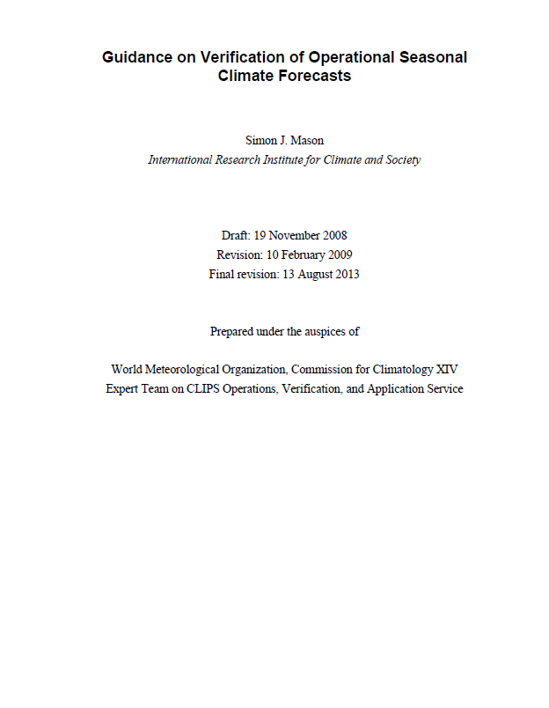

Slide 7
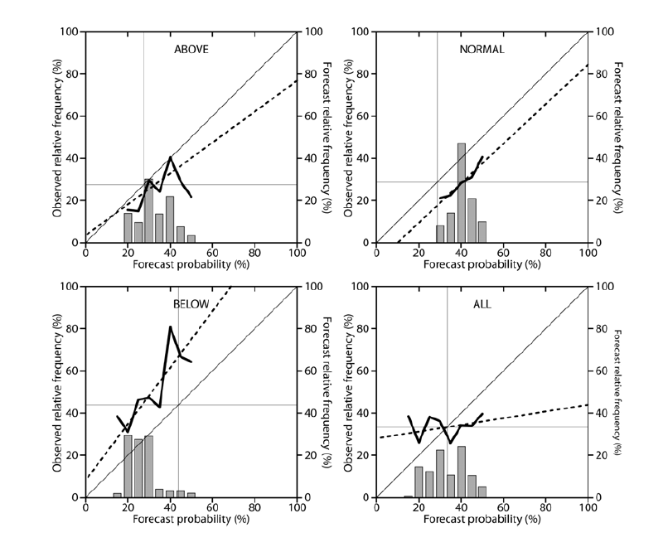
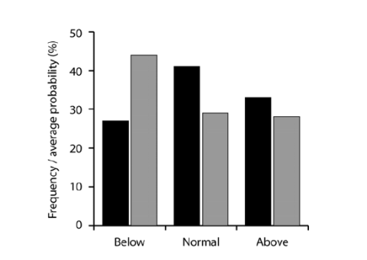
Reliability diagrams for the first 10 years of PRESAO (seasonal rainfall forecasts Jul-Sept)
Over-forecasting in normal category
Weak sharpness
Under-forecasting in below normal category

Slide 8
Wrap-up
LRF training → 3 blocks:
  Monitoring and verification
    Need of standarized verification of prob. consensus outlook
    Need of monitoring info for verification
  Available information sources
    Models: different skill → Every model used has to be evaluated/verified
    Systematic approach to the sources of predictability → empirical algorithms
  Methods, algorithms and projects
    Room for statistical algorithms/downscaling
    Need of updated info on relevant projects/initiatives

Slide 9
Way forward
Joint LRF training (MedCOF, SEECOF, PRESANORD)?
Once a year rotating N-S, E-W?
Themes for the next LRF training session?
Lectures/practical sessions?

