Slide 1
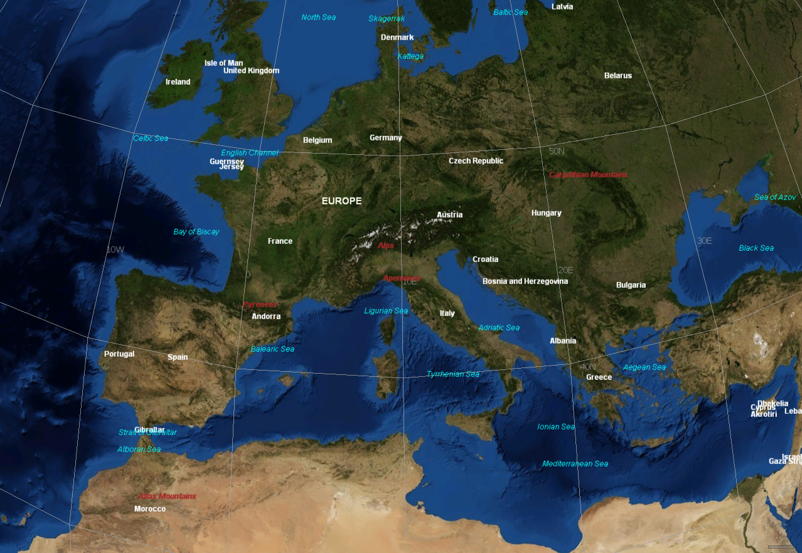
SEASONAL FORECASTS
BASED ON
STATISTICAL ALGORITHMS
Massimiliano Pasqui
Institute of Biometeorology National Research Council Rome, Italy.
m.pasqui@ibimet.cnr.it
with contributions from:
V. Pavan, F.J. Doblas-Reyes, J. Primicerio, S. Quaresima, E. Di Giuseppe, F. Guarnieri, L. Genesio, R. Benedetti, A. Crisci
REGIONAL TRAINING ON LONG-RANGE FORECASTS, CLIMATE WATCH RELATED
ASPECTS AND CLIMATE SCENARIOS - LRF Training
13 - 16 November 2013, Belgrade, Serbia

Slide 2
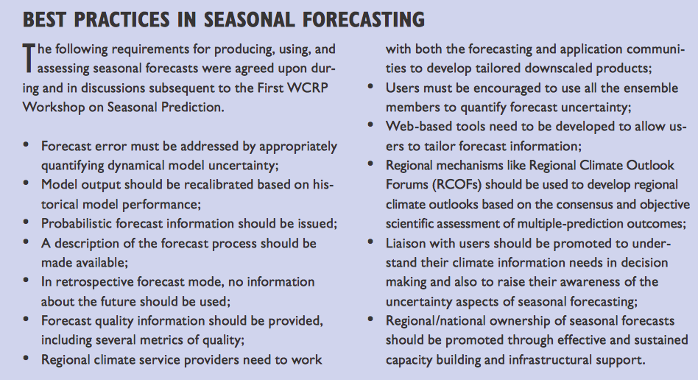

Kirtman, Ben, Anna Pirani, 2009: The State of the Art of Seasonal Prediction: Outcomes and Recommendations from the First World Climate Research Program Workshop on Seasonal Prediction. Bull. Amer. Meteor. Soc., 90, 455–458.doi: http://dx.doi.org/10.1175/2008BAMS2707.1

Slide 3
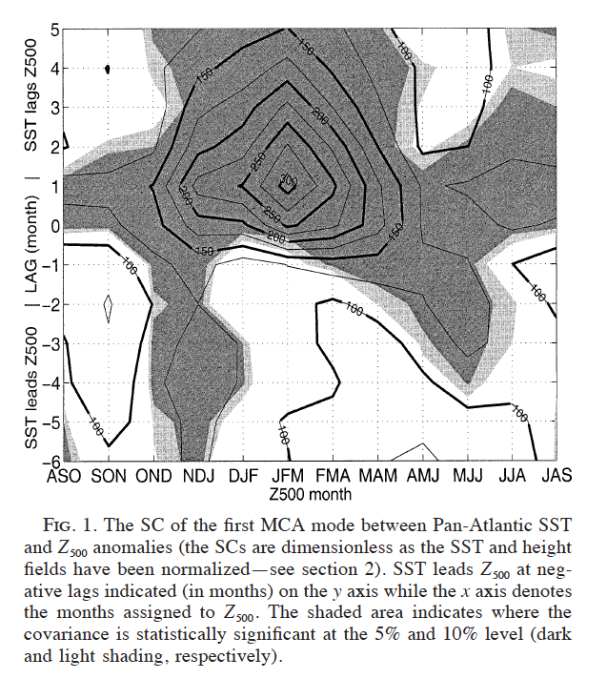
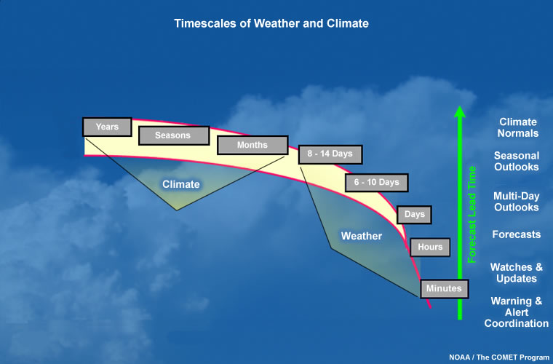
Interesting Timescales
Czaja and Frankignoul, 2002

Slide 4
Interesting Timescales #2
Days
Weeks
Month
Season
Decadal?
Wind Storms
Forest Fires
Cold Air Outbreaks
Dry/Wet Spells
Drought Evolution
Heat/Cold Waves
Water Supply
Energy Supply
Normal Conditions (e.g. for Agri. Act. Planning)

Slide 5
Remarks
Seasonal forecasting represents the attempt to predict the spatial and temporal distribution of atmospheric anomalies few months in advance.
- Even though the detailed dynamical evolution of atmospheric system is not predictable on those time scales, some of its statistical features and behaviors can be forecasted.
In particular it is possible to infer the mean behavior over a month or season and how much the PDFs of such values, or anomalies, differ from "climatology". Or in other words it can be highlighted a specific regimes.

Slide 6
In the Mediterranean basin where a changing climate seems acting towards a remarkable footprint both for rainfall and more pronounced on heat wave related events, the water management should be adopted at seasonal time scale for critical scenario modelling.
Nowadays seasonal forecast systems should still cover a dynamical scale gap to reach local scale and sub monthly climatic variability.
E.g. drought is a composition of different physical mechanisms: large scale climatic anomalies and local environmental factors and it is of prime interest for civil, agricultural and industrial activities.
Seasonal forecasting deals mainly with large scale climatic phenomena.

Slide 7
Dynamical models become a major tool in seasonal prediction and have demonstrated a significant progress in tropical seasonal to inter-annual predictions (e.g., ENSO dynamic), but their direct outputs seem to be much less satisfactory for middle and higher latitudes;
On the other side statistical models can give comparable and even higher skills for specific regions and for some variables, and their results can be easily applied for practical use without a full comprehension of physical mechanisms behind.
Finally statistical models need little computational resources being much more simple to be used than dynamical ones.
But they requires some careful attentions since reliability is obtained through a balance between goodness-of-fit and stability of the model.

Slide 8
IBIMET on SeaFor
Main Activities related:
Early – Warnings
Monitoring and Survey
Seasonal Forecasts
Target Areas
Italy
TEMPIO Project
Italian Ministry of Agriculture and Forest
Mediterranean Basin
Internal funding
West African Mosoon
Many different projects: AMMA, etc.
Institutional End Users
National Civil Protection Department: Monthly and Seasonal forecast group. It meets monthly, provides outlook for one to three months ahead mainly for the management of water scarcity crisis [it started in winter 2007]. It is composed by IBIMET, ARPA-SIM, CNMCA, CRA-CMA (ex UCEA), ISAC-CNR.
Arno river basin Water Safeguard Commission: monthly meetings

Slide 9
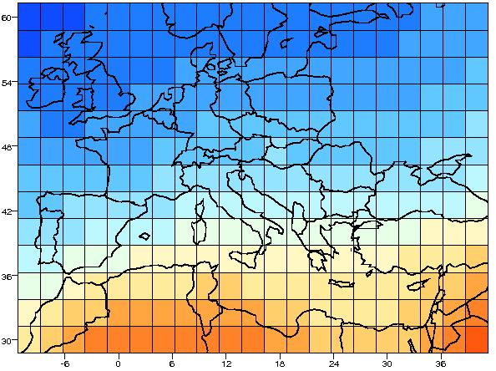
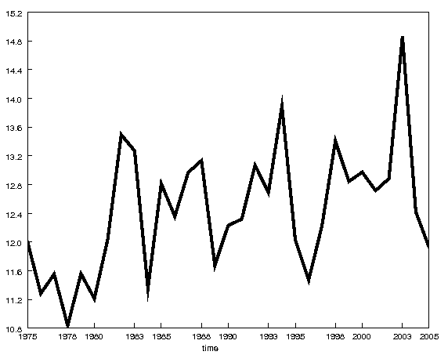
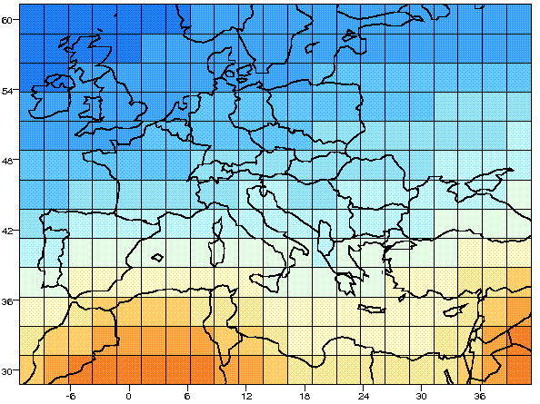

Seasonal Forecast Overview
Observed
Temperature
Matrix
2010
Temperature at location (x,y)
……
1976
1979
Multivariate Linear
Regression algorithm
Predictors
Matrix
Forecasted Temperature at (x,y) for time (t) expressed as probability of occurrence

Slide 10
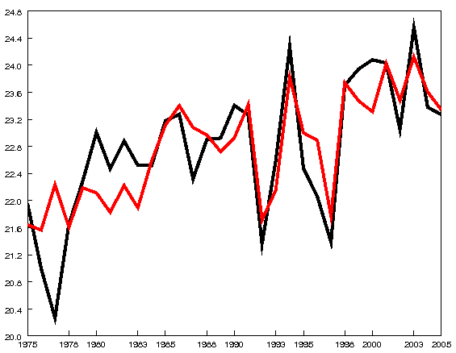
Iteration over time and space
Hindcast Temperature Matrix
Hindcasted Temperature at location (x,y)
2010
……
1976
1979

Slide 11
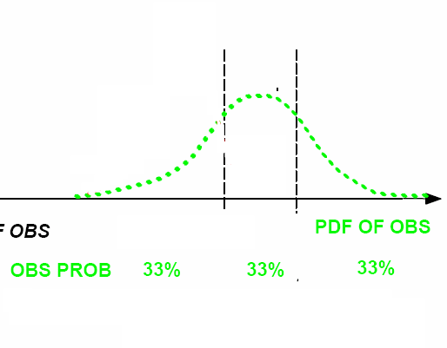

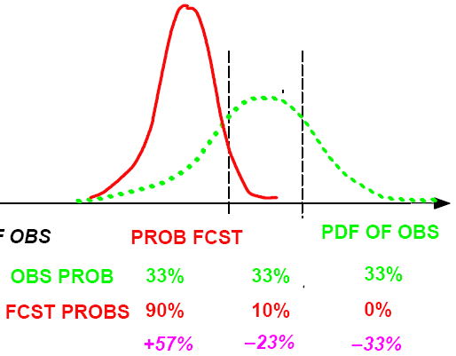

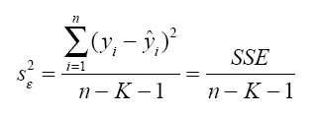
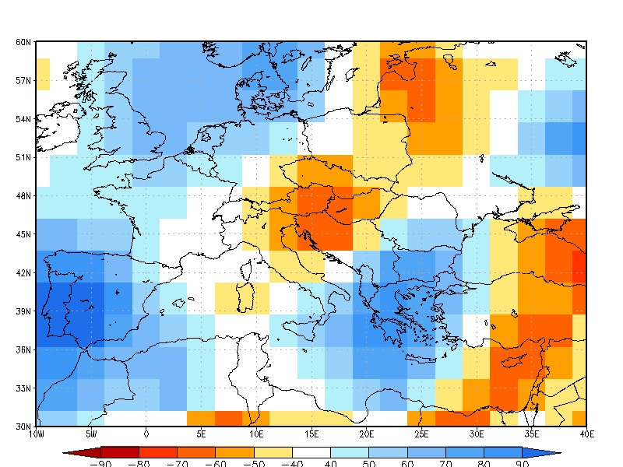
Towards a probabilistic view
Multiregressive
DRY
NORM.
WET
Forecast
Multiregressive Errors
P_{forecast(D,N,W)} ≡ PFcst ┴ PObs_{D,N,W}
s_{ε}² : Forecast Error Variance
SSE: Sum Square Errors
n : Sample amount
K : Predictors
Prob. Dry
Prob. Wet
Norm.Ter.
11
Dominant tercile maps

Slide 12
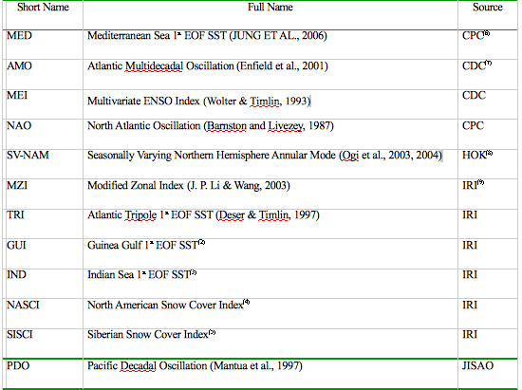
Method Overview
The multi-regressive method based on physical atmospheric indices and sea surface anomalies, at monthly time scale.
Lead – time choices are made on physical basis and on a maximization of the regression values between observed and forecasted field anomalies thus performing an “adaptation” for the best choice of predictors.

Slide 13
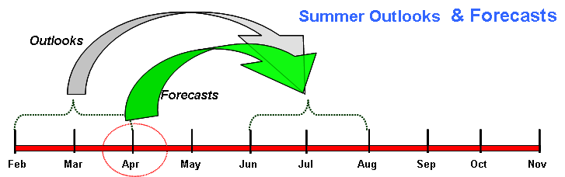
Winter – Summer Predictions
Summer variability could be associated to winter atmospheric variability (SV – NAM, snow cover, etc.) and to Atlantic SST anomalies (Tripole and 1st EOF Guinea).

Slide 14
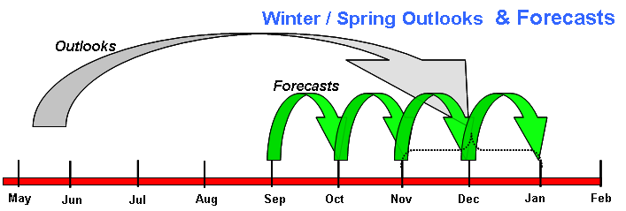
Fall – Winter Predictions
Fall to Winter variability could be associated to Spring to SST anomalies through reemerging Atlantic SSTA mechanism (OUTLOOKS) plus the atmospheric fall – winter variability (MONTLY).

Slide 15
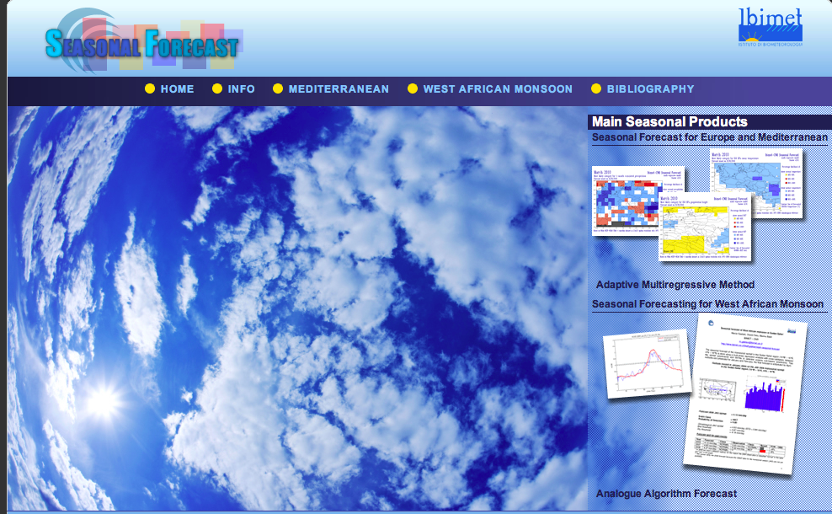
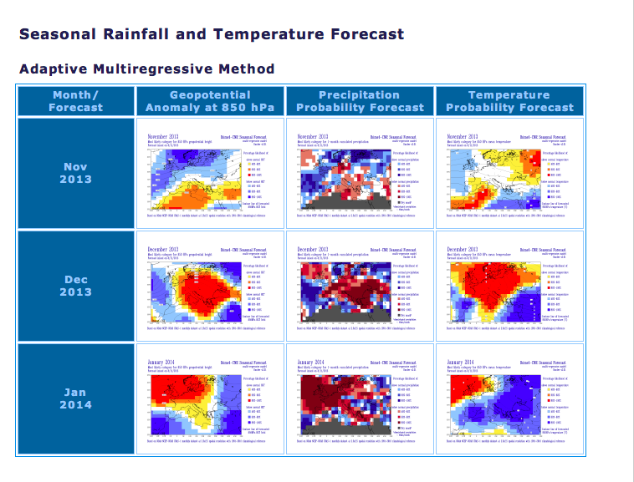
Web Products
http://web.fi.ibimet.cnr.it/seasonal/

Slide 16
Interannual Variability: an example
August Tmp 850hPa Anom [Lag -2]
August Precip Anom [Lag -2]
CRU dataset
Forecasted tmp 850hPa [°C]
±0.5 / ±1 sigma band
Obs surface Anom [°C]
PRECL Based

Slide 17
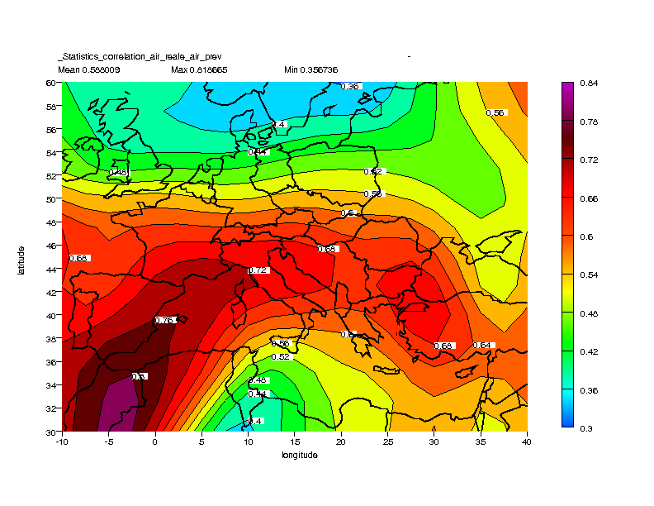
More validation
Es.: Temp 850hPa JJA issued in April
RMS_{fore}
RMS_{clim}
1
1979 – 2009

Slide 18
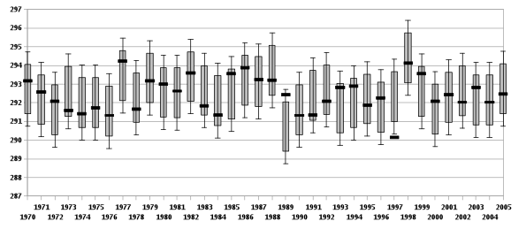
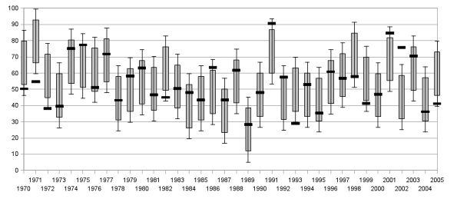
Aug Temp
EasternMed
Reference
Values
Dec Pcp
EasternMed

Slide 19
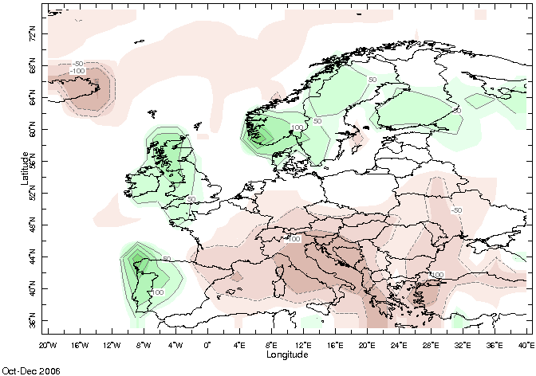
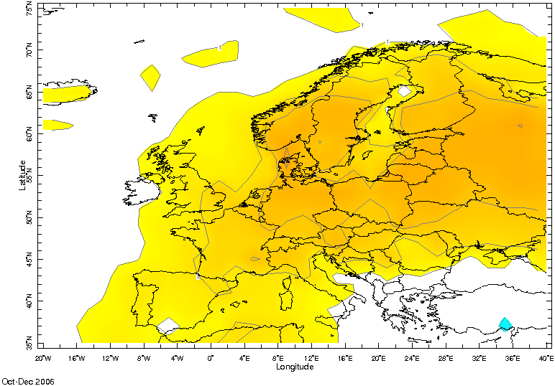
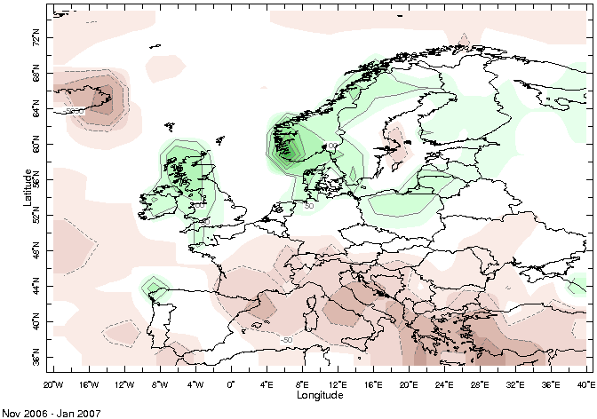
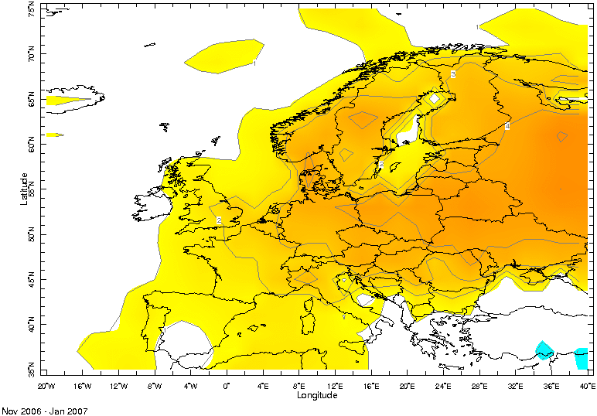
An exceptional (*) warm period in Europe and a long dry period in southern Europe.
In Jan 2007 Italian Civil Protection (DPC) established a technical working group for monthly to seasonal forecasts for drought emergency. It consist of 5 groups: ARPA-SIMC, AM, CRA-CMA, CNR-ISAC, CNR-IBIMET.
3-months seasonal forecast from ARPA-SIMC & CNR – IBIMET are shown here.
Oct – Dec 2006
Nov 2006 – Jan 2007
(*) Luterbacher J.; Liniger, M. A.*; Menzel, A.; Estrella, N.; Della-Marta, P. M.*; Pfister, C.; Rutishauser, T. ;Xoplaki, 2007Exceptional European warmth of autumn 2006 and winter 2007: Historical context, the underlying dynamics, and its phenological impactsGeophys. Res. Letter, 34, L12704

Slide 20
The Italian Civil Protection started a monthly to seasonal permanent forecast board since the (Extreme Dry/Warm) Winter 2006-2007 with monthly meeting regarding major critical environment and planning issue: next three months along with a focus on the following month.
Days
Weeks
Month
Season
When?
Wind Storms
All Season
Forest Fires
Summer
Cold Air Outbreaks
Winter/Summer
Dry/Wet Spells
All Season
Drought Evolution
All Season
Heat/Cold Waves
Winter/Summer
Water Supply
Winter/Summer
Energy Supply
Winter/Summer
Normal Conditions (e.g. for Agri. Irrigation Planning)
Extended Summer

Slide 21
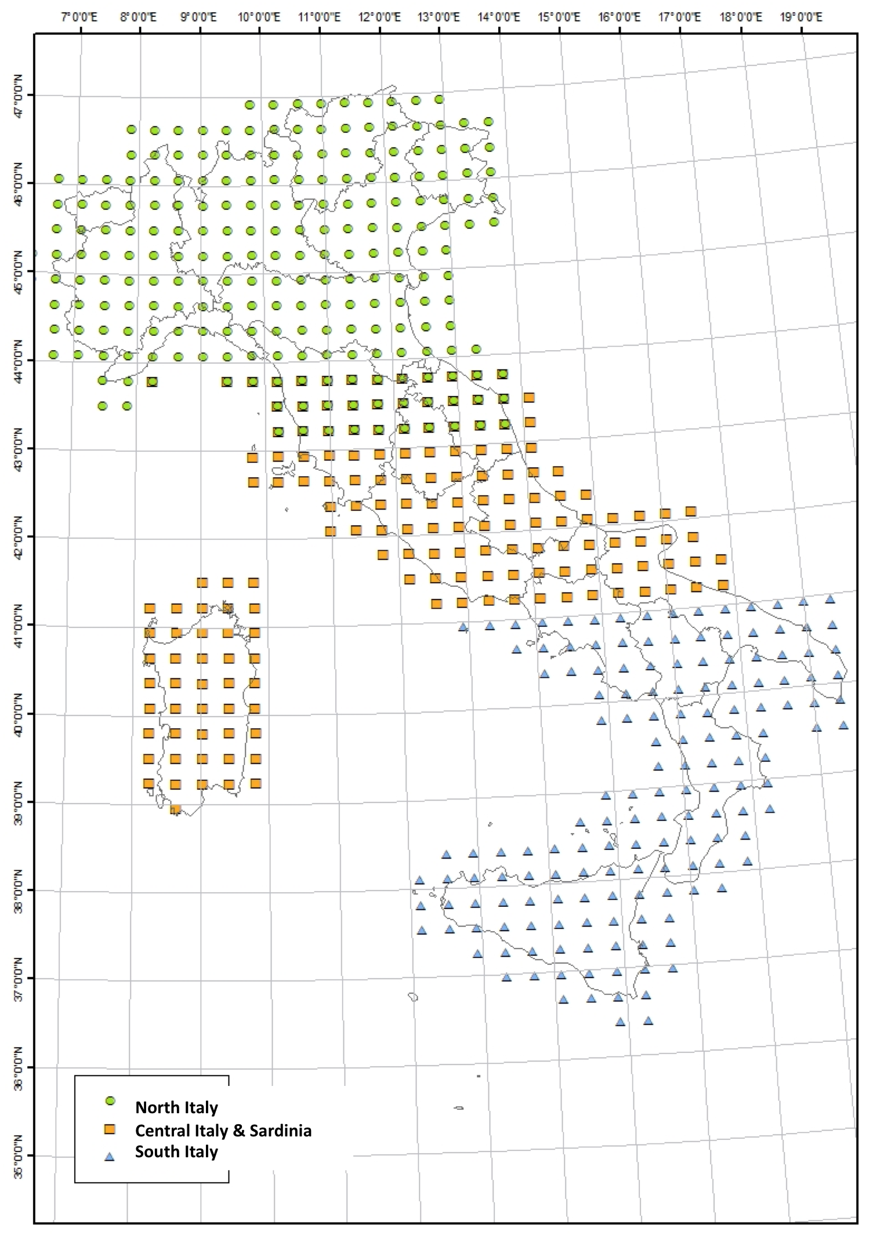
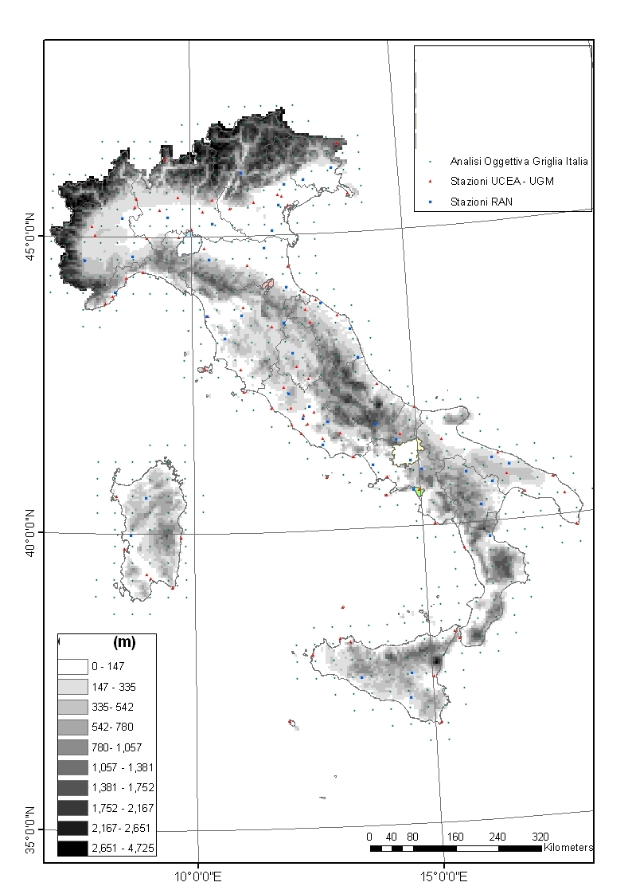
A reference “ground truth”
North
Centre
South
Three reference areas were established according to the DPC needs of observation, long term forecast and a consensus basis, thus not purely climatic.
The CRA-CMA Analysis data-set consists of an objective analysis of station data (AM & CRA-CMA) covering the whole Italian territory with a regular 35Km grid from 1951 to present and includes daily minimum, maximum temperature and precipitation.

Slide 22
ARPA-SIMC Calibration Scheme
Large-scale Predictions
(monthly Z500-T850)
Euro-SIP @ 2.5°x2.5° over
Euro Atlantic
PC An.
Predictors
MLR
in cross-val.
Probabilistic Forecast Maps
EOF obs + PC pred
Local Obs.
(daily T_{max},T_{min}, Prec)
UCEA analysis @ 35Km over Italy
PC An.
Predictands

Slide 23
Skill of T_{max} JJA predictions over Italy
Results refere to ENSEMBLES-STREAMII multi-model seasonal forecasts (1971-2005)
Preprocessing | DMO |  | Calibrated
 | Cor | BSS | Cor | BSS
Full fields | 0.38* | 0.14 | 0.49** | 0.21
Detrended | -0.01 | 0.004 | 0.27 | 0.11
Full fields - 2003 | 0.45 | -0.08 | 0.60** | 0.17
(Full fields – 2003) detrended | 0.09 | -0.03 | 0.49 | 0.09
Pavan and Doblas-Reyes (2013)

Slide 24
Calibrated seasonal multi-model seasonal predictions have better skills than DMO multi-model predictions
Over Italy and in the summer season the DMO T_{max} predictions skill is mostly due to the correct representation of linear trends.
Calibration can still produce skilful predictions even if trends are removed.
The presence of extreme events in the data-set has a strong influence on the evaluation of the skill of the system and on the calibration process.

Slide 25
IBIMET – Statistical Forecast System
Worldwide Observed Climatic Indexes: SSTA & Atmos.
ERSSTvs3b & Atmos. Mostly Reanalysis II Based
PC An. & Correlation Analysis
Predictors
MLR
In cross-val.
1-month & 3-months
Forecast Maps
Grid point Calculation
Monthly Reanalysis 2 T850, PREC, HGT850, 1979 - present
Predictands

Slide 26
SeaFor Validation Results: ARPA-SIMC & IBIMET
Ranking primarily the BSS and considering POD & FAR:
… general considerations:
both 2-classes & 3-classes performances are similar good;
JJA results are slightly better than DJF;
T is slightly better than P;
No major differences between P and T for same quarter year, areas;
the southern area precipitation is the most critical;
… and specific considerations
overall ARPA-SIMC performances are clearly better than IBIMET;
… it is clear in DJF, less evident in JJA;
IBIMET forecasts are poor in DJF, especially for T (even at 850hPa);
ARPA-SIMC T&P very good for both JJA and DJF in N-C areas;

Slide 27
Winter 2006/2007 Case Study
Outcome
Outcome
Outcome
Terget Season
Feb
Mar
Apr
May
Jun
Jul
Aug
Sep
Oct
Nov
Dec
Jan
Feb
Outlooks
Monthly
Outlooks: Temp / Precip
Monthly: Temp / Precip / SPI.3

Slide 28
Observed status in Italy
From: www.protezionecivile.gov.it

Slide 29
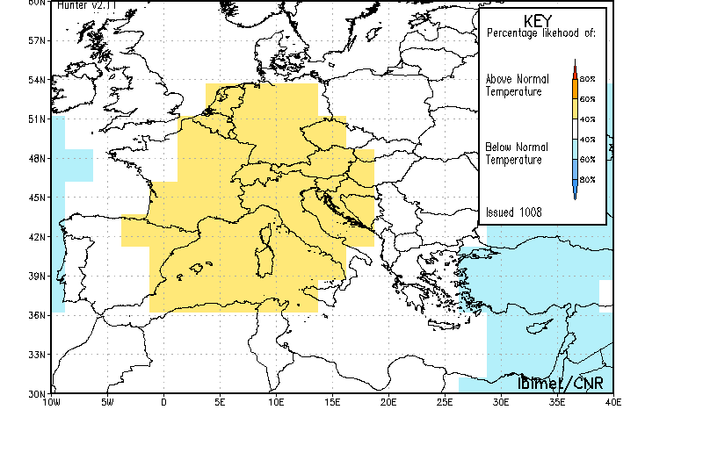
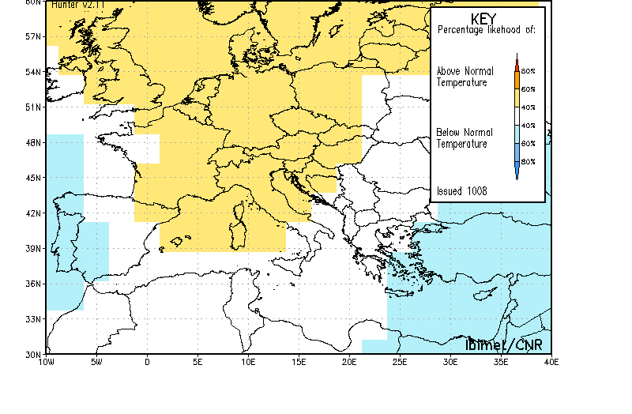
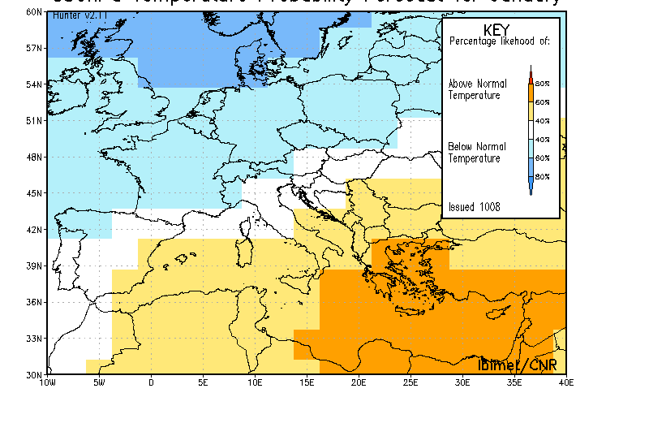
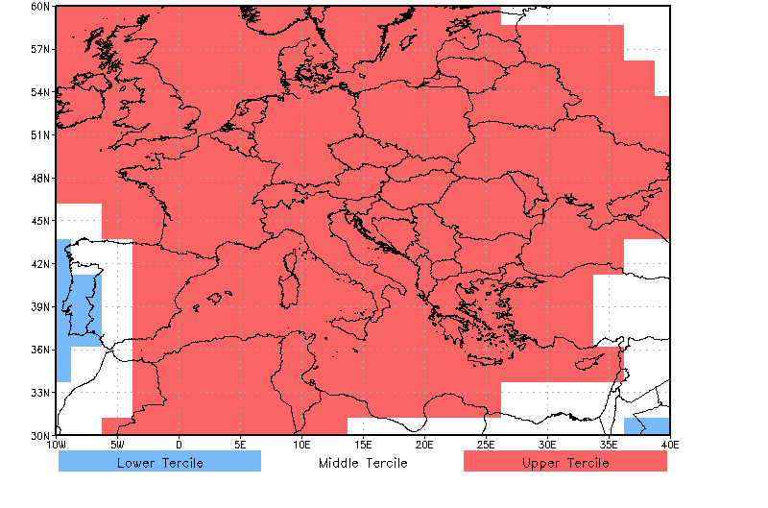
Outlooks Temp850hPa Anom DJF
April 2006
July 2006
November 2006
Reanalysis 1971-2000

Slide 30
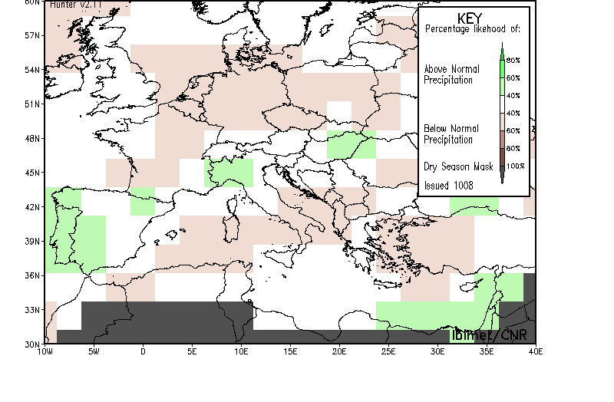
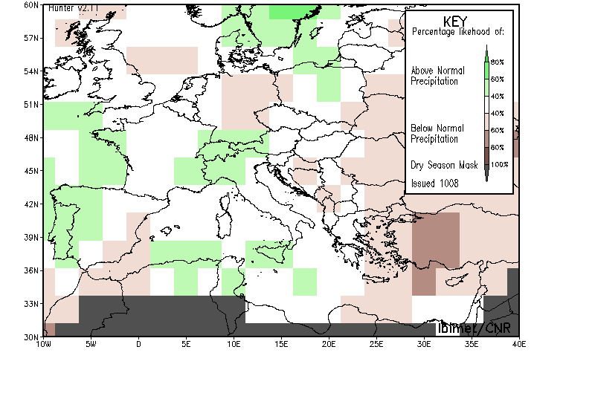
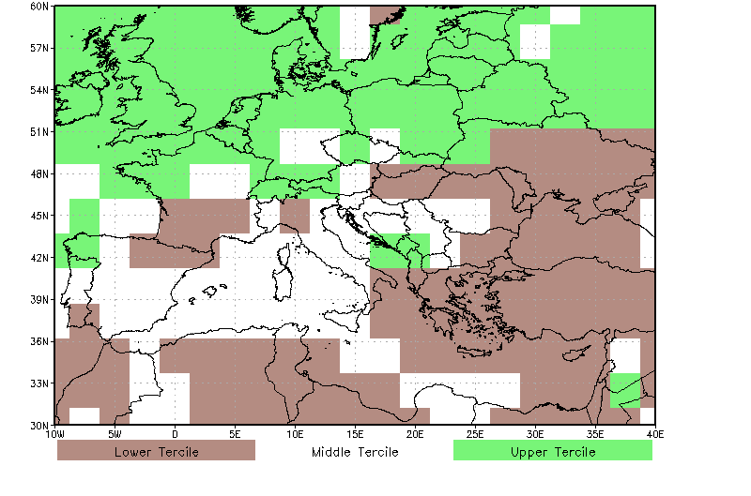
Outlooks PCP Anom DJF
April 2006
November 2006
Reanalysis 1971-2000

Slide 31
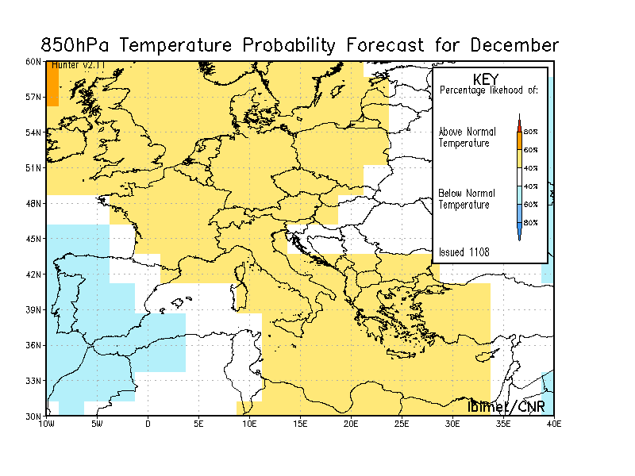
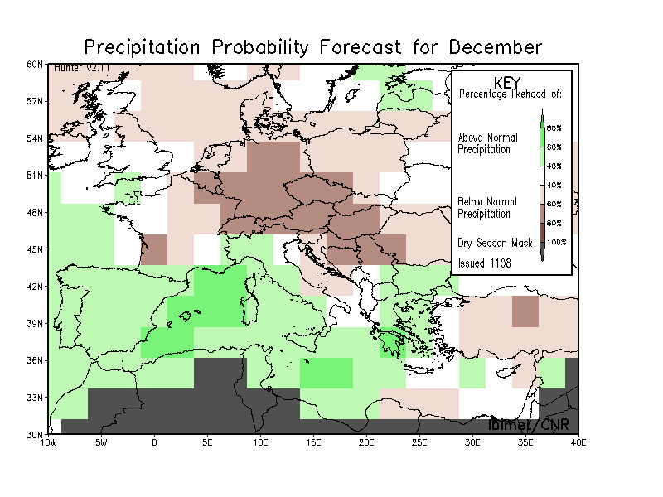
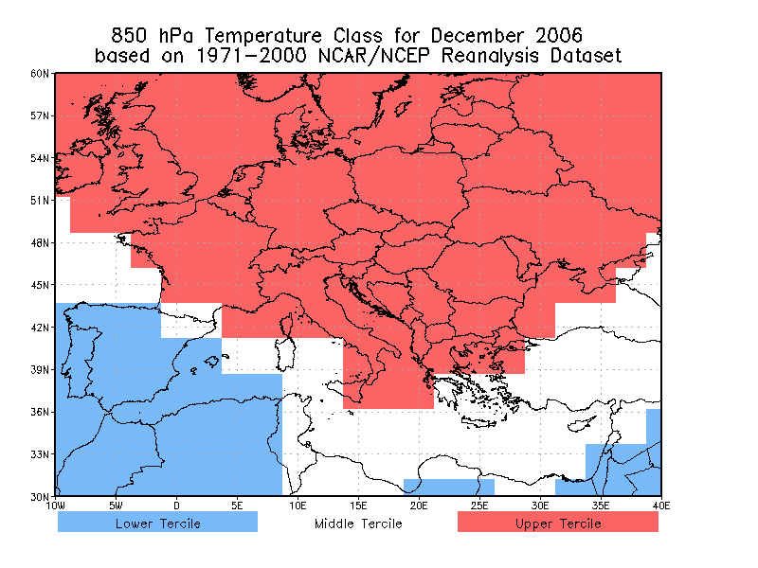
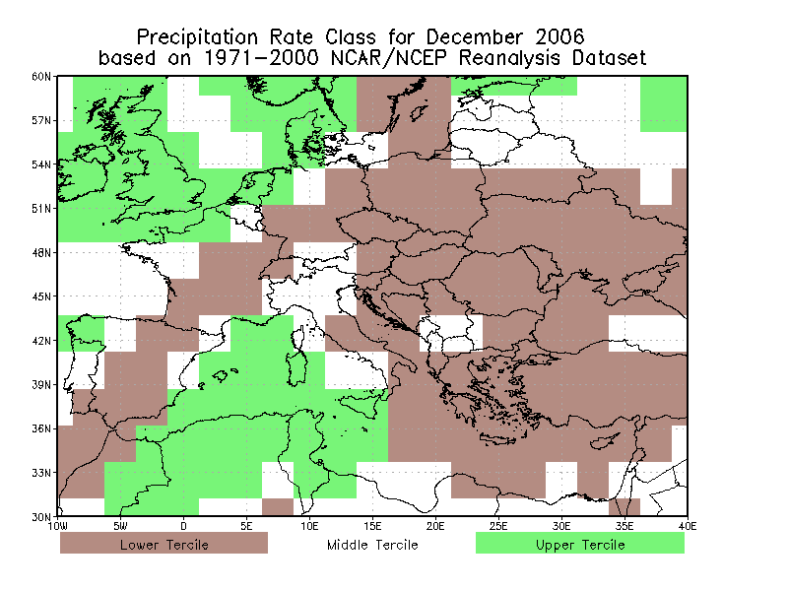
December 2006
Data from Nov 2006
Reanalysis 1971-2000

Slide 32
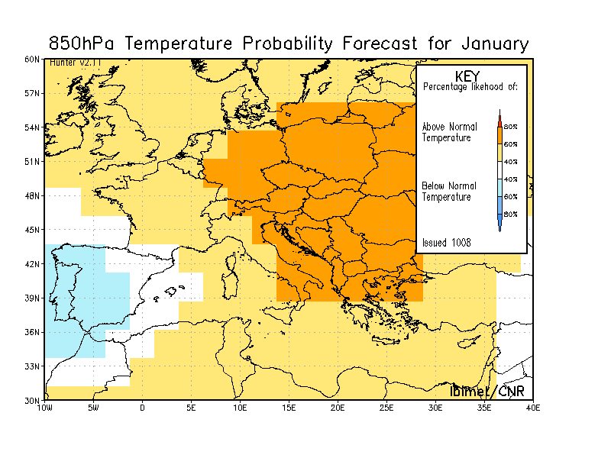
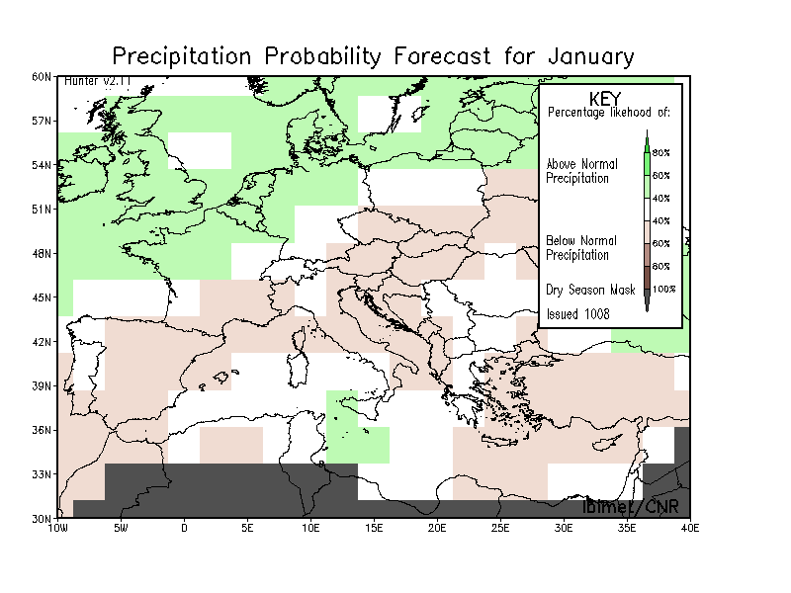
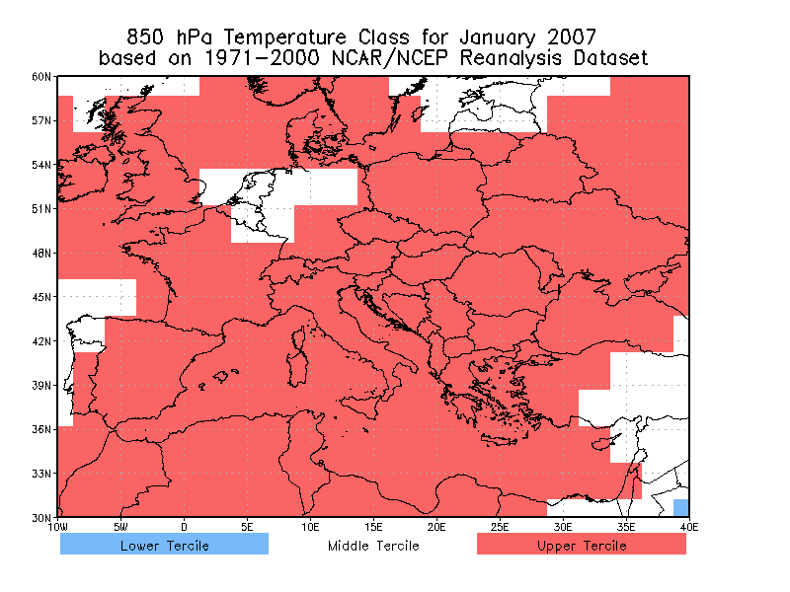
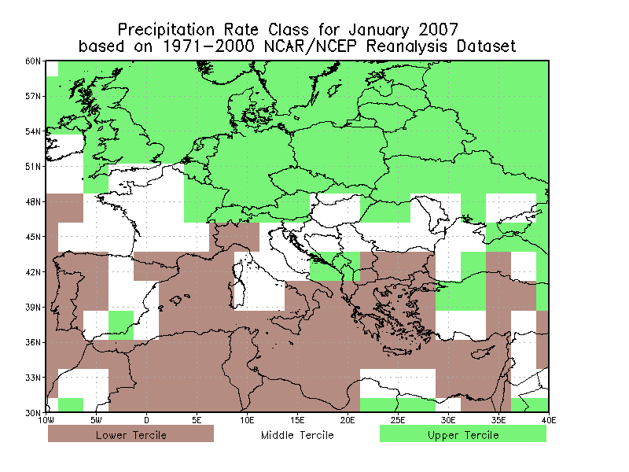
January 2007
Data from Dec 2006
Reanalysis 1971-2000

Slide 33
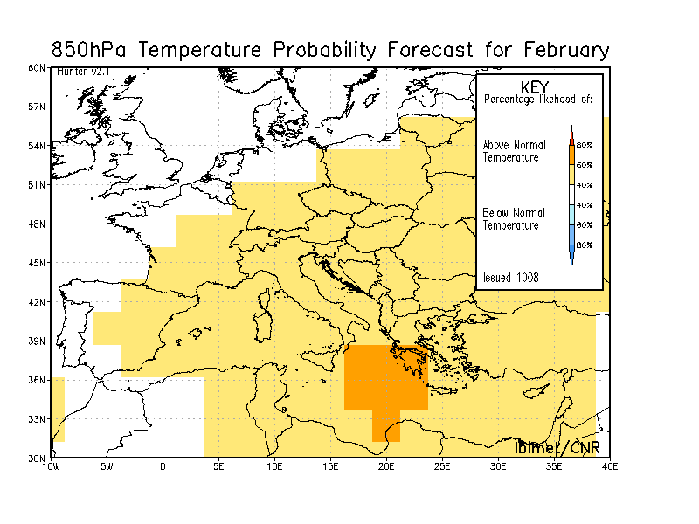
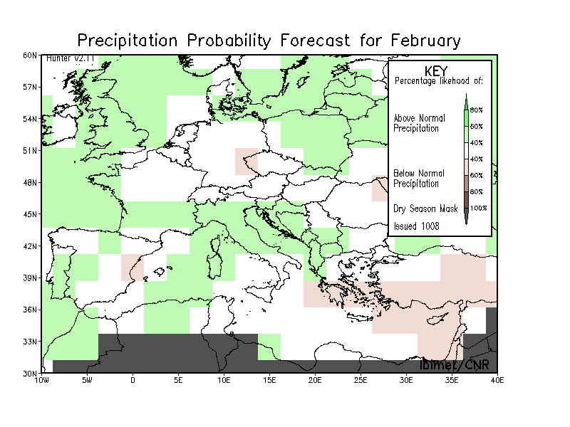
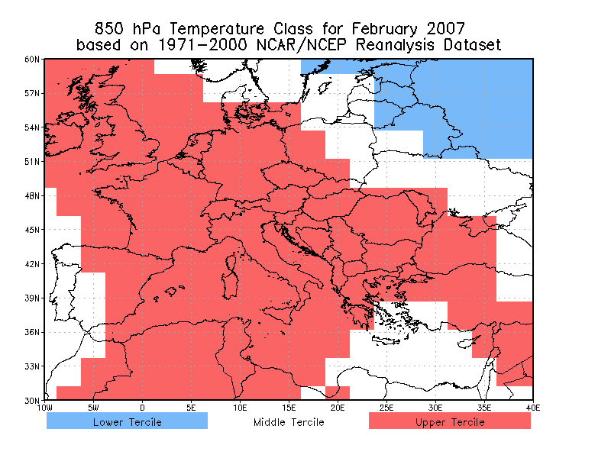
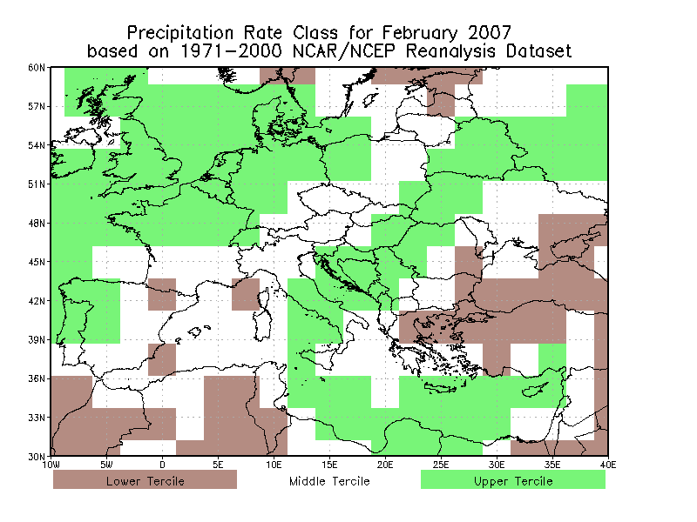
February 2007
Data from Jan 2006
Reanalysis 1971-2000

Slide 34
CONCLUSIONS
This seasonal prediction method shows encouraging results over the Mediterranean area: large scale features and correspondent anomalies location have a reliable skill level.
The successful key for summer season seems to be the choice of physical predictors and their long range memory which is linked to the Winter North Hemisphere Snow Cover extent and Spring melting.
In particular winter SV-NAM and the Spring Atl. Tripole & 1st EOF Guinea, seem to produce the “core” Summer variability over that area.
Even winter atmospheric anomalies present a reliable skill level.
Further investigations will be focused on downscaling techniques based on statistical methods.

Slide 35
… some sub-seasonal
(synoptic/regime) characterization …

Slide 36
Motivations
Monthly and quarterly climate anomalies, issued by seasonal forecast systems, even if reliable, could be of marginal use without an associated synoptic regime characterization.
Circulation classifications, along with a canonical correlation analysis, represent a promising and practical way to reduce the existing temporal gap, between monthly or quarterly climate anomalies and synoptic regime characterization.

Slide 37
Motivations
Canonical (which means: reduced to the simplest or clearest possible scheme) Correlation Analysis approach is wide used in climatology and in particular it is applied, since late ’80s for extracting information among predictors. (e.g. Barnett and Preisendorfer, MWR, 1987)
Two papers, Moron et al. (part I and part II, J.Climate, 2008), an inter – annual variability characterization of Sahel precipitation based on the WT inter – annual regime analysis from historical and forecast GCMs.

Slide 38
Basic Idea
The basic idea is to find a (linear) relationship, at month or season time scale, between two daily datasets: temperature anomalies and a WTC daily catalogue.
In order to move from daily to monthly or quarterly time scale, daily data could be classified. A possible choice is computing a class occurrence matrix.
The seasonal forecasting goal is capability of capturing the inter and intra annual variability of atmospheric fields. Statistical methods are dealing with inter – annual variability, while global models approach mainly deal with intra – annual variability

Slide 39
Basic Idea
A very general hypothesis follows:
PDF(Temp.Anom)_{year}⬄ PDF(WTC_{occ}) _{year}· PDF(WTC_{char}) _{year}
A less general hypothesis follows:
(Temp.Anom)_{year,class} = Σ_{type} (WTC_{occ}) _{year,type}· (WTC_{char}) _{year,type,class}
CCA: (Temp.Anom)_{year,class} & (WTC_{occ}) _{year,type}
2 ways:
CCA: (Temp.Anom)_{year,class} & (WTC_{occ}) _{year,type,class}

Slide 40
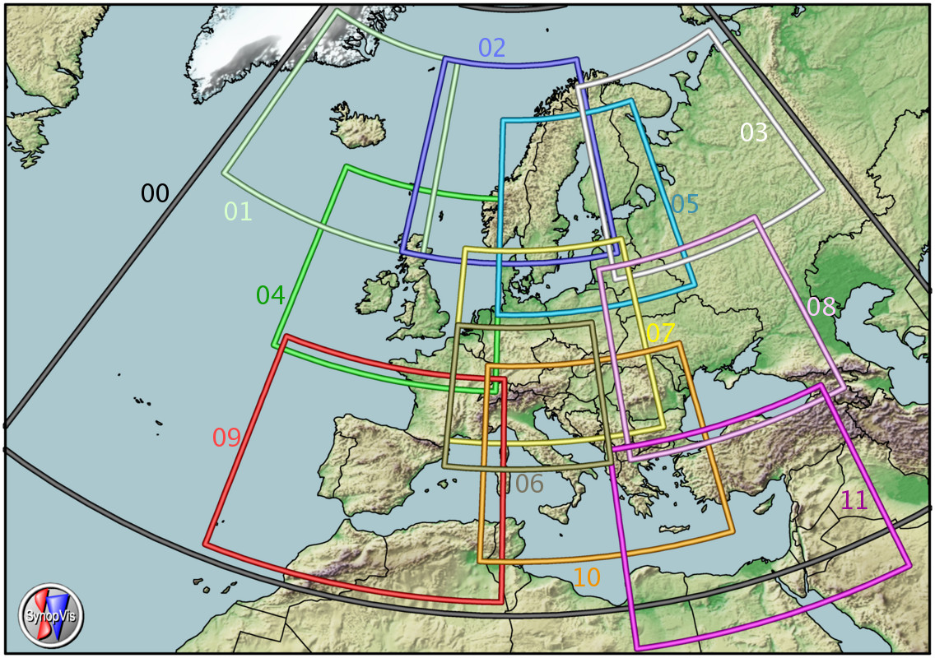
Data
Catalogue Candidate
Daily temp. anomalies
Among the large number of WTC catalogues available in the COST733 repository we select one “candidate” among circulation classifications: TPCA07 (Huth 2000); and 2 domains: D00 and D10.
86 station datasets were collected for the 1961 – 2001 period. After a PCA analysis, these datasets were grouped into 6 homogeneous areas, in the framework of a seasonal forecast research project: TEMPIO.

Slide 41

Canonical Correlation Analysis
Y₁, Y₂, … Y_{p} and X₁, X₂, … X_{q}
Considering 2 datasets:
Construct a linear combination:
U= u₁ Y₁+ u₂ Y₂+ … u_{p} Y_{p}
V= v₁ X₁+ v₂ X₂+ … v_{q} X_{q}
u’=[u₁, u₂, …, u_{p}]
v’=[v₁, v₂, …, v_{q}]
with
such that correlation R(U,V) is a maximum
Let S be the variance – covariance matrix of X and Y datasets

Slide 42
Canonical Correlation Analysis
^{X dataset}
^{Y dataset}
u₁
^{New Coordinate System}
v₁
^{Original Coordinate System}
Finding two sets of basis (u, v) vectors such that the correlation between the projections of the variables onto these basis vectors is maximized

Slide 43
CCA overview scheme
Original Datasets
X and Y
Find u and v with CCA and then
expressing original datasets in terms of the new
coordinate systems: U and V
Express each V_{i} as a linear
function of correspondent U_{i}:
V_{i} = ρ_{i} U_{i}
Going back to the original coordinate system:
Y* = L(U₁)

Slide 44
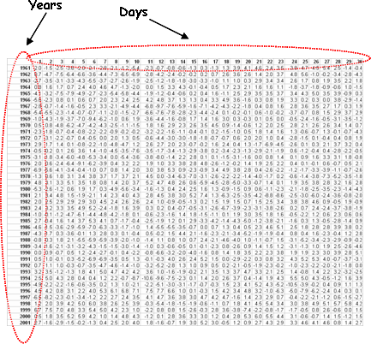
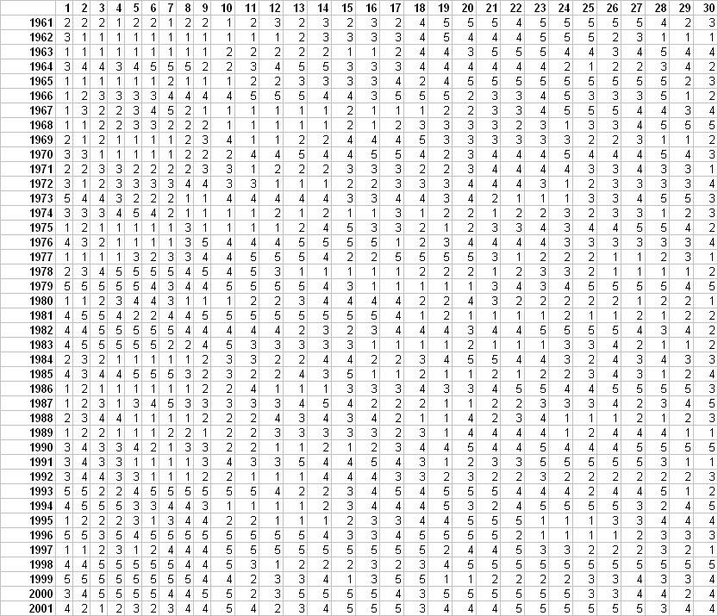
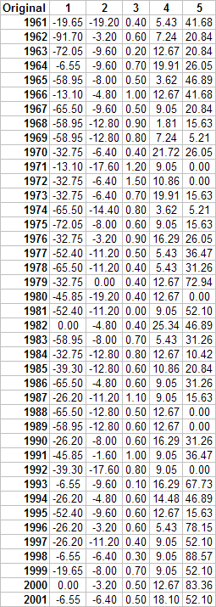
Data Preparation
^{Daily Anomaly}
^{Categorized Daily Class}
^{# Days}
^{Original Data}
^{Years}
^{Categorized Data}
^{Categories}
A 5 – days smoothed daily time series anomaly (1971 – 2000 based climatology) for each area.
Time series is from 1961 – 2001.
Reference period is JJA and June, July, August.

Slide 45
CCA Results
JJA – canonical variates
JJA – 1° pair

Slide 46
CCA Results
JJA – 1°
Expressing V₁ as a linear
function of U₁

Slide 47
CCA Results
Finally, going back to the original coordinate system, we obtain the initial Y dataset in terms of the first canonical variate of X by means: Y* = L(U₁) where L is a linear operator.
y₁₁
…
y_{1p}
y*₁₁
…
Y*_{1p}
y₂₁
…
y_{2p}
y*₂₁
…
Y*_{2p}
…
…
…
…
…
…
y_{n1}
…
y_{np}
Y*_{n1}
…
Y*_{np}
We can compare each column of Y with the correspondent column of Y*

Slide 48
Physical Interpretation
We have now a canonical vectors pair which have the highest correlation between the two datasets. In other words we can express the inter-annual variability of Y (thermal categories) in terms of X (WTC occurrence).

Slide 49
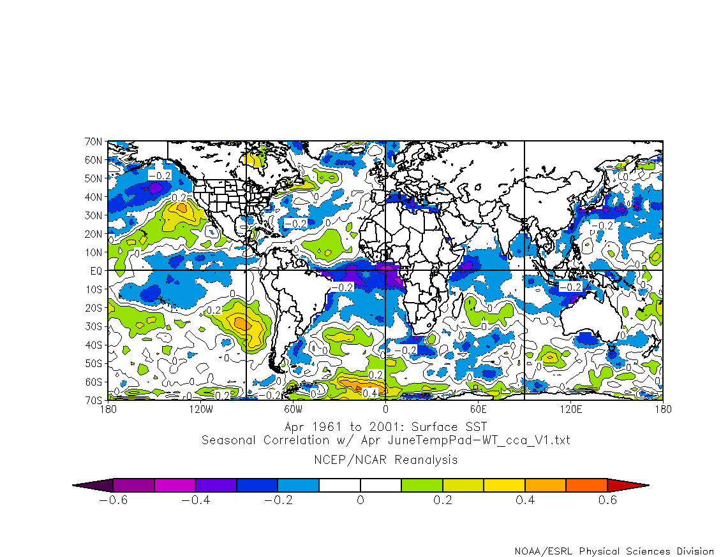
Seasonal Applications
Since U₁ (WT occurrence) is the “essence” of such inter-annual variability correlated with V₁ (thermal categories) we can use it to explore its possible climatic sources. Some examples: SST (April) – WTC occurrence (JJA) relationship.
Thus we can forecast U₁ using SST predictors.

Slide 50
Seasonal Applications
It is possible to forecast U₁ , for example with a multi regressive approach, and then going back to V₁ to get the thermal distribution, instead of forecasting directly the thermal anomaly.
We can also reverse the strategy and associate a possible seasonal regime to an thermal seasonal forecast (coming from an independent system).
Since the CCA method is quite general, the Y dataset could be any classified inter – annual observables: e.g. number of rainy days of different thresholds, dry or wet spells of different duration, heat or cool waves of different duration.

Slide 51
Seasonal Applications
It could be applied to any climatic index after a simple phase classification in terms of strength or duration: Blocking, AO, NAO, etc.
Not only the inter – annual variability of WTC occurrence could be used, but also its climatological “character”, by means the thermal character of each WTC.

Slide 52
CCA and COST 733
Is there any information, coming from the CCA, that could be used for “selecting” a WTC among the huge number of available catalogues? We think so! Let’s expand the previous example: for each WTC methods we have:
different number of classes (original number plus some fixed amounts: 9, 18, 27);
different domains (large, small, often superimposed);
different climatic areas: Italy, North – East, North – West, etc.

Slide 53
CCA and COST 733
For example applying the CCA to the same WTC, with 7 classes, but for: 2 domains D00 and D10; 3 climatic areas: Italy, N_EAST, N_WEST; WT occurrence and characters.
Italy
NE
NW
Previous Example
JJA – 7 Classes
WTC_{char} vs. WTC_{occ}

Slide 54
CCA and COST 733
As before, but for “9” classes:
Italy
NE
NW
JJA ~ 9 Classes (D10=7 / D00=8)
WTC_{char} vs. WTC_{occ}

Slide 55
CCA and COST 733
Going to the monthly time scale and using the WTC_{occ} to predict the temperature anomalies:
Jun – 7 Classes
Jul – 7 Classes
Aug – 7 Classes

Slide 56
The CCA method was applied to highlight linear correspondence between inter – annual variability of temperature anomalies and WTC occurrence/ WTC type character variability. Such correspondence exists and depends on number of classes/time scale/areas. Furthermore it is completely reversible, by means that we can linear predict one dataset in terms of the other.
Inter – annual WTC occurrence could be used as mid – level description tool between climatic anomalies and temperature or rainfall anomalies, in a seasonal forecast system.

Slide 57
From the eigenvalues analysis seems possible to describe both the seasonal and the monthly timescale inter – annual variability. This is quite important because the seasonal forecasting systems based on global models are not able to distinguish among different months in the target season.
More catalogues was analysed with CCA and will be available for interested people.

Slide 58
Thank you for your attention!
Some References and further reading:
Barnett, T., and R. Preisendorfer, 1987: Origins and Levels of Monthly and Seasonal Forecast Skill
for United States Surface Air Temperatures Determined by Canonical Correlation Analysis. Mon. Wea. Rev., 115, 1825–1850.
Moron, V., A.W. Robertson, M.N. Ward, and O. Ndiaye, 2008:
Weather Types and Rainfall over Senegal. Part I: Observational Analysis. J. Climate, 21, 266–287.
Moron, V., A.W. Robertson, M.N. Ward, and O. Ndiaye, 2008:
Weather Types and Rainfall over Senegal. Part II: Downscaling of GCM Simulations. J. Climate, 21, 288–307.
Kirtman, Ben, Anna Pirani, 2009: The State of the Art of Seasonal Prediction: Outcomes and Recommendations from the First World Climate Research Program Workshop on Seasonal Prediction. Bull. Amer. Meteor. Soc., 90, 455–458.
Benestad, Chen and Hanssen-Bauer: A compendium for statistical downscaling (version 0-9, updated on 16 June 2007): http://rcg.gvc.gu.se/edu/esd.pdf
Pavan, V. and F.J. Doblas-Reyes (2013). Calibrated multi-model ensemble summer temperature predictions over Italy. Climate Dynamics, 41, 2115-2132, doi:10.1007/s00382-013-1869-7.
Gaetani M. and M. Pasqui (2012), Synoptic patterns associated with extreme dust events in the Mediterranean Basin. Regional Environmental Change. 10.1007/s10113-012-0386-2
Di Giuseppe E., G. Jona Lasinio, S. Esposito, M. Pasqui, (2012) Functional clustering for Italian climate zones identification. Theoretical and Applied Climatology 10.1007/s00704-012-0801-0
http://cost733.geo.uni-augsburg.de/cost733wiki

Slide 59




… and what about next NDJ ?
http://www.businessweek.com/news/2013-10-24/if-new-york-is-freezing-in-january-blame-today-s-siberian-snow#p1

Slide 60


… but … in January 2014 …
… there is still room for a cold period!

