Slide 1
Integrated Earth Modeling System (IEMS) at
RHMSS/SEEVCCC
- Numerical models in use -

Slide 2

SEEVCCC Integrated Earth Modeling System
NCEP NMMB atmospheric model
● global/regional/local
● hydrostatic/nonhydrostatic
Aerosol ↔ radiation
HYPROM
Hydrology model
Aerosol ↔ cloud
DREAM Dust
Sea salt
Carbon
Pollution
Fe and P
nutrients
Ocean
model

Slide 3
NMMB model characteristics
Grid point model on Arakawa B grid
Sigma vertical p-hybrid coordinate, Lorenz vertical grid
Easily can be run as global or regional model
Novel implementation of the nonhydrostatic
Dynamical core with horizontal differencing that preserves many important properties of differential operators and conserves a variety of basic and derived quantities including, energy and enstrophy
Two land surface packages: NOAH and LISS
Two radiation schemes: RRTM and GFDL
Two microphysics: Ferrier and Zhao
Bets-Miller-Janjic convection
Melloer-Yamada-Janjic turbulence and surface layer
For more information please check references:
(Janjic, 2005; Janjic and Black, 2007; Janjic et al., 2001, 2011,2013)

Slide 4
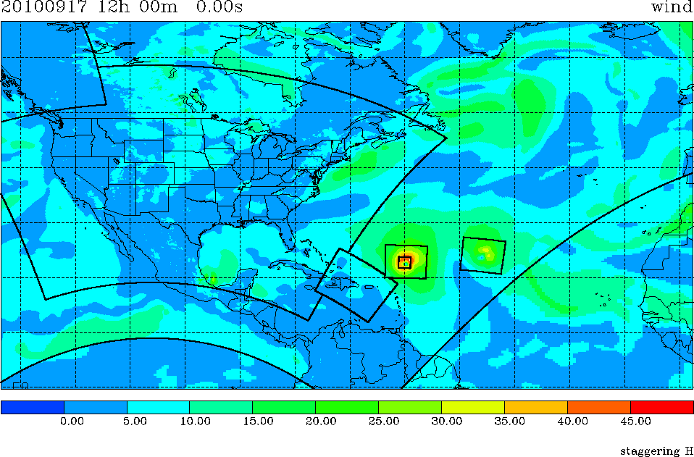
Hypothetical NMMB Simultaneous Run
Global [with Igor & Julia] and NAM [with CONUS nest]
Courtesy of DiMego et al.
12 km NAM NMMB
9 km Julia NMMB
4 km NAM-nest NMMB
9 km Igor NMMB
12 km NAM NMMB
27 km Global NMMB
27 km Global NMMB

Slide 5
Introduction: downscaling set-up
Regional model: NMMB (Nonhydrostatic Multiscale Model)
  Horizontal resolution: 14km and 8km experiment
Initial and lateral boundary data: ERA40 reanalysis
  Horizontal resolution: 250km
Downscaled period: 1971-2000
Data used for verification
  Observations from RHMSS station network
  ERA40 surface fields, 250km resolution
  EOBS, gridded climatology for EU, 25km resolution
  CARPATCLIM, gridded climatology for Carpathian region, 10km resolution

Slide 6
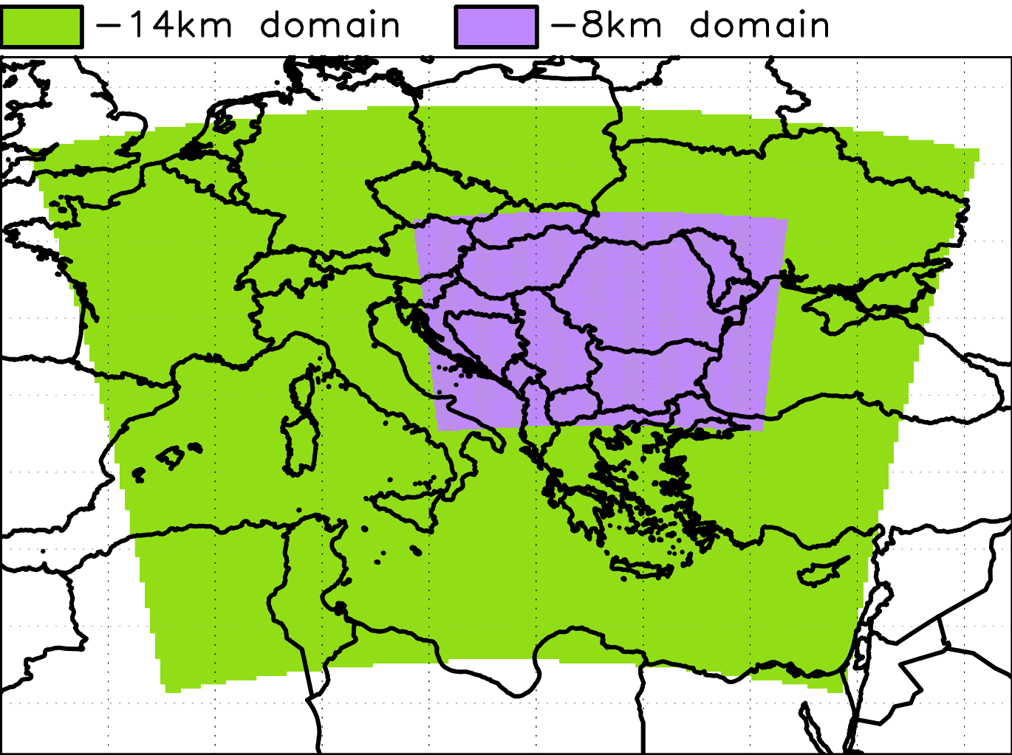
Introduction: downscaling set-up
NMMB domains: green – low resolution
purple – high resolution

Slide 7
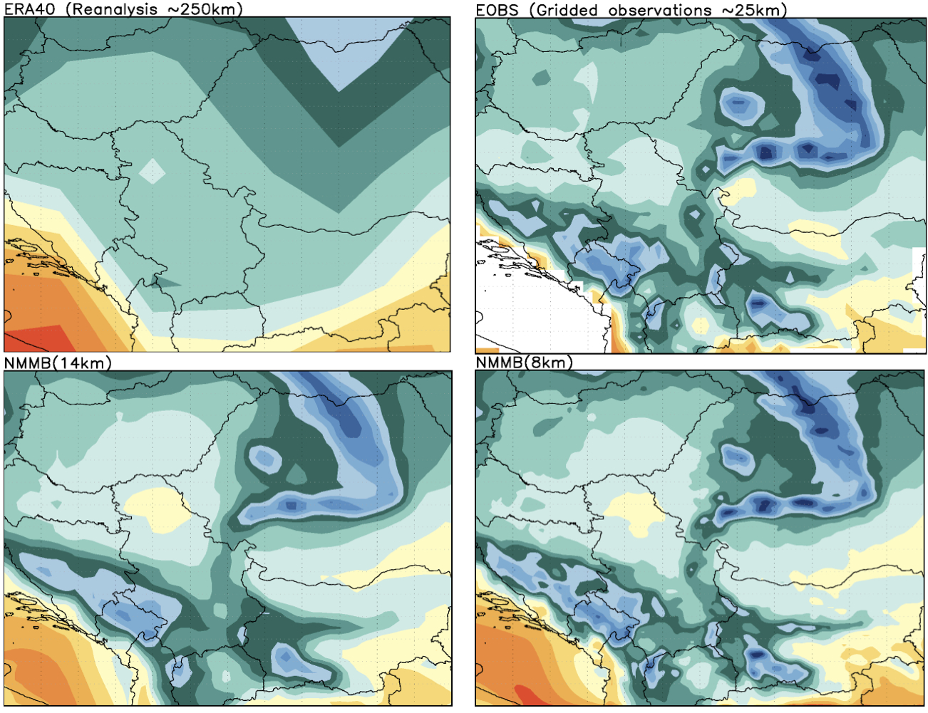

Mean annual temperature 1971-2000

Slide 8
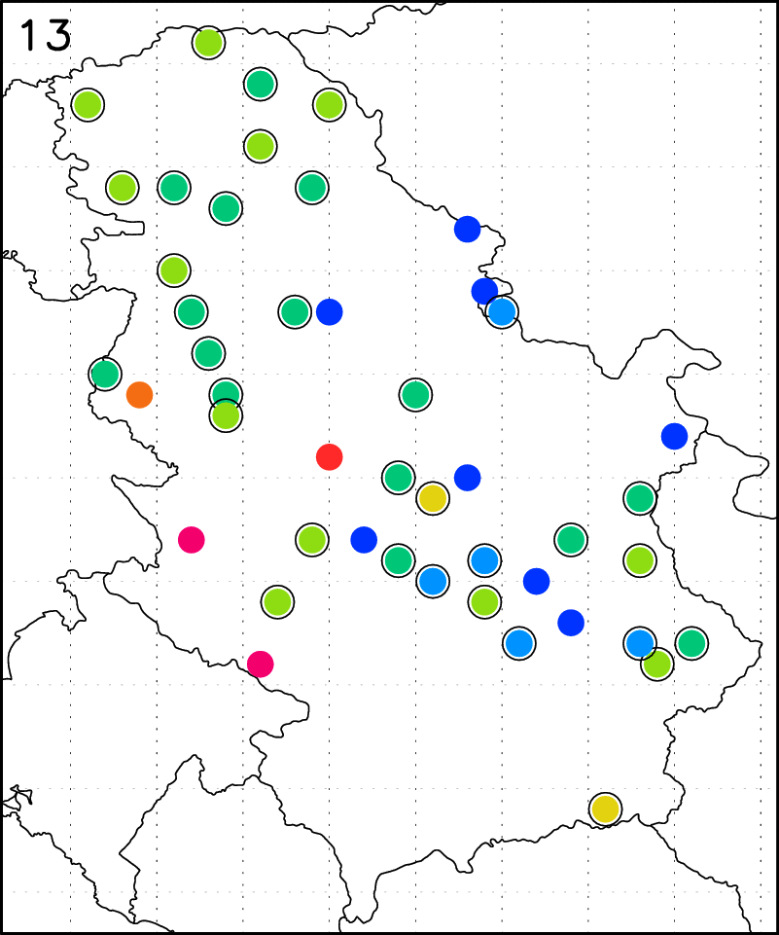
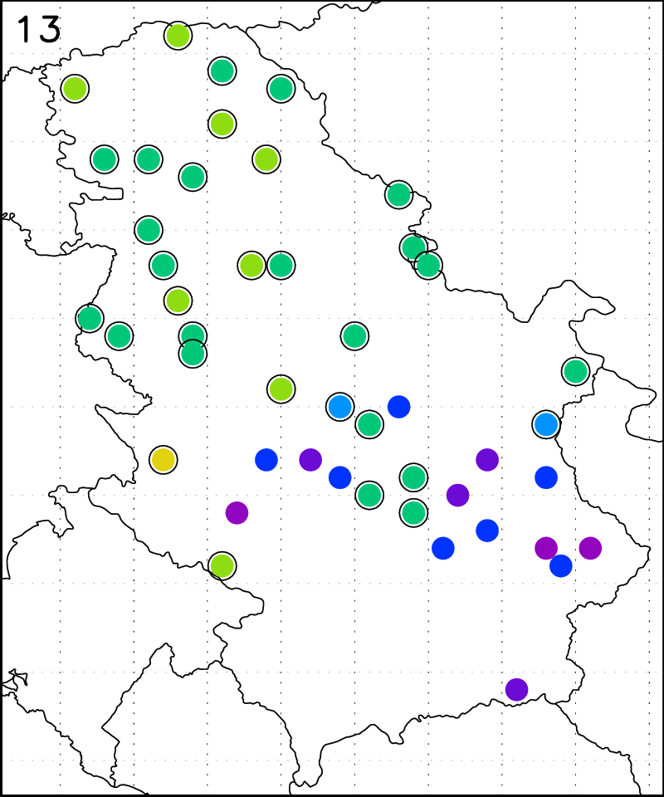
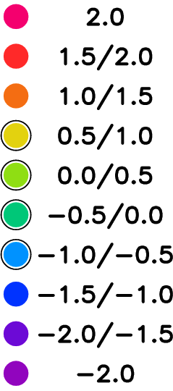
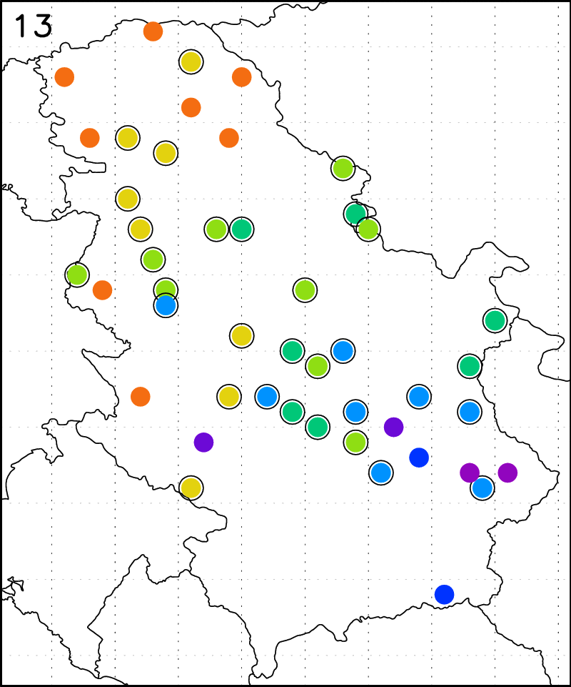
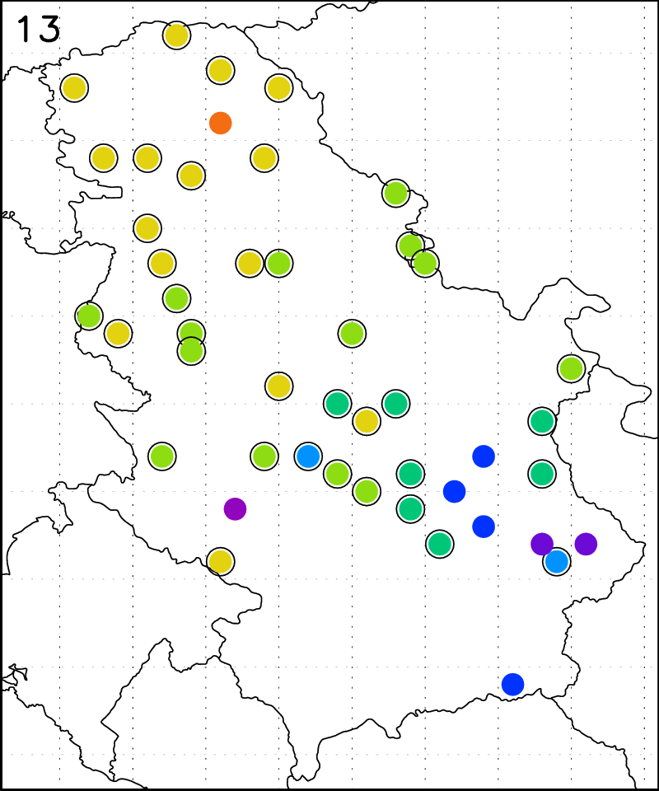
Temperature annual mean bias (daily temperatures)
BIAS (°C)
ERA40
EOBS
NMMB 14km
NMMB 8km

Slide 9
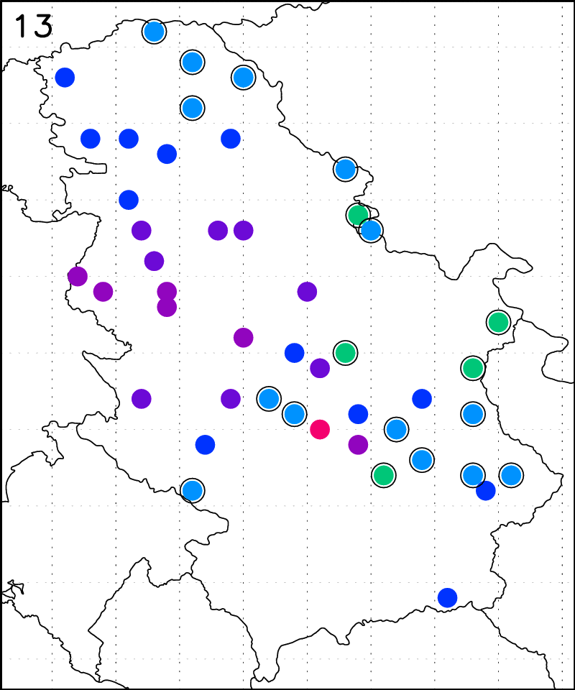
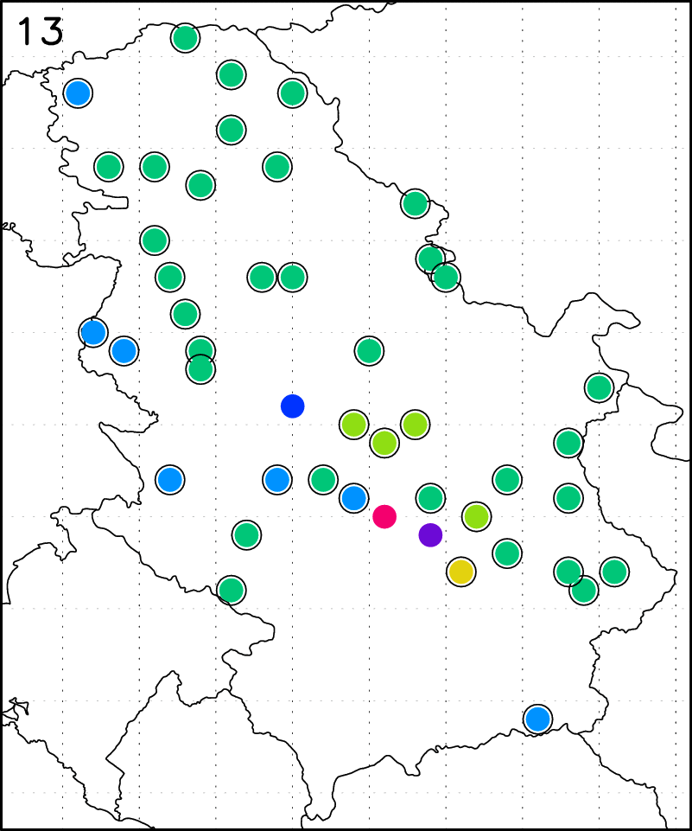
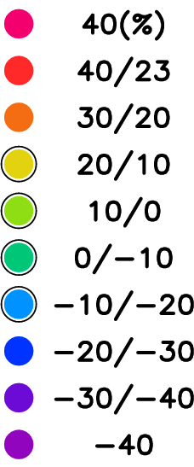
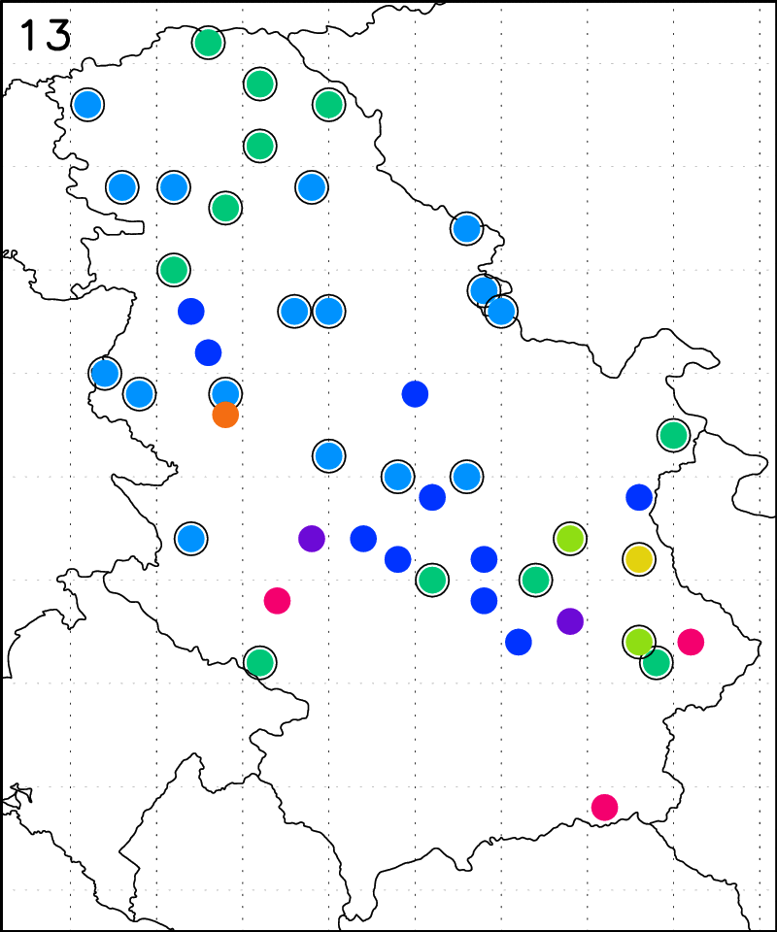
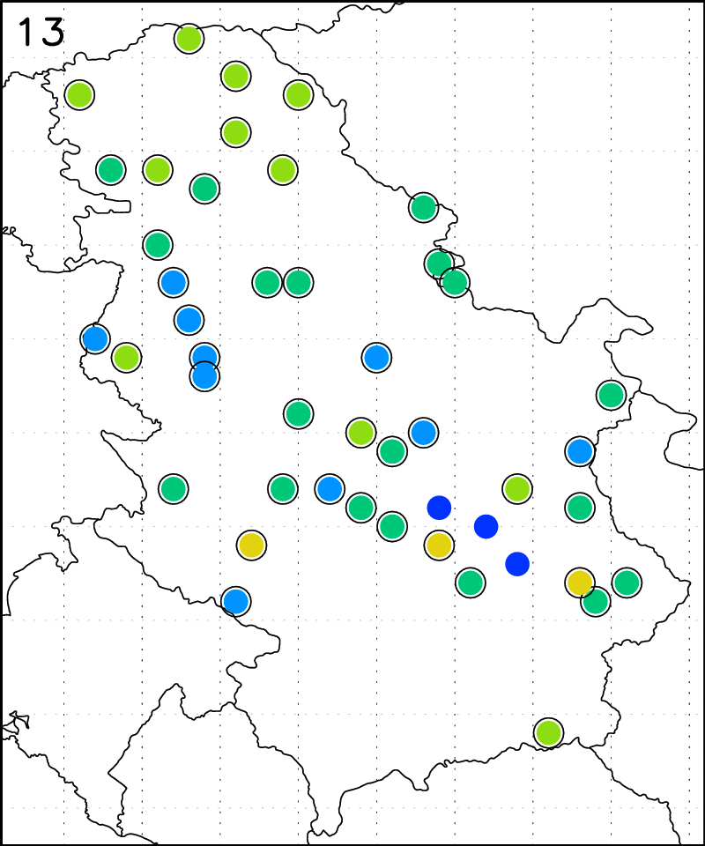
Precipitation annual mean bias (daily precipitation)
BIAS (%)
ERA40
EOBS
NMMB 14km
NMMB 8km

Slide 10
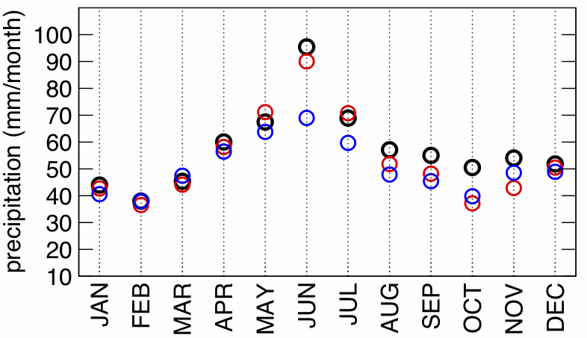
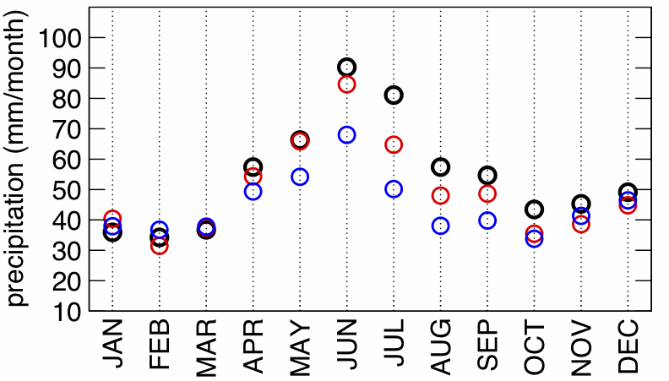
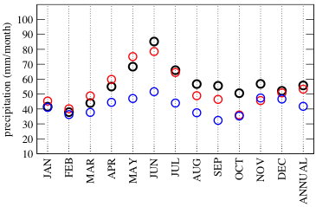
Precipitation annual cycle (daily precipitation)
o ERA40; o NMMB8; o OBS
Selected stations:
o - Oservationas
o - NMMB-8
o - NMMB-14
Beograd
Vrsac

Slide 11
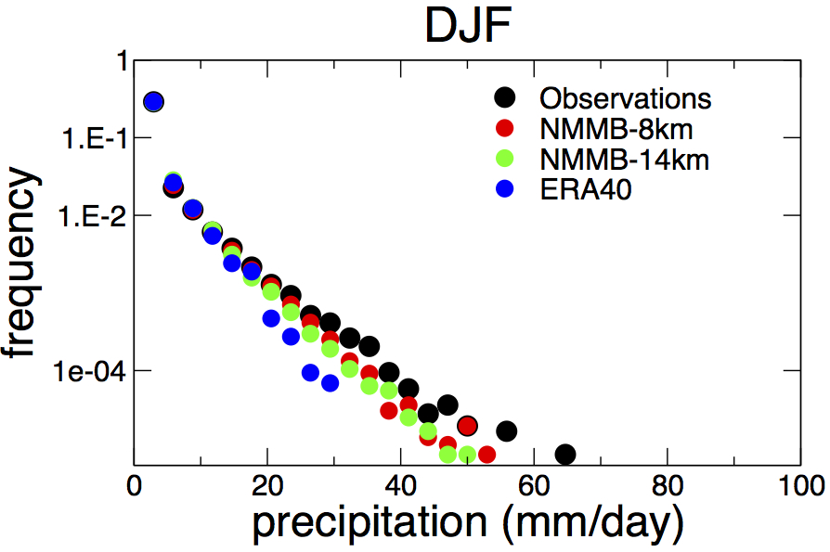
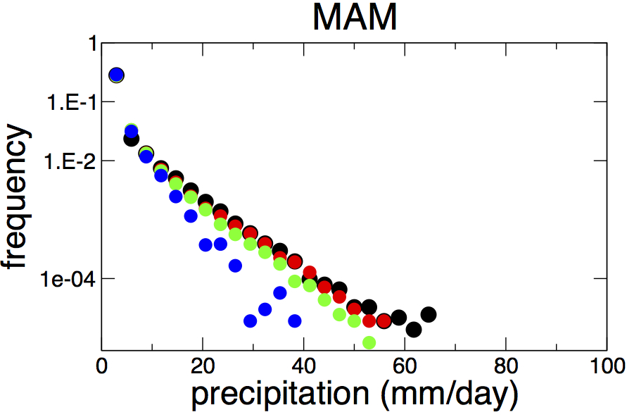
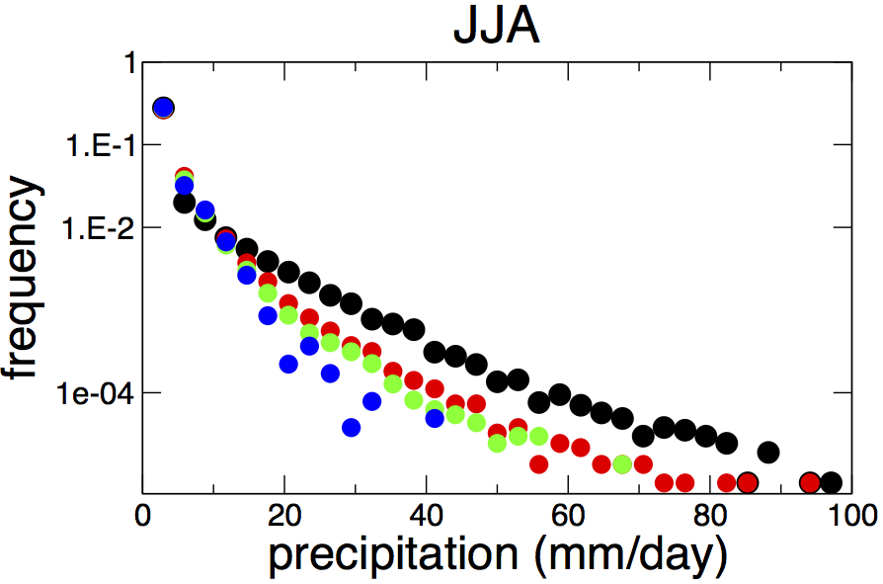
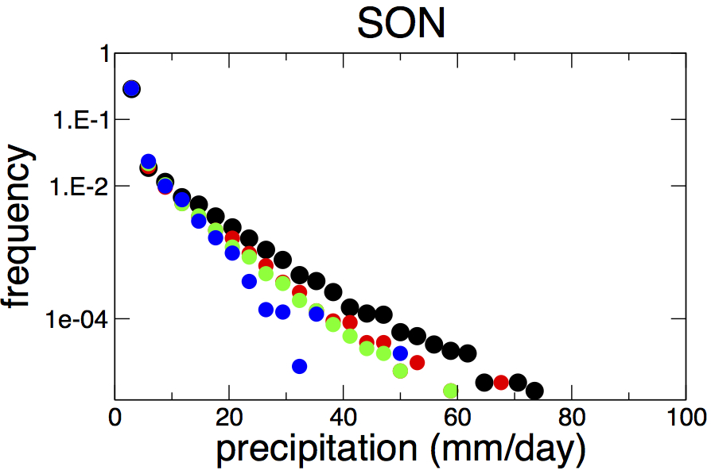
Daily precipitation - seasonal distributions
(winter)
(spring)
(summer)
(autumn)

Slide 12
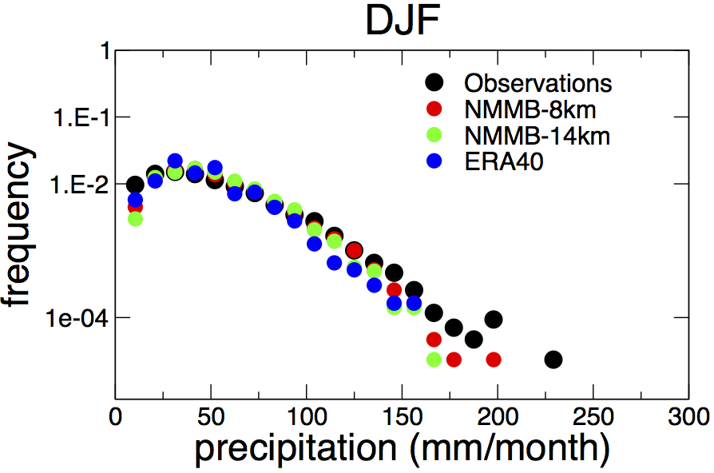
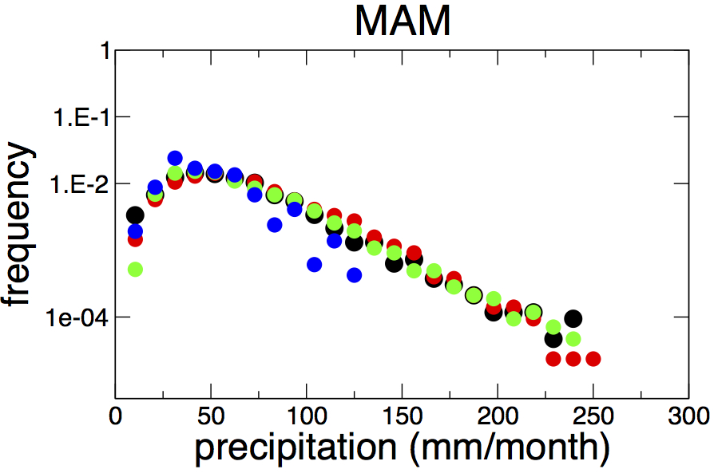
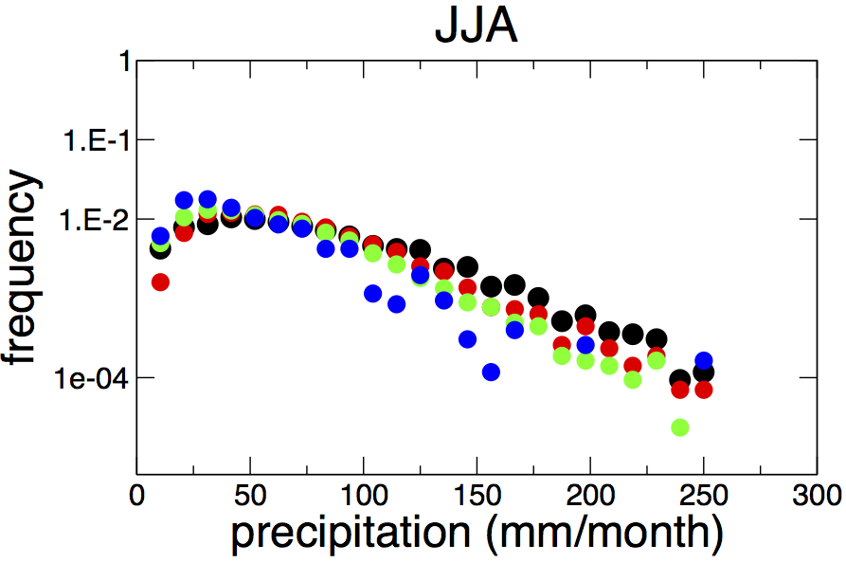
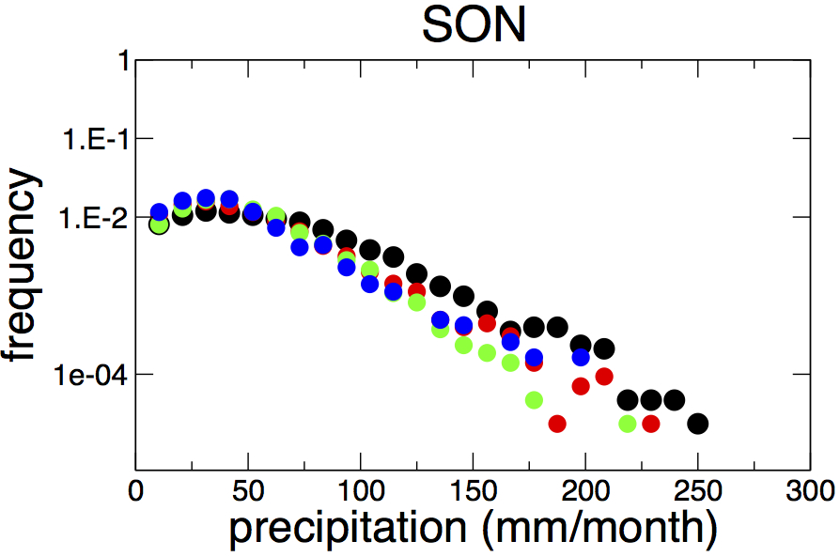
Monthly precipitation - seasonal distributions
(winter)
(spring)
(summer)
(autumn)

Slide 13

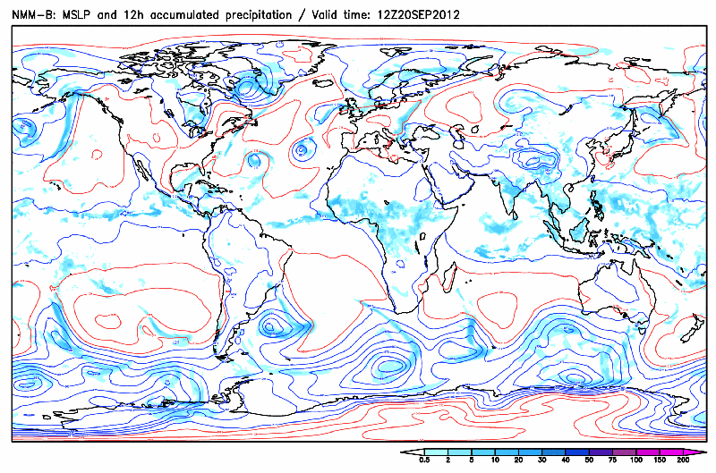
Non-hydrostatic Multiscale Model – NMMB (NCEP/Zavisa Janjic)
Global operational forecast at RHMSS/SEEVCCC
NMMB
Global domain
Horizontal res 0.48 x 0.36 deg
Vertical res 64 levels
10 days forecast
Initial conditions from GFS/ECMWF

Slide 14
Republic Hydrometeorological Service Of Serbia
Hydrology component of IEMS
- HYPROM model -
HYPROM model is developed to simulate overland watershed processes. It is designed to be easily applied to different watersheds and across a broad range of spatial scales, from local to regional and global. HYPROM can be useful tool for predicting short-term flood events, as well as for water balance assessments and climate studies (Nickovic et al., 2010).
HYPROM consists of two sub-models: two-dimensional representation of overland flow and one-dimensional river routing component that collects the excess water in a drainage basin. It uses real topography, river routing and soil texture data from USGS datasets.
HYPROM model is driven with the advanced non-hydrostatic NCEP/NMM-E atmospheric model (Janjic et al., 2001; Janjic, 2003), which is widely used to produce operational weather forecasts. It simulates precipitation and calculate surface and base runoff from rainfall and snowmelt using the NMM-E land surface scheme.

Slide 15
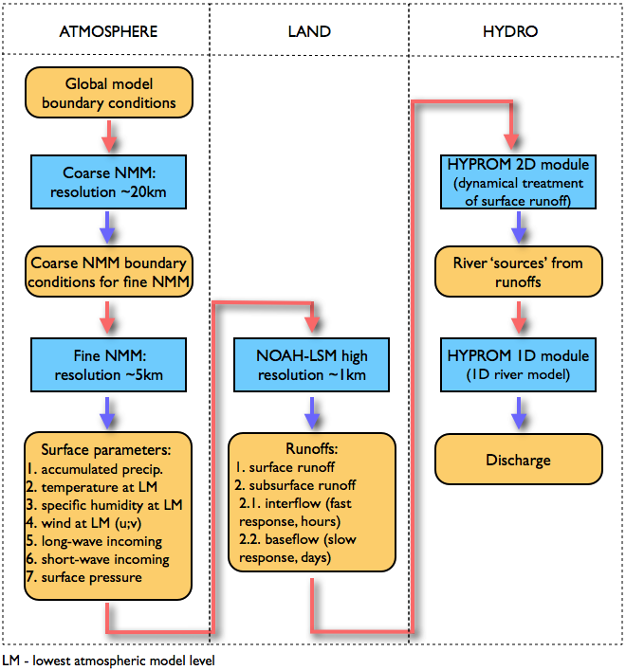
HYdrology PROgnostic Model
HYPROM model:
Dynamical treatment of overland flow
Suitable for long term and flash floods simulations
Applicable to small and large watersheds
Computationally efficient

Slide 16
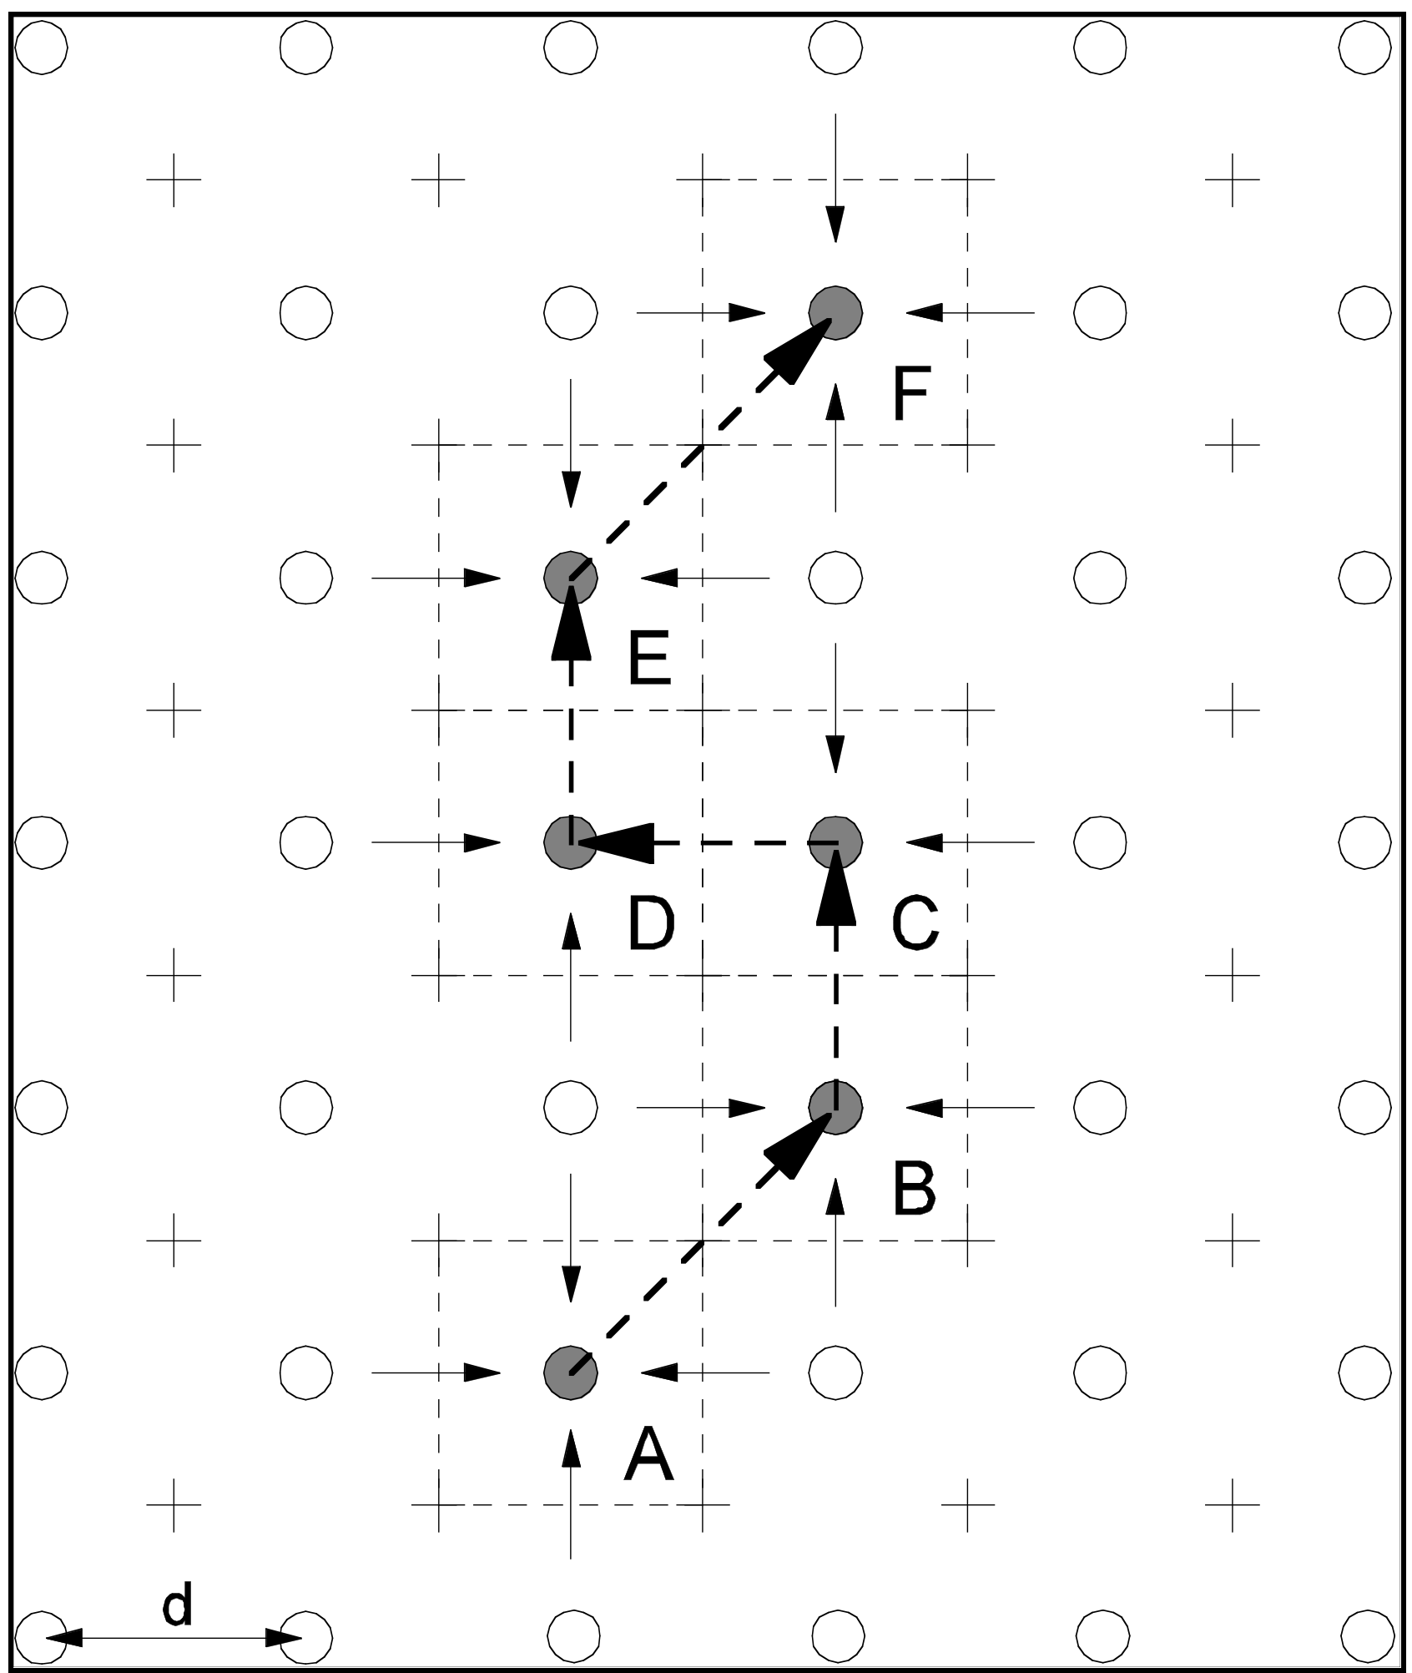
Governing equations
h - points
u,v -points
A-B-C-D-E-F river points
}One-D River routing
dynamical treatment of overland flow
(NO kinematic approximation!)
numerically stable implicit time scheme
for the friction term
new numerical technique for
preventing grid decoupling noise
suitable for long term and
flash flood simulations
Ničković S. et al, 2010: HYPROM hydrology surface-runoff prognostic model, Water Resource Research
computationally efficient

Slide 17
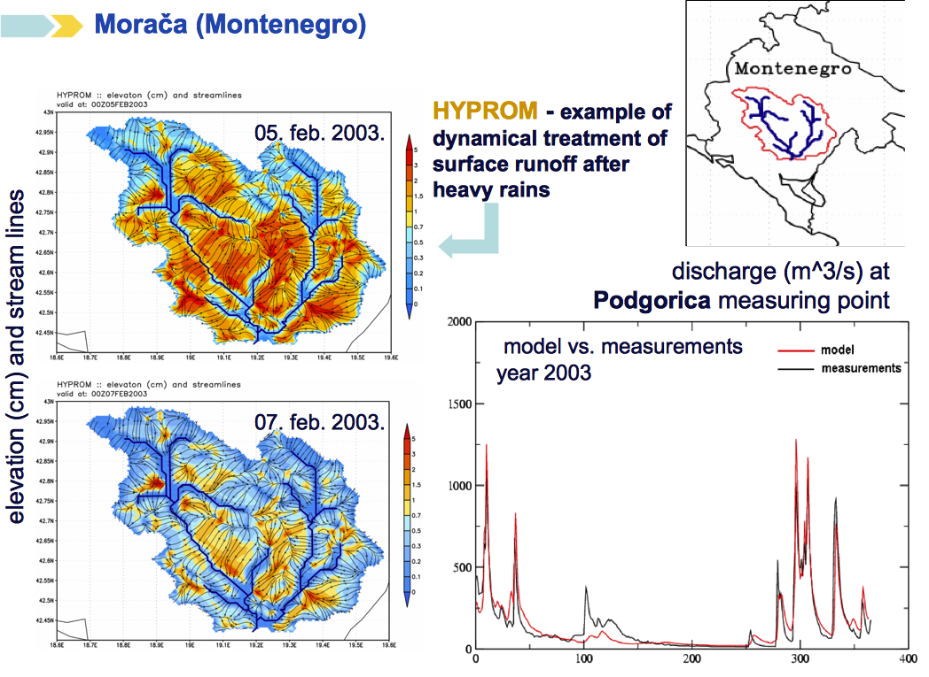
Hydrology Prediction Model HYPROM Case study: the Moraca river
watershed: 3200 km²

Slide 18
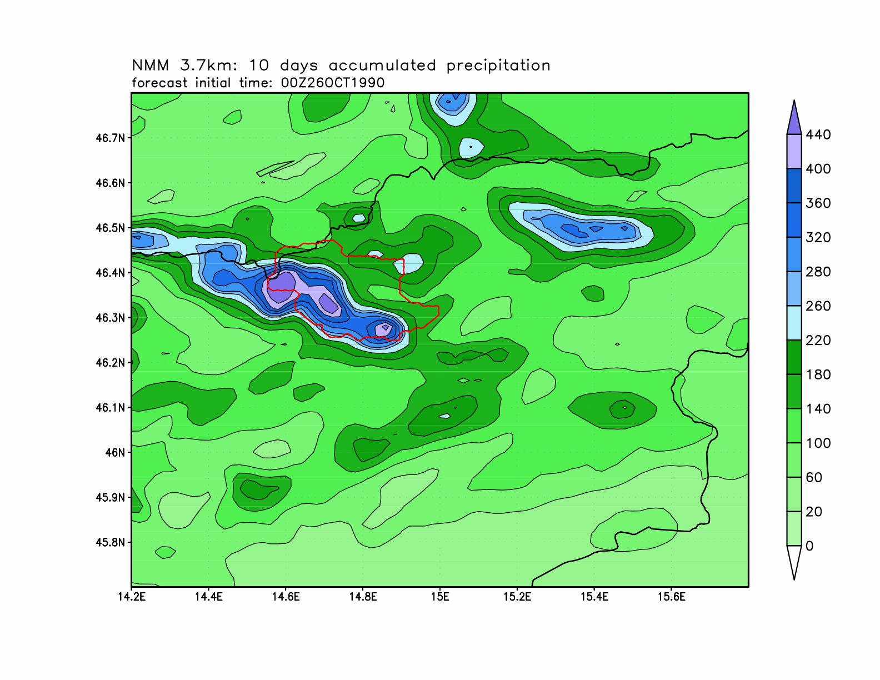
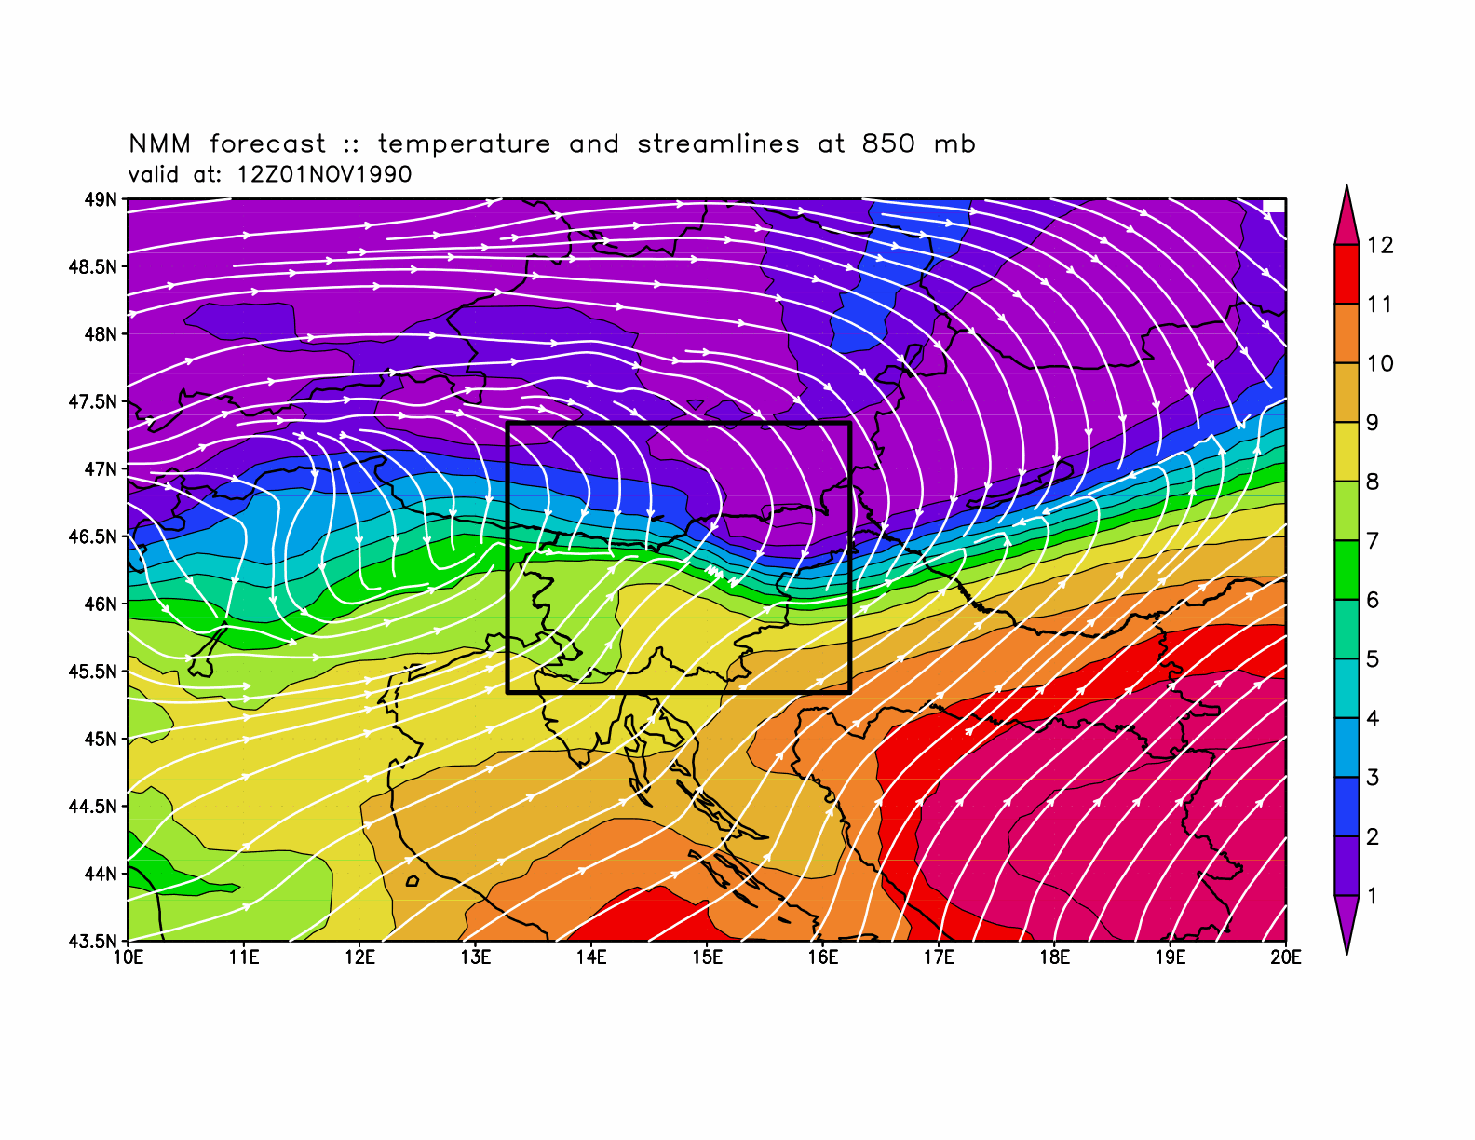
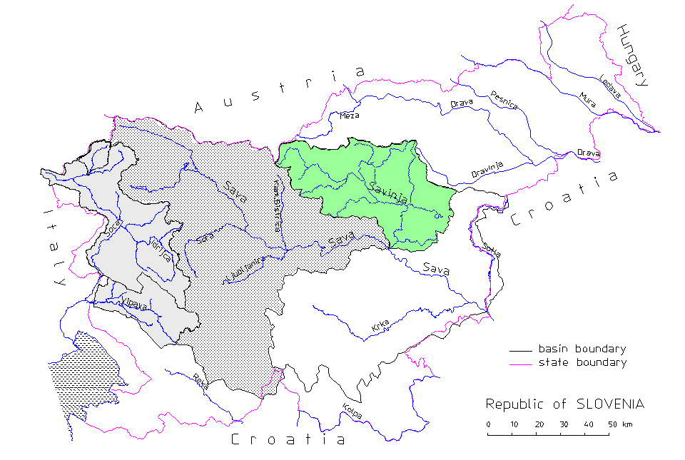
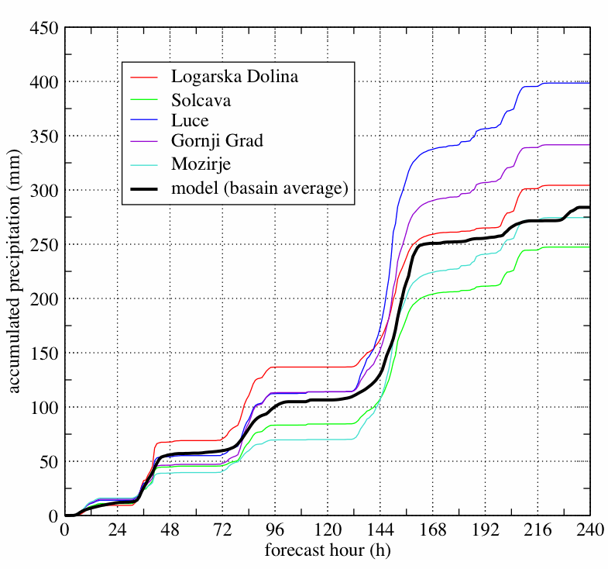
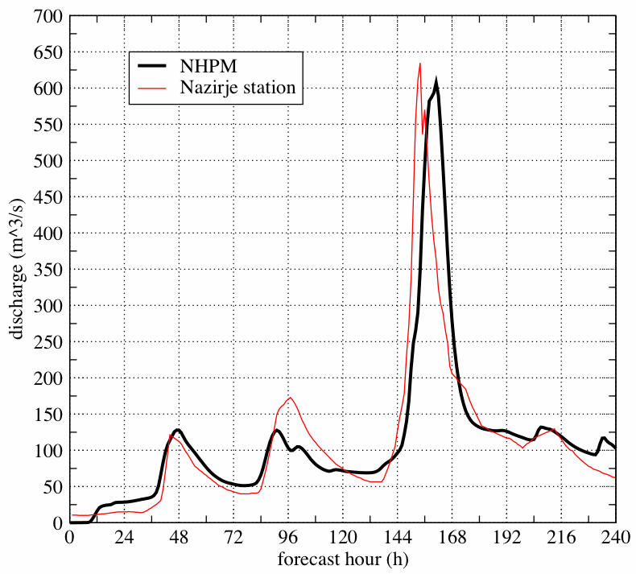
Case study: the Savinja river, flash flood event
watershed: 1850 km²
T and V at 850 hPa,
1Nov1990
acc. rainfall
26 Oct – 6 Nov1990
model .vs. observations
accumulated precipitation (mm)
river discharge (m^3/s)
forecast hour (h)
forecast hour (h)

Slide 19
Republic Hydrometeorological Service of Serbia
Aerosol component of IEMS
DREAM dust model
DREAM model is developed as an add-on component of the atmospheric model and is designed to simulate and/or predict the atmospheric cycle of mineral dust aerosol. It solves the Euler-type partial differential nonlinear equation for dust mass continuity. Dust concentration is one of the governing prognostic equations in an atmospheric numerical prediction model (Janjic, 1990, 1994, and references thereinafter).
DREAM simulates all major processes of the atmospheric dust cycle (Nickovic et al., 2001). During the model integration, calculation of the surface dust emission fluxes is made over the model cells declared as deserts. A viscous sub-layer parameterization regulates the amount of dust mass emission for a range of near-surface turbulent regimes. Once injected into the air, dust aerosol is driven by the atmospheric model variables: by turbulence in the early stage of the process when dust is lifted from the ground to the upper levels; by winds in the later phases of the process when dust travels away from the sources; and finally, by thermodynamic processes and rainfall of the atmospheric model and land cover features which provide wet and dry deposition of dust over the Earth surface.

Slide 20
Impacts of Sand and Dust
Human Health (asthma, infections, meningitis in Africa, valley fever in the USA)
Marine productivity
Aviation
Agriculture
Ground transportation

Slide 21
Impact on radiation: Cooling surface atmosphere by ~5○C
Perez et al, 2006

Slide 22
Comparison of DREAM Model Aerosol Mass with Ice Nuclei Measurements at Kleinerfeldberg Frankfurt 20 May – 3 June 2008
Bingemer, Ničković, Barrie, 2009

Slide 23
Significance of mineral composition in
desert soils
Fe and P embedded in dust → ocean nutrients
Cloud ice nucleation sensitive to mineral composition
Hypothesis: Fe as an enhancement factor in meningitis
outbreaks (Thompson, 2008)
Notes:
Dr Eric Achterberg, from the National Oceanography Centre, Southampton (NOCS) is leading a study into the dust's effect on nutrients, plankton production and the food chain.

Slide 24
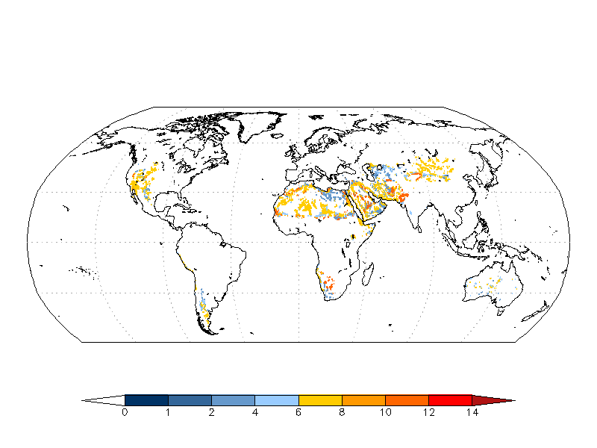
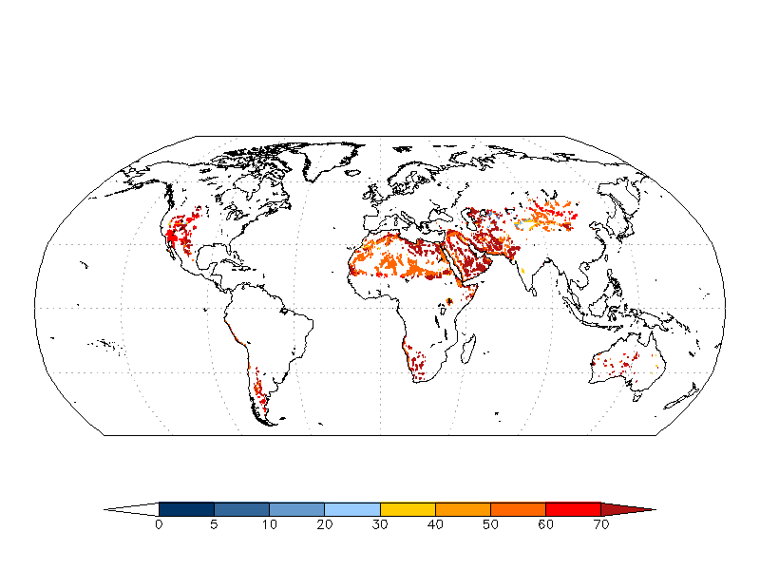
Minerals in erodible soils
mineral composition of dust aerosols is important for:
human health, ocean productivity, cloud ice nucleation, atmospheric radiation
we develop 1km resolution global data set of mineral fractions in arid soils:
silicates (quartz, feldspar, illite, kaolinite, smectite), carbonates (calcite), qypsum,
iron oxides (hematite)
work on implementation of mineral transport in atmospheric models
mineral data set will be used as mask of mineral sources for uptake in atmospheric
models with included transport on mineral particles
Example: quartz (mineral with largest percentage) content in erodible soils in silt and clay part

Slide 25
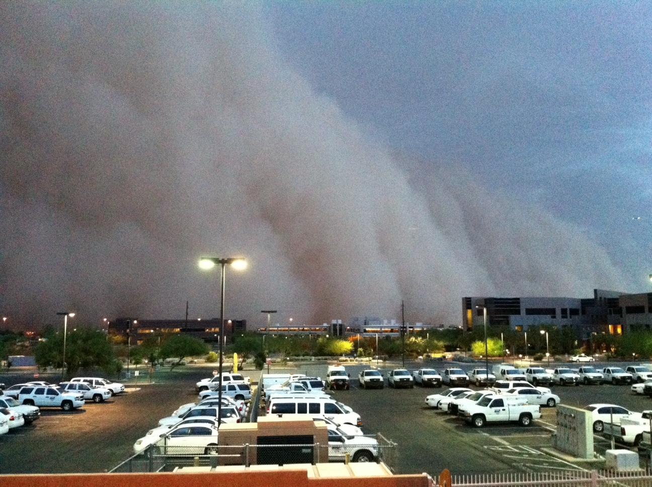
Phoenix (Arizona) Haboob, 5 July 2005
7:45 PM Phoenix as the dust storm neared
Dust modeling – NMME DREAM (operational model)
Improved by assimilation of the dust analysis
CCOR ~0.6 – quality forecast
Among leading models by verification scores in WMO SDS-WAS project
In high resolution case runs (<5km) for severe dust storms it shows potential for application in warning systems (work in progress).
W.A.Sprigg, S. Ničković, G. Pejanović, J. Galgiani, A. Vuković

Slide 26
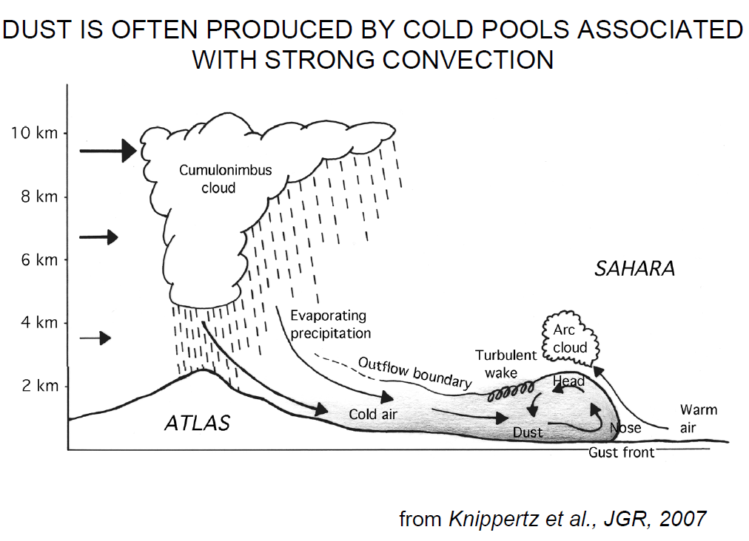
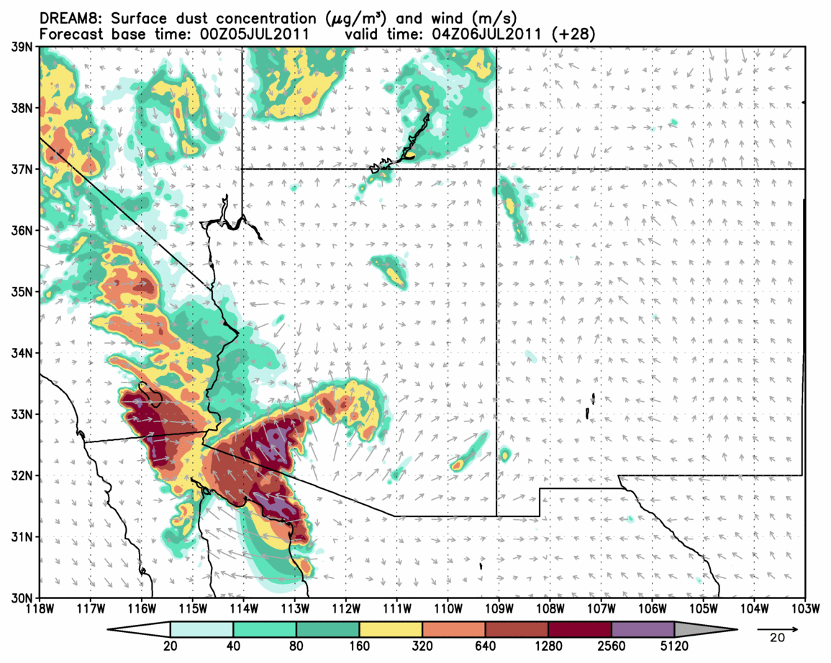
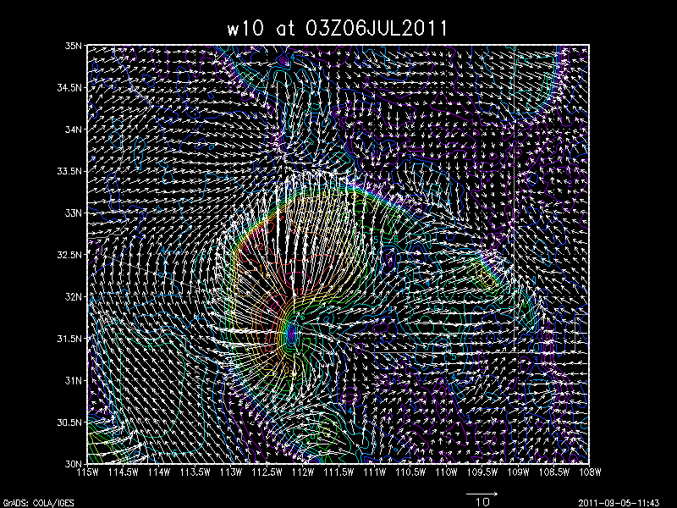
Successful simulation of the Phoenix Haboob: NMME-DREAM
(collaboration: SEEVCCC and Chapman University dust modeling group)
DUST SIMULATION: 3.5-km model
10m WIND MAGNITUDE
Phoenix
Phoenix
W.A.Sprigg, S. Nickovic, G. Pejanovic, A. Vukovic

Slide 27
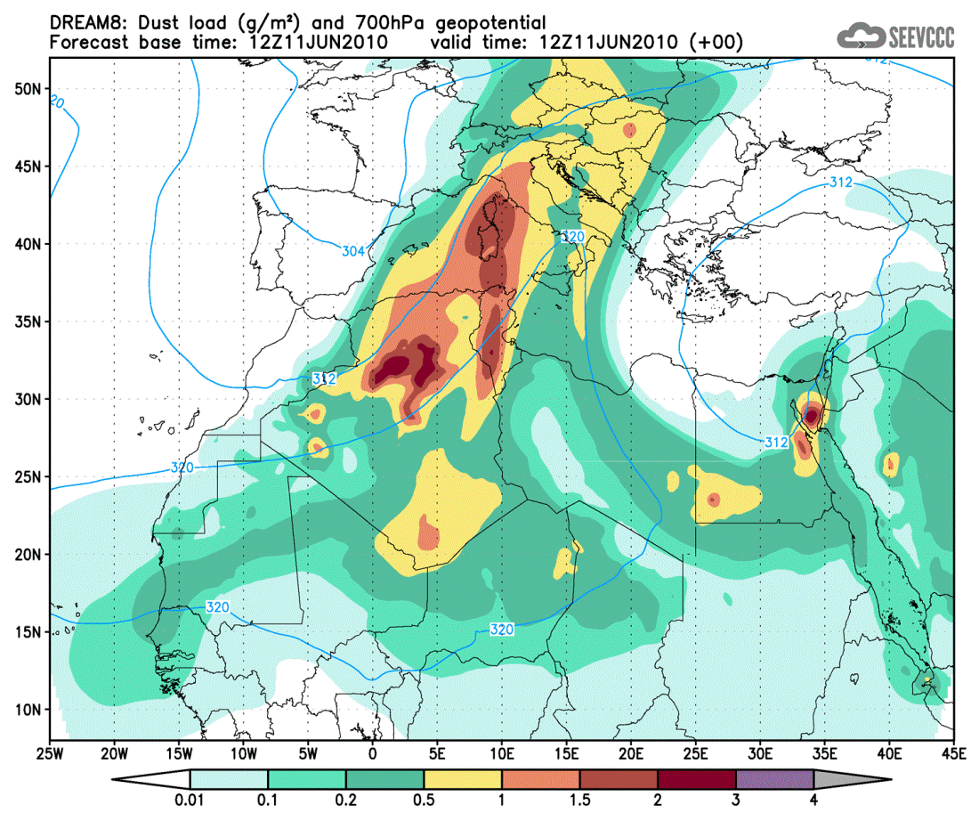
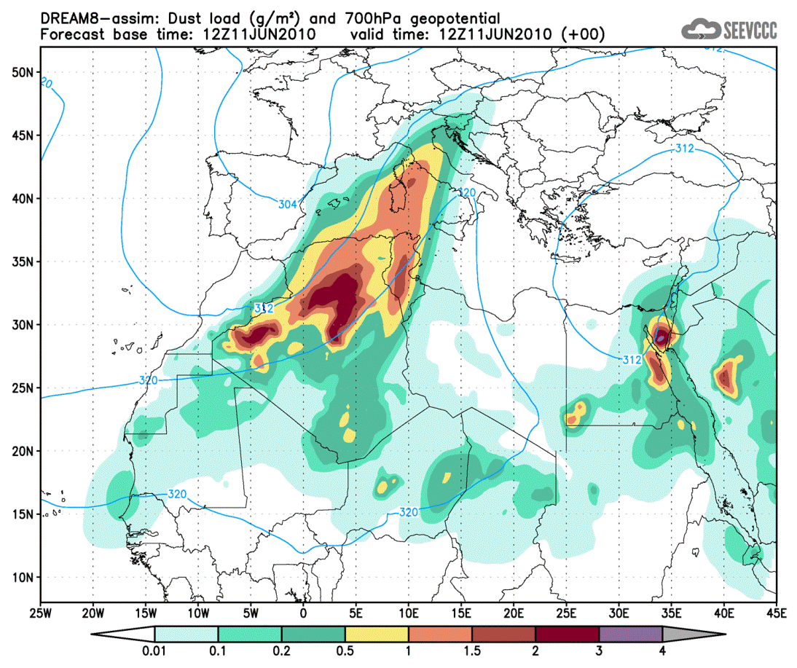
Operational dust forecast: DREAM
● DREAM8: Dust Regional Atmospheric Model with 8 categories for particle sizes
model runs: 12UTC start ; +72h forecast
model resolution: 1/3 degrees (~35km)
models: DREAM8 and DREAM8-assim (assimilation using ECMWF dust aerosol analysis)
presented: model run from June 11th 2010 12UTC
DREAM8
DREAM8 – assim

Slide 28
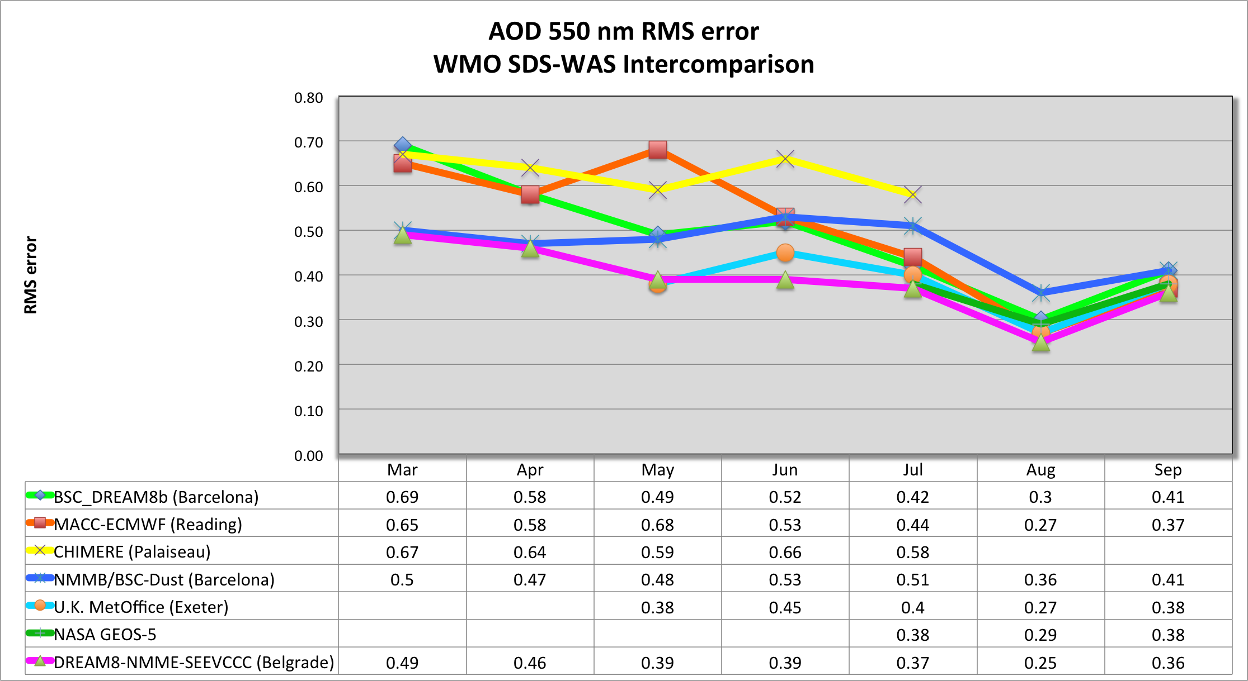
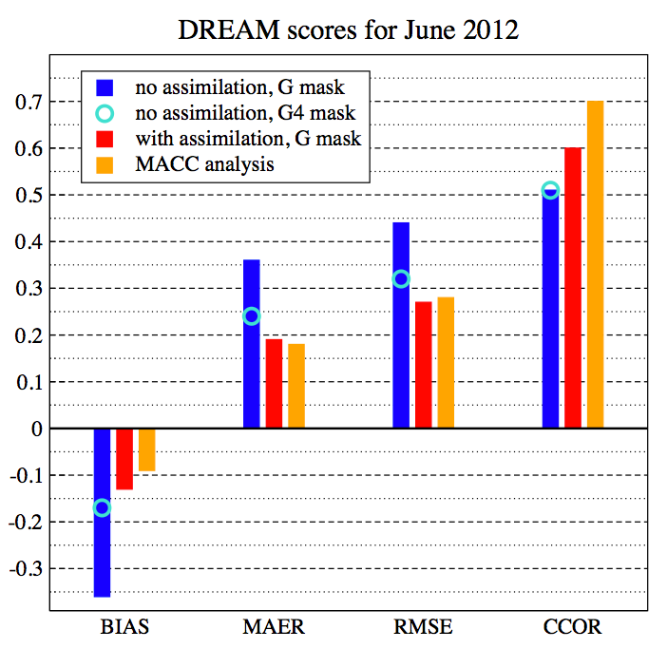

Slide 29
Thank you

