Slide 1
Sources of predictability and error in ECMWF long range forecasts
Tim Stockdale
European Centre for Medium-Range Weather Forecasts

Slide 2
Outline
Overview of System 4
Some recent research results
Notes:
Seasonal prediction at ECMWF
History/approach
Strengths and weaknesses of S4
History of EUROSIP, including theory of multi-model
Inc DEMETER results as motivation
Also theoretical basis for mm averaging
Practical considerations – real-time risks, confidence etc
NCEP joining
Mention Paco’s assessment
Difficulty of 14 years for assessment
Show some results from Laura
New suite and products
Mention that NCEP processing suite now operational
New multi-model suite still in esuite – want to be sure everything is complete, and manage handover for MS
Example plots, esp inc Nino pdfs.
Summary
Operational system, plus benefits for research, some already, more for future. Plus meeting together, discussing, sharing expertise etc.

Slide 3
Seasonal prediction at ECMWF
Started in the 1990’s
Strategy: fully coupled global GCMs
Real-time forecasts since early 1997
  Forecasts issued publicly from December 1997
Now using “System 4”
  Lifetime of systems has been about 5 years each
S1
S2
S3
S4
Dec 1997
Mar 2002
Mar 2007
Nov 2011
Notes:
This gives some stability to users, allows us to carefully manage the transition between systems
Also allows us to focus on improving performance and extensively test prototypes before releasing a new system.
Science: early focus was very much on ENSO, still considered crucial but now have broader objectives

Slide 4
System 4 seasonal forecast model
IFS (atmosphere)
  T_{L}255L91 Cy36r4, 0.7 deg grid for physics (operational in Dec 2010)
  Full stratosphere, enhanced stratospheric physics
  Singular vectors from EPS system to perturb atmosphere initial conditions
  Ocean currents coupled to atmosphere boundary layer calculations
NEMO (ocean)
  Global ocean model, 1x1 resolution, 0.3 meridional near equator
  NEMOVAR (3D-Var) analyses, newly developed.
Coupling
  Fully coupled, no flux adjustments
  Sea-ice based on sampling previous five years

Slide 5
Reduced mean state errors
T850
U50
S4
S3
Notes:
JJA T850 bias (left), DJF U50 – stratosphere – right.
S4 bias (top), S3 (bottom) – on same scale!!
Note for T850, much reduced error in structure of T850 field over N America And surrounding oceans
These plots are typical of very many fields – almost all aspects of climate improved. Almost all!

Slide 6
Tropospheric scores
Spatially averaged grid-point temporal ACC
One month lead
Four month lead

Slide 7
Capturing trends is important. Time-varying CO2 and other factors are important in this.
There is a strong link between seasonal prediction and decadal/ multi-decadal climate prediction.

Slide 8
More recent ENSO forecasts are better ....
1981-1995
1996-2010

Slide 9
System 4 configuration
Real time forecasts:
  51 member ensemble forecast to 7 months
  SST and atmos. perturbations added to each member
  15 member ensemble forecast to 13 months
  Designed to give an ‘outlook’ for ENSO
  Only once per quarter (Feb, May, Aug and Nov starts)
Back integrations from 1981-2010 (30 years)
  15 member ensemble every month
  15 members extended to 13 months once per quarter

Slide 10
How many back integrations?
Back integrations dominate total cost of system
  System 4: 5400 back integrations (must be in first year)
  612 real-time integrations (per year)
Back integrations define model climate
  Need both climate mean and the pdf, latter needs large sample
  May prefer to use a “recent” period (30 years? Or less??)
  System 2 had a 75 member “climate”, S3 had 275, S4 has 450.
  Sampling is basically OK
Back integrations provide information on skill
  A forecast cannot be used unless we know (or assume) its level of skill
  Observations have only 1 member, so large ensembles are less helpful than large numbers of cases.
  Care needed e.g. to estimate skill of 51 member ensemble based on past performance of 15 member ensemble
  For regions of high signal/noise, System 4 gives adequate skill estimates
  For regions of low signal/noise (eg <= 0.5), need hundreds of years

Slide 11
QBO
System 4
30hPa
System 3
50hPa

Slide 12
Problematic ozone analyses

Slide 13
Stratospheric trends
Stratospheric temperature trend problem. This is due to an erroneous trend in initial conditions of stratospheric water vapour.
Notes:
Global mean T at 50 hPa. The observed cooling at this altitude is mainly driven by trends in ozone, which our model does not include. The volcanic spikes of El Chichon and Pinatubo are also clear in the observed data.

Slide 14
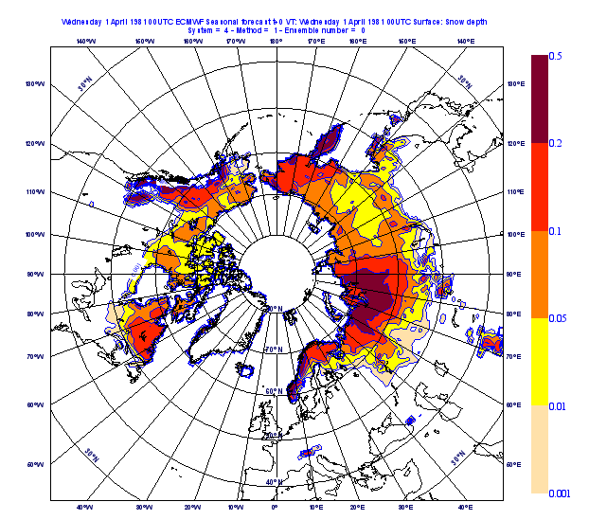
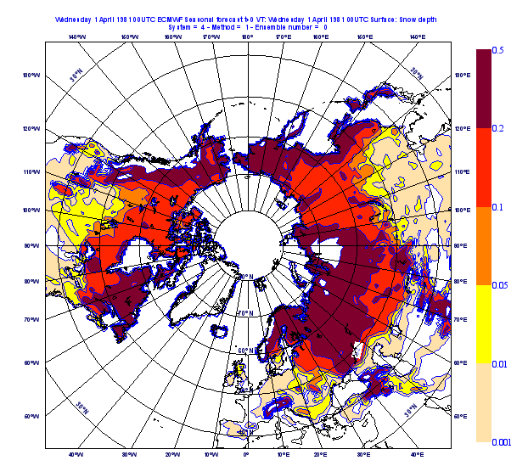
Land surface
Snow depth limits, 1st April

Slide 15
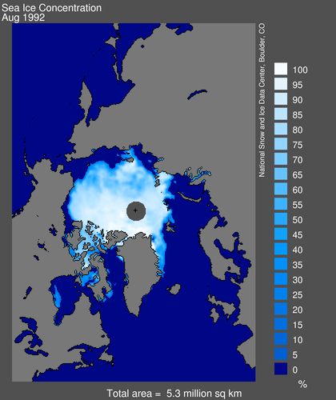
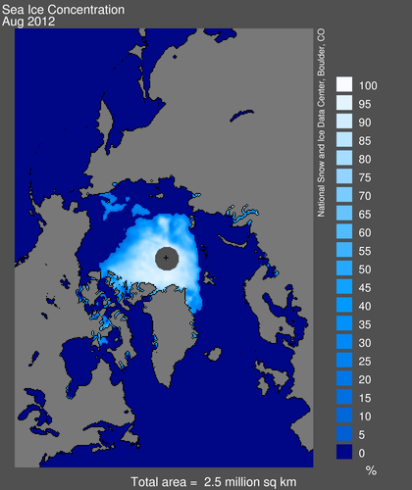
Sea ice

Slide 16
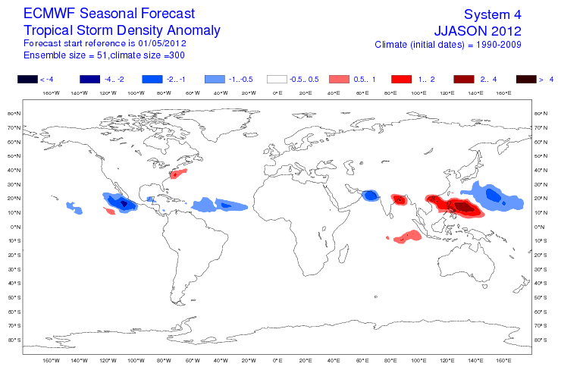
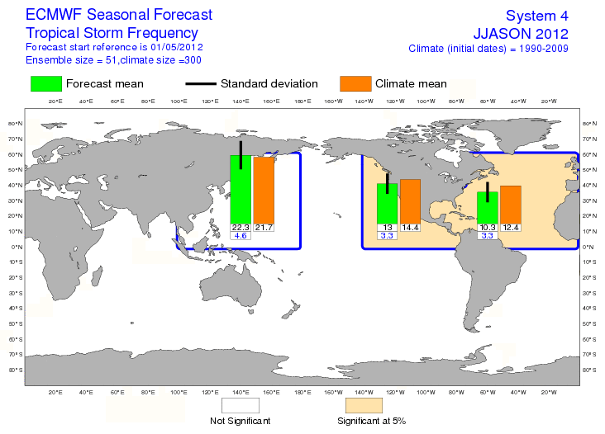
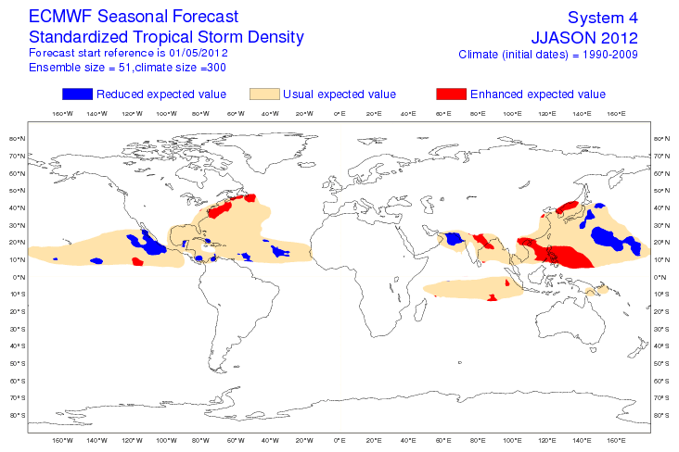
Tropical storm forecasts

Slide 17
Model errors are still serious …
Models have errors other than mean bias
  Eg weak wind and SST variability in System 2
  Past models underestimated MJO activity (S4 better)
  Suspected too-weak teleconnections to mid-latitudes
Mean state errors interact with model variability
  Nino 4 region is very sensitive (cold tongue/warm pool boundary)
  Atlantic variability suppressed if mean state is badly wrong
Forecast errors are often larger than they should be
  With respect to internal variability estimates and (occasionally) other prediction systems
  Reliability of probabilistic forecasts is often not particularly high (S4 better)

Slide 18
Recent Research

Slide 19
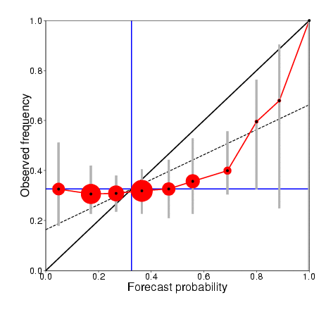
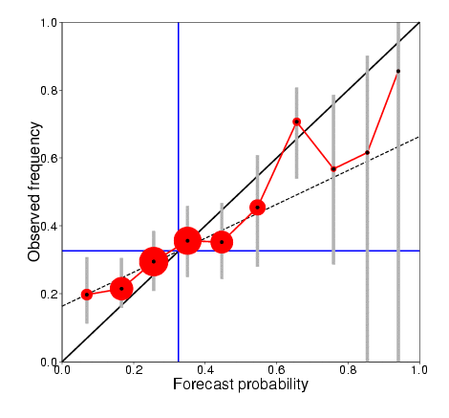
S4 extended hindcast set
15 members
DJF Europe T2m>upper tercile
Re-forecasts from 1 Nov, 1981-2010
Reliability score: 0.902
ROC skill score: 0.06
51 members
DJF Europe T2m>upper tercile
Re-forecasts from 1 Nov, 1981-2010
Reliability score: 0.981
ROC skill score: 0.22
(Figures from Susanna Corti)

Slide 20
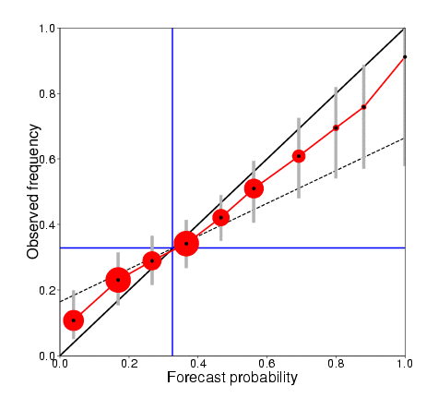
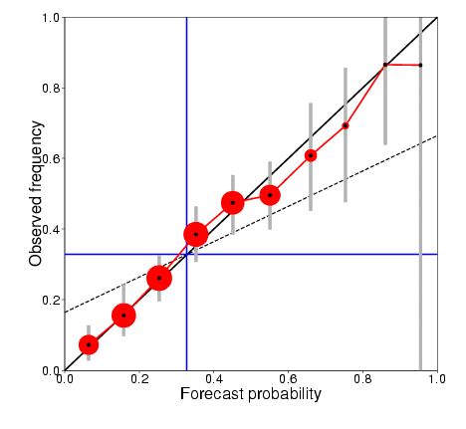
S4 extended hindcast set
15 members
JJA Europe T2m>upper tercile
Re-forecasts from 1 May, 1981-2010
Reliability score: 0.987
ROC skill score: 0.38
51 members
JJA Europe T2m>upper tercile
Re-forecasts from 1 May, 1981-2010
Reliability score: 0.996
ROC skill score: 0.43
(Figures from Susanna Corti)

Slide 21
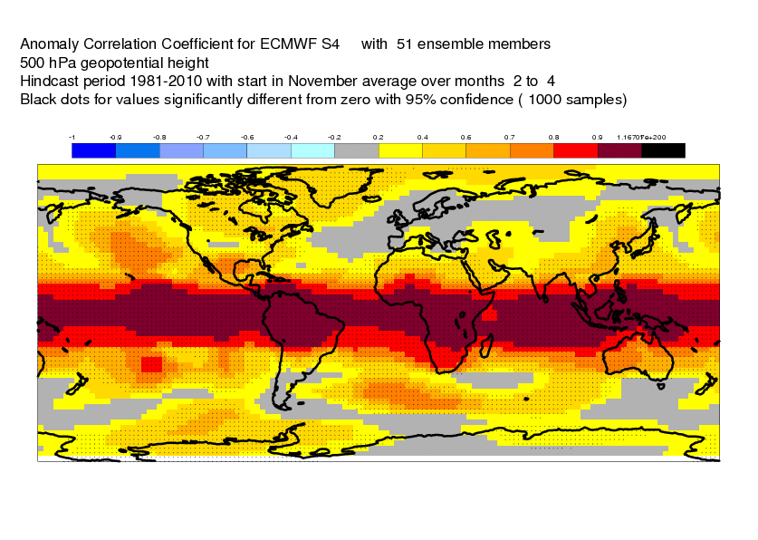
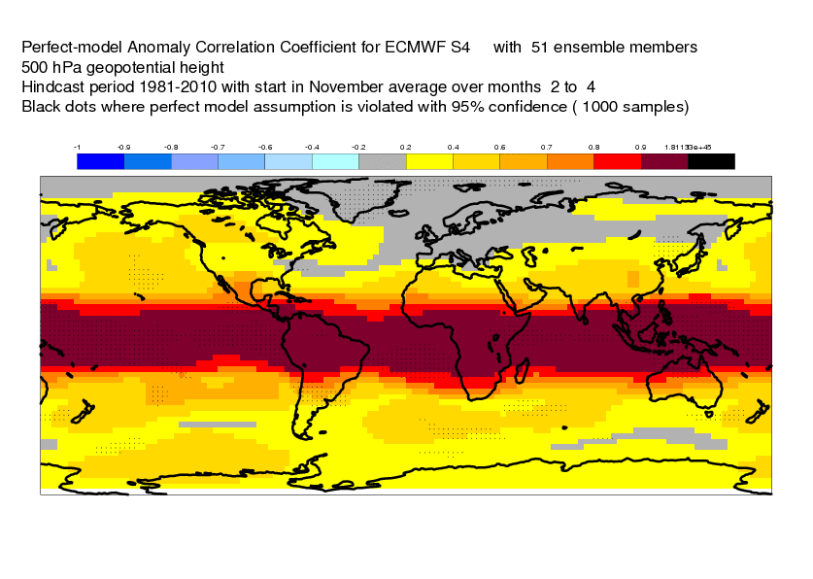
S4 ACC
DJF Z500
S4 ACC perfect model limit

Slide 22
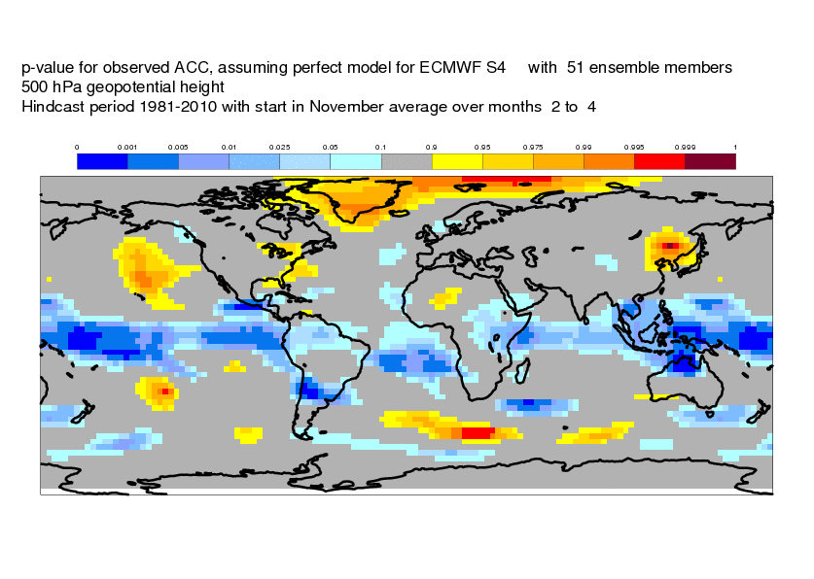
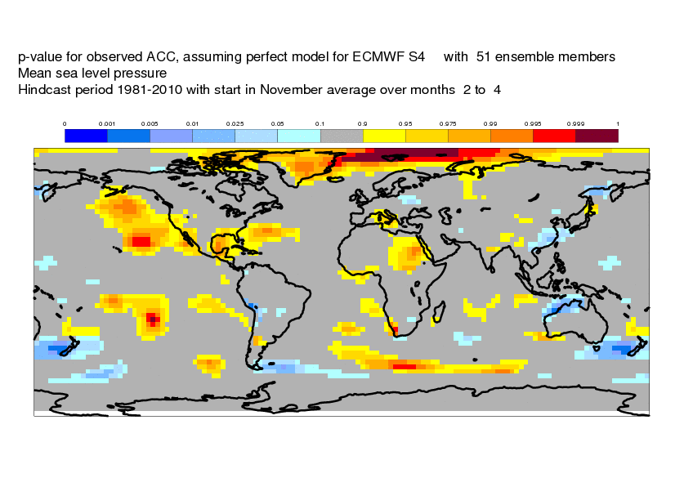
Local p-value for perfect model
Indistinguishable from perfect
Worse than perfect
Better than perfect

Slide 23
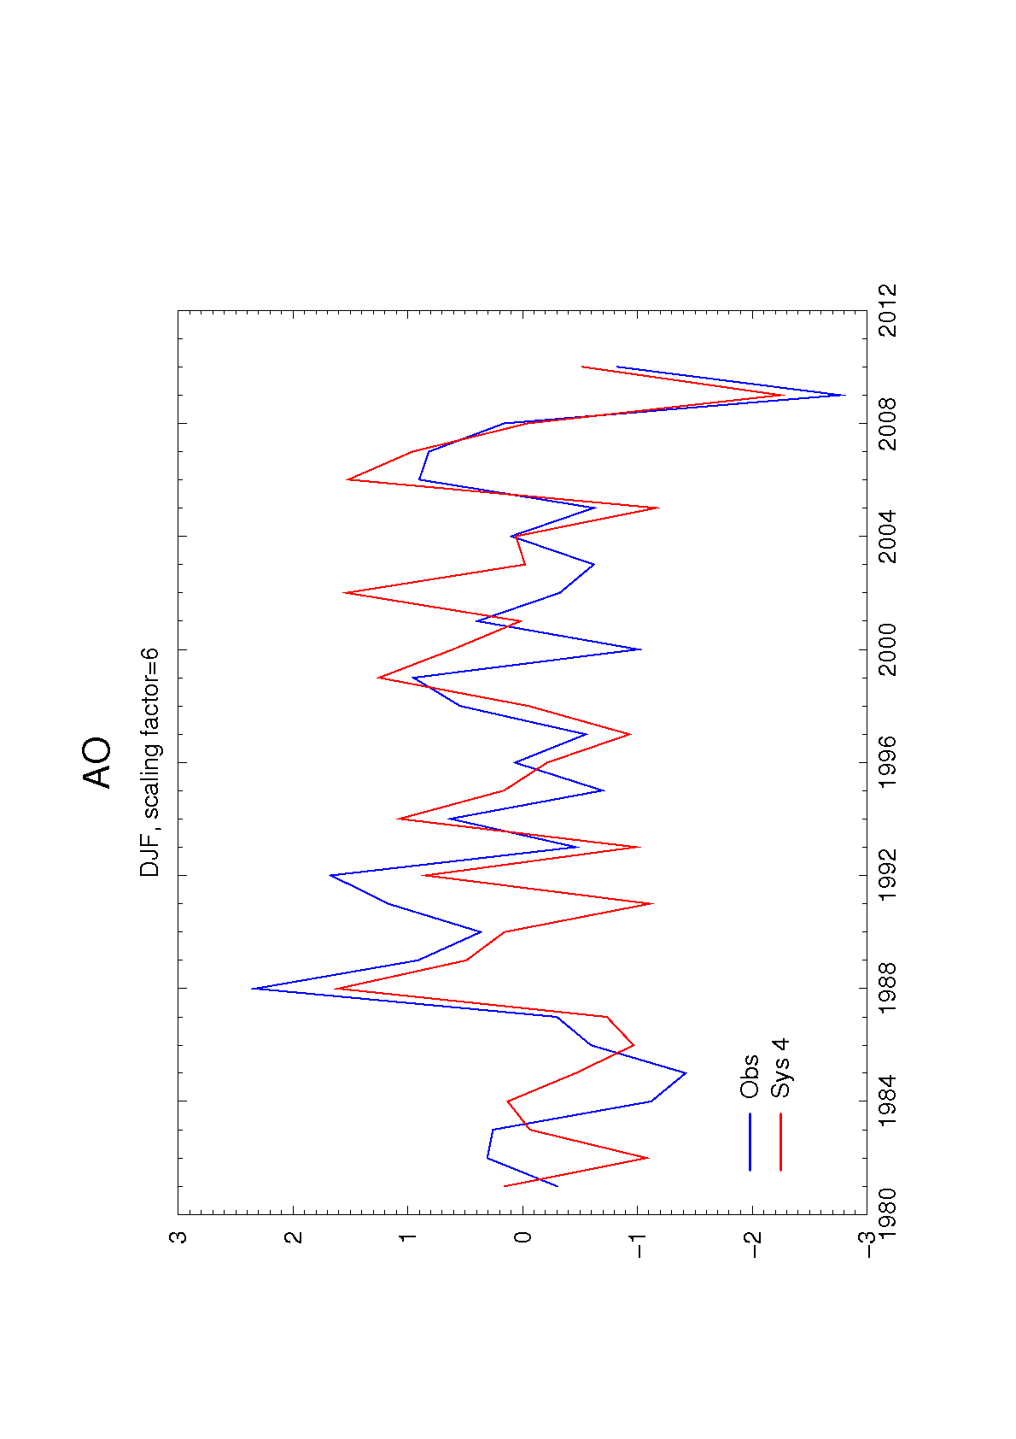
ACC=0.61
Fig. 1. The Arctic Oscillation Index for DJF, as analysed from ERAI (blue) and as predicted by the S4
ensemble mean from the 1st November (red). The S4 ensemble mean is scaled by a factor of 6 to be
of comparable amplitude to the observed index.

Slide 24
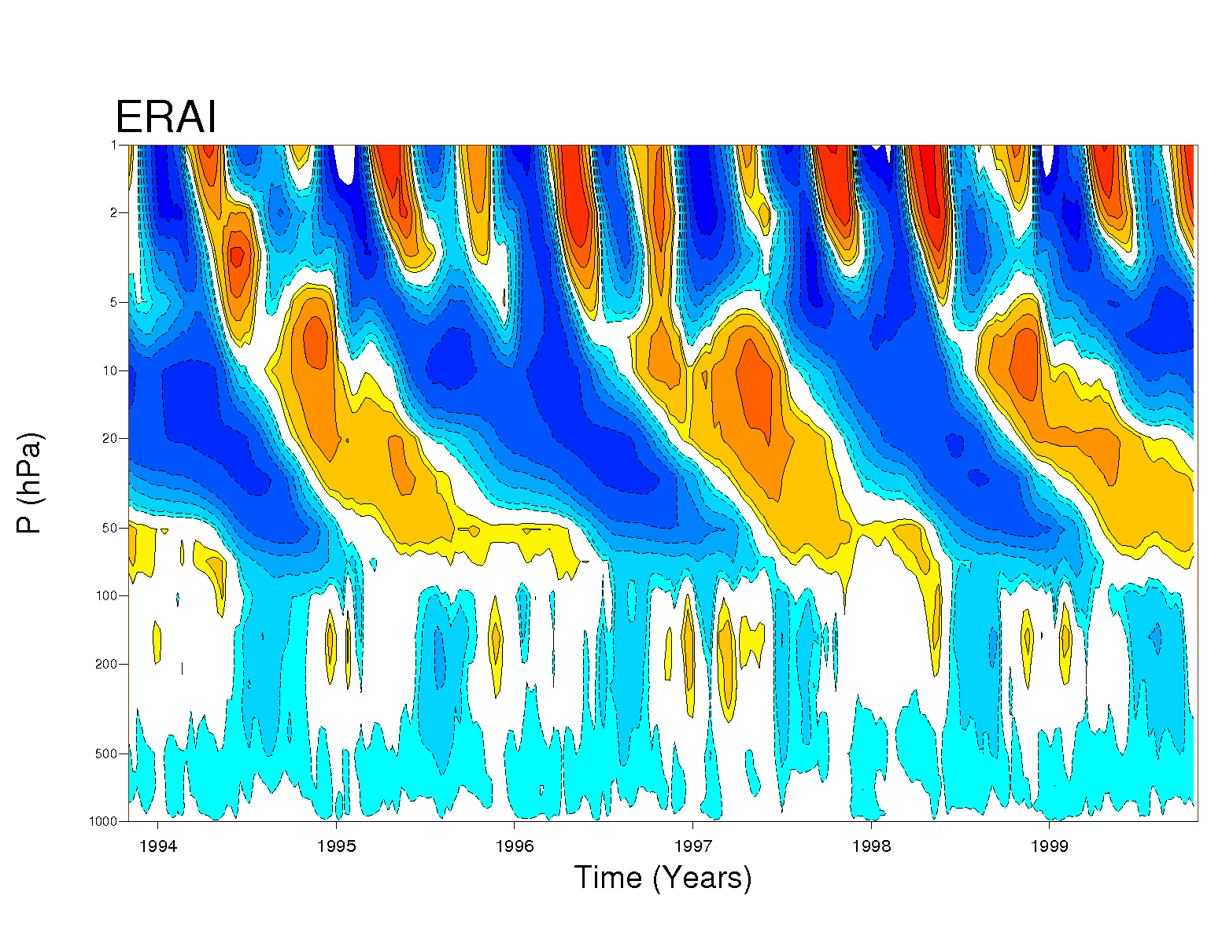
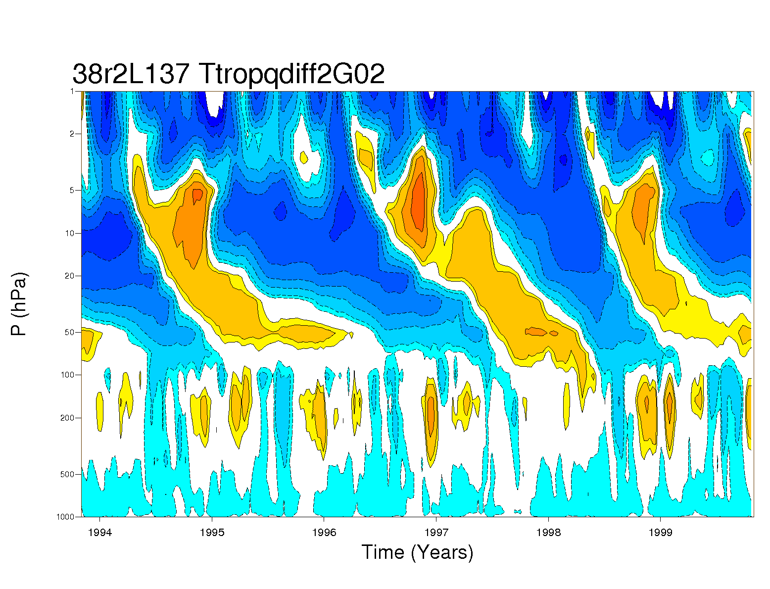
QBO
A big reduction in vertical diffusion, and a further tuning of non-orographic GWD, has given a big additional improvement in the QBO compared to S4.
Period and downward penetration match observations
Semi-annual oscillation still poorly represented

Slide 25
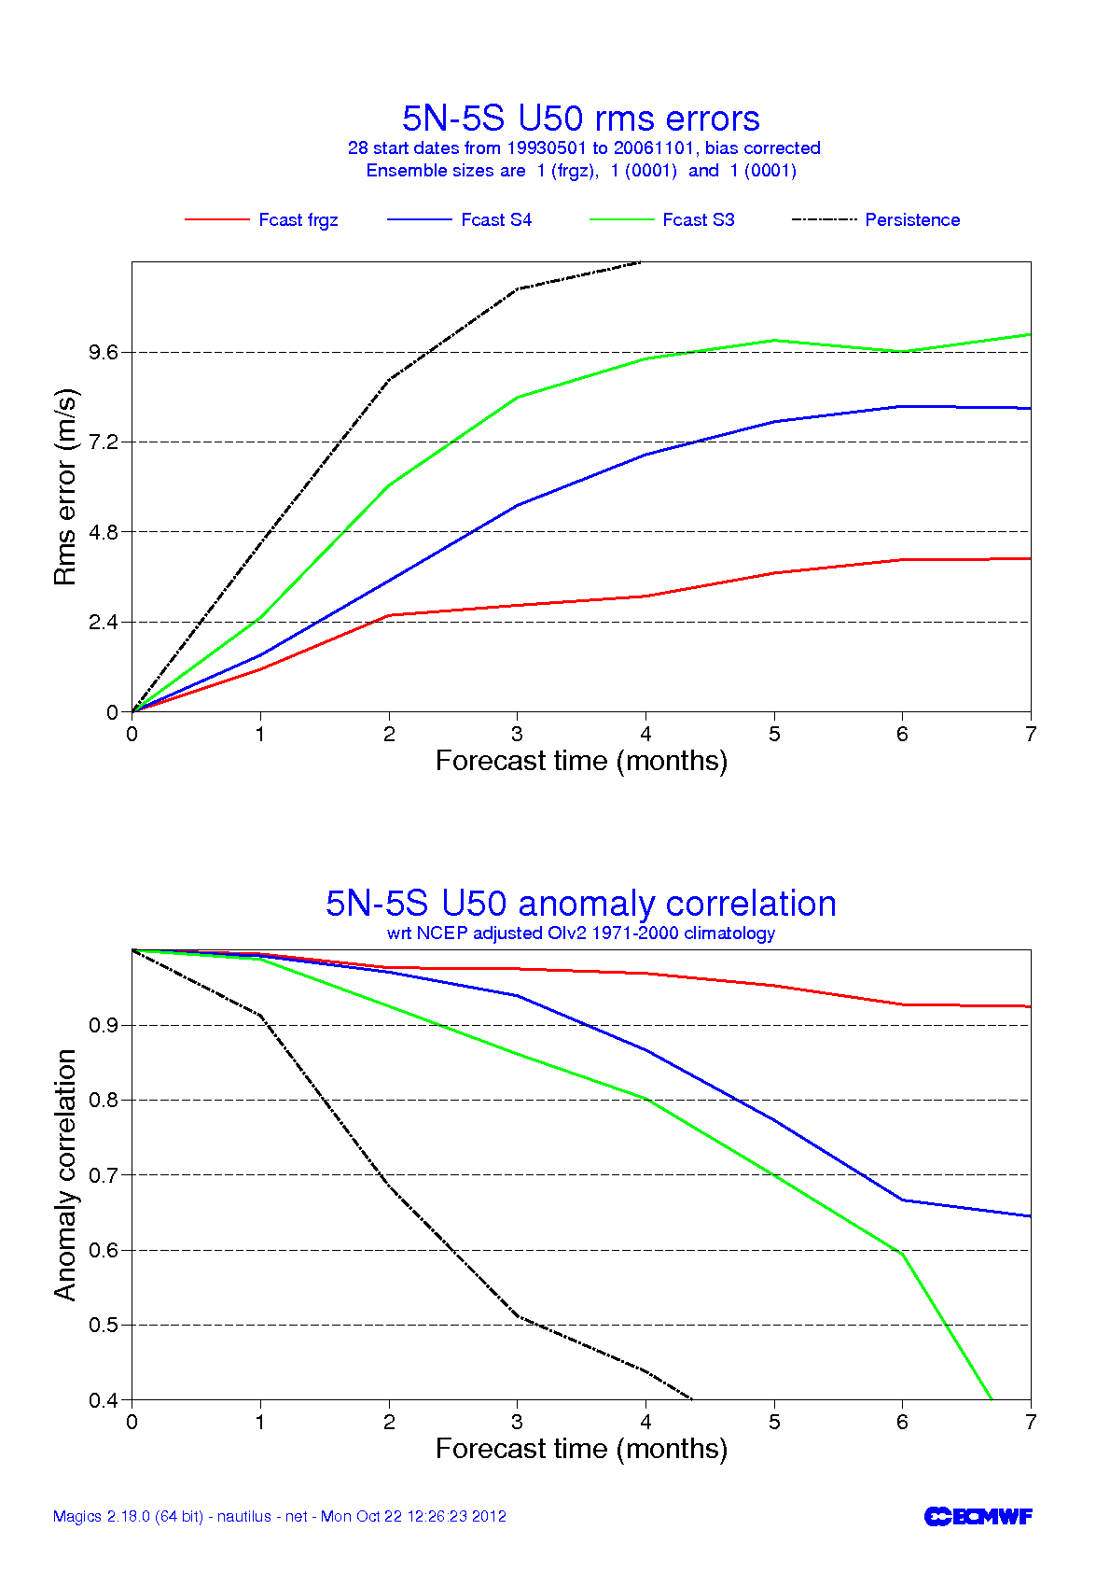
QBO forecasts
S3
S4
New

Slide 26
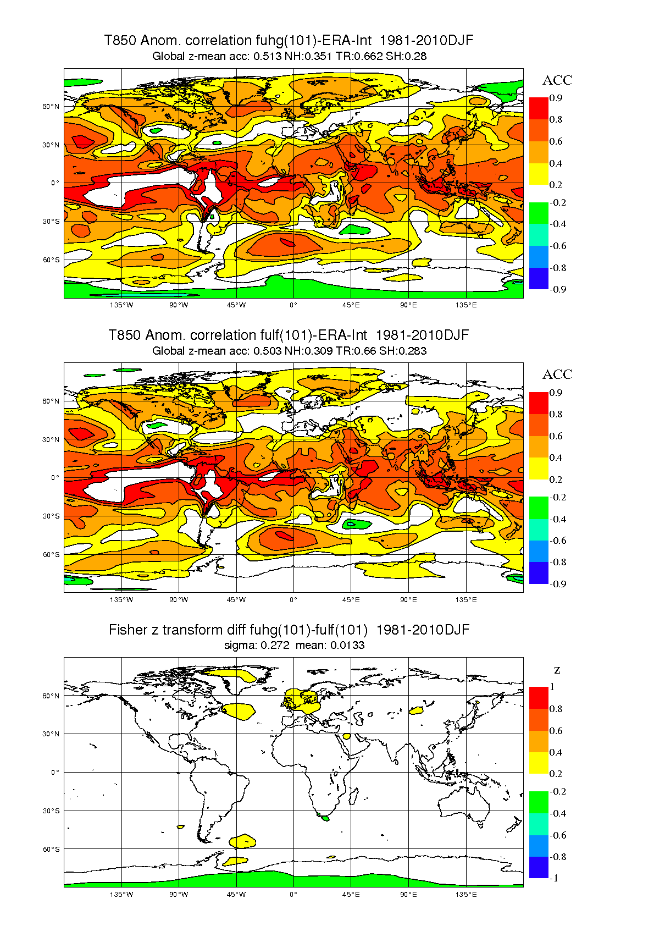
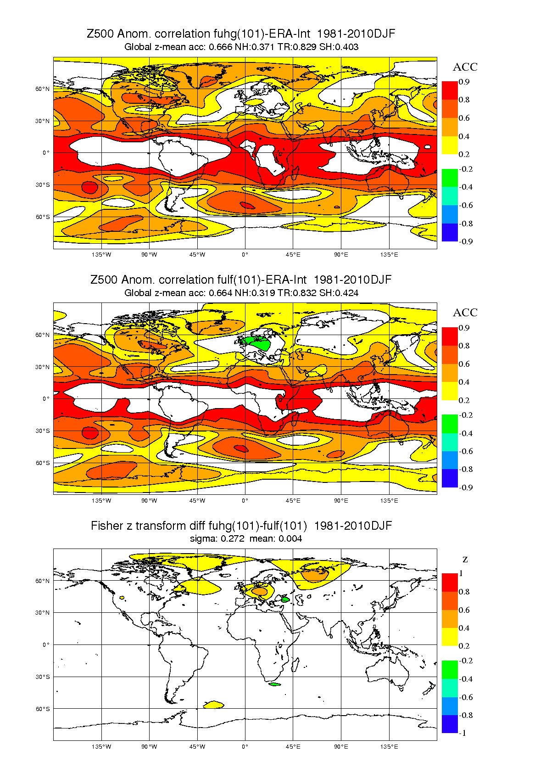
NH winter forecasts: vertical diffusion
0.371
0.319

Slide 27
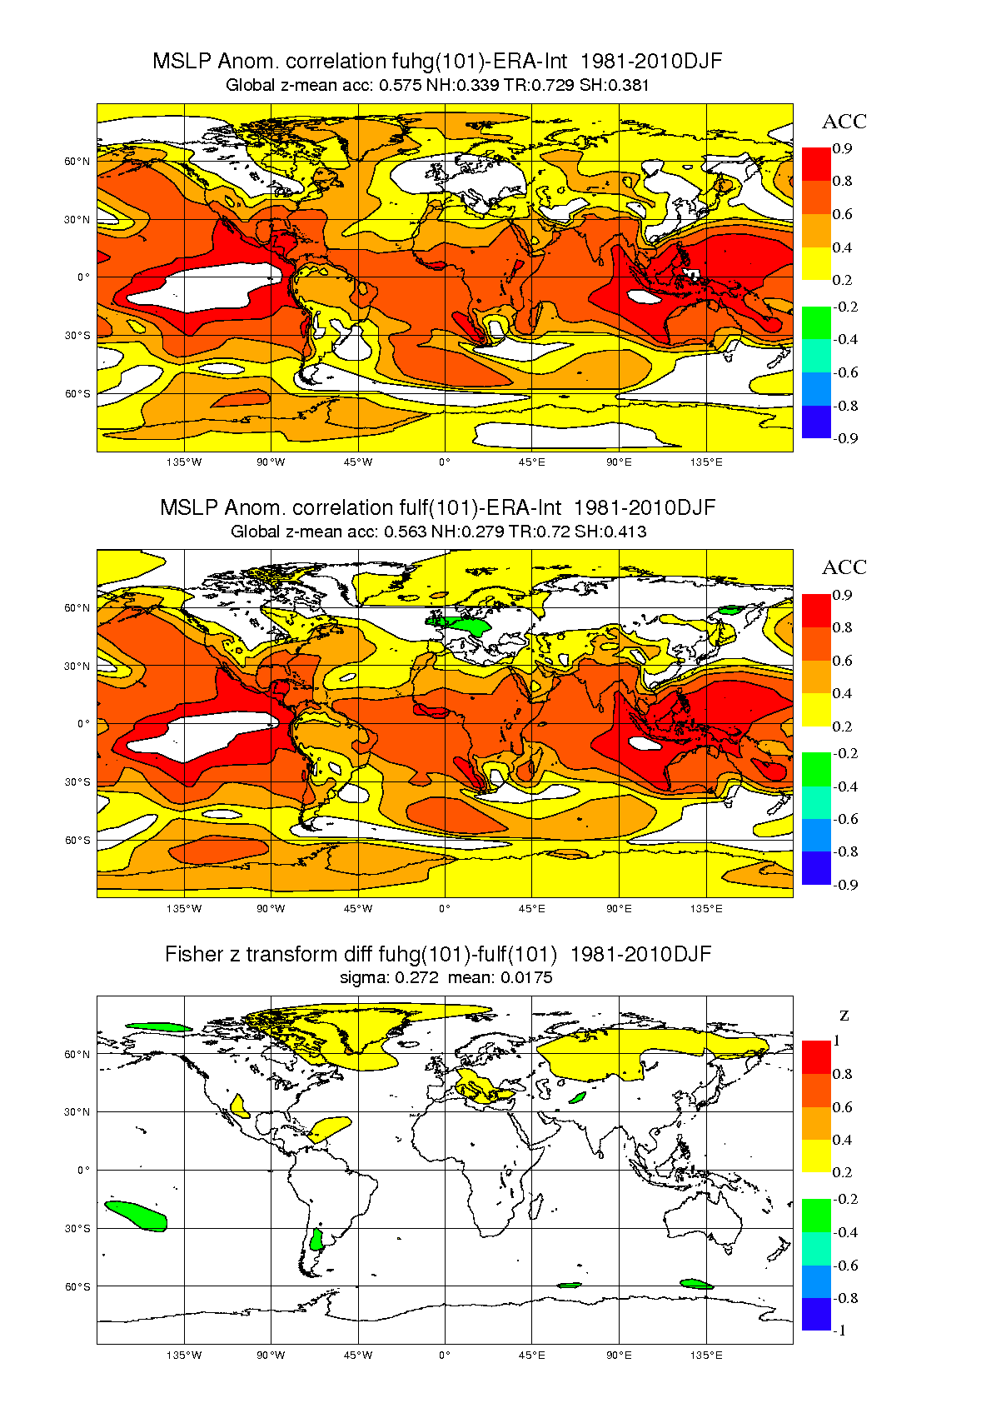
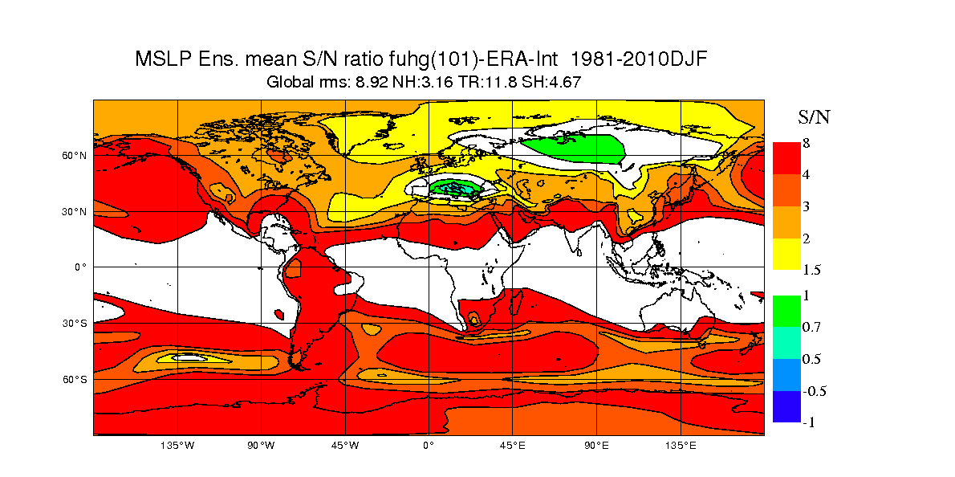
NH winter forecasts
Even with 101 members, ensemble mean signal not always well defined

Slide 28
Conclusions
Models are improving
  Gradual but continuous improvement in scores
  Reliability can be high in many situations
Forecast systems still have deficiencies
  Need calibration, and often cannot be trusted at face value
  Some issues may affect real-time forecasts more than re-forecasts
Further improvements lie ahead
  Research results suggesting that previous estimates of predictability limits might be wrong.
  Hard work needed to improve models and capture new sources of predictability.

