Slide 1
Operational sub-regional Long-Range Forecasting Unit at RA VI Regional Climate Center – South-East European Virtual Climate Change Center
Vladimir Djurdjevic
Institute for Meteorology, Faculty of Physics, University of Belgrade, Serbia
Southeast European Virtual Climate Change Center-SEEVCCC, Serbia
November, 2013
Long-Range Forecasting Traning

Slide 2
Introduction
Operational dynamical long range forecast in SEEVCCC started in mid 2009 as a one of the first activities in SEEVCCC.
The activity was initiated through RHMSS/SEEVCCC participation in WMO RA VI - Europe RCC network.
Climate data node
Climate monitoring node
Long range forecast node
(dynamical downscaling of global LRF is recommended function)

Slide 3
Approach
Dynamical downscaling of global long range forecast.
Dynamical downscaling is widely accepted approach that provides increased temporal and spatial resolution of global model results over area of interest (mainly continental or sub-continental scales),
It assumes the introduction of regional (limited area) model,
Time horizon: from short range over medium to long range forecast and climate scenarios.

Slide 4
RCM-SEEVCCC model
RCM-SEEVCCC is a two-way regional coupled model, with Eta/NCEP limited area model as its atmospheric part and Princeton Ocean Model (POM) as its ocean part.
Model has been used and verified for various applications:
Medium range forecast of atmosphere and sea,
Reanalysis downscaling,
Climate change scenarios downscaling.

Slide 5
RCM-SEEVCCC model
Atmospheric model Eta/NCEP:
Grid point model on Arakawa E grid and eta vertical coordinate,
Dynamical core with horizontal differencing that preserves many important properties of differential operators and conserves a variety of basic and derived quantities including, energy and enstrophy,
NOAH land surface scheme,
Radiation adopted from ARPS model,
Bets-Miller-Janjic convection,
Melloer-Yamada-Janjic turbulence and surface layer.
Ocean model: POM (Princeton Ocean Model)
Primitive equation model on C grid and sigma vertical coordinate,
Free surface,
Mellor-Yamada turbulence.
Coupler:
Hard coded,
Coupling frequency: after every physical time step in atmospheric model (order of minutes),
Atmosphere to ocean: radiation, turbulent and precipitation fluxes,
Ocean to atmosphere: seas surface temperature.

Slide 6
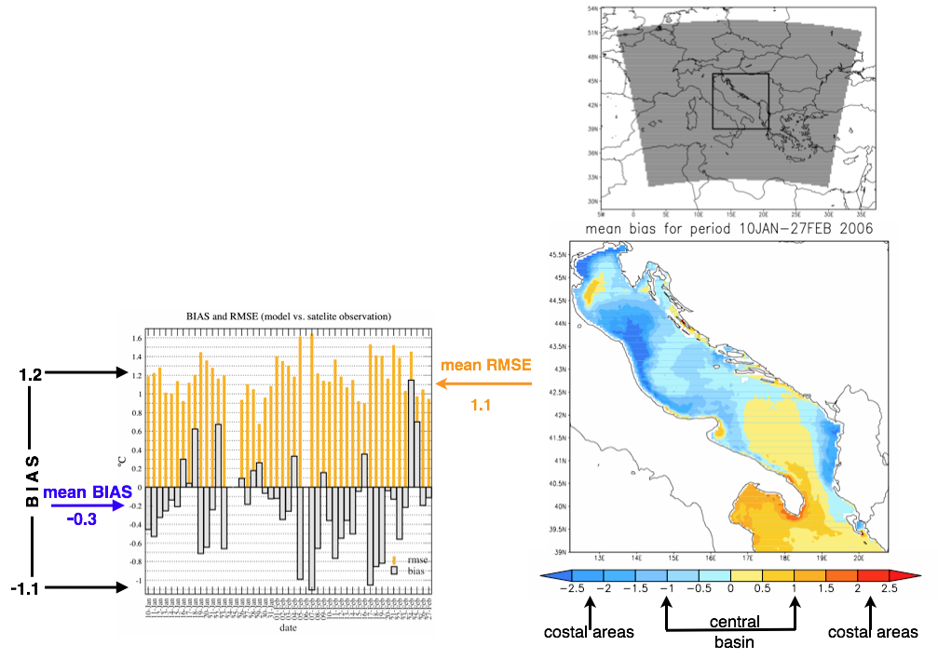
RCM-SEEVCC: Some application and verification exsamples
Medium range forecast
Downscaling of ECMWF and NCEP
7 day forecasts
Adriatic sea
Verification of SST forecast against
satellite observations

Slide 7
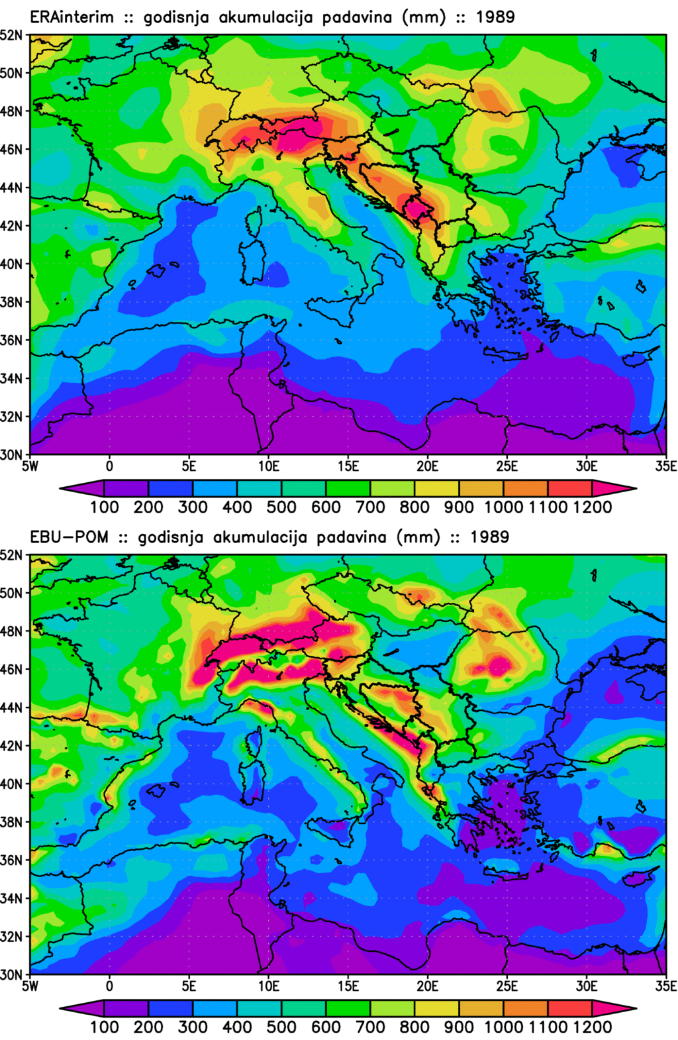
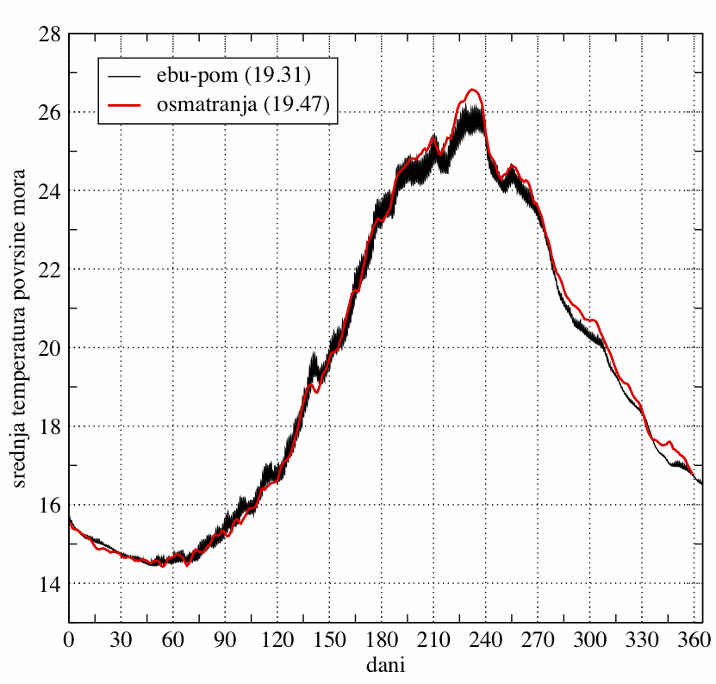
RCM-SEEVCC: Some application and verification exsamples
Annual precipitation
ERA – Interim downscaling
Mean Mediterranean sea surface temperature
one year cycle; black – model; red - observations
ERA-Interim
MODEL

Slide 8
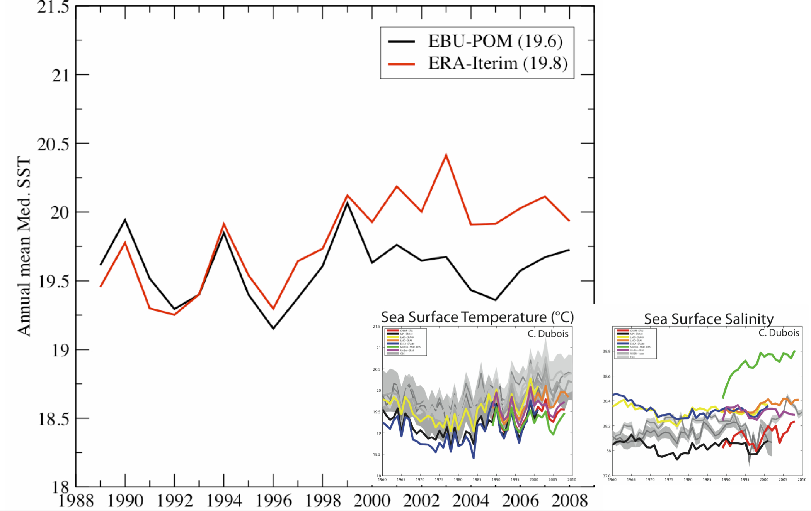
RCM-SEEVCC: Some application and verification exsamples
ERA – Interim downscaling

Slide 9
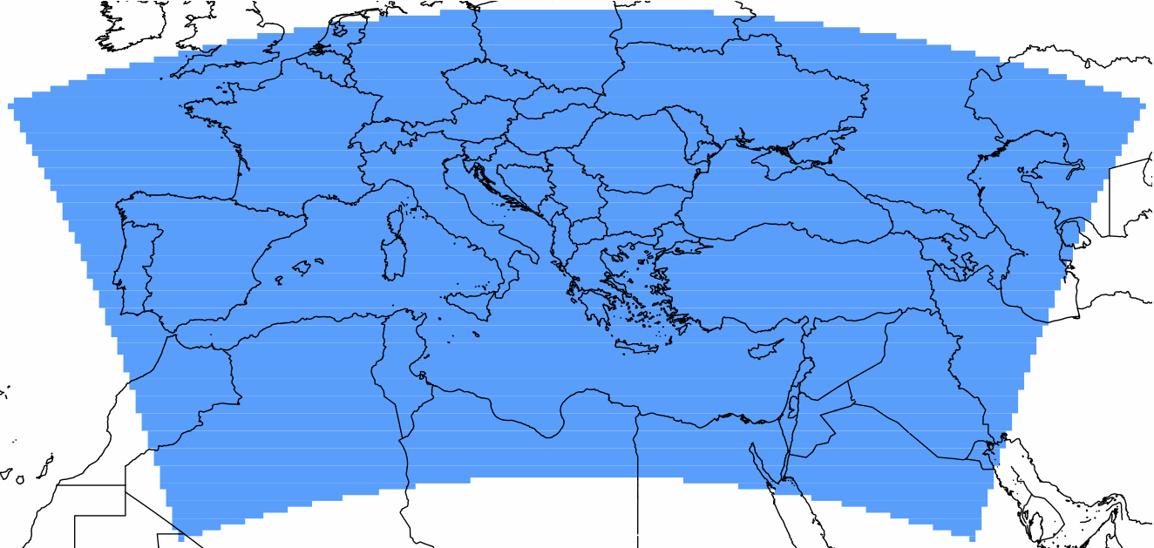
RCM-SEEVCC set-up for LRF downscaling
Atmospheric model:
Horizontal resolution 0.25º,
42 vertical levels,
Top at 50mb,
Long term annual vegetation cycle.
Ocean model:
Domain cover Mediterranean sea,
Horizontal resolution 0.2º,
21 vertical levels.
Coupler:
Every 360 seconds.

Slide 10
RCM-SEEVCC set-up for LRF downscaling
Initial & boundary conditions: ECMWF SYSTEM-4,
Model start: 10th of each month,
51 ensemble members,
Forecast duration: 7 months (~215 days),
Ocean initial condition long term Mediterranean climatology,
My-Ocean project?
Single code run on separate CPU, 51 runs in parallel,
About 1.5 day from download start to graphical products.

Slide 11
Graphical products are available on SEEVCCC web site
www.seevccc.rs
Operational Products tab

Slide 12
Graphical products are available on SEEVCCC web site
Ensemble mean
Monthly temperature,
Monthly precipitation,
Monthly temperature anomaly,
Monthly precipitation anomaly,
Seasonal temperature,
Seasonal precipitation,
Seasonal temperature anomaly,
Seasonal precipitation anomaly,
Mediterranean monthly mean SST.

Slide 13
Graphical products are available on SEEVCCC web site
www.seevccc.rs
Variable
Forecast initial month and year
Slide bar for lead months

Slide 14
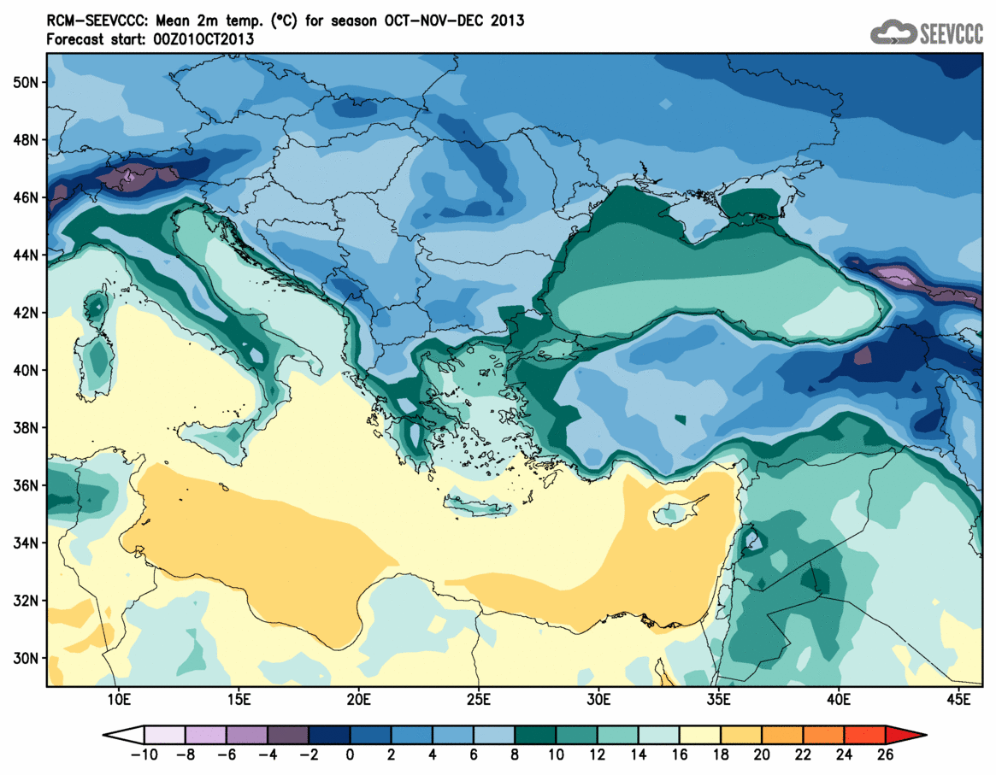
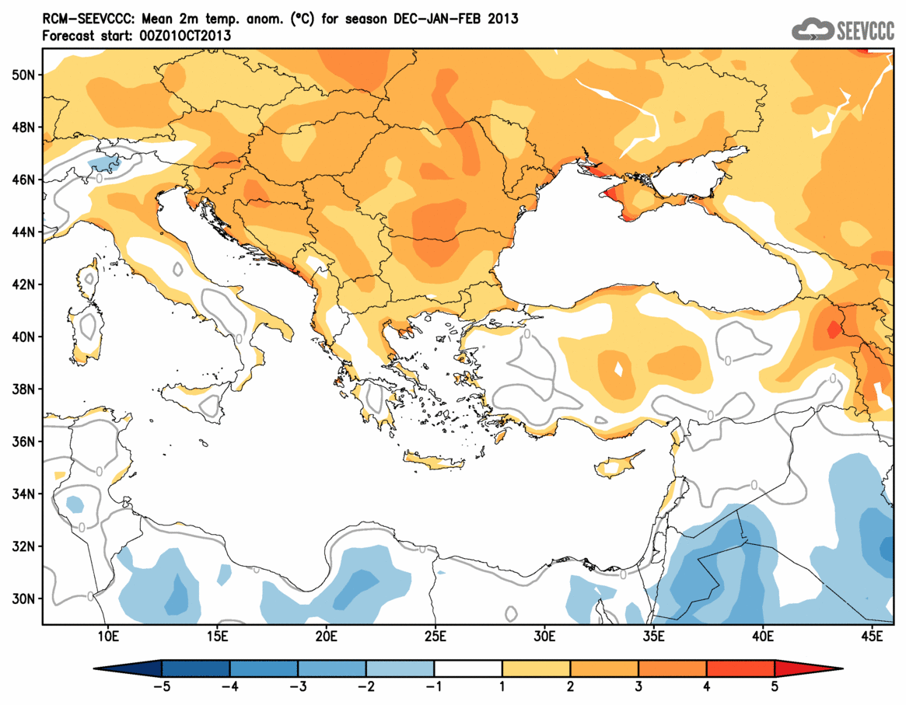
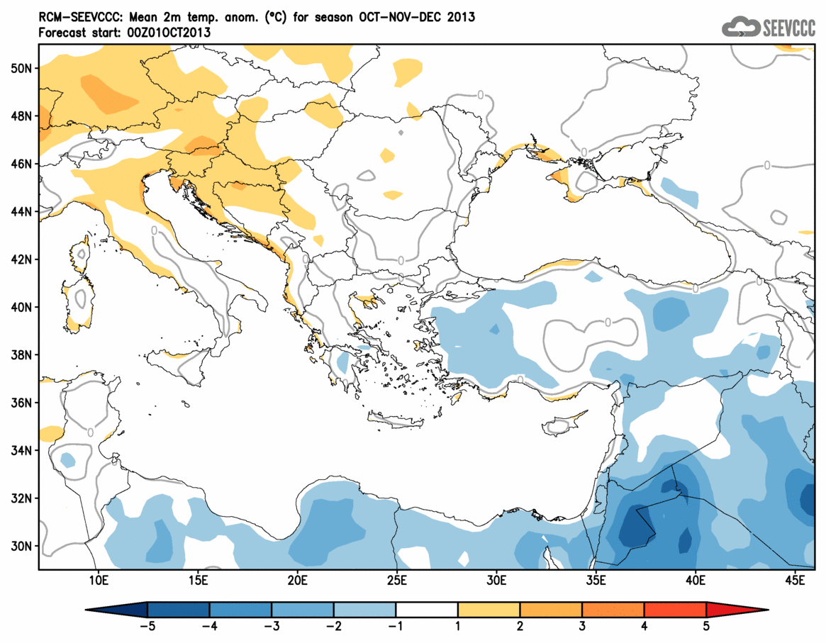
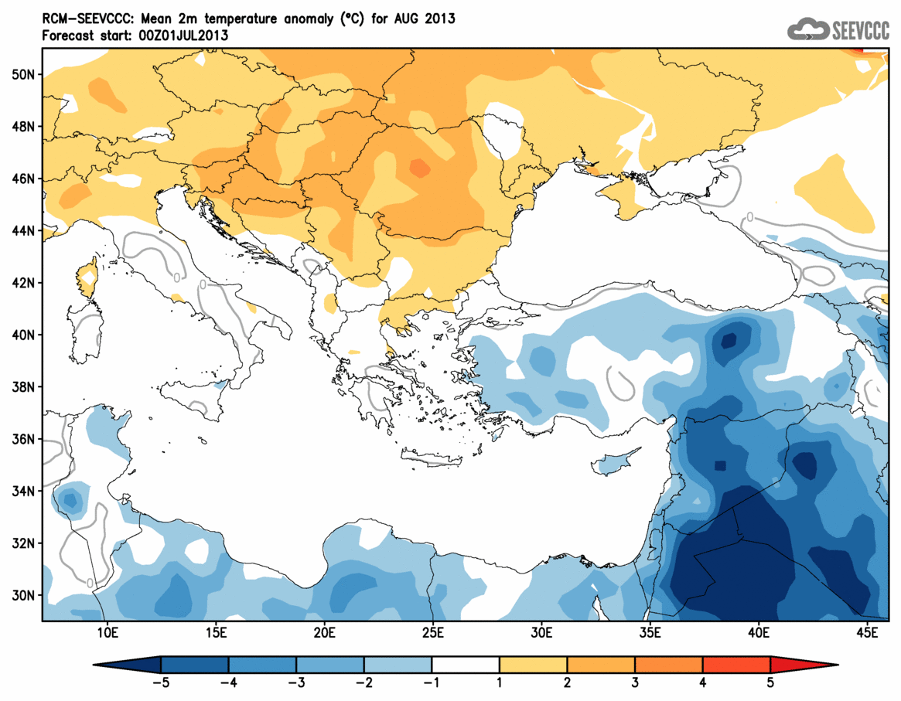
Graphical products
Monthly and seasonal temperature and anomalies

Slide 15
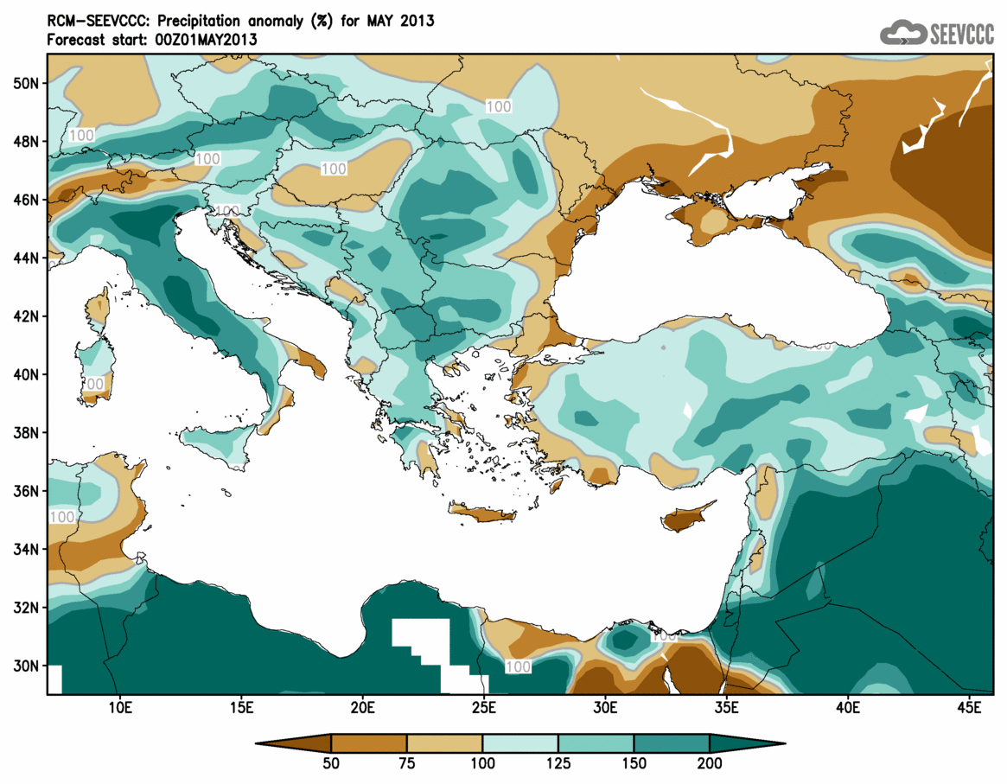
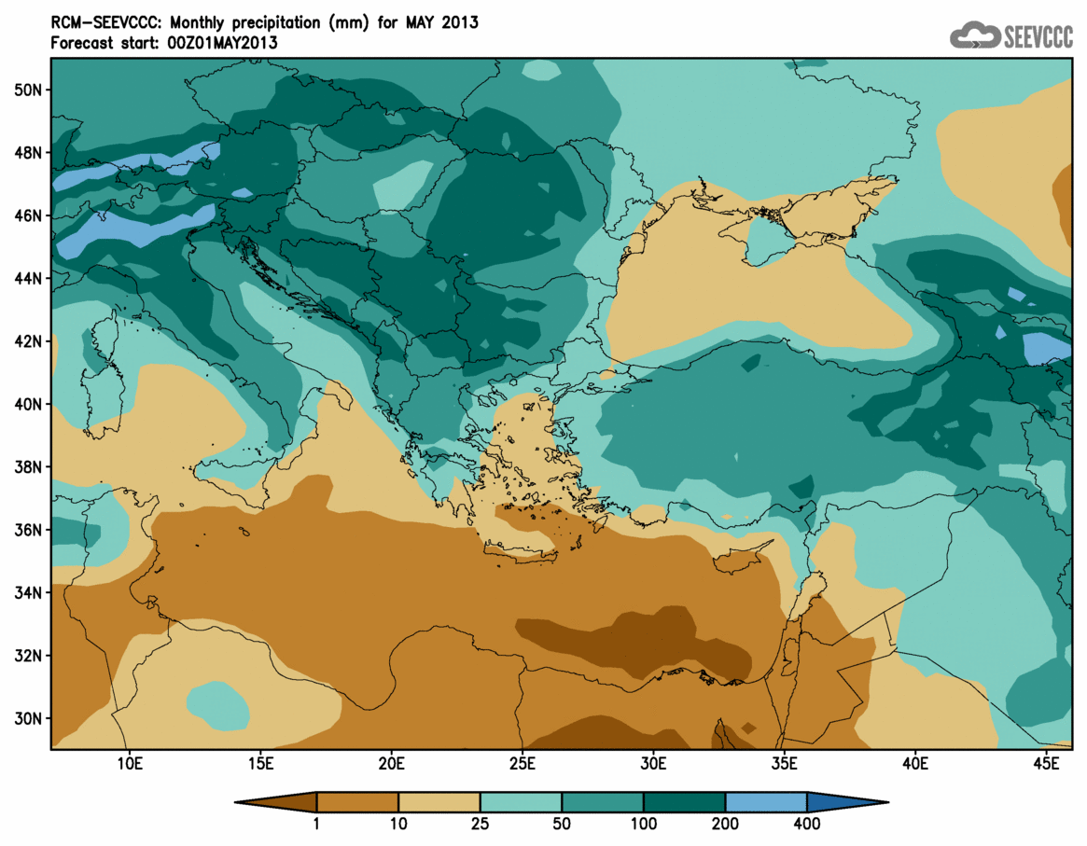
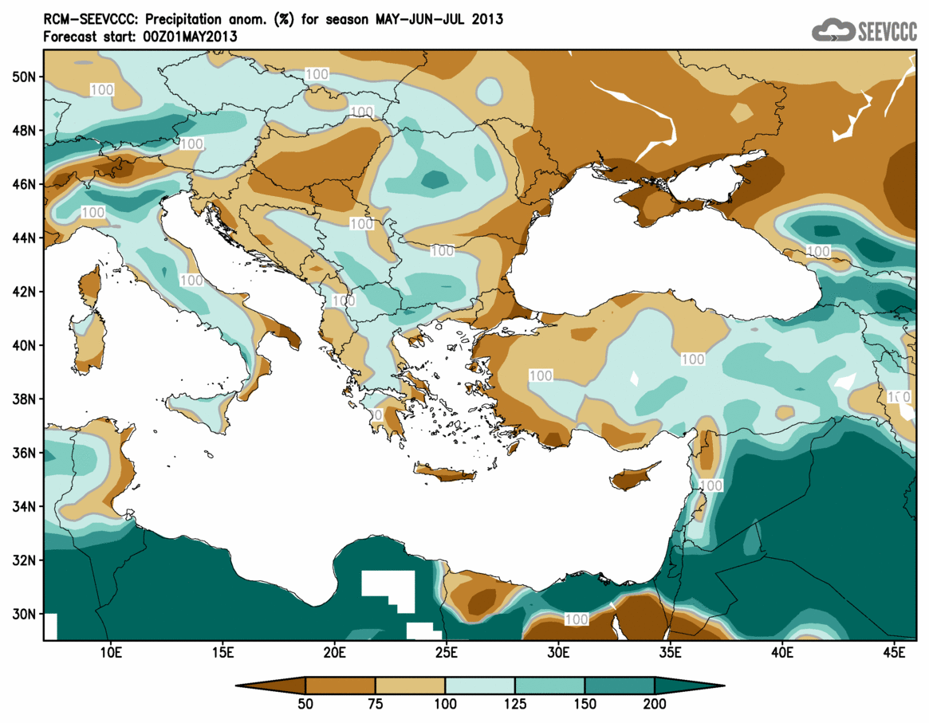
Graphical products
Monthly and seasonal precipitation and anomalies

Slide 16
Products available via WMO WIS
http://wis-geo.hidmet.gov.rs:8080/geonetwork/srv/en/main.home

Slide 17
Products available via WMO WIS
FTP access to long range forecast forecast
wis-geo.hidmet.gov.rs
Monthly mean temperature and accumulated precipitation
All 51 ensemble member
Re-gridded to regular lat-lon grid, 0.25º

Slide 18
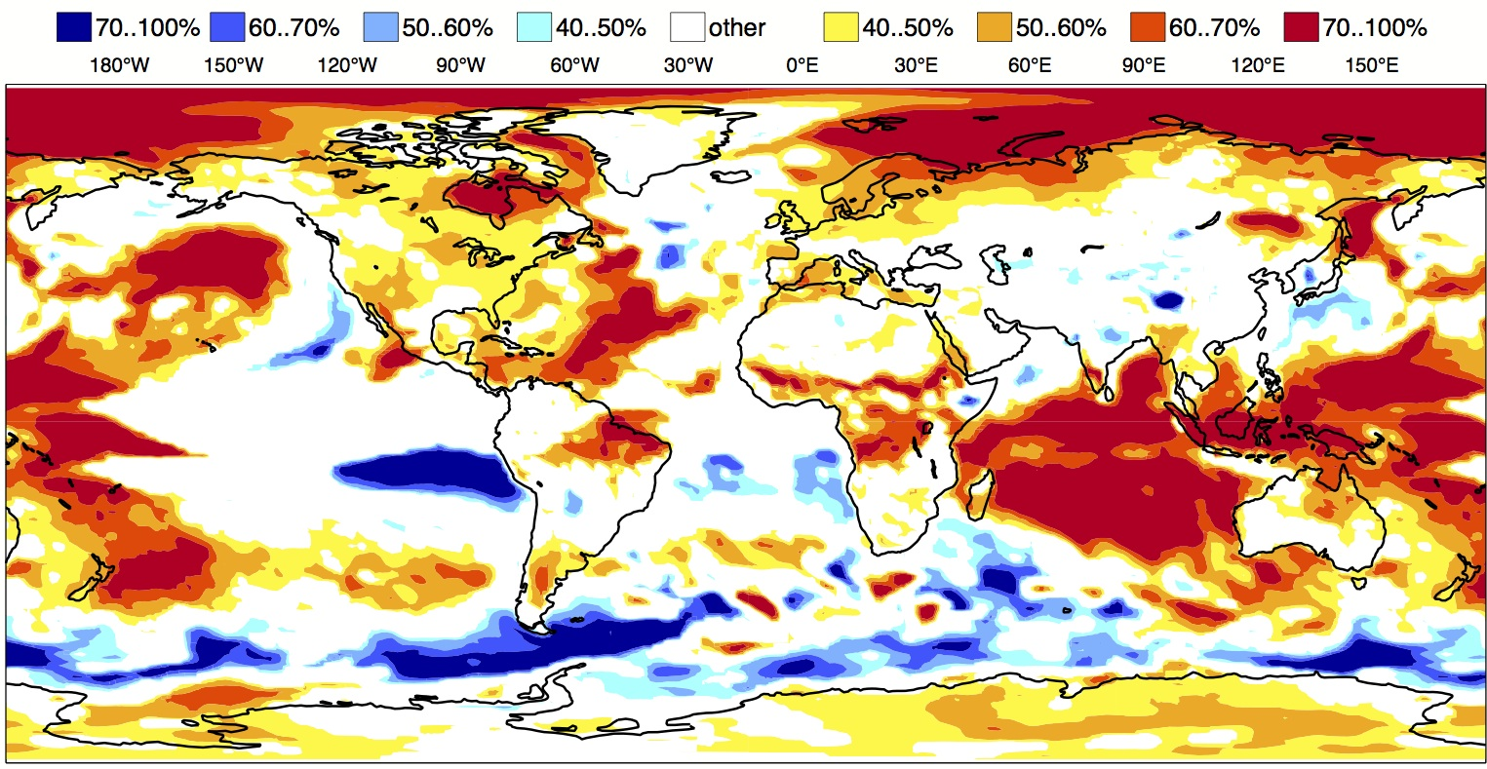
From GCM to end users
GCM
RCM
Local soil condition
CROP MODDEL
Phenology
Production

Slide 19
Thank you

