Slide 1

Activities of seasonal modelling at the Euro-Mediterranean Center on Climate Change (CMCC)
Stefano Materia, Andrea Borrelli,
Alessio Bellucci, Silvio Gualdi,
Enrico Scoccimarro
LONG-RANGE FORECASTING
TRAINING (LRF Training)
Belgrade, 14 November 2013

Slide 2
The Euro-Mediterranean Center on Climate Change (CMCC)
an Italian research centre on climate science and policy
a network of Italian public and private research institutions
funded by the Italian Ministries MIUR (university & research),
MATTM (environment) and MEF (economy & finance), within
the framework of the National Research Plan
    Mission:
    to investigate and model the climate system and its interactions with society to provide reliable, rigorous, and timely scientific results to stimulate sustainable growth, protect the environment and to develop science driven adaptation and mitigation policies in a changing climate.

Slide 3
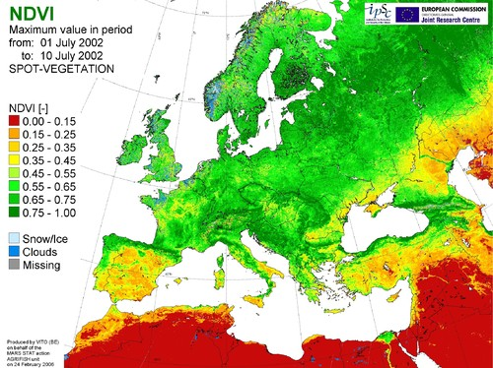

The CMCC Divisions
Climate Services (SERC)
Activities:
  Production of climate predictions at seasonal to decadal time-scale and climate change projections (global scale, regional focuses).
  Communication of the results and information obtained to a broad range of users: decision makers and stakeholders, political bodies and public administration, researchers from other disciplines.
  Coordinate research on adaptation policies to climate change and provide technical and scientific support to the institutions for multilateral negotiation processes in the field of climate change (EU, IPCC, UNFCCC).

Slide 4
The CMCC Climate Model
Atmosphere
ECHAM5
(from 200-to-80 km)
(Roeckner et al 1996, 2003)
Initialization (off-line)
Land Surface
SILVA
(Alessandri 2006)
Atmospheric I.C. from AMIP-type runs or from Re-analyses (ERA)
Coupler
OASIS3
(Valcke et al, 2000)
Sea Ice
LIM (ORCA2)
(Timmerman et al, 2005)
Ocean initial conditions from spin-up or from CMCC analyses
Global Ocean
OPA 8.2 (ORCA2)
(Madec et al, 1998)
Med Sea
NEMO-MFS
(~6.7 km)
Oddo et al. (2009)
Marine Bio-
Geochemistry
PELAGOS
Vichi et al. 2007
Coupling Daily (or higher frequency) & no flux adjustment

Slide 5
The CMCC Climate Model (CMIP5 configuration)
Atmosphere
ECHAM5
(from 200-to-80 km)
(Roeckner et al 1996, 2003)
CMCC-CM
PHYSICAL CORE
Coupler
OASIS3
(Valcke et al, 2000)
Sea Ice
LIM (ORCA2)
(Timmerman et al, 2005)
Global Ocean
OPA 8.2 (ORCA2)
(Madec et al, 1998)
Fogli et al. (2010, CMCC Sci. Rep.)
Scoccimarro et al. (J. Climate. 2011)
Bellucci et al. (Clim. Dyn., 2012)
Coupling Daily (or higher frequency) & no flux adjustment

Slide 6
The CMCC Climate Model (CMIP5 configuration)
Atmosphere
ECHAM5
(from 200-to-80 km)
(Roeckner et al 1996, 2003)
Land Surface
SILVA
(Alessandri 2006)
CMCC-CESM
Coupler
OASIS3
(Valcke et al, 2000)
CARBON CYCLE
Sea Ice
LIM (ORCA2)
(Timmerman et al, 2005)
Global Ocean
OPA 8.2 (ORCA2)
(Madec et al, 1998)
Marine Bio-
Geochemistry
PELAGOS
Vichi et al. 2007
Vichi et al. (Clim. Dyn. 2011)
Coupling Daily (or higher frequency) & no flux adjustment

Slide 7
The CMCC Climate Model (CIRCE configuration)
Atmosphere
ECHAM5
(from 200-to-80 km)
(Roeckner et al 1996, 2003)
CMCC-MED
FOCUS ON THE MEDITERRANEAN REGION
Gualdi et al. (BAMS, 2013)
Coupler
OASIS3
(Valcke et al, 2000)
Sea Ice
LIM (ORCA2)
(Timmerman et al, 2005)
Global Ocean
OPA 8.2 (ORCA2)
(Madec et al, 1998)
Med Sea
NEMO-MFS
(~6.7 km)
Oddo et al. (2009)
Coupling Daily (or higher frequency) & no flux adjustment

Slide 8
How do we use our climate model?
Climate simulations: explore the mechanisms that drive the climate variability and climate change. Process oriented investigations on a wide range of spatial and temporal scales.
Climate projections: assess the climate change signal according to prescribed scenarios of radiative forcing. Generally long simulations starting from spin-up initial conditions. Identification of long-term trends and changes in the statistics of parameters of interest.
Short-term projections: assess the climate variations due to both the internal variability and changes in the external forcings. Ensembles of short-term (~10-to-30 years) projections, but initialized with observed conditions (specific start date). Change in the statistics of parameters of interest.
Seasonal predictions: assess the climate variations mostly due to the internal variability of the climate system. 6-to-12 month simulations initialized with observed conditions (specific start date). Prediction of possible anomalous conditions in the “current statistics” (current climate).

Slide 9
The CMCC Seasonal Prediction System
Coupled Model component
Radiative forcings
GHGs & SO4
Off line Initialization Tools
The CMCC Global Model represents the various components of the Earth system.
Atmospheric and Land Surface IC from ERA-Interim Reanalysis
Land Surface
SILVA
(Alessandri 2006, 2007)
Atmosphere
ECHAM5 (T63 ≈ 1.87°x1.87°)
(Roeckner et al 1996, 2003)
Spectral & Time interpolation INTERA
(Kirchner, 2001)
Coupler
OASIS3
(Valcke et al, 2000)
SPSv2
Ocean initial condition
T & S - OI assimilation SOFA 3.0
(De Mey and Benkiran 2002)
CIGODAS
Sea Ice
LIM (ORCA2)
(Timmerman et al, 2005)
Ocean
OPA 8.2 (ORCA2)
(Madec et al, 1998)
Bellucci, Masina, Di Pietro & Navarra, 2007. MWR
Coupling Daily No flux adjustment
SPSv1
The CMCC Seasonal Prediction System is initialized with the “closest to reality” state of the ocean (SPSv1) and land-atmosphere (SPSv2), which drive the model towards a state affected by the initialization itself other than boundary conditions and its internal physics.

Slide 10
Approaching seasonal forecasts
Uncertainties on initial data could be large. To supply for this issue: ensemble technique with perturbed initial conditions.
Deterministic Forecast
Uncertainty on the forecats
Uncertainty on Initial Conditions
X
Reanalyses
Climatology
Probabilistic Forecast
time
Readapted from Trzaska (http://portal.iri.columbia.edu)

Slide 11
The experimental setup
Retrospective forecasts (hindcasts) for validation
OFF LINE interpolated
Land-Atmosphere IC from
ECMWF Operational analysis
Day lag every 12 hours
-5 0
-5 0
-5 0
-5 0
Time
INITIALIZED COUPLED RUNS
1° Feb start date
1° Mar start date
1° Apr start date
1° May start date
Time
OFF LINE assimilated
CMCC OCEAN ANALYSIS
For the operational forecasts
Start date every month 1st
6-month-integration for the period 1989-2010
12 start dates per year (once a month)
9 ensemble members for each start date

Slide 12
Results from three different versions of the CMCC-SPS
Materia et al., 2013
CIGODAS is the CMCC-INGV Global Ocean Data Assimilation System
ERA Interim is the ECMWF Re-Analysis product at T255 (about 60 km).
Atmosphere initialization: Temperature, Winds, Specific Humidity, etc on the atm. Lev.
Land surface initialization: Soil moisture, Temperature, Snow

Slide 13
Validation of the CMCC-SPS
Tsurf Anomaly Correlation (ACC) lead time 1
Lead time 1 refers to the season starting one month after the start date (e.g. Feb lead 1 = MAM)
ACC is a measure of the skill of the system, indicating the correlation between forecast and ERAinterim reanalyses between 1989-2010. Values close to 1 => high predictability.
Predictability is higher in the Tropics and in the oceans than on continents.
High skill in the ENSO area and teleconnected regions.
Good skill in the northern Atlantic region, particularly in the winter and the spring

Slide 14
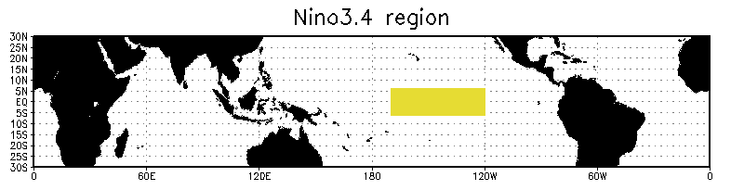
Validation of the CMCC-SPSv2
Predictability of ENSO
SST anomalies in the NINO 3.4 region
Lead 1 (2) refers to the season starting one (two) month after the start date (here, Nov lead 1 (2) = DJF (JFM))
The ENSO signal is well predicted by the CMCC-SPS, with anomaly correlation coefficients higher than 95% in the NINO3.4 region

Slide 15
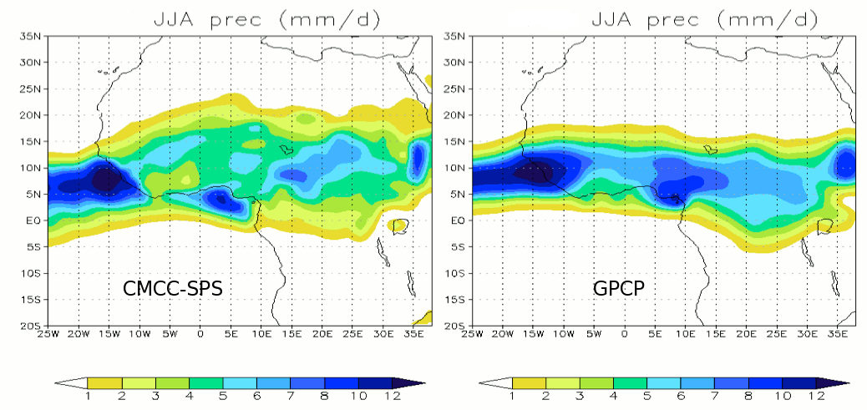
Validation of the CMCC-SPSv2
WAMI anomaly (m/s) May start date, lead 1 (JJA)
Predictability of the
West African Monsoon
ERA Interim
WAMI = u_{850hPa} - u_{200hPa}
Fontaine et al., 1995 J.Clim
CMCC-SPSv2 intercepts the interannual variability of Monsoon winds.
CC model/obs = 0.66
CMCC-SPS
Nevertheless, precipitation during the summer, turns out to be too weak and to penetrate too much northward compared to GPCP observations.

Slide 16
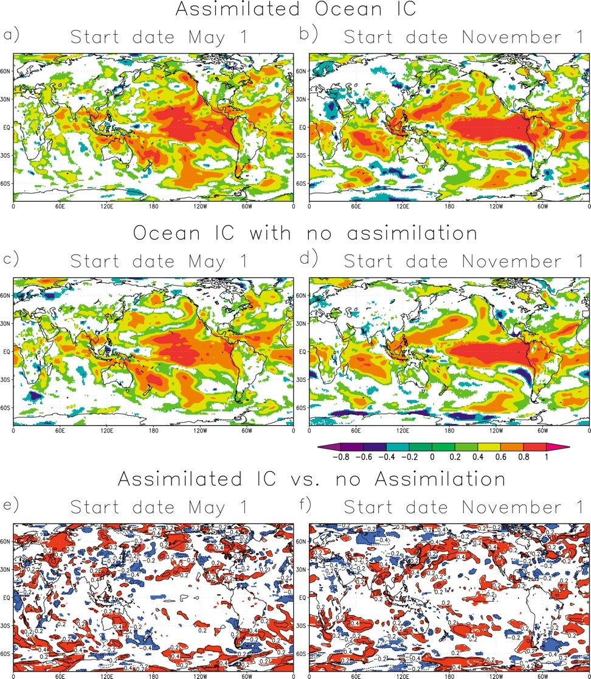
The importance of an accurate ocean (CIGODAS Reanalysis)
MAY
NOVEMBER
ACC for the start date of May and November (SPSv1) which assimilates observed profiles of temperature and salinity through the water column of the global configuration of the OPA8.2 ocean model.
Ocean IC
with
Assimil.
Ocean IC
without
Assimil.
Comparison with an AMIP-like initialization, performed by prescribing observed SST (HadISST1.1; Rayner
et al. 2003) boundary forcing to the atmospheric model.
Difference
From Alessandri et al., 2010

Slide 17
The introduction of land-atmosphere initial state
Difference SPSv2 - SPSv1
lead season 0 - MJJ
lead season 1 - JJA
lead season 2 - JAS
lead season 3 - ASO
May
NDJ
DJF
JFM
FMA
November
Surface temperature ACC (reference ERAinterim), difference between SPSv2 and SPSv1
SPS2 provides a remarkable improvement of the forecast skill at lead-season 0, where the effect of initialization is clearly reflected. Continental areas benefit the most from the more realistic initial state, but enhancements are mainly lost after lead-season 0. In the ocean instead
northern Pacific, long-lasting skill improvements due to strong air-sea coupling in the region during the fall. SSTAs force a PNA pattern response, atmo reaction could in turn change SSTs
ENSO region in May. In the season of major upwelling, SSTs are mostly determined by upwelling of deep water, which does not change in the two experiments

Slide 18
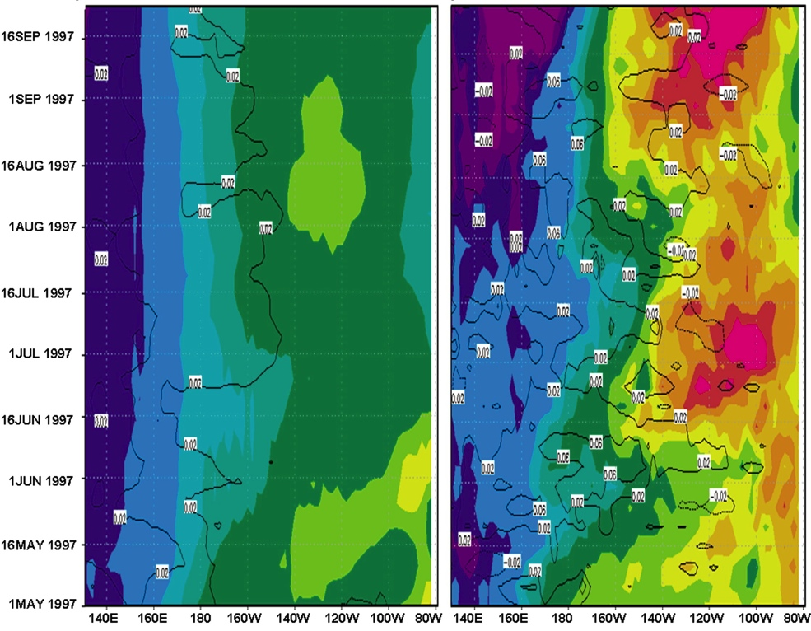
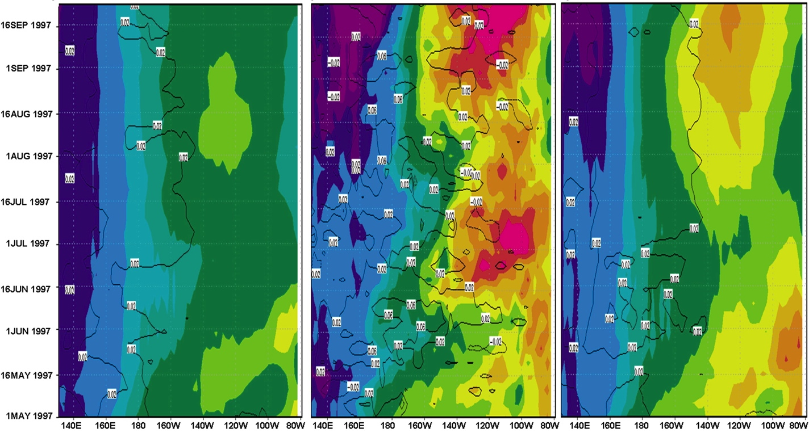
El Nino 1997/1998: onset
No assimilation
Ocean analysis
Assimilation (SPSv1)
Evolution of the heat content anomaly (shaded) and zonal wind stress anomaly (contour) averaged between 5S and 5N. Forecast anomalies are ensemble means.
From Alessandri et al., 2010

Slide 19
Separating the contribution of
atmosphere and land surface initial state
The SPSv1.5 experiment maintains the atmosphere initial conditions, but excludes the prior knowledge of land-surface state.
May
Nov
SPSv2-SPSv1.5, May/Nov start dates: Surface temperature ACC
Differences in ACC are larger on continents than over ocean, and improvements carried by SPSv2 are season and region dependent. Sometimes better land surface IC degrade the quality of the forecast, most likely due to the initialization technique (Materia et al. 2013)

Slide 20

The seasonal forecast bulletin
Quasi-monthly product
Still a scientific exercise (not operational yet)
It provides updates about actual situation, verification versus the latest season, and the forecast for the next one
Available upon request, on-line soon

Slide 21
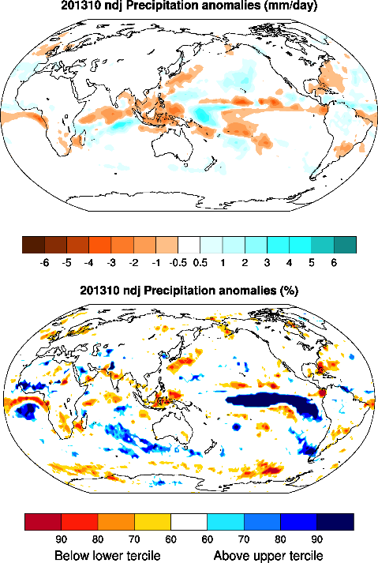
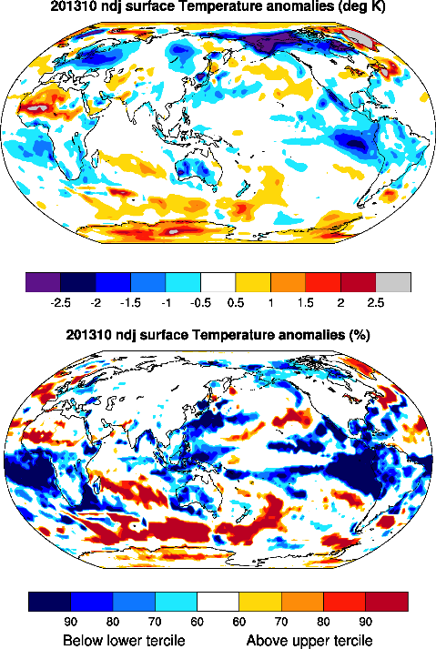
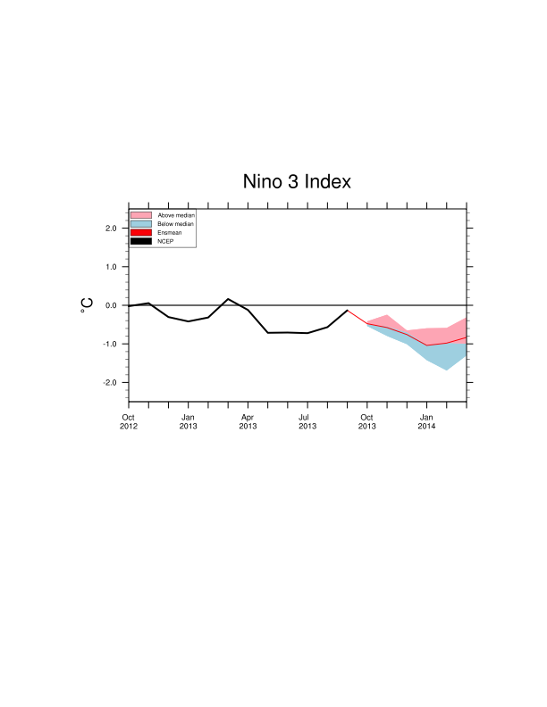
Seasonal forecast for late autumn-early winter (NDJ)
GLOBAL VIEW
PRECIPITATION
TEMPERATURE

Slide 22
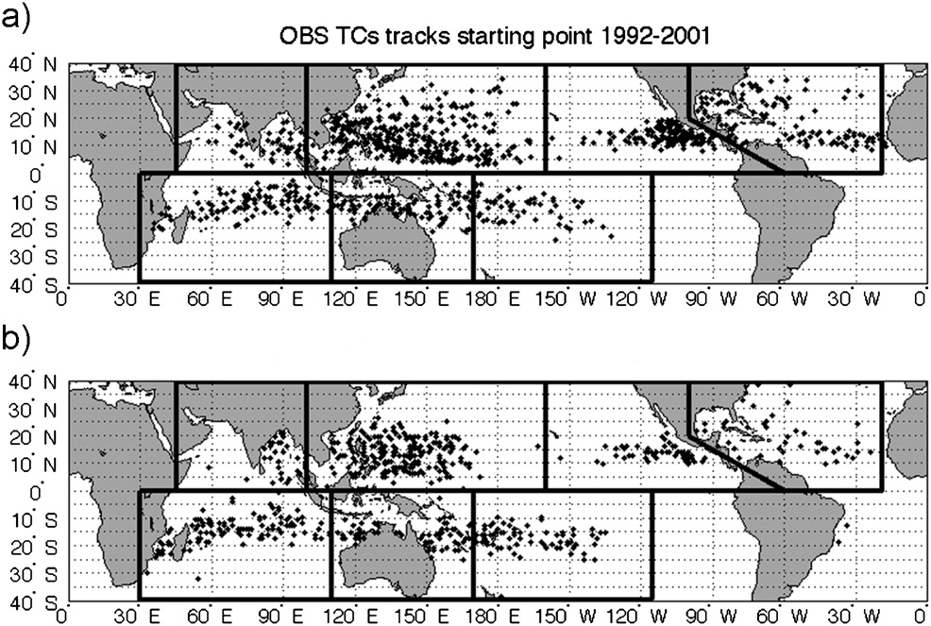
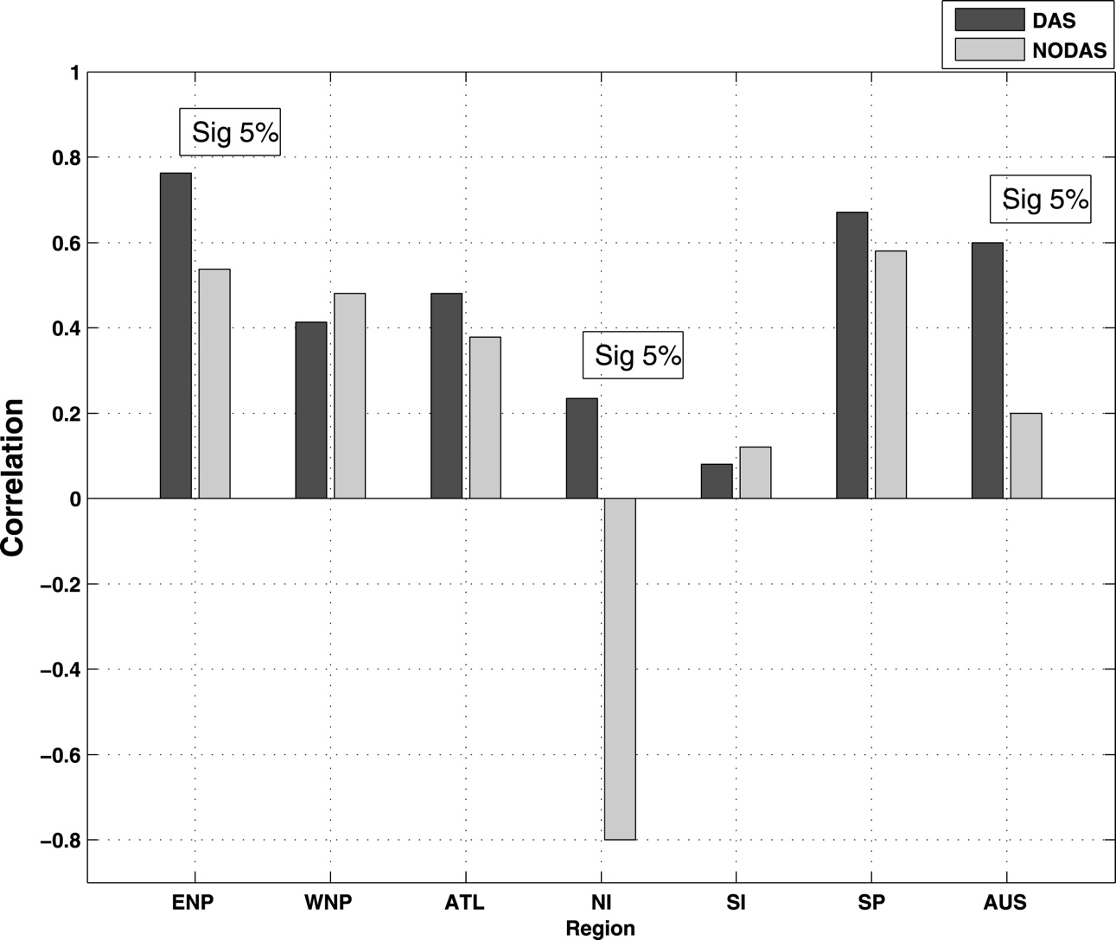
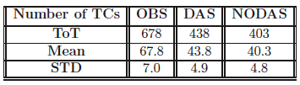
The CMCC Seasonal Prediction System
Seasonal Predictions of Tropical Cyclone Activity
Correlation between predicted and observed number of TCs increases significantly when the ocean analyses are used to initialize the forecasts
CMCC-SPSv0 TCs tracks starting point 1992-2001
Ocean Initialization vs. no Ocean Initialization
Ocean analyses
Although CMCC-SPS underestimates the number of Tropical Cyclones, their location is well detected.
No Ocean analyses
Alessandri et al. J. Climate 2010
Gualdi et al. J. Climate 2008
Scoccimarro et al. J. Climate 2011

Slide 23
Thanks!
enrico.scoccimarro@bo.ingv.it

Slide 24
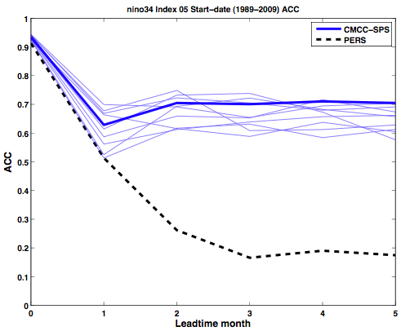
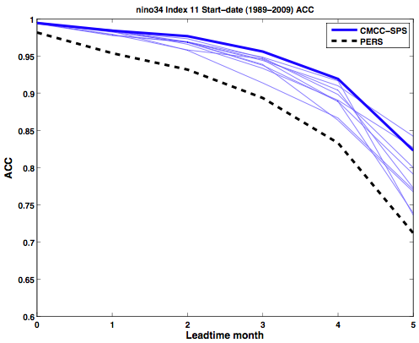
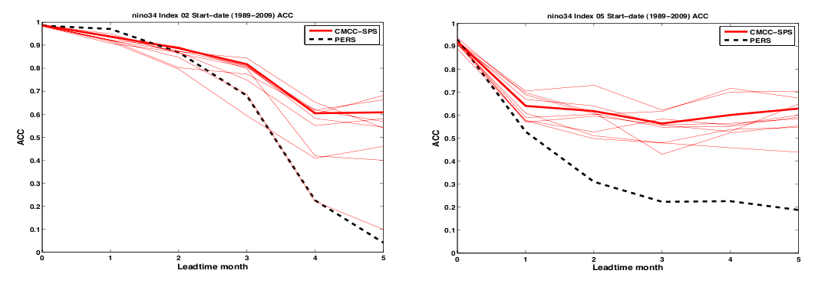
NINO3 Index
SST ACC
May
November
Higher ACC
Higher ACC
Lower ensemble spread
The introduction of land-atmosphere initial condition demonstrates an important and potentially predictable impact on the forecasts of equatorial Pacific SST (particularly in May), either as a result of the intra-seasonal stochastic component of the atmospheric initial state (Shi et al., 2011), or for the amplification of initial condition error in such a coupled system (Hudson et al., 2011).
Similar
ensemble spread
SPSv2
SPSv1

Slide 25
Future Plans
NEW COUPLED MODEL: NEMO-CAM
Coupling interface
Atm.
30 min
Land
30 min
CPL7
30 min
Sea ice
Daily
or higher freq.
Ice fraction
Wind/ice-ocean stress (x & y)
Penetrating shortwave
Longwave heat flux
Latent/sensible heat flux
Evap./cond., rain & snow
Runoff
Fresh water flux from sea ice
Salt Flux from sea ice
Heat flux from sea ice
Sea level pressure
10m wind speed
SST/SSS
Surf. ocean currents (x & y)
Sea surface slope (x & y)
Frezing/melting potential
Ocean

Slide 26

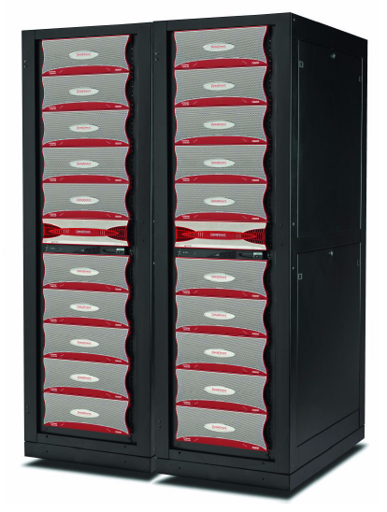
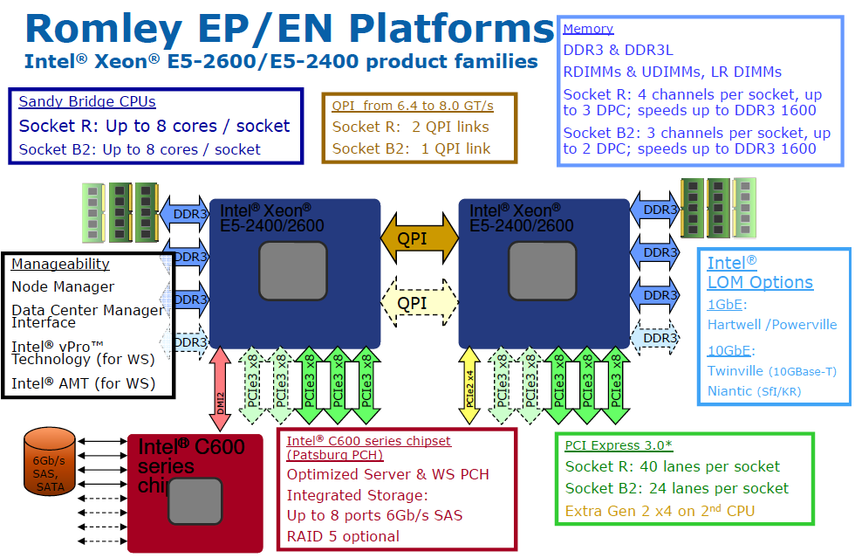
The CMCC supercomputing facility
482 nodes IBM dx360 M4
7712 cores Intel Xeon Sandy Bridge 2,6GHz
30,1 TB of RAM ( 4GB RAM per core )
peak performance: 160 TFlops
Infiniband 4x FDR Interconnection
workload manager: LSF
operating system: Linux CentOS x86_64
IBM iDataPlex solution
160 Tflops
Intel Xeon E5-2600 basic architecture
two DDN SFA10000 storage systems
840TB raw space
6 GB/s I/O throughput per disk array

Slide 27
MAY
NOVEMBER
Lead season 3
Anomaly correlation for the tree different version of CMCC-SPS
Lead season 0
Lead season 2
Lead season 1
SPSv1
SPSv1.5
SPSv2
Materia et al., 2013

Slide 28
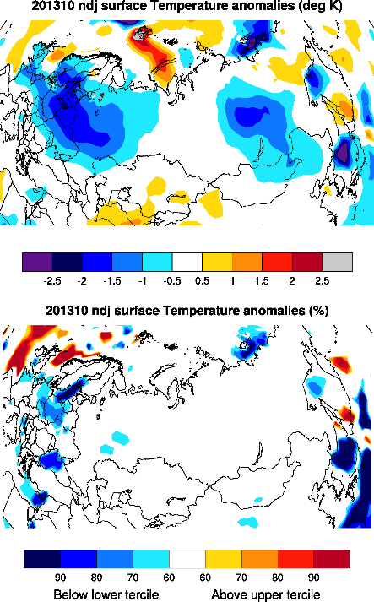
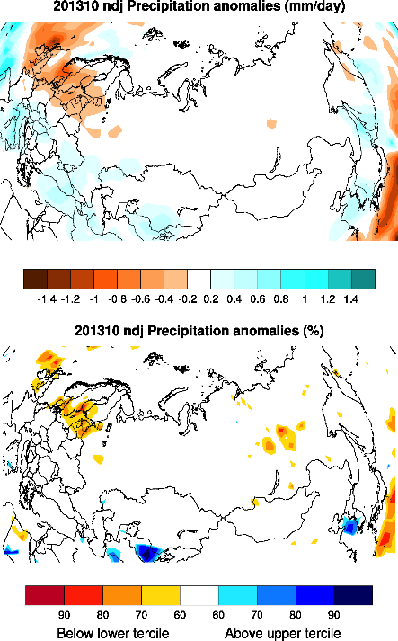
Seasonal forecast for late autumn-early winter (NDJ)
NORTH EURASIAN REGION

Slide 29
The CMCC Approach
Numerical
Methods
Climate
Research
Software
Development
Numerical
Simulations
Impacts:
Agricultural
Impacts:
Energy and
Economy
Impacts:
Forests
Impacts:
Water
Impacts:
Tourism
Impacts:
Coastal Areas
Impacts:
…

Slide 30
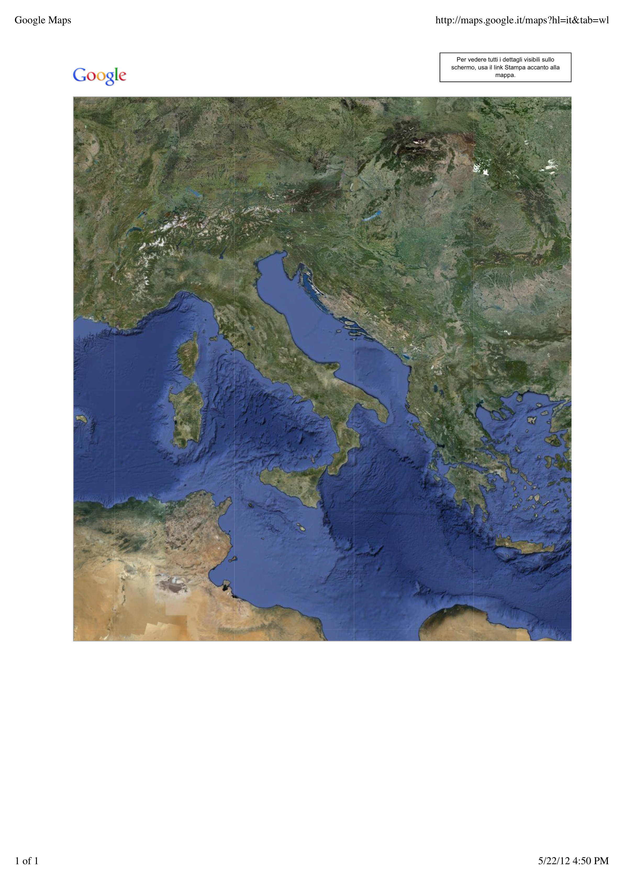
The CMCC Network
CMCC has a network structure composed by Research Divisions and Partners, which are distributed along seven Italian headquarters
Fondazione Eni Enrico Mattei – FEEM (Milano)
Università Ca’ Foscari (Venezia)
Istituto Nazionale di Geofisica e
Vulcanologia – INGV (Bologna)
Università della Tuscia (Viterbo)
Università di Sassari (Sassari)
Centro Italiano Ricerche Spaziali – CIRA (Capua)
Università del Salento (Lecce)

