Slide 1
Verification of ECMWF long range forecast systems
Tim Stockdale
Laura Ferranti
European Centre for Medium-Range Weather Forecasts

Slide 2
Outline:
1. Factors limiting model performance
  Bias
  Errors in variability
  Simple calibration
2. Measuring seasonal forecast skill
3. Important issues affecting skill assessment
4. EUROSIP calibrated products
Notes:
The talk is confined to dynamical seasonal predictions.
After running a dynamical model , regardless of its complexity, corrections needs to be made for systematic errors because the model’s climate and the observed climate are different. I will describe the procedure used by Ecmwf to correct for those errors
I will then describe the way we assess the seasonal predictions and highlight some issues that can limit the skill assessment.

Slide 3
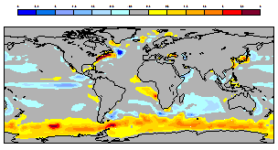
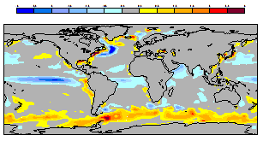
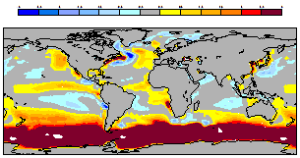
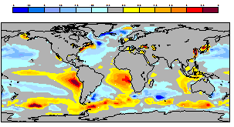
SST Biases for DJF
Biases from 4 independent coupled systems included in the EUROSIP multi-model
(1996-2009)
a
b
c
d
Notes:
To show that mean biases are a feature of any seasonal forecast system here we have the mean biases for SST from 4 different models. These are 4 coupled models and are the one that are used to create the present Eurosip multi-model ensemble forecasts. It is interesting to note that some of systems have similar biases. For example the cold tounge over the Eq Pacific is a common feature to system a and b.

Slide 4
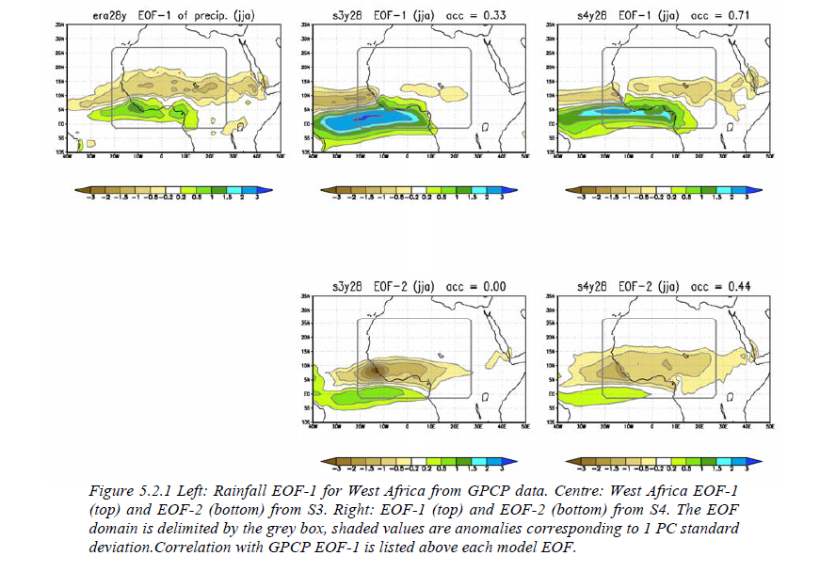
Assessing spatial errors : leading modes of rainfall variability
Observed
System 3 r=0.33
System 4 r=0.71
EOF 1
r=0.0
r=0.44
EOF 2
Notes:
Another aspect of systematic error is associated to spatial errors in the model. The figure here compares the first dominant mode of rainfall variability in the observations (GPCP) over West Africa with the first 2 dominant modes from 2 versions of the ECMWF seasonal forecast system. System 4 is the operational system at present. It was introduced in Nov 2011 when replaced System 3. The anti-correlation between rainfall along the G. Coast and Sahel represented by the observed mode is not simulated by System 3. In fact neither of the 2 leading modes presents such feature. EOF1 S3 has too much amplitude over the ocean and coastal region and little signal over the Sahel. The dipole structure of EOF2 S3 is displaced too far South. System 3 was not a very succesfull system for rainfall predictions over West Africa. With the more recent system we have The first EOF of S4 is far better match for the observed pattern in fact its spatial correlation with the observed leading mode is 0.77. Analysis of this type is crucial in the construction of seasonal forecast calibrated products.

Slide 5
Bias correction
Model drift is typically comparable to signal
  Both SST and atmosphere fields
Forecasts are made relative to past model integrations
  Model climate estimated from 30 years of forecasts (1981-2010), all of which use a 15 member ensemble. Thus the climate has 450 members.
  Model climate has both a mean and a distribution, allowing us to estimate e.g. tercile boundaries.
  Model climate is a function of start date and forecast lead time.
  EXCEPTION: Nino SST indices are bias corrected to absolute values, and anomalies are displayed w.r.t. a 1971-2000 climate.
Implicit assumption of linearity
  We implicitly assume that a shift in the model forecast relative to the model climate corresponds to the expected shift in a true forecast relative to the true climate, despite differences between model and true climate.
  Most of the time, assumption seems to work pretty well. But not always.

Slide 6
SST bias is a function of lead time and season.
Some systems have less bias, but it is still large enough to require correcting for.

Slide 7
Nino plumes: variance scaling
  Model Nino SST anomalies in S4 have too large amplitude
  Problem is especially acute in boreal spring and early summer (model bias of “permanent La Nina” does not allow spring relaxation physics to apply; this was something S3 did very well)
  We plot the “Nino plumes” corrected for both mean and variance, instead of just the mean.
  This is done by scaling the model anomalies so that the model variance matches the observed variance in the calibration period
  We use the same approach (cross-validated) when calculating scores
  This affects the plotting, not the model data itself
  The spatial maps are not affected: the tercile and quintile probability maps are already implicitly standardized wrt model variance
  General technique: is also used in our multi-model system

Slide 8
Variance adjusted
Unadjusted model anomalies

Slide 9
2. Measuring seasonal forecast skill
  A set of verification scores for deterministic and probabilistic forecast should be used.
  There is no single metric that can fully represent the quality of the probabilistic forecasts.
  The robustness of verification statistics is always a function of the sample size. WMO –SVSLRF suggests 20 years.
  Typically verification is performed in cross-validation mode.
  The skill depends strongly on the season, so forecasts evaluated separately for different starting months.
Notes:
(e.g. spatial acc and MSSE)- The main attributes of the forecast are : reliability, resolution-discrimination, sharpensess
Providing verification for a few seasons or even over a few years only may be misleading and may not give a fair assessment of the skill of any LRF system. LRF systems should be verified over as long a period as possible in hindcast mode. Although there are limitations on the availability of verification data sets and in spite of the fact that validating numerical forecast systems in hindcast mode requires large computer resources, the hindcast period should be as long as possible. LRF recommended hindcast period of 1981-2001

Slide 10
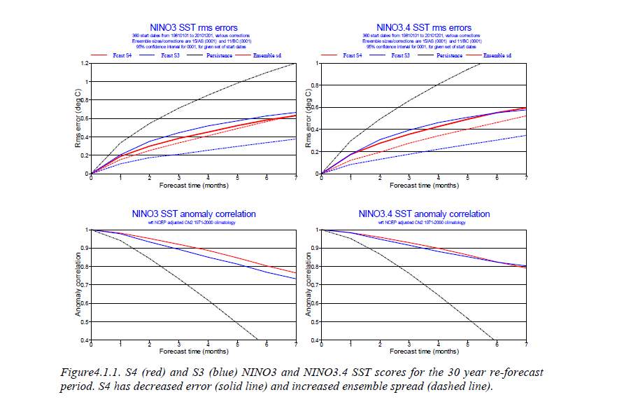
SST deterministic scores
Notes:
Few example These diagrams here shows the scores for SST over the tropical Pacific ( NINO3.4 area 5n-5s 170-120w) and over the tropical Atlantic.
The statistics are computed using the re-forecast for a common period of years. The S4 values are calibrated by the mean and the variance while the values from S3 are corrected only by the mean as we want to compare the performance of the final forecast product. On the other hand is worth saying that in most of the cases the calibration of S3 variance tends to deteriorate the scores. The top panels show the RMSE solid lines and the spread dashed lines. Where red indicate s4 and blue s3. It is clear from both top panels that the relationship between the rmse and spread it is better reproduce in S4 than in S3. The bottom panels show the anomaly correlations for the same areas while the performance of S4 over the Nino3.4 area is only marginally better over the Equatoral Atlantic S4 show a significant advantage in comparison with S3. With S4 the forecast over the eq. Atlantic becomes substatially better then persistence or climatology. (improvement over the Atlantic due to : better representation of the climate, better ocean analysis)of scores for system 4

Slide 11
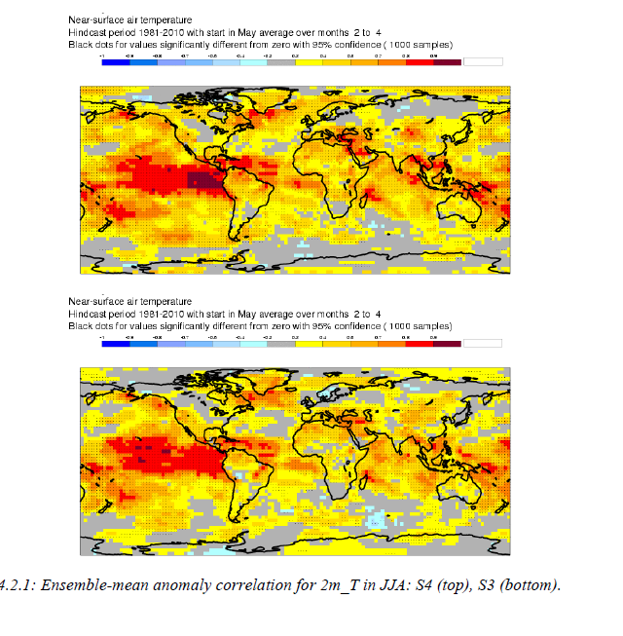
2m temp grid-point anomaly correlation
Sys 4
JJA month 2-4
Sys 3
Notes:
The performance of the seasonal predictions is not only based on the ENSO scores. Here we have the 2m temperature local correlation between the ensemble mean and era-interim. The regions with orange to red shadings are the regions with correlations larger than 0.6. We compare the anomaly correlation between most recent system and the previous one for the JJA season.
It is clear that there is higher predictive skill in the tropics than in midlatitudes.
The most recent system shows an overall higher level of skill over East Pacific and West Africa. Over Scandinavia the skill is also improved although we would need a much larger number of cases to estimate the significance of such improvement since this is a region where the signal to noise ratio is rather small.

Slide 12
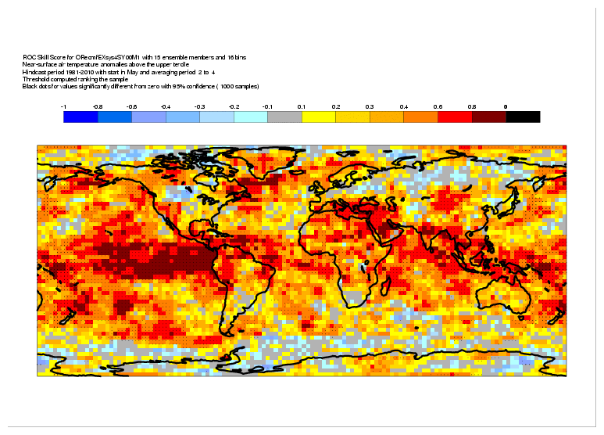
Roc skill score
Notes:
This shows the ROC (Relative Operating Characteristic) skill scores of June/July/August seasonal mean 2-metre
temperatures predicted from May for the years 1981 -2010 ROC skill score is effective at measuring the signal contained in a set of probabilistic forecasts and it does not punish forecasts for having poorly calibrated probabilities. Black dots indicate
values significantly different from zero with 95% probability.
Scores are locally noisy, but the overall skill distribution is similar to the one given by the ACC.

Slide 13
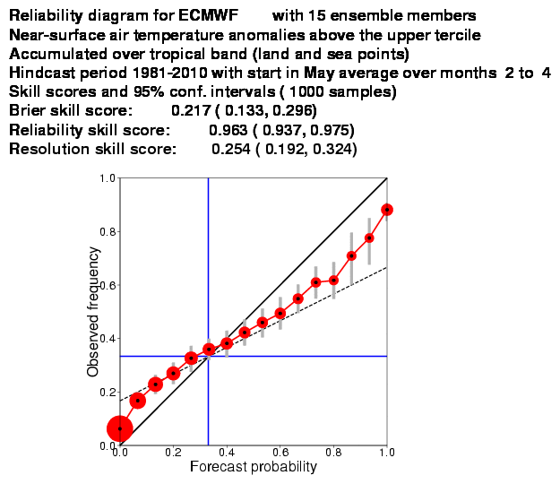
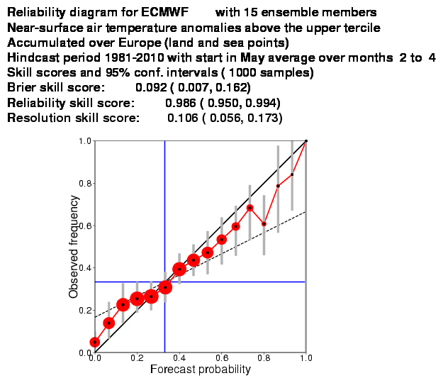
Reliability diagrams
JJA 2m temp upper tercile
Tropical band Europe
Notes:
Reliability diagrams for Tropics and for Europe
The event is JJA 2m temp anomalies being above the upper third of the climate.
The verification cover 30-years (1981-2010) and is based on the re-forecast initiated in May.
It is very evident that the forecast over Europe has similar reliability but has less sharpeness
The grey error bars showing the effect of sampling uncertainty. The blue lines show the climatological frequency
of the event. The black dashed line separates skillful from unskillful regions in the diagram: points with forecast probabilities smaller (larger) than the climatological frequency, which fall below (above) this line, contribute to positive BSS; otherwise they contribute negatively to the BSS.

Slide 14
3. Important issues for skill assessment
The limitation associated with the sample size
The effect of long term trend
The effect of the ensemble size

Slide 15
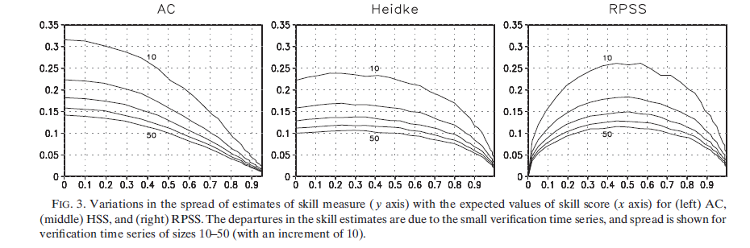
The limitation associated with the sample size
Variations in the spread of estimates of AC (y-axis) with the expected values of AC(x axis).
The differences in the AC estimates are due to the limited length of the verification time series. Spread is shown for verification size 10-50.
Kumar 2009
For an “accurate” estimate of deterministic skill over the tropics
20 years sample might be sufficient while over mid-latitudes a larger sample (>40 years) is needed.
Notes:
We have already seen that in the tropics where the ENSO signal is large the predictability is high and in mid-latitude where the effect of ENSO is less strong the signal to noise ratio is smaller and therefore the predictability is limited.
There are strong variations in the estimate of the skill measure depending on the sample size and depending on the predictability range. In this diagram from Kumar 2009 we can see how the spread of the estimates of the anomaly correlation varies with respect to the sample size and with respect to the predictive range. For high predictive ranges like for the tropical regions the spread of the estimates using different sample size is smaller than for lower predictive ranges.
This indicates that to have a accurate estimate of the anomaly correlation (lets say an estimate with spread < 0.1 we need to consider a sample of 20 years. On the other hand over Europe where the predictive skill is much lower (typically acc<0.6) in order to have the same level of spread in the estimate of the anomaly correlation we need to consider a sample of about 40 years. The variations in spread of the skill measure

Slide 16
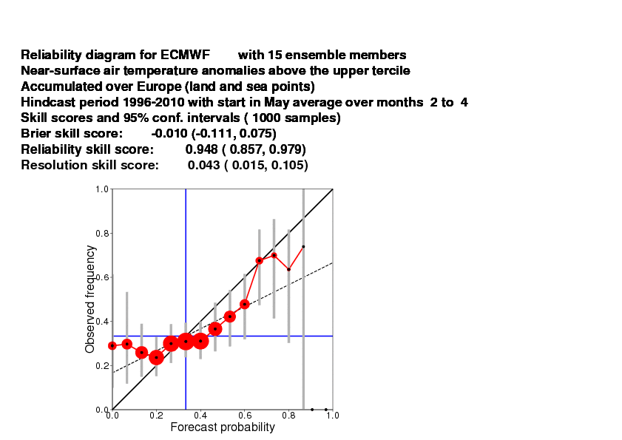
Sensitivity to the re-forecast period over Europe (but see later!)
JJA - Reliability for 2m temp anomaly in the upper tercile
1981-2010
1996-2010
Notes:
When we compare the relibility over Europe computed over 30 year with the one computed over 14 years period the reliability diagram is very different showing a much pessimistic view of the skill for the shorter period. In fact both reliability and sharpness is decreased.
Consistent with the reduced verifying sample the uncertainty on the scores are larger.
It is particularly relevant to estimate some confidence intervals ar to set some bounds on the expected value of the verification score.
This also helps to assess whether differences between competing forecast systems are real.
SVSLRF recommends the use of confidence level for all the skill measures

Slide 17
Seasonal forecast skill assessment:
The limitation associated with the sample size
The effect of long term trend
The effect of the ensemble size

Slide 18
The effect of long term trend in the sample
  The surface air temperature during the last 30 years exhibits a warming trend.
  This global warmth in the last decades is a continuation of the upward warming trend observed since the mid-20 century in response to the increase of GHGs.
  Correct GHGs are important for seasonal forecast systems (Doblas-Reyes at al. 2006, Liniger et al. 2007, Cai et al. 2009)
  In the skill assessment can we distinguish the ability of reproducing the effect of climate change from the ability of predicting the year-to-year variations of anomalies?

Slide 19
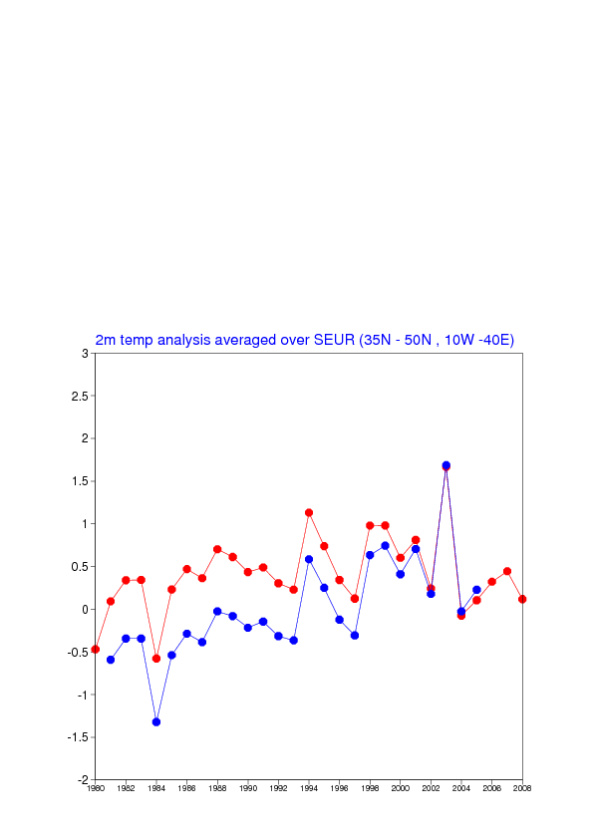
Verification with a moving climate to filter out the effects of long term trends:
Anomalies with respect
to a fixed climate (1981-2005)
Anomalies with respect
to a moving climate (1960-1979,
1961-1980, ……..1988-2007)

Slide 20
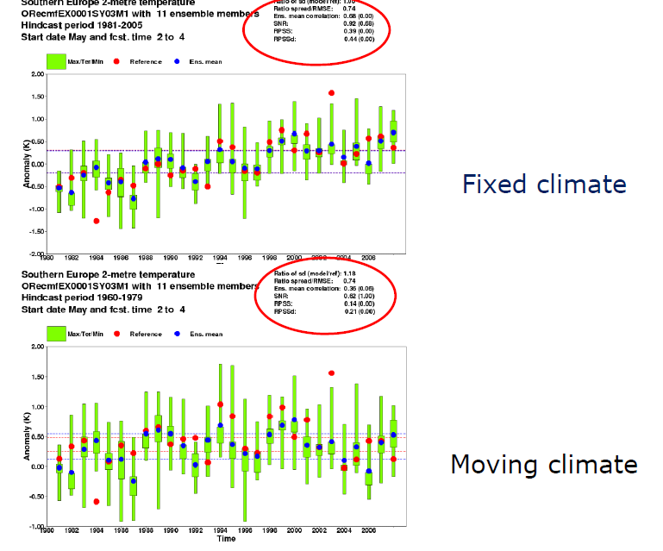
ACC=0.68
ACC=0.35

Slide 21
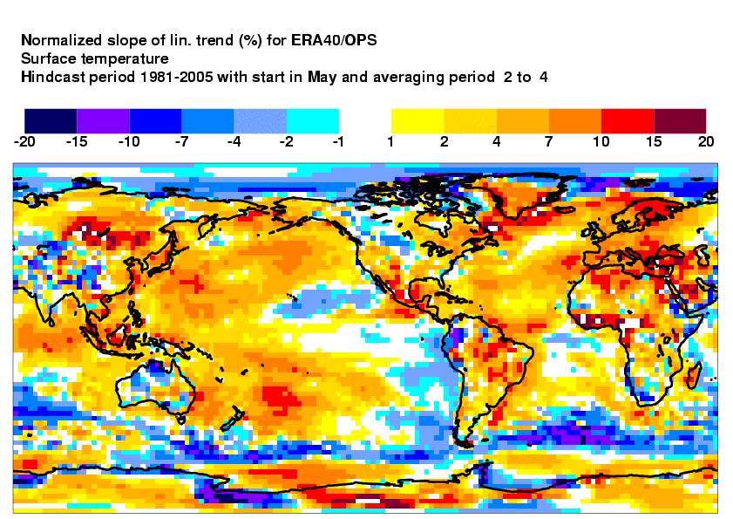
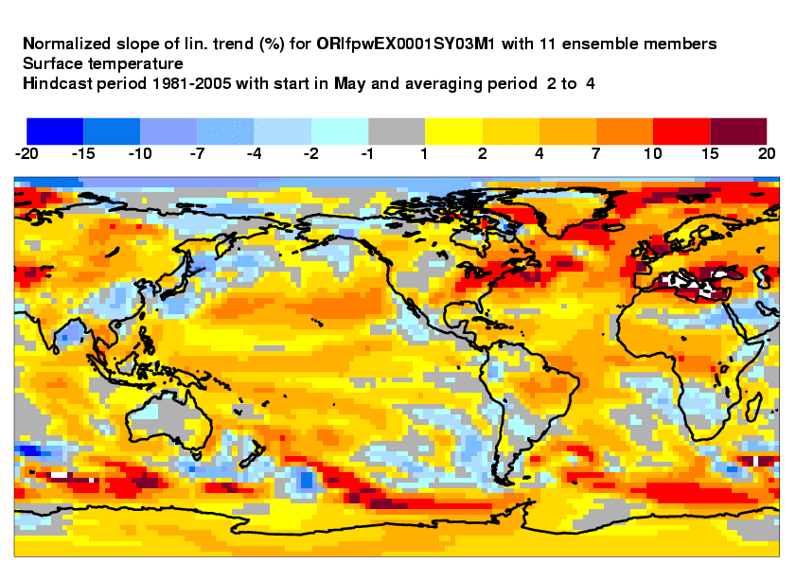
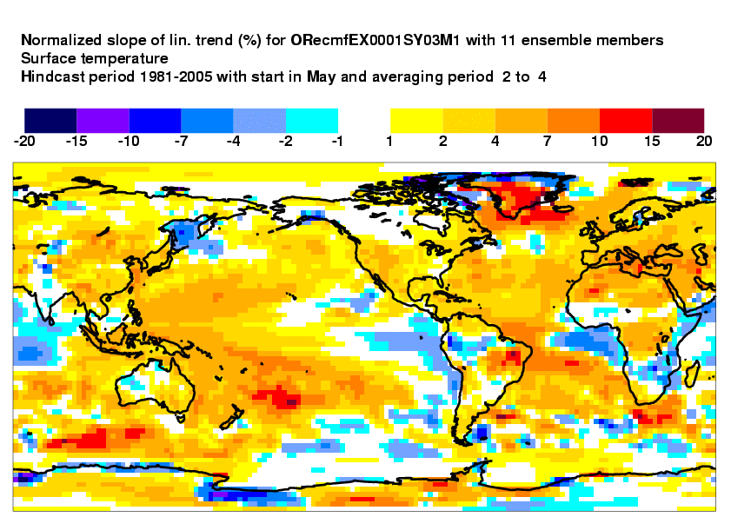
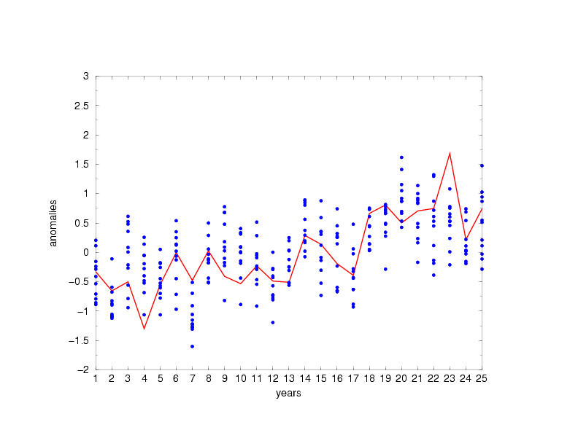
LONG TERM TRENDS surface temp
Eurosip m2
analysis
ECMWF
Notes:
Last year at this meeting some users commented that the skill of the seasonal forecast can be different when the scores are computed for a period shorter than the 25 years of the hind-cast. We then discussed the fact that long term trends in temperature make a contribution to the seasonal forecast skill.
As a follow up of that discussion in collaboration with Paco we have looked at the long term trend in temperature and assess their spatial distribution. For each grid point we have estimated the slope of the linear trend computed for the 25 years period 81-2005 considering both analysis and model data.
Some area like the Medit show a clear warming and by looking at the time series (just for the JJA values) it is clear that the warming occurred in the 90s. The forecast (blue dots) seems to reproduce the tren over this area although in some other area model show spurios signals

Slide 22
Seasonal forecast skill assessment:
The limitation associated with the sample size
The effect of long term trend
The effect of ensemble size

Slide 23
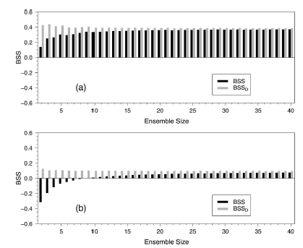
Compensating for ensemble size?
Müller et al. 2005 and Weigel et al. 2007 suggested the use of a de-biased Brier and ranked probability skill score to avoid the dependency on the ensemble size.
The BSSd and RPSSd are effective tools: to evaluate Prob. Forecasts with small ensemble size
to compare different Prob. Syst. of different ensemble size.
BUT these techniques correct for (expected) bias only, do not account for random error in score
From Weigel et al. 2007

Slide 24
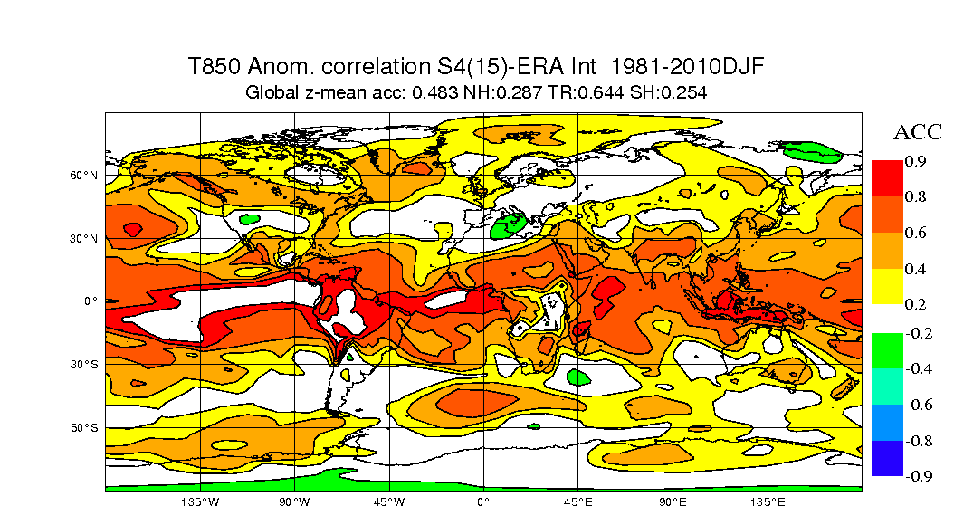
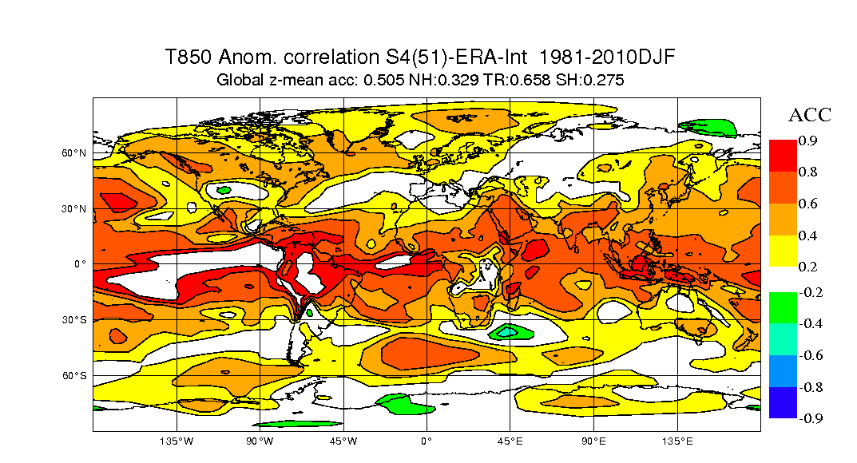
S4 extended hindcast set
Scores are smoother and systematically higher with 51 member hindcasts

Slide 25
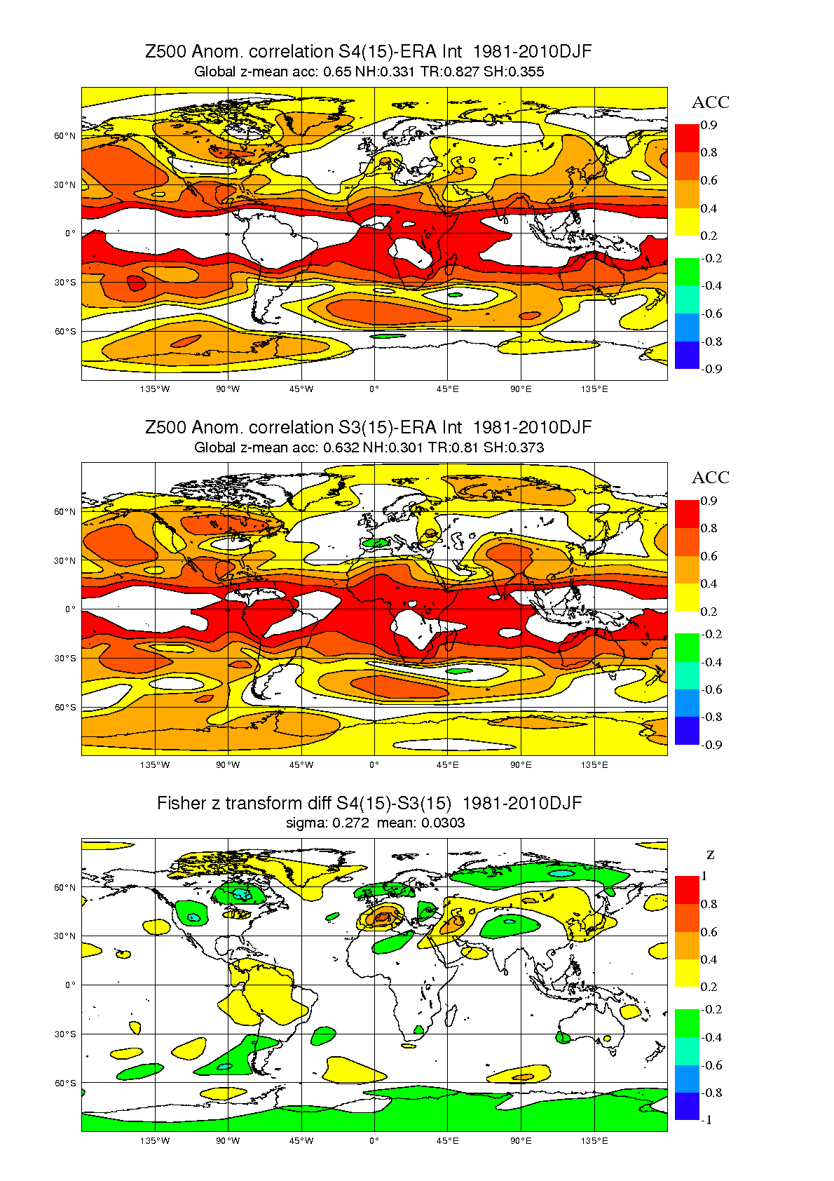
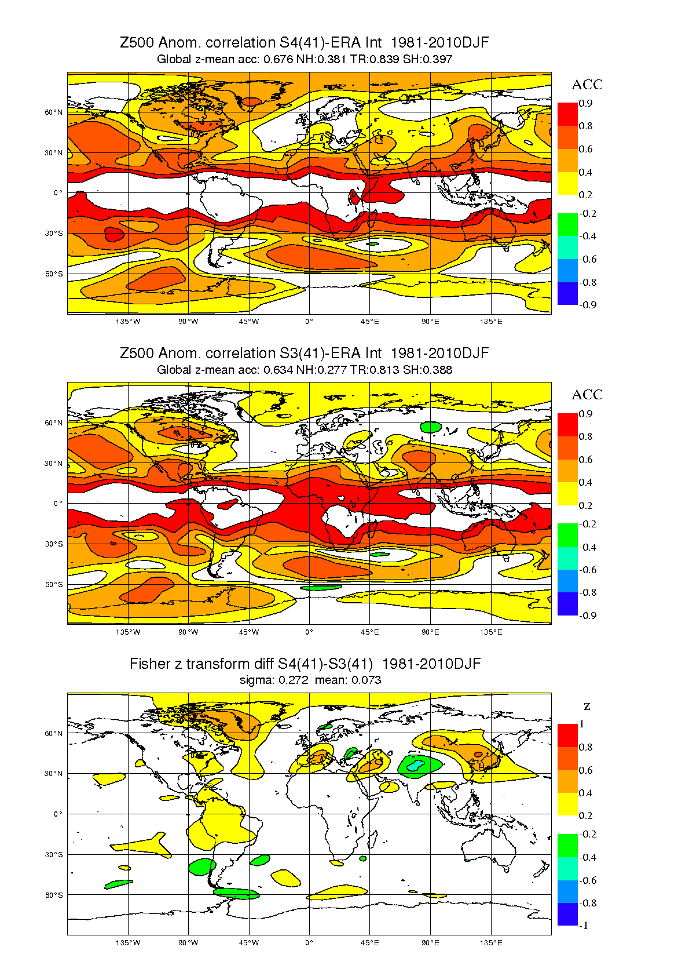
S4 extended hindcast set
Gain over S3 is now stronger and more robust

Slide 26
4. EUROSIP calibrated products
A European multi-model seasonal forecast system
  Operational since 2005
  Data archive and real-time forecast products
  Initial partners: ECMWF, Met Office, Météo-France
  NCEP an Associate Partner; forecasts included since 2012
  Products released at 12Z on the 15th of each month
  Aim is a high quality operational system
  Data policy issues are always a factor in Europe
Notes:
Initially, all models ran at ECMWF, comprehensive data archive; now, some models run remotely with reduced data volumes
Also more diversity in forecast/re-forecast strategy

Slide 27
Error vs spread (uncalibrated)

Slide 28
Calibrated p.d.f.
ENSO forecasts have good past performance data
  We can calibrate forecast spread based on past performance
  We can also allow varying weights for models
  We have to be very careful not to overfit data at any point.
Represent forecast with a p.d.f.
  This is the natural output of our calibration procedure
  Easier visual interpretation by user
Calibration and combination in general case
  Ideally apply similar techniques to all forecast values (T2m maps etc)
  More difficult because less information on past (higher noise levels)
  Hope to get there eventually ….. .

Slide 29
Nino 3.4 plume and p.d.f.

Slide 30
P.d.f. interpretation
P.d.f. based on past errors
  The risk of a real-time forecast having a new category of error is not accounted for. E.g. Tambora volcanic eruption.
  We plot 2% and 98%ile. Would not go beyond this in tails.
  Risk of change in bias in real-time forecast relative to re-forecast.
Bayesian p.d.f.
  Explicitly models uncertainty coming from errors in forecasting system
  Two different systems will calculate different pdf’s – both are correct
Validation
  Rank histograms show pdf’s are remarkably accurate (cross-validated)
  Verifying different periods shows relative bias of different periods can distort pdf – sampling issue in our validation data.

