Slide 1
Climate monitoring by RAI RCC
On behalf of
Andre Kamga (ACMAD)

Slide 2
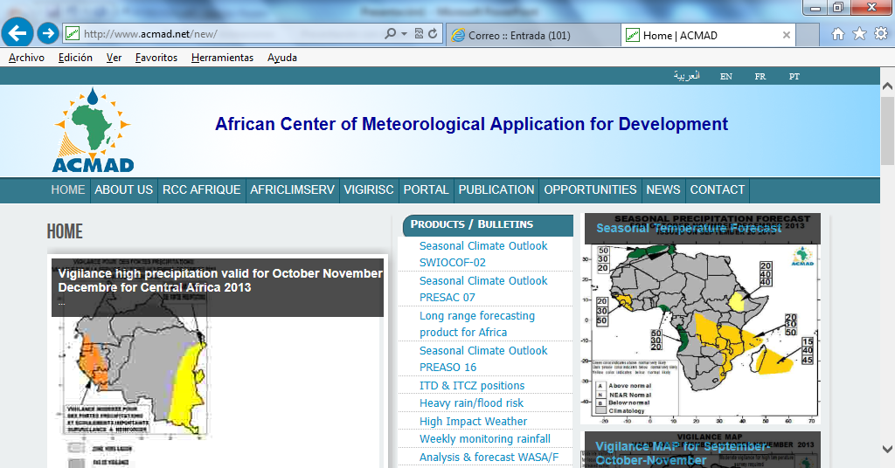

Slide 3
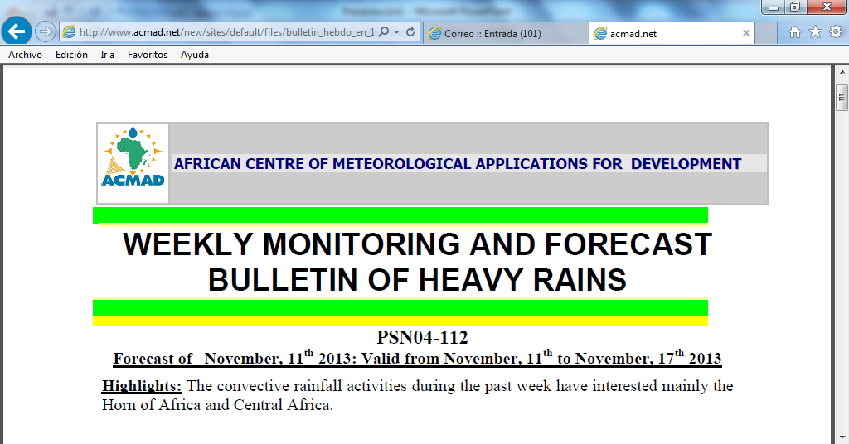

Slide 4
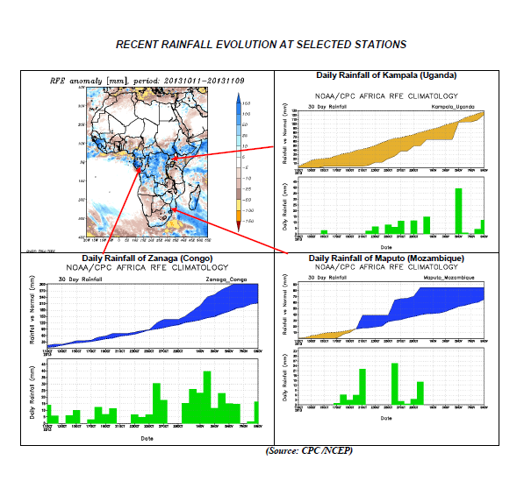

Slide 5
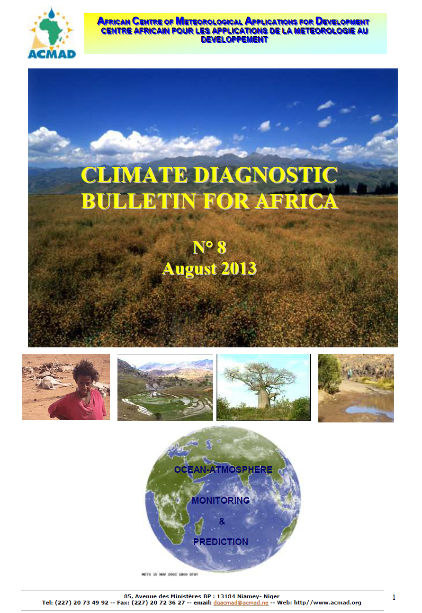

Slide 6
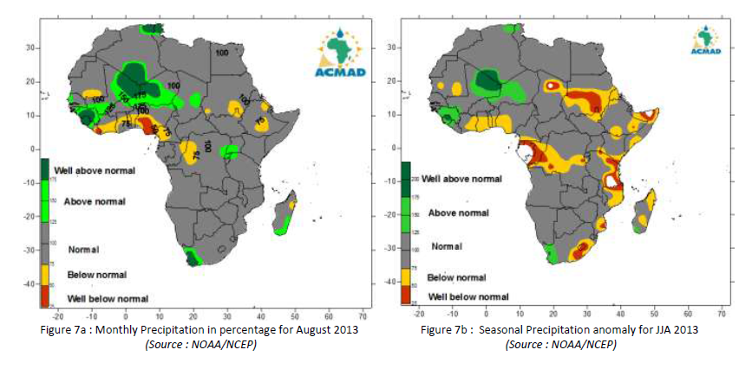

Slide 8
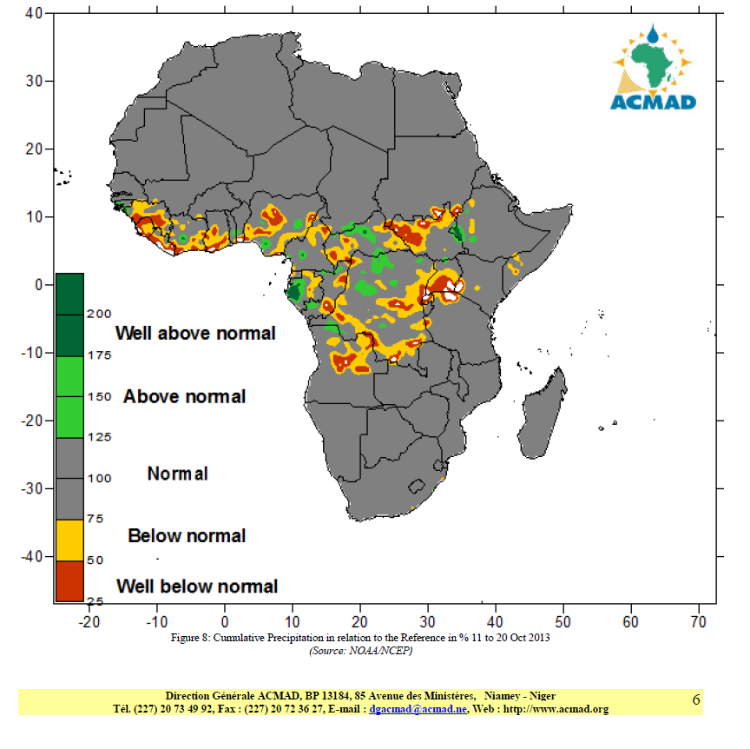

Slide 9
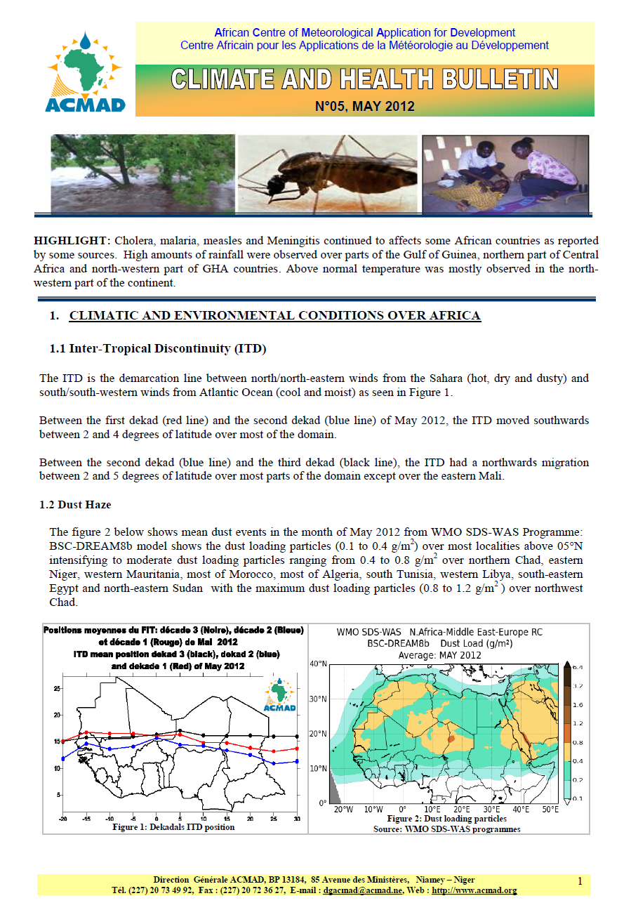

Slide 10
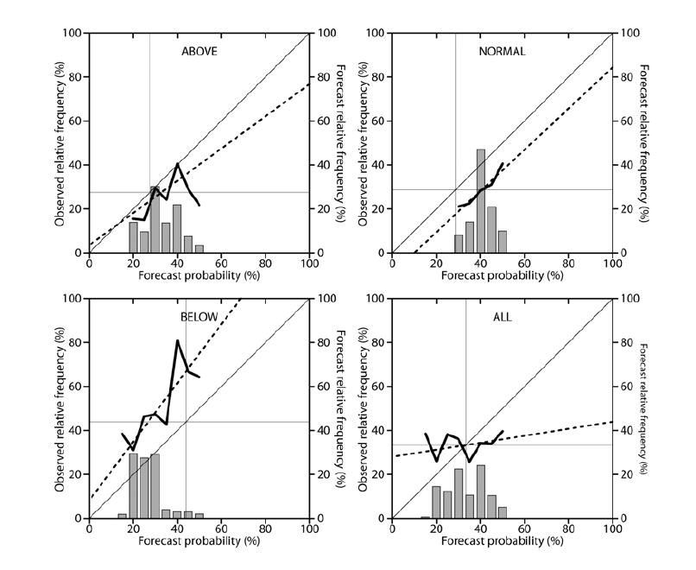
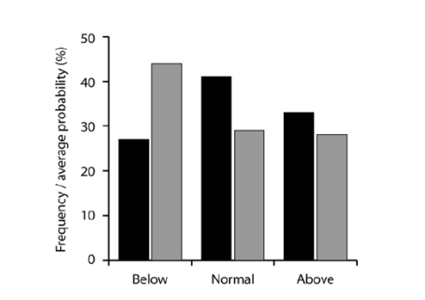
Reliability diagrams for the first 10 years of PRESAO (seasonal rainfall forecasts Jul-Sept)
Over-forecasting in normal category
Weak sharpness
Under-forecasting in below normal category

Slide 11
Conclusions
Many bulletins including monitoring and forecast information for different periods (7 days, 10 days, 1 month, …) different users (health, water, …) mainly based on external sources
Long experience in RCOFs → around 10 years
Some attempts of objective verification based on consensus forecasts.

