Slide 1
Guidance of the WMO Commission for CIimatology on verification of operational seasonal forecasts
Ernesto Rodríguez Camino
AEMET
(Thanks to S. Mason, C. Coelho, C. Santos, E. Sanchez)

Slide 2
Forecasts possess no intrinsic value. They acquire value through their ability to influence the decisions made by users of the forecasts.
(Murphy 1993)

Slide 3
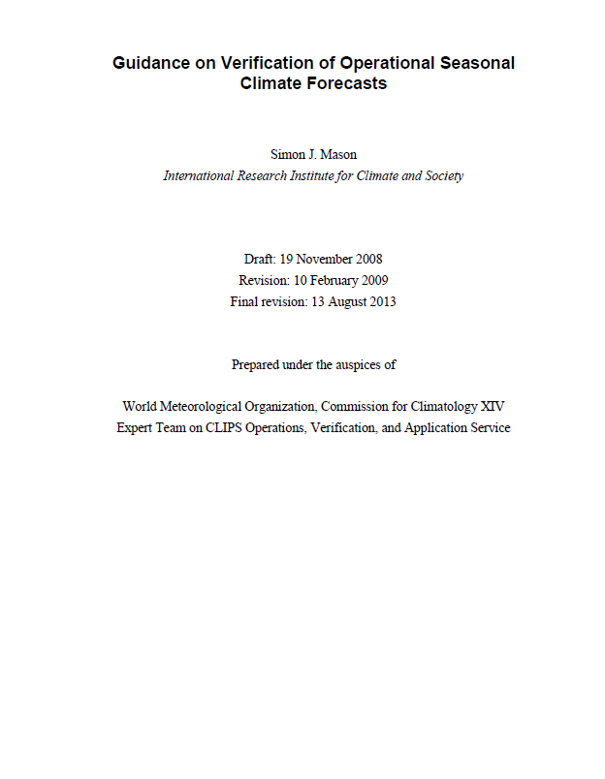

Slide 4
Why verify operational seasonal forecasts?
Does a new system improve the current one?
Is the cost of the forecast justified?
Is it a good idea to use (or pay for) the forecast?
If so, how can they best used?
All operational forecast should be accompanied by readily available information on the quality of forecast (minimum set of diagnostics)

Slide 5
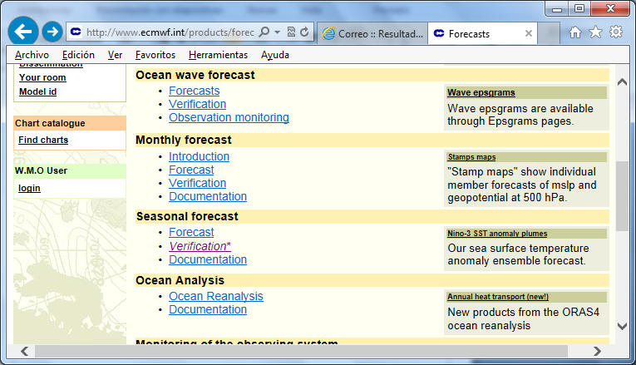
Example: ECMWF
Unfortunately, this is not the case for most RCOFs!

Slide 6
Motivation
There is quite a lot of experience veryfing probabilistic outputs of seasonal models.
Complement the Standardized Verification System for LRFs (SVSLRF) for GPC products.

Slide 7
Example verification seasonal forecasts from GCMs: RPSS

Slide 8
Motivation
There is quite a lot of experience veryfing probabilistic outputs of seasonal models.
Complement the Standardized Verification System for LRFs (SVSLRF) for GPC products.
So far most RCOFs are limited their verification to qualitative procedures → need move towards use of objective scores!!
There are no formal WMO verification procedures, but some guidance on procedures is being published by WMO CCl
Focus on how well forecasts correspond with observations (quality), and also on attributes making forecasts potentially useful (value).
Small sample sizes (few years, few stations) typical of seasonal forecasts → large sampling errors

Slide 9
What is a good forecast? (Murphy 1993)
3 types of goodness:
CONSISTENCY → true indication of what the forecaster thinks is going to happen
QUALITY → how well what was forecast corresponds with what happened
VALUE/UTILITY → “value” economic, or social, or otherwise.
Notes:
9
The three main ingredients of a good forecast …

Slide 10
Probabilistic forecasts and forecast quality
A forecaster says there is a 100% chance of rain tomorrow → It rains → Very good forecast!
A forecaster says there is a 80% chance of rain tomorrow→ It rains → ?
A forecaster says there is a 50% chance of rain tomorrow→ It rains → ?
A forecaster says there is a 10% chance of rain tomorrow→ It rains → ?
How good are the different forecast?

Slide 11
How good are the different forecast?
One reasonably common practice is to define probabilistic forecasts as “correct” if the category with the highest probability verified.
Most RCOFs verify qualitatively in this way
Forecasters typically become tempted to hedge towards issuing higher probabilities on the normal category to avoid a two category “error” → Scoring strategy is an issue!!

Slide 12
Verification procedures suitable for the forecasts in the format in which they are presented.
If forecasts are delivered in form of tercile-based categories → Verification should fit to it!

Slide 13
Attributes of “good” probabilistic forecasts (Murphy 1993)
Resolution
    Does the outcome change when the forecast changes? OUTCOME CONDITIONED BY FORECAST
    Example: does above-normal rainfall become more frequent when its probability increases?
Discrimination
Does the forecast differ when the outcome differs? FORECAST CONDITIONED BY OUTCOME
Example: is the probability on above-normal rainfall higher when above-normal rainfall occurs?
Reliability
if observation falls in the category as FREQUENTLY as the forecast implies
Sharpness
Probabilities differing MARKEDLY from the climatology
Skill
It COMPARES two forecasts with some metric

Slide 14
From EUMETCAL( http://www.eumetcal.org)
 | High reliability | High resolution | High Sharpness | Discriminatory | High Skill
The forecaster predicts the long term climatological frequency on each occasion
The forecaster predicts categorically, that is, he assigns a forecast of 100% to the category he thinks is most likely, and 0 to the other.
The forecaster manages to forecast 45% probability when the event does not occur and 55% when it does.
A forecaster who is sure, but never absolutely certain, forecasting 80% when he thinks rain will occur and 20% when he thinks it won’t.
The forecaster sits back with a smile on his face: He went out on a limb and predicted 90% probability of rain in his dry climate where it normally rains on only 10% of the days. And sure enough, it rained.

Slide 15
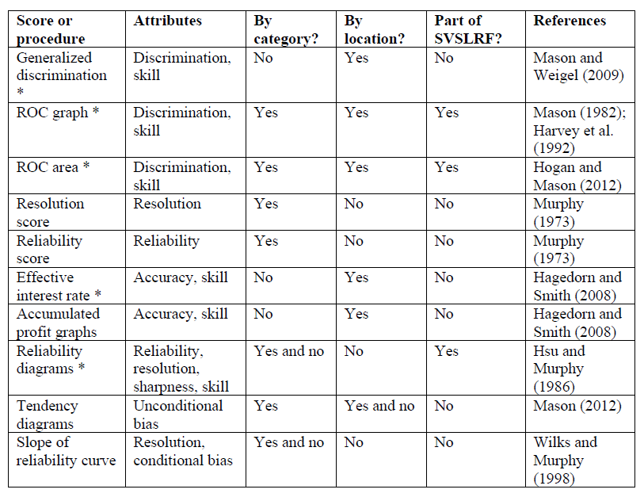
Recommended scores/procedures for series of forecasts
(*) Minimum set for an operational centre

Slide 16
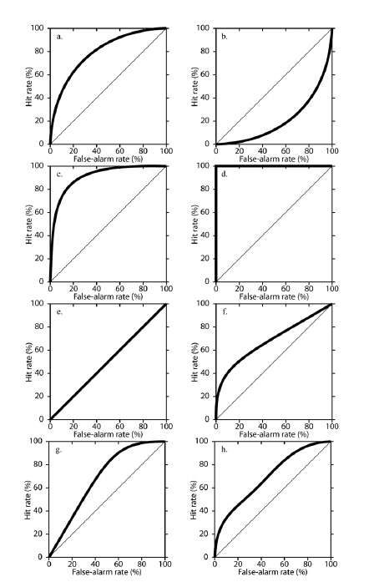
ROC curves: idealized examples
(b) good discrimination but bad skill
(d) good discrimination
(f) good discrimination for high probability forecasts
(h) good discrimination for confident (high and low probability) forecasts.
(a) good discrimination and good skill
(c) excellent discrimination
(e) no discrimination
(g) good discrimination for low probability forecasts

Slide 17
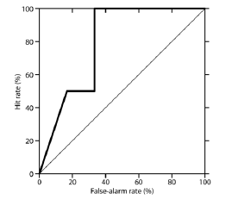
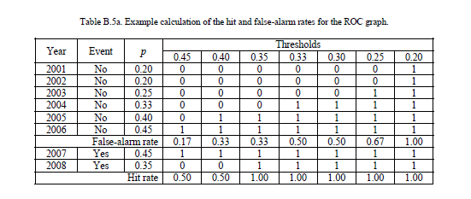
Simple realistic example

Slide 18
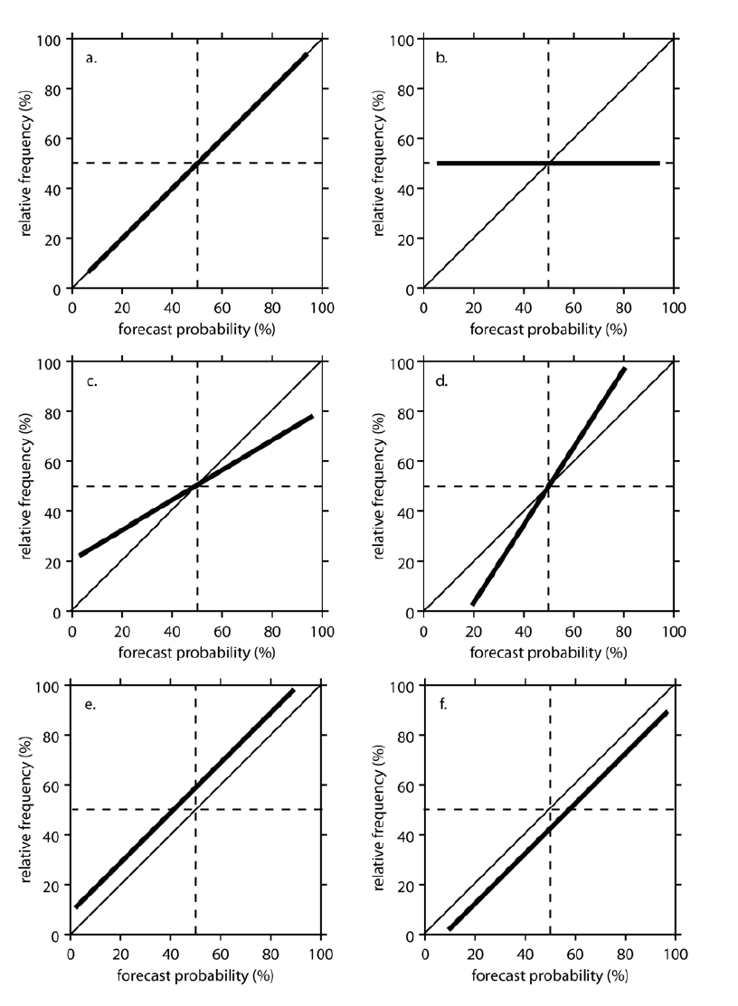
Reliability diagrams: observed relative freq. vs forecasted relative freq.
(a) perfect reliability,
(c) over-confidence
(e) under-forecasting
(b) no resolution
(d) under-confidence
(f) overforecasting

Slide 19
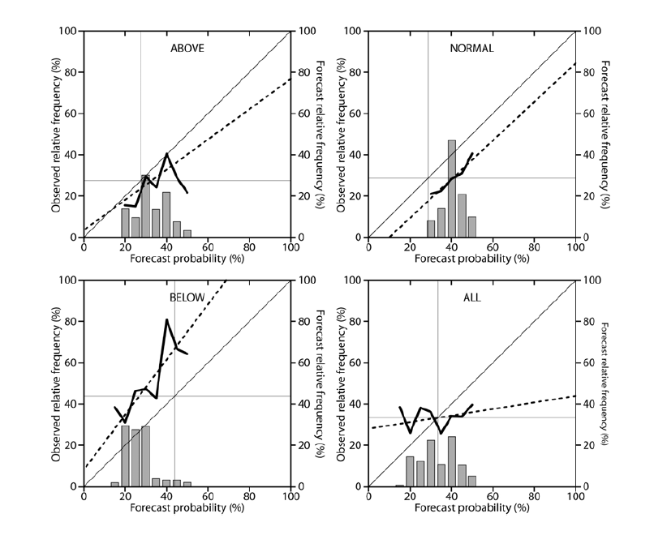
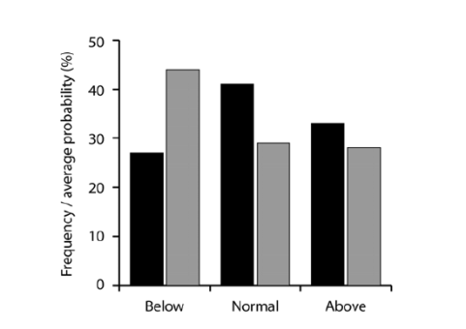
Reliability diagrams for the first 10 years of PRESAO (seasonal rainfall forecasts Jul-Sept)
Over-forecasting in normal category
Weak sharpness
Under-forecasting in below normal category

Slide 20
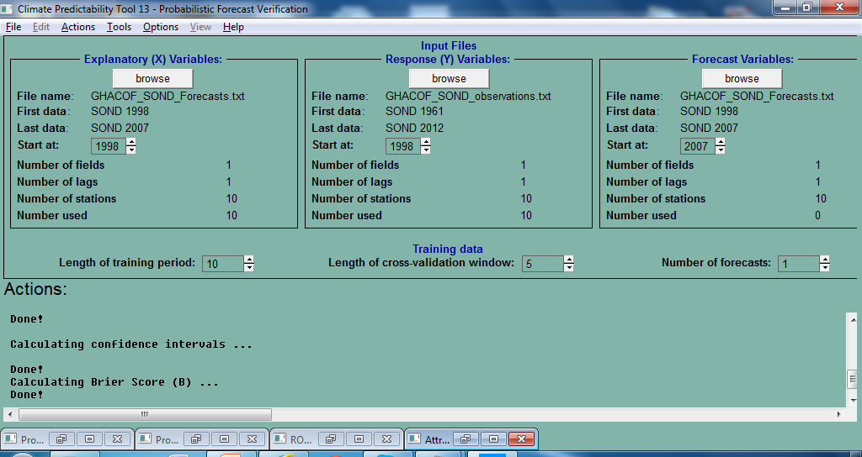
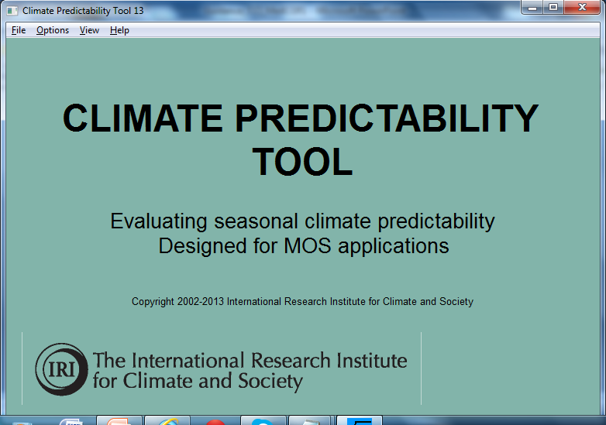
Verification with CPT

Slide 21
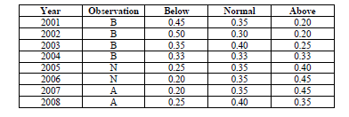
Verification of tercile-based forecasts only requires information of the obs. category → problems related data policy circumvected

Slide 22
Scores to verify the consensus forecasts and scores to improve the consensus process

Slide 23
Reference climatology is relevant!
Paco’s tranparency!!
Tercile-based seasonal forecasts refered to a climatology
Climatologist → long reference periods (30 y)
Users → short (10 y) recient periods

Slide 24
Recommendations
Assess the degree to which forecasts are being hedged on normal → Eliminate, or at least reduce, the hedging:
  Use “proper” scoring procedures
  Review procedures for setting probabilities
Agree upon a minimum set of verification procedures for RCOF products.
Encourage greater standardization in forecast production

Slide 25
Proposal
Start with a minimum verification package (following WMO-CCI guidelines) verifying consensus forecast (tercile-based) produced so far by SEECOF and PRESANORD
Use initially ECA&D data from a set of selected stations and tercile-based obs. (A, N, B)
Agree on a reference period to establish our tercile values
Report on MedCOF-2

Slide 26
THANK YOU FOR YOUR ATTENTION! and discussion on RCOF verification to be continued!!!

Slide 27
Discrimination
Perfect Very bad
2003 | 70% | T
2004 | 60% | T
2005 | 30% | F
2006 | 40% | T
2007 | 20% | F
2008 | 10% | F
2009 | 35% | T
2010 | 50% | T
2011 | 25% | F
2012 | 10% | F
2003 | 70% | F
2004 | 60% | T
2005 | 30% | T
2006 | 40% | T
2007 | 20% | F
2008 | 10% | T
2009 | 35% | T
2010 | 50% | F
2011 | 25% | F
2012 | 10% | T
If prob>35% always T

