Slide 1
MedCOF input to SEECOF

Slide 3
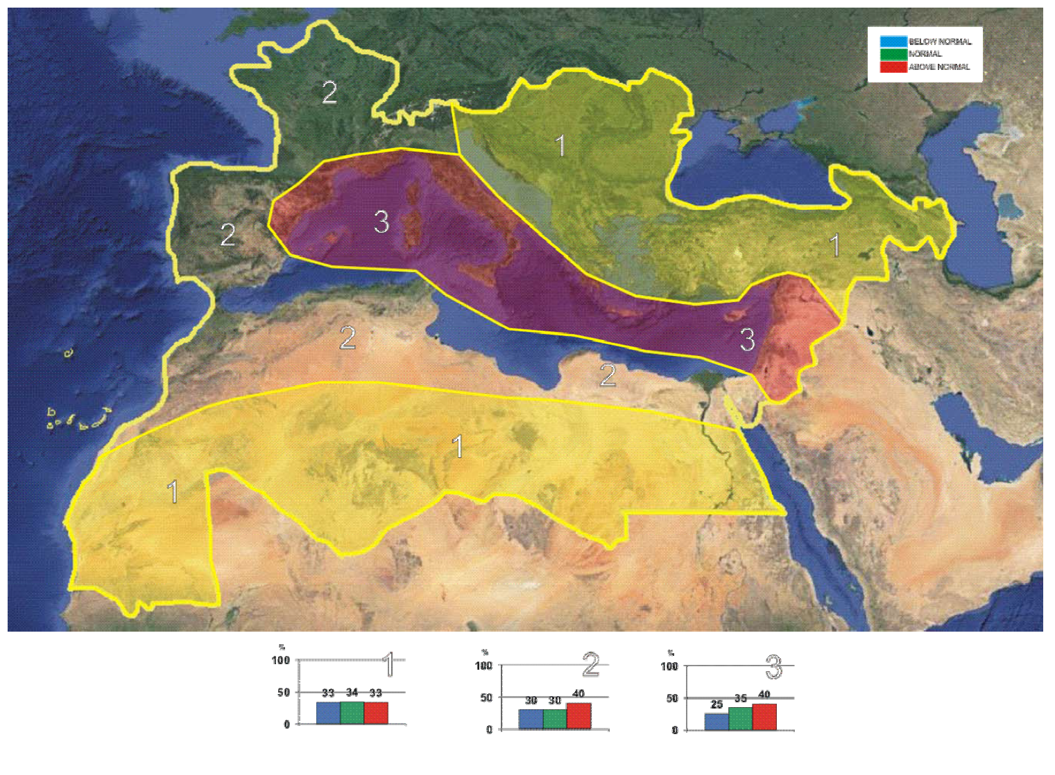

Slide 4
