Slide 1
Importance of meteo and hydro services in HEP group
Barbara Tolić, HEP Trgovina d.o.o.
SEECOFF-10
20.-21.11.2013., Belgrade

Slide 2
HEP Group

Slide 3
HEP Trade Ltd
Optimization of power plants operation and trading intermediation in the domestic and international market
Midterm planning – a week up to a year ahead
Short term planning – day ahead up to a week ahead
Intraday planning – hourly re-planning
Electricity trading
Goal – profit maximization of entire HEP Group in consideration with power system needs

Slide 4
Users of meteo and hydro data in HEP Group
Hourly forecasts and hourly historical data
Temperatures (°C)
Cloud cover (%)
Fog (%)
Low clouds (%)
Middle clouds (%)
High clouds (%)
Humidity (%)
Dew point (°C)
Precipitation(mm)
Inflow (m³/s)
Evaporation (m³/s)
Pressure (hPa)
Wind direction(°)
Wind speed (m/s)
Satellite maps
Radar maps
Lightning maps

Slide 5
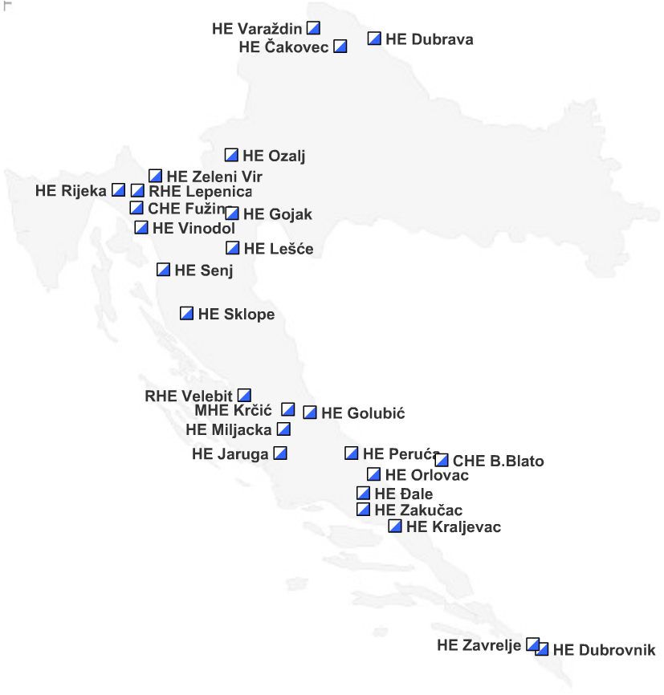
Installed generation capacities in Croatia
Hydro power plants

Slide 6
Energy balance in Croatian power system
GWh
GWh

Slide 7
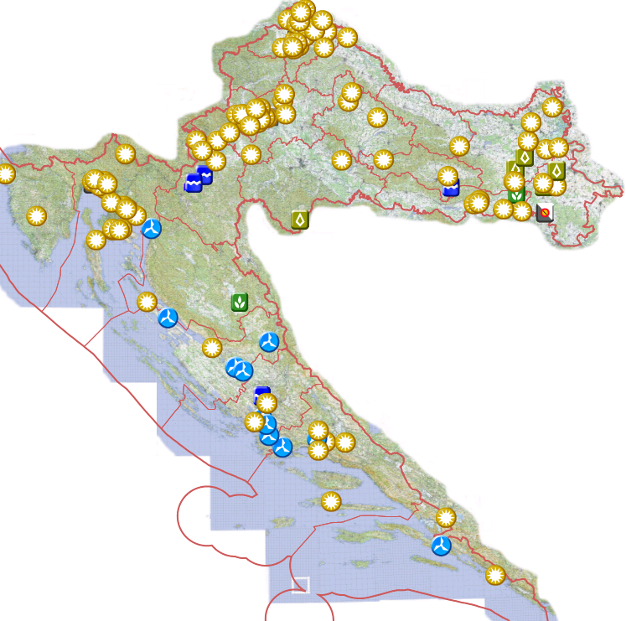
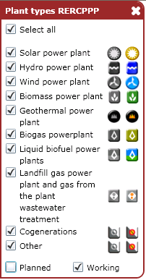
Renewables in Croatia
Generation capacity
Wind | 205,95 MW
Other | 31,05 MW
Total | 237 MW
Notes:
Map – source - http://oie-aplikacije.mingo.hr/InteraktivnaKarta/

Slide 8
Midterm planning
Very deterministic
Seasonal planning
Weekly and monthly planning

Slide 9
Midterm planning - seasons
Energy consumption forecasts
Large reservoirs management strategy – depending on long term precipitation forecasts
Fuel purchase and management (coal, natural gas and oil)
Guidelines for maintenance planning
Generation (hydro and thermal power plants)
Transmission system
Long term trade

Slide 10
Weather forecast - seasonal
Input data for planning
Temperature trends (normal, unusualy hot/cold)
Forecasts for regional capitals Zagreb, Split, Rijeka and Osijek
Precipitation (normal, dry or wet year/season)
Regional capitals and river basins

Slide 11
Midterm planning – weekly and monthly
Electric energy consumption curves – very dependant on weather
Smaller reservoirs management strategy
All but two of our reservoirs fall into this category
Torrential rivers – reservoirs have a high risk of overflow
Run-of-river power plants – daily reservoirs
Renewables planning (wind farms and solar power plants)
Short term electricity trading plan

Slide 12
Weather forcasts – weekly and monthly
10-15 days ahead meteograms
Daily temperature (average, high, low)
Precipitation (quantity and type)
Clouds and fog (big influence on energy consumption)
Relative moisture
Wind speed and direction
Regional capitals (especialy on the Adriatic coast)
Wind farm locations
Extreme weather conditions (storms, floods)

Slide 13
Forecast interpretation
Our planning – very deterministic
Weather forecasts – probabilistic
Problem – we need quantitative input data
How to interpret probabilistic weather forecasts?
{probability, interval, quantity} → {quantity, reliability}?

Slide 14
Thank you!

