Slide 1
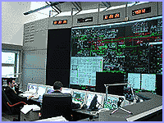
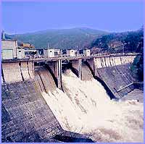
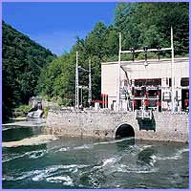
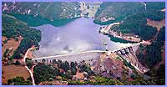
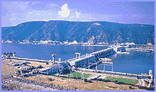
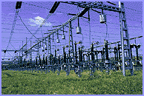
ELECTRIC POWER INDUSTRY OF SERBIA
Head Department for Electricity Trade
THE TENTH SESSION OF THE
SOUTH-EAST EUROPEAN CLIMATE OUTLOOK FORUM (SEECOF-10)
Belgrade, Serbia, November 20-21, 2013.
Influence of Meteorological Factors on Electric Energy Consumption
and Use of Meteorological Data and Forecasts
for the Planning of the Power System Operations
Branko Sparavalo, meteorologist
November 21st, 2013. Belgrade

Slide 2
Head Department for Electricity Trade
LEVELS OF POWER SYSTEM OPERATION PLAN:
ANNUAL
SEASONAL
MONTHLY
WEEKLY
DAILY
For each level we prepare meteorological and hydrological forecasts of different scales, from one hour to the average monthly, seasonal and annual values.

Slide 3
THE MAIN METEOROLOGICAL FACTORS OF CONSUMPTION INCREASE IN SERBIA
Head Department for Electricity Trade
TEMPERATURE
HIGH WIND
DAYLIGHT CLOUDINESS
PRECIPITATION

Slide 4
TEMPERATURE EFFECT ON CONSUMPTION INCREASE IN SERBIA
Head Department for Electricity Trade
WINTER TIME - DAILY
∆T = -1 ºC → Consumption = +1.5 to +2.5 GWh
(i.e. 1.5% to 2.5% higher comsumption)
Example:
7. November 2011.
T= 10 ºC → Consumption = 105 GWh
21. november 2011.
T= 0 ºC → Consumption = 125 GWh (+20%)
SUMMER TIME - DAILY
∆T= +1 ºC → Consumption = +0.8 to 1.2 GWh
(i.e. 0.8% to 1.2% higher comsumption)
Several years ago it was 0.7 GWh but now is about 1.0 GWh

Slide 5
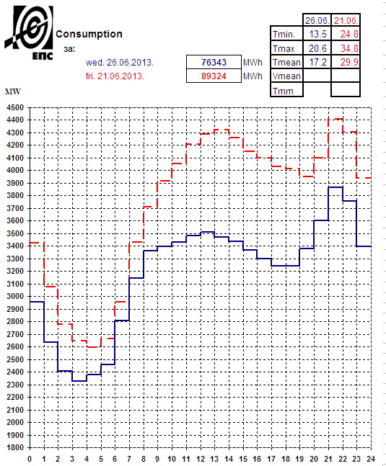
Head Department for Electricity Trade
SUMMER TIME - DAILY
5

Slide 6
TEMPERATURE EFFECT ON CONSUMPTION INCREASE IN SERBIA
Head Department for Electricity Trade
WINTER TIME - MONTHLY
November mean temperature in Belgrade
T= 7.1 ºC (1981-2010.)
November 2010. T = 12.2 ºC → second hotest november ever
and the first november warmer than october in the same year
Consumption = 2953 GWh
November 2011. T = 4.6 ºC
Consumption = 3370 GWh
∆T = 7.6 ºC
∆Consumption = 417 GWh i.e. 14% higher 2011. year
Thats production of TENT B 600 MW for a month

Slide 7
THE INFLUENCE OF TEMPERATURE TREND ON CONSUMPTION DURING THE MONTH
Head Department for Electricity Trade
September mean temperature in Belgrade
T= 18.0 ºC (1981-2010.)
Sep 2008. 17.1 ºC → 2556 GWh
(+8% than average with “normal” month)
Because:
1.-12.9. Tave=25.0 C
(increased use od Air Conditioners)
14.-22.9. Tave=10.6 C (13.-30.9. T=11.8 C)
(used electricity for heating houses)

Slide 8
Head Department for Electricity Trade

Slide 9
Head Department for Electricity Trade

Slide 10
Head Department for Electricity Trade

Slide 11
Head Department for Electricity Trade

Slide 12
THE INFLUENCE OF DRY AND WET YEAR ON HYDRO POWER PRODUCTION IN SERBIA
Head Department for Electricity Trade
10.5 TWh → Average annualy Hydro Power production (30% of all power production)
8.5 TWh → DRY year → 2011.
12.5 TWh → WET year → 2010.
4 TWh → The difference between DRY and WET year
in money, 4 TWh= 200 million EUR
(mean value at the EU electricity market)

Slide 13
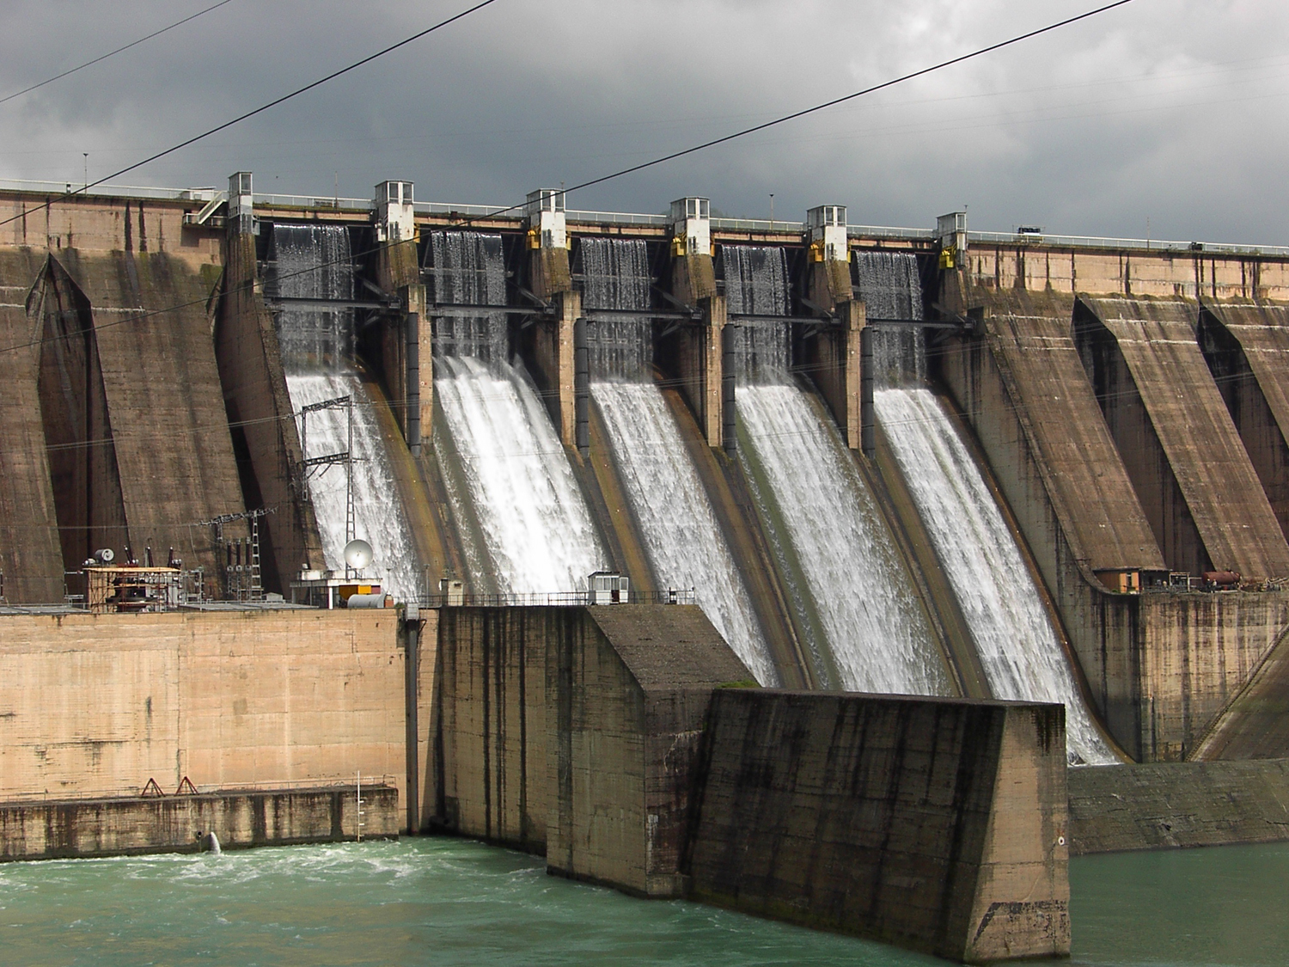
Head Department for Electricity Trade
SYSTEM FOR THE FORECAST OF THE DRINA RIVER BASIN INFLOW - METEOSAR
HE “BAJINA BAŠTA”

Slide 14
SYSTEM FOR THE FORECAST OF THE DRINA RIVER BASIN INFLOW - METEOSAR
Head Department for Electricity Trade
System was developed to provide operational river forecasting for making hydropower operating plans
Main INPUT: forecasts of precipitation and temperature using several meteo models
6h time step discretization up to xx days (7-10+)
The river basin divided into altitude zones through performed snowmelt process and also accumulation of snow above a certain level
Model calculates runoff from rainfall and melting snow

Slide 15
SYSTEM FOR THE FORECAST OF THE DRINA RIVER BASIN INFLOW - METEOSAR
Head Department for Electricity Trade
System is used for:
HYDROPOWER OPERATING PLANS
HYDROPOWER COORDINATION
WATER CONTROL DATA SYSTEM
We also have another independent system for operational river inflow forecasts, but not finished yet
Hydro-meteorological Information System of the Drina river basin
HIS of the Danube river basin is being planned.
As we use several meteorological models, we want to use at least two independent sources of inflow forecast (hydro-meteorological models). In any case, we need more and more meteorological input data, and of course, more and more accurate forecasts.
15

Slide 16
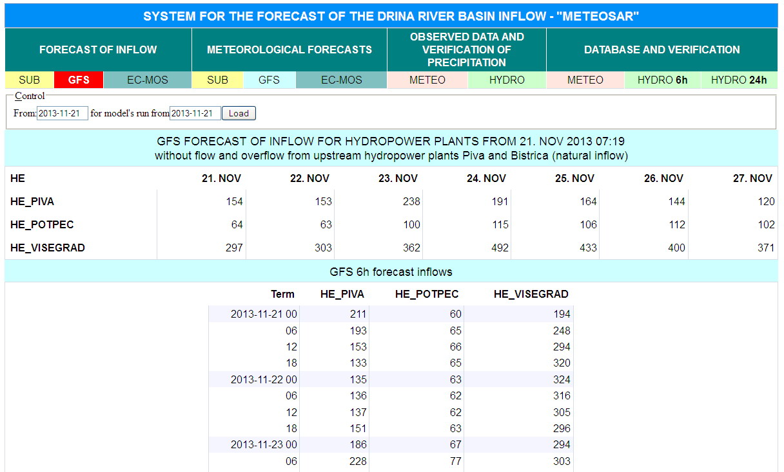
Head Department for Electricity Trade
16

Slide 17
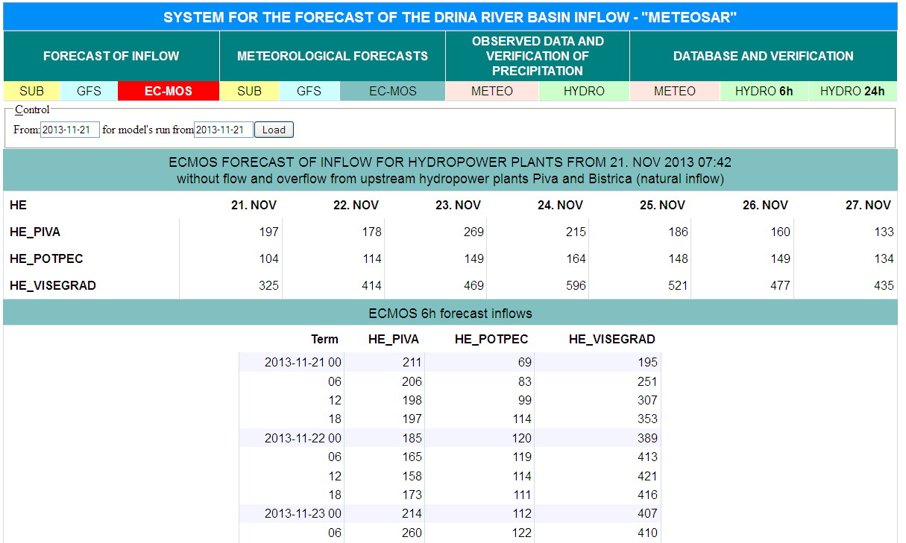
Head Department for Electricity Trade
17

Slide 18
Head Department for Electricity Trade
USER SUGGESTIONS:
Normal period should be 1981-2010 for practical purposes,
the period 1961-1990 or 1971-2000 does not fully comply with our applications
We would be glad if SEECOF discussed and
adopted more month by month seasonal forecast
and also by weeks or decades if it would be possible in the future.
(for the first month it is possible)
We would also be glad if SEECOF begin to use exactly values in the future
to express forecast by months (instead of “little above normal”:
“+1.2 C” or “from +0.4 C to +2.0 C” like we saw in Hungary presentation)
For all of our activities in the planning, we need more accurate forecasts
and for a longer period. It is your mission.
THANK YOU !

