Slide 1
Introduction : what is the goal of consensus seasonal forecast?

Slide 2
Why MedCOF?
Recommendations given by RA VI Task Team on RCOF and supported by the RA VI Working Group on Climate and Hydrology targeting South Western Europe / Mediterranean basin as suitable for a RCOF implementation.
Recommendation by the Scoping Workshop on Seasonal climate Prediction (Algeria, January 2012) of extending the existing RA I PRESANORD to the whole Mediterranean area involving thus RA I and RA VI.
The 65th session of WMO Executive Council (May 2013) stressed the vital importance of collaboration and joint contribution of RAs in developing capacities for the Climate Services Information System, and welcome the initiative of RA VI and RA I of jointly launching an RCOF for the Mediterranean Region.

Slide 3
MedCOF Scoping Meeting (Madrid, 12-14 June 2013)
Strong agreement in creating a single MedCOF for the whole Mediterranean region.
Existing RCOFs –PRESANORD and SEECOF- will continue working and coordinated through the MedCOF umbrella.
Possibility of creating a South Western Europe RCOF
Network of Mediterranean RCOFs focusing in the most operational aspects of the RCOF responsibilities
Focus MedCOF sessions initially on seasonal timescale
Winter and summer emerged as the seasons for which the information is crucial
Common climate/hydrological approach
Highlight the synergetic and cooperation aspects of MedCOF.
Nomination of an Interim Management Team (IMT) tasked with
preparation of the first MedCOF meeting,
preparation of a proposal of Terms of Reference for IMT and
preparation of any needed relevant document
Seek sources of funding
First MedCOF meeting in November with the option of holding it together the SEECOF meeting in Belgrad

Slide 4
First, large scales!
From a scientific point of view, it seems more reasonable to look first at large-scales and then, regional ones.
First, produce a MedCOF consensus seasonal forecast for the whole Mediterranean basin.
Then SEECOF and PRESANORD refine the consensus forecast for their respective regions.
Avoid overlaps and repetitions!

Slide 5
Why consensus forecast?
Avoid contradictory messages
Estimulate transfer of knowledge
Develop and implement of GFCS at regional/national level

Slide 6
What is the main goal of the seasonal consensus forecast?
To ensure the proper flow of information
GPCs RCCs RCOFs
NMSs +others
To analyse/diagnose the LS state of the system and its predictability
To discuss and evaluate of pieces of available information and generate a probabilistic forecast

Slide 7
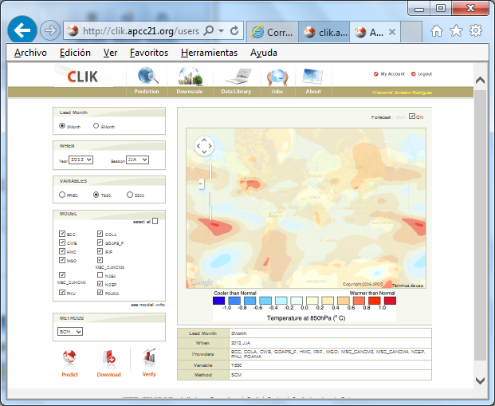
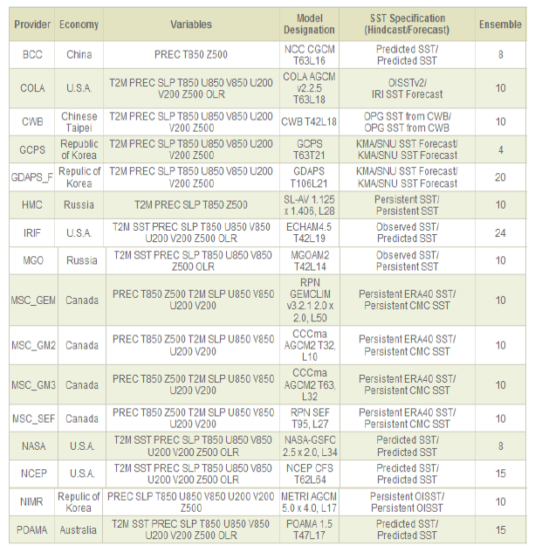
APCC (http://www.apcc21.org)

Slide 8
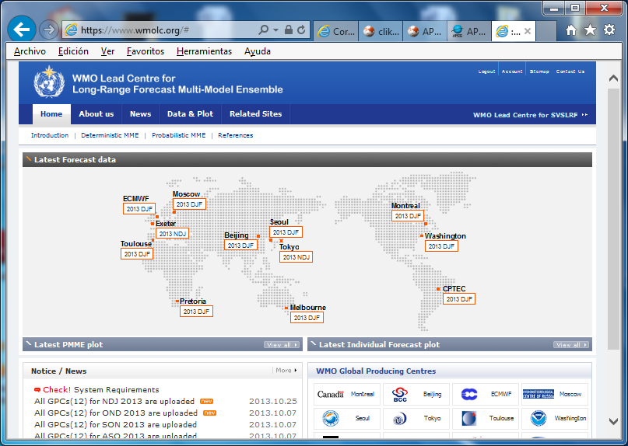
WMO LC LRFMME (https://www.wmolc.org)

Slide 9
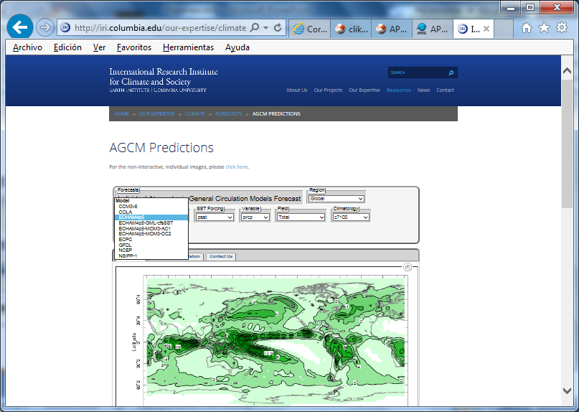
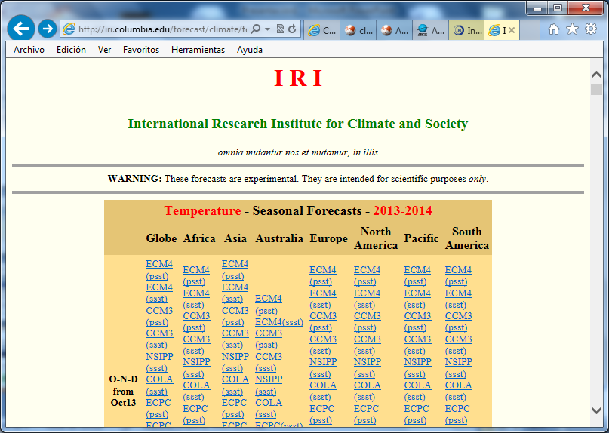
IRI (http://iri.columbia.edu)

Slide 10
Careful with
Models →some are fully couple atm/ocean (others 2-tier models)
Caution with ensemble averages → better look models individually
Caution with models not providing info on verification scores
Caution with non robust/significant empirical relationships
Caution with schedule. RCOFs should accomodate to the availability of information from GPCs, RCCs, etc.
RCOFs success depends critically on the good functioning and support of the respective RCCs

Slide 11
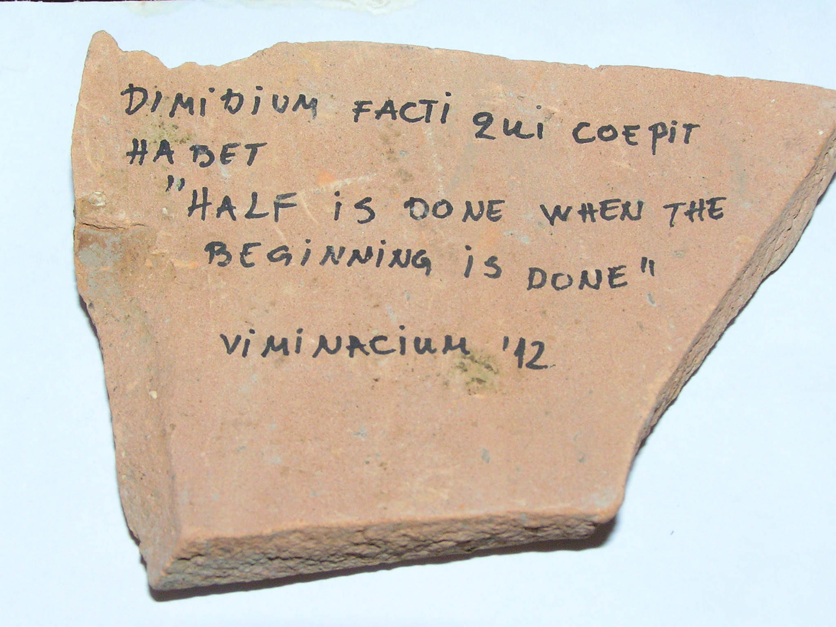
A good omen!

