Slide 1
Dust forecast – 1 Apr 2015 dust storm Doha case
Slobodan Nickovic
(for internal use only)
Dust model – Dust Regional Atmospheric Model (Nickovic et al, 2001; Vukovic et al, 2014)
Horizontal resolution – 0.25 deg; 28 vertical levels

Slide 2
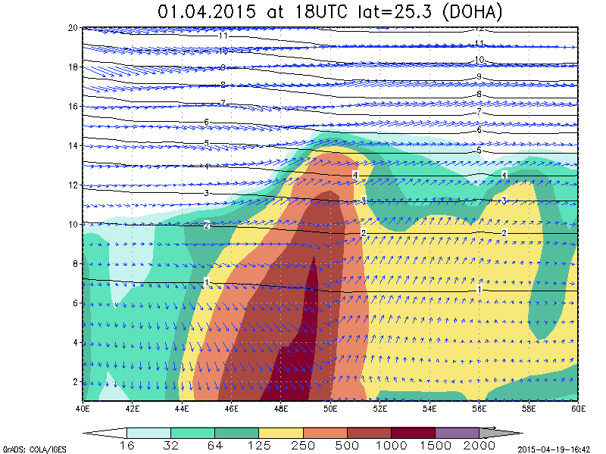
Doha Airport
Dust concentration in the W-E section crossing at 25.3º cross section dust load (µg m⁻³) forecast valid at 18UTC 01 Apr 2015. Black lines – height in km; arrows – horizontal wind

Slide 3
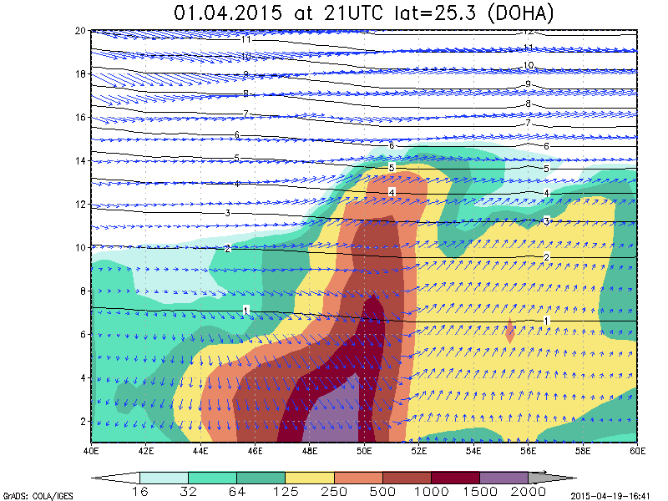
Doha Airport
Dust concentration in the W-E section crossing at 25.3º cross section dust load (µg m⁻³) forecast valid at 21UTC 01 Apr 2015. Black lines – height in km; arrows – horizontal wind

Slide 4
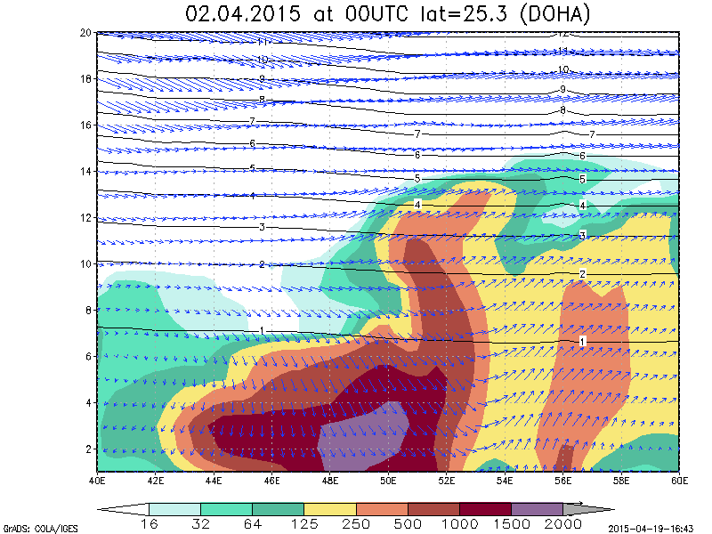
Doha Airport
Dust concentration in the W-E section crossing at 25.3º cross section dust load (µg m⁻³) forecast valid at 00UTC 02 Apr 2015. Black lines – height in km; arrows – horizontal wind

Slide 5
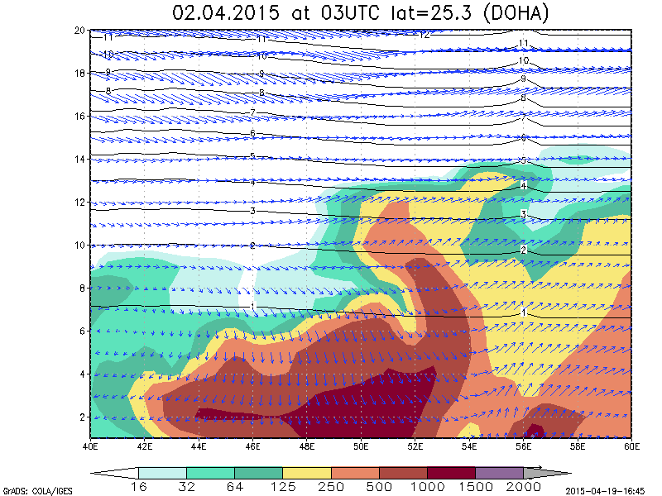
Doha Airport
Dust concentration in the W-E section crossing at 25.3º cross section dust load (µg m⁻³) forecast valid at 03UTC 02 Apr 2015. Black lines – height in km; arrows – horizontal wind

Slide 6
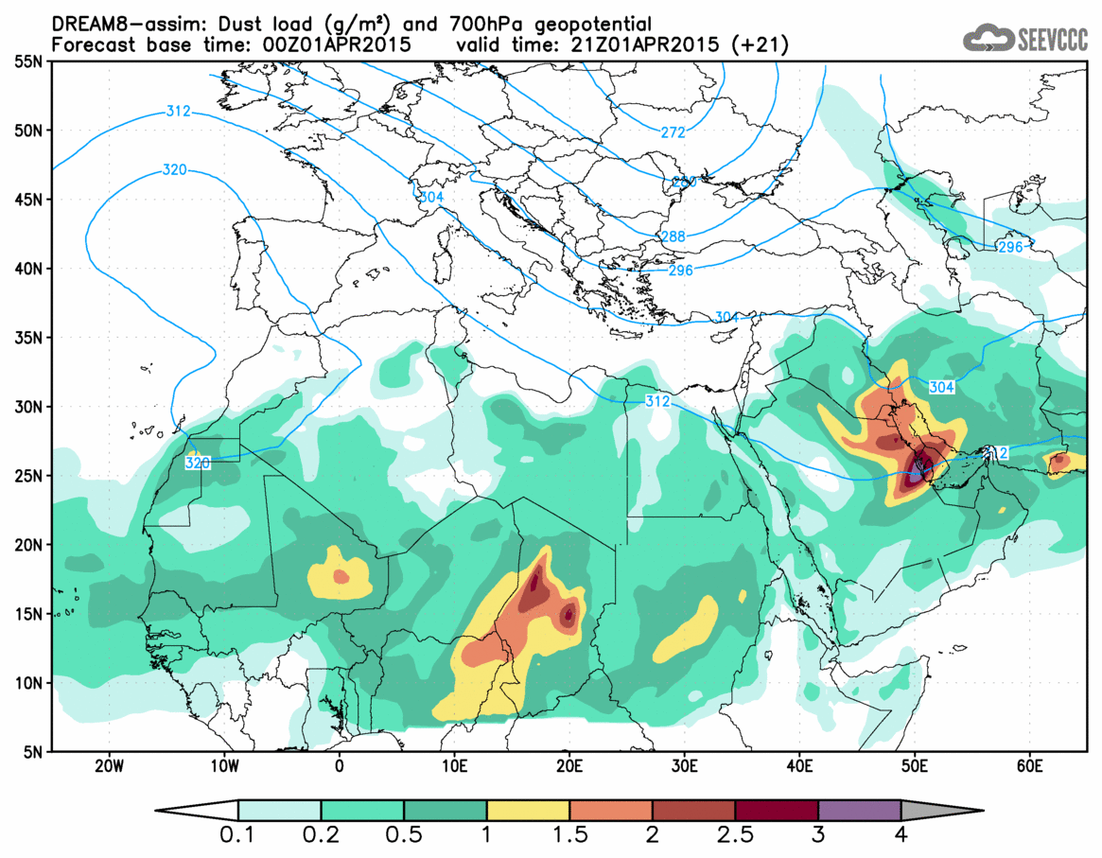
Vertical dust load (µg m⁻²) forecast valid at 21UTC 01 Apr 2015

Slide 7
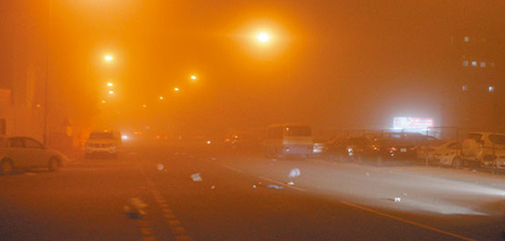
Sandstorm envelops Qatar

