Slide 1

South East European Virtual Climate Change Center
hosted by Hydrometeorological Service of Serbia

Slide 2
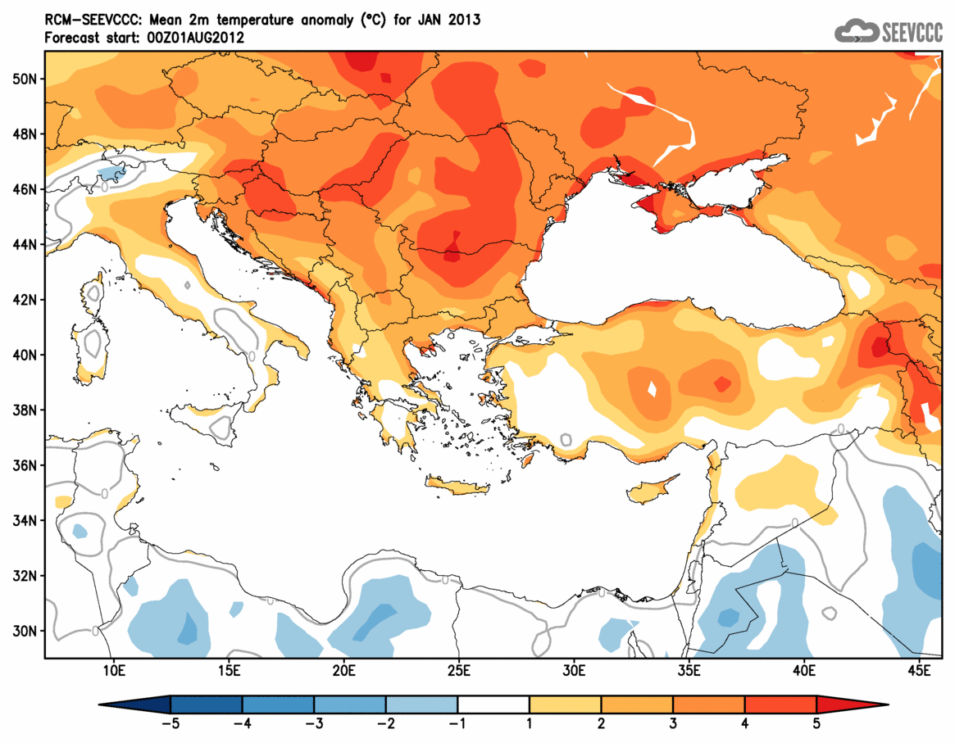
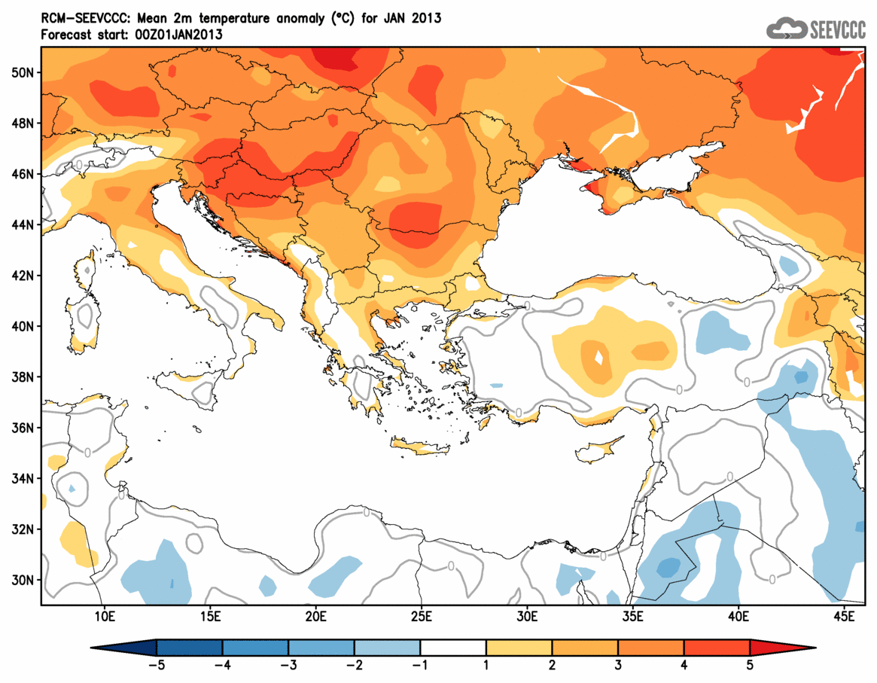
Operational Functions
Long Range Forecast
Present work:
Dynamical downscaling of ECMWF ensemble LRF forecast for 7 months, using coupled atmospheric-ocean model EBU-POM.
Forecast: available ~15th in the month, 51 ensemble, ~30km resolution.
Model domain: Euro-Mediterranean region
Products: Monthly temperature and precipitation, Seasonal temperature and precipitation (3 months); Anomalies from observed climatology for 1961-1990 for the same parameters.
Forecast is continuously available from June 2009.
Other details and forecast can be found at web-site.
Future work:
Dynamical downscaling of the hindcast and presentation of the anomalies with respect to hindcast.
Example: Mean monthly temperature for January 2013:
Forecast from August 2011 Forecast from January 2013
Operational Functions
Long range forecast
Monthly Forecast
Climate Monitoring
Dust Forecast
NCEP/NMMB Global Forecast
Research and Development
Earth Modeling System
Model Coupling
Hydrology modeling
Minerals in Soils
Case Studies
Climate Change
Future Plans

Slide 3
Operational Functions
Monthly Forecast
Present work:
Direct use of ECMWF ensemble monthly forecast, using 51 ensembles from forecast and hindcast 5 ensembles for SEE region and statistical downscaling for Serbia.
Variables: daily maximum and minimum temperature and precipitation
Forecast updated once a week.
Products for SEE:
weekly values: maps of ensemble mean values and probability forecast with respect to hindcast 1994-2010 (probability for variable to be with anomaly above 0, below lower tercile, between lower and upper tercile and above upper tercile)
monthly values: the same but using both, terciles and percentiles.
Products for Serbia:
Data are interpolated into the meteorological stations for verification purposes and creating forecast modified with observed data (experimental).
Working on monthly forecast started ~ May 2012.
Forecast is not officially available on the web-site, still in experimental stage,
Can be found at link: http://www.seevccc.rs/IDX/ecmwf_monthly.html
Future work:
Recent future:
Make product for whole 2011 and 2012.
Improving methodology for modified forecast using observed values.
Plans: Dynamical downscaling of ensemble ECMWF monthly forecast using NMMB.
Operational Functions
Long range forecast
Monthly Forecast
Climate Monitoring
Dust Forecast
NCEP/NMMB Global Forecast
Research and Development
Earth Modeling System
Model Coupling
Hydrology modeling
Minerals in Soils
Case Studies
Climate Change
Future Plans

Slide 4
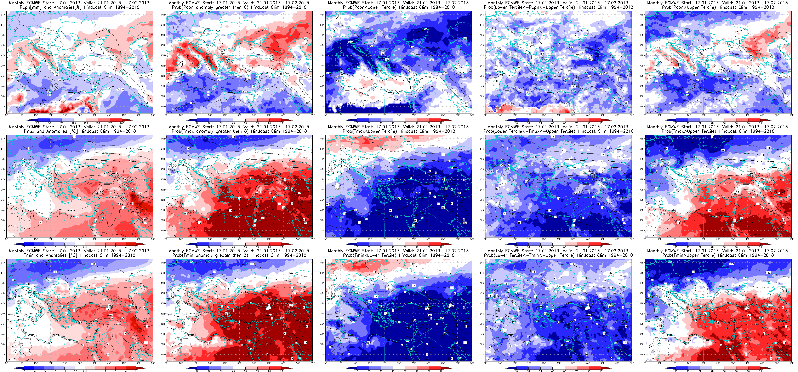
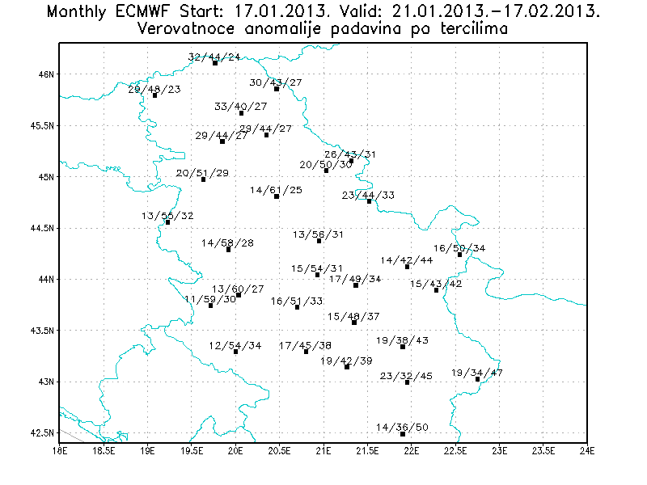
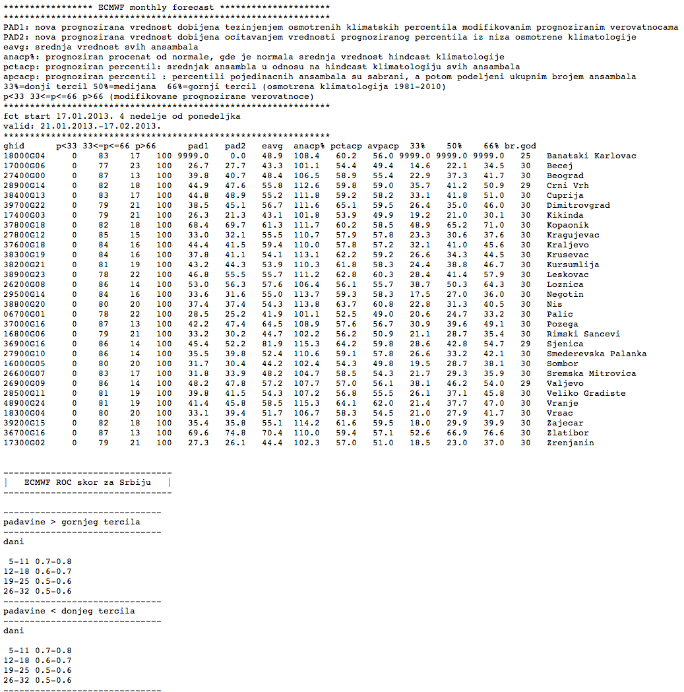
Operational Functions
Monthly Forecast (continued)
Example for January 2013:
Operational Functions
Long range forecast
Monthly Forecast
Climate Monitoring
Dust Forecast
NCEP/NMMB Global Forecast
Research and Development
Earth Modeling System
Model Coupling
Hydrology modeling
Minerals in Soils
Case Studies
Climate Change
Future Plans

Slide 5
Operational Functions
Climate Monitoring
Collecting all available observations of monthly precipitation and temperature data for SEE region (~450), each month, from 2009.
Results are presented in form of maps for monthly and seasonal (3months) temperature and precipitation, the same for anomalies with respect to climatology 1961-1990.
More information and results are available on the SEEVCCC web-site here.
Operational Functions
Long range forecast
Monthly Forecast
Climate Monitoring
Dust Forecast
NCEP/NMMB Global Forecast
Research and Development
Earth Modeling System
Model Coupling
Hydrology modeling
Minerals in Soils
Case Studies
Climate Change
Future Plans

Slide 6
Operational Functions
Dust Forecast
Present work:
Dust forecast using regional NMME-DREAM model, with assimilation of ECMWF dust analysis for obtaining better dust concentration initial field. Boundary and initial fields for atmospheric model are from ECMWF.
Forecast updated once a day, 72h forecast.
Forecast is delayed one day, because ECMWF dust analysis is late one day.
Model domain and resolution: 5N-55N, 25W-65W, ~30km.
Model is part of the WMO SDS-WAS Project from the beginning (March 2012).
Future work:
Improving the dust mask.
Problems:
ECMWF dust analysis is late one day, which is the reason our forecast is late one day and is not available on WMO SDS-WAS page with latest forecasts.
Is it possible for ECMWF to make their dust analysis available the same day?
This would be of a great importance for RHMSS/SEEVCCC because NMME-DREAM is generally the model with leading scores.
Dust forecast is available at SEEVCCC web-site here, under the name Dream8assim,
and SDS-WAS link http://sds-was.aemet.es/forecast-products/forecast-evaluation,
under the name DREAM8-NMME-MACC.
Operational Functions
Long range forecast
Monthly Forecast
Climate Monitoring
Dust Forecast
NCEP/NMMB Global Forecast
Research and Development
Earth Modeling System
Model Coupling
Hydrology modeling
Minerals in Soils
Case Studies
Climate Change
Future Plans

Slide 7
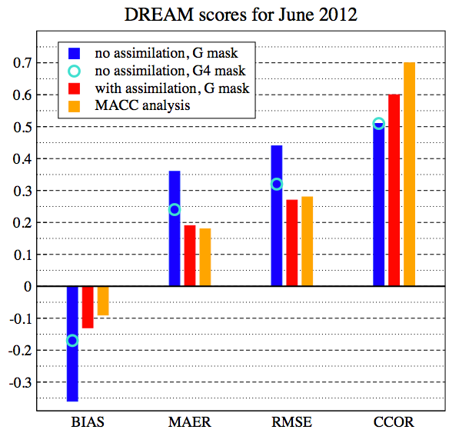
Operational Functions
Dust Forecast (continued)
More on the assimilation method can be found on the www.seevccc.rs.
Improvement of the dust forecast using ECMWF assimilation of dust forecast:
More details about scores and comparison vs. other models that participate in SDS-WAS:
http://www.seevccc.rs/wp-content/uploads/2013/01/Kuvajt_poster2012_mali.jpeg
Operational Functions
Long range forecast
Monthly Forecast
Climate Monitoring
Dust Forecast
NCEP/NMMB Global Forecast
Research and Development
Earth Modeling System
Model Coupling
Hydrology modeling
Minerals in Soils
Case Studies
Climate Change
Future Plans

Slide 8
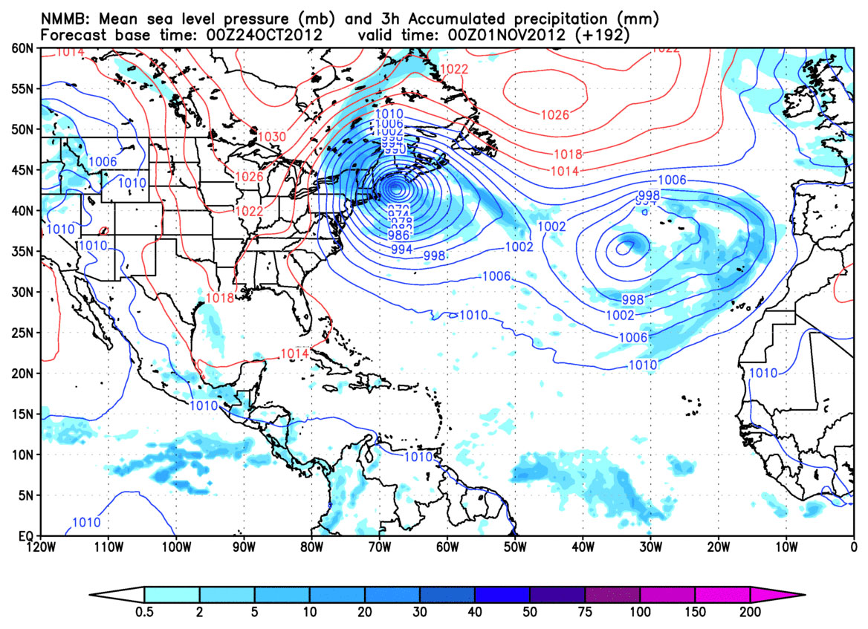
Operational Functions
NMMB Global Forecast
NCEP/NMMB (Nonhydrostatic Multiscale Model on B grid) as global model is operational since January 2010, using GFS initial fields.
Forecast: start 00UTC each day, 10 days forecast, resolution ~35km.
Forecast is archived in the MARS database, soon available for users.
Hurricane Sandy: start time 00UTC Oct 24th 2012
Operational Functions
Long range forecast
Monthly Forecast
Climate Monitoring
Dust Forecast
NCEP/NMMB Global Forecast
Research and Development
Earth Modeling System
Model Coupling
Hydrology modeling
Minerals in Soils
Case Studies
Climate Change
Future Plans

Slide 9
Research and Development
Earth Modeling System
Operational Functions
Long range forecast
Monthly Forecast
Climate Monitoring
Dust Forecast
NCEP/NMMB Global Forecast
Research and Development
Earth Modeling System
Model Coupling
Hydrology modeling
Minerals in Soils
Case Studies
Climate Change
Future Plans
NCEP NMMB atmospheric model
● global/regional/local
● hydrostatic/nonhydrostatic
Aerosol ↔ radiation
HYPROM
Hydrology model
Aerosol ↔ cloud
DREAM Dust
Sea salt
Carbon
Pollution
Fe and P
nutrients
Ocean (POM)

Slide 10
Research and Development
Model Coupling
NCEP/NMMB – Nonhydrostatic Multiscale Model on B grid
Numerical Weather Prediction Model (NWPM)
Works on global, regional (res. ~10km) and local scales (res.~100m)
Valuable tool to perform simulations on any desirable resolution
Atmospheric particles
Implementation of dust, sea salt, minerals and other atmospheric particles:
transport and their interactions with atmosphere and ocean
(influence on cloud formation, radiation, ocean flora and fauna,…)
for now dust component (DREAM) is prepared for implementation in NMMB
Hydrology
Dynamical hydrology model is developed – HYPROM
simulation of hydrology cycle
HYPROM ready to be included into atmospheric driver NMMB
Ocean
NMMB is coupled with POM
necessary because of large influence of sea on climate in the region
RCM-SEEVCCC Earth Modeling System with its components ATM, DUST, OCEAN, HYPROM is in the process of upgrading with the new atmospheric driver.
Operational Functions
Long range forecast
Monthly Forecast
Climate Monitoring
Dust Forecast
NCEP/NMMB Global Forecast
Research and Development
Earth Modeling System
Model Coupling
Hydrology modeling
Minerals in Soils
Case Studies
Climate Change
Future Plans

Slide 11
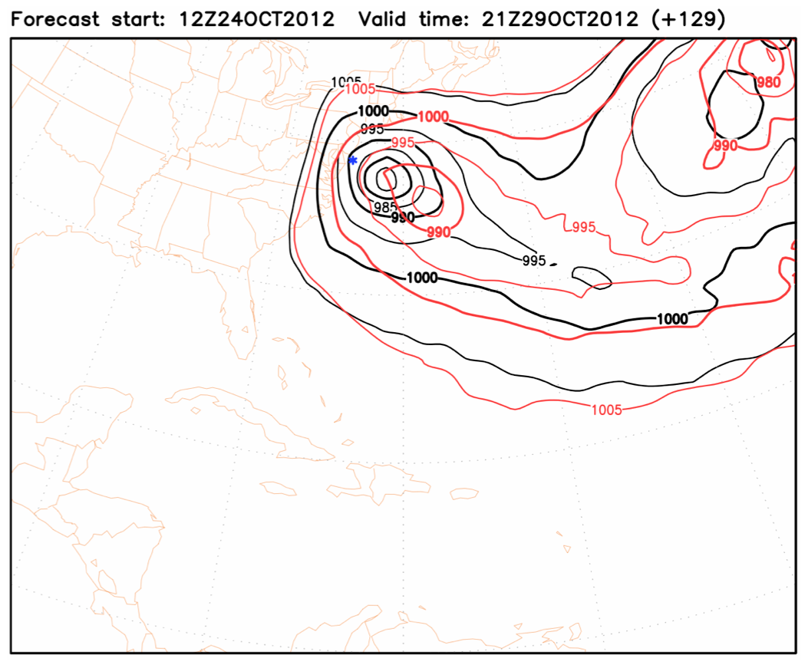
Research and Development
Model Coupling (continued)
Example for NMMB-POM performance:
Black – coupled NMMB with POM
Red – only NMMB
Blue – observed location
First results of coupled model (resolution 100km)
Operational Functions
Long range forecast
Monthly Forecast
Climate Monitoring
Dust Forecast
NCEP/NMMB Global Forecast
Research and Development
Earth Modeling System
Model Coupling
Hydrology modeling
Minerals in Soils
Case Studies
Climate Change
Future Plans

Slide 12
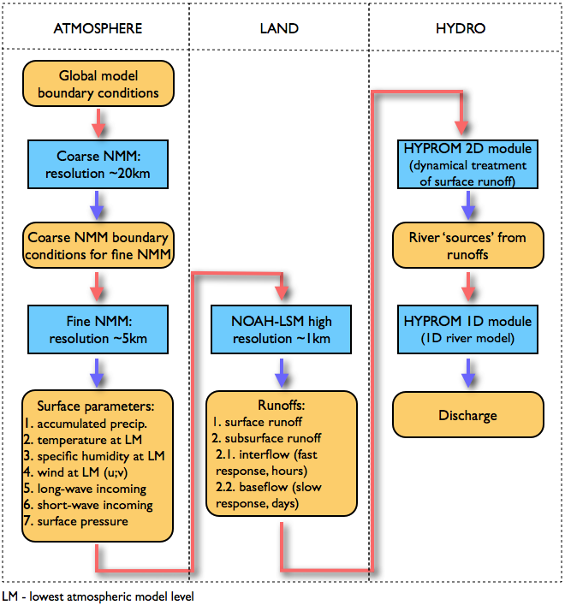
Research and Development
Hydrology Modeling
Dynamical hydrology model is developed:
HYPROM (HYdrology PROgnostic Model)
Nickovic S., Pejanovic G., Djurdjevic V., Roskar J and Vujadinovic M., 2010: HYPROM Hydrology Surface-Runoff Prognostic Model. Water Resources Research, 46, W11506
Operational Functions
Long range forecast
Monthly Forecast
Climate Monitoring
Dust Forecast
NCEP/NMMB Global Forecast
Research and Development
Earth Modeling System
Model Coupling
Hydrology modeling
Minerals in Soils
Case Studies
Climate Change
Future Plans

Slide 13
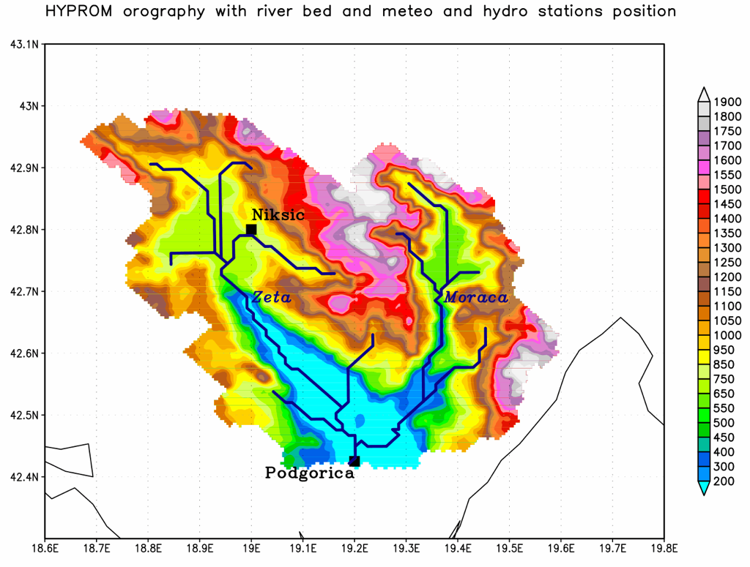
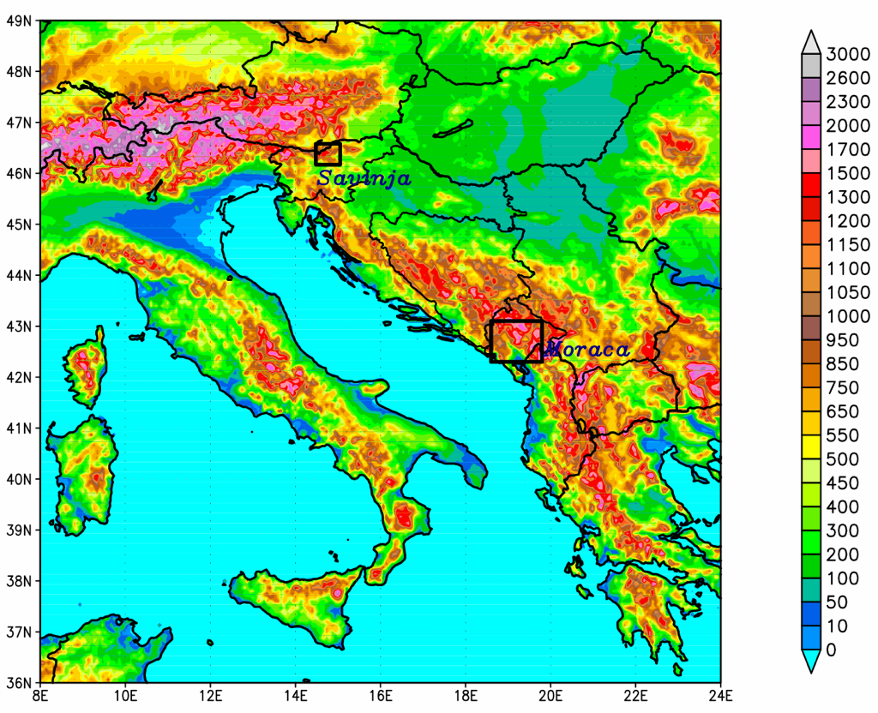
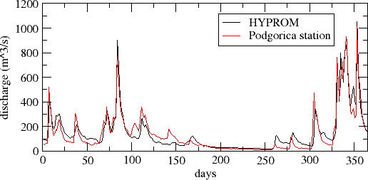
Research and Development
Hydrology Modeling (continued)
Example: Moraca river, Montenegro
HYPROM discharge forecast vs. observations:
Moraca river – Podgorica sub-basin (2008)
Operational Functions
Long range forecast
Monthly Forecast
Climate Monitoring
Dust Forecast
NCEP/NMMB Global Forecast
Research and Development
Earth Modeling System
Model Coupling
Hydrology modeling
Minerals in Soils
Case Studies
Climate Change
Future Plans

Slide 14
Research and Development
Minerals in soils
Mineral transport modelling:
Developed global mineral database GMINER30, more details can be found here.
It is available for download http://www.seevccc.rs/GMINER30/
Nickovic S., Vukovic A., Vujadinovic M., Djurdjevic V., Pejanovic G., 2012, “Technical Note: Minerals in dust productive soils – impacts and global distribution”. Atmospheric Chemistry and Physics, 12, 845-855
Currently working on Iron (carried by durst particles) transport modeling (DREAM-IRON):
Using GMINER30 database and knowing how much Fe is in minerals, we made the model for Fe transport carried with dust particles. Fe interacts with environment (clouds, pollution) and transferring from non-soluble to soluble. When deposited into the ocean soluble Fe can cause see blooming and thereby effect SST and sea biology.
Nickovic S., Vukovic A., Vujadinovic M., 2013: Atmospheric Processing of Iron Carried by Mineral Dust, ACPD. Manuscript under review.
Operational Functions
Long range forecast
Monthly Forecast
Climate Monitoring
Dust Forecast
NCEP/NMMB Global Forecast
Research and Development
Earth Modeling System
Model Coupling
Hydrology modeling
Minerals in Soils
Case Studies
Climate Change
Future Plans

Slide 15

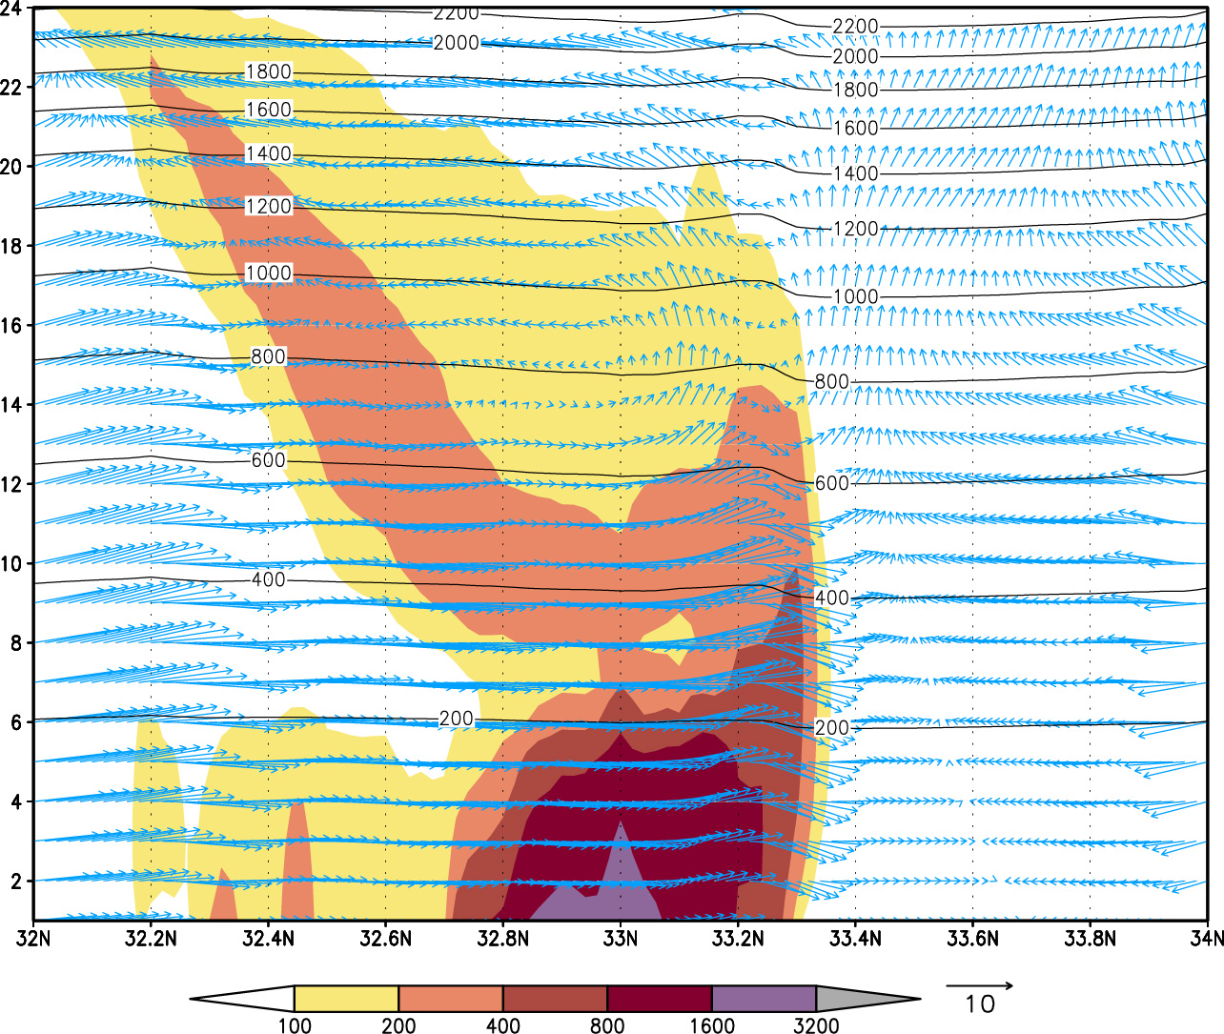
Research and Development
Case studies
Volcano ash transport modelling:
Eyjafjallajokull eruption case study, more about simulation and results can be found here.
High resolution dust modelling:
NMME-DREAM case studies of local
dust storms, special definition of dust
sources, resolution bellow 5km.
Example: Phoenix 5 July 2011,
duration of the event several hours,
pm10 over 2000ug/m3,
whole event is a scale of ~200km
with severe wind uplifting
the dust up to ~1500m.
Operational Functions
Long range forecast
Monthly Forecast
Climate Monitoring
Dust Forecast
NCEP/NMMB Global Forecast
Research and Development
Earth Modeling System
Model Coupling
Hydrology modeling
Minerals in Soils
Case Studies
Climate Change
Future Plans
vertical cross section
at the time of the storm (21h AZ time)

Slide 16
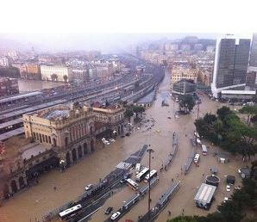
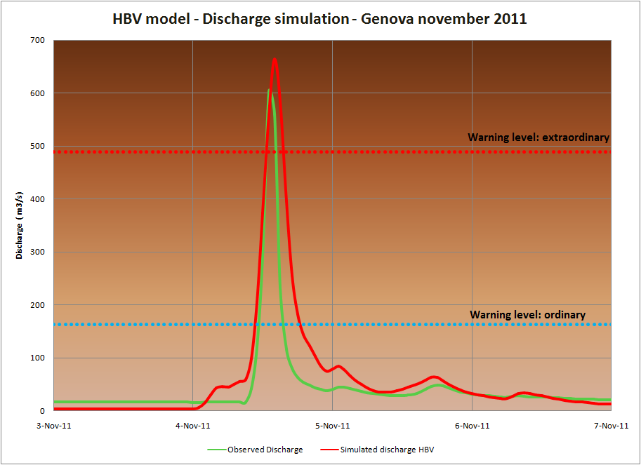
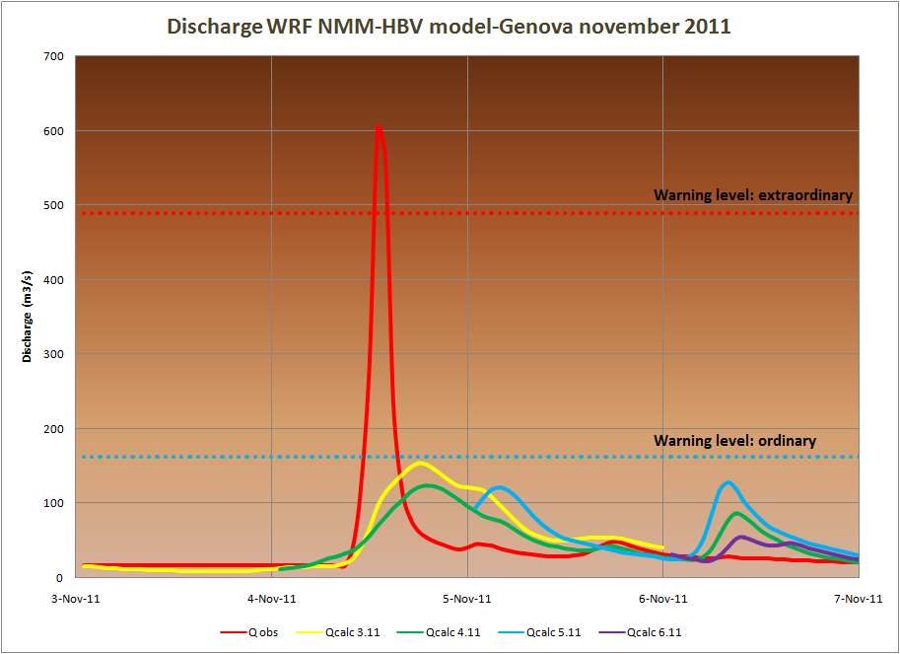
Research and Development
Case studies (continued)
Latest work work in hydrology modeling – extreme cases:
DRIHM Project: Genoa, 4 November 2011
Flash Flood (Bisagno River).
Precipitation ~450mm in 6h, six deaths,
raging waters uprooted trees, swept cars,
shattered shops and flooded the town center.
Operational Functions
Long range forecast
Monthly Forecast
Climate Monitoring
Dust Forecast
NCEP/NMMB Global Forecast
Research and Development
Earth Modeling System
Model Coupling
Hydrology modeling
Minerals in Soils
Case Studies
Climate Change
Future Plans
HBV calibrated with observations
and forced with observations
Discharge: HBV (red) vs. obs. (green)
HBV calibrated with observations
and forced with WRF-NMM:
forecasts from 3Nov (yellow),
4Nov (green),5Nov (blue), 6Nov (purple)
Problem with NWPM model,
maximum precipitation shifted
toward west 15-20km
– problem for hydrology forecast!

Slide 17
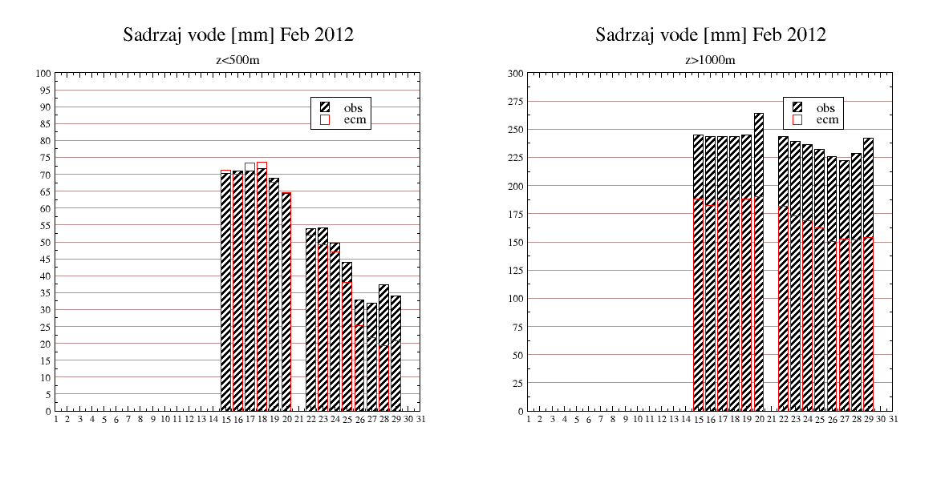
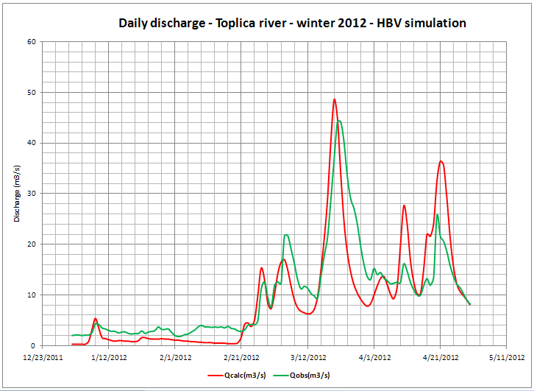
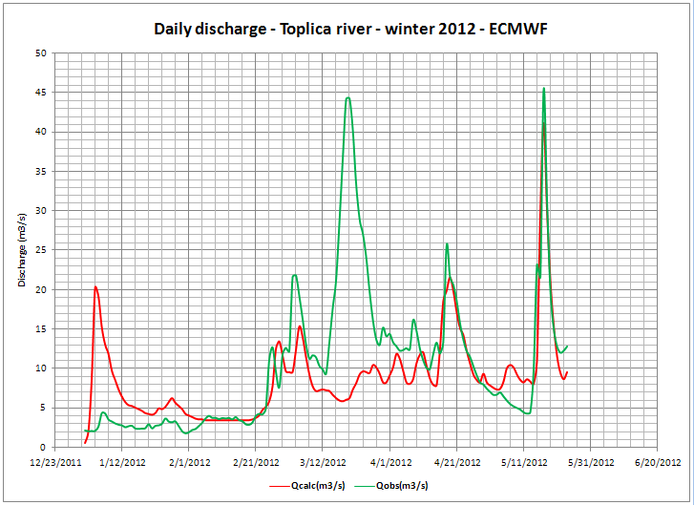
Research and Development
Case studies (continued)
Latest work work in hydrology modeling – extreme cases:
Toplica river – winter 2012, high snow/snowmelt
problem with forcing from NWPM (ECMWF), HYPROM is developing to be the fully dynamical model (without any calibrations)
Operational Functions
Long range forecast
Monthly Forecast
Climate Monitoring
Dust Forecast
NCEP/NMMB Global Forecast
Research and Development
Earth Modeling System
Model Coupling
Hydrology modeling
Minerals in Soils
Case Studies
Climate Change
Future Plans
ECMWF snow water eq. Feb 2012
HBV model (calibrated with observations)
in stations
bellow 500m
HYPROM (no calibration)
in stations
over 1000m
Not enough snow to melt
Large deficit in snow on high altitudes

Slide 18
Research and Development
Climate Change
Climate projections:
EBU-POM climate simulations for 1961-1990 (20c3m), 2001-2030 (IPCC/SRES A1B), 2071-2100 (IPCC/SRES A1B and A2).
Domain: Euro-Mediterranean region, ~30km (atmosphere) and ~20km (ocean) resolution.
More on this subject can be found here.
SEEVCCC developed a method for statistical bias correction of daily temperature and precipitation RCM output. This is very important for the climate change impact studies on a local level, in many different areas of research (agriculture, forestry, hydrology, energy, tourism, …)
Recent impact studies:
Impact on economy, agriculture, energetics, etc.
Operational Functions
Long range forecast
Monthly Forecast
Climate Monitoring
Dust Forecast
NCEP/NMMB Global Forecast
Research and Development
Earth Modeling System
Model Coupling
Hydrology modeling
Minerals in Soils
Case Studies
Climate Change
Future Plans

Slide 19
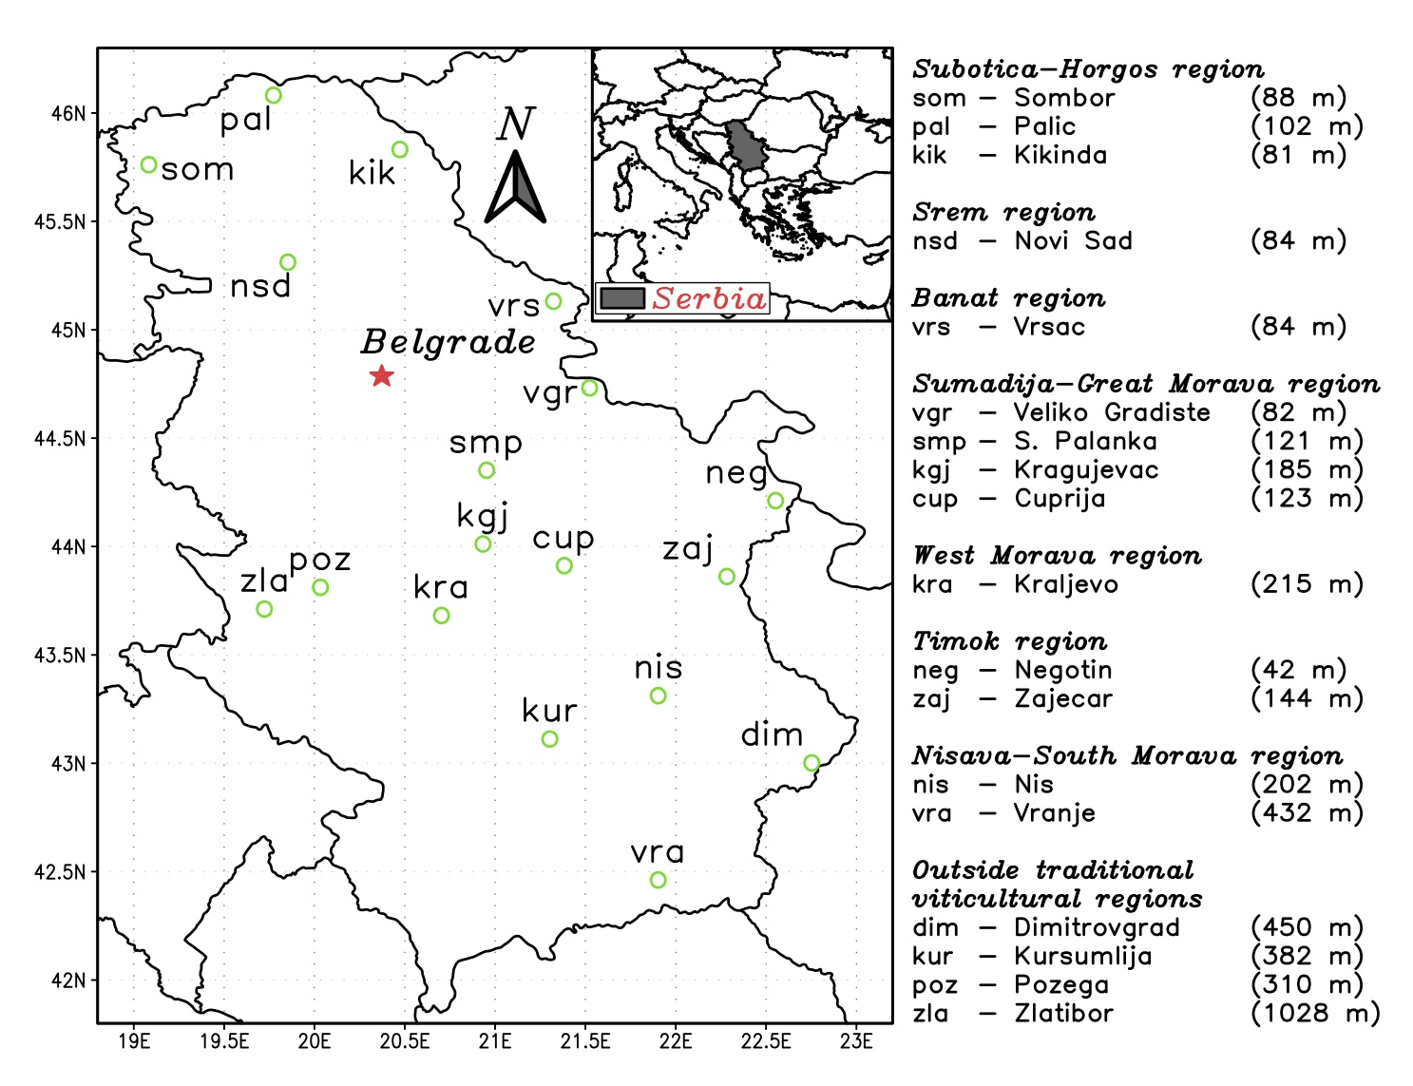
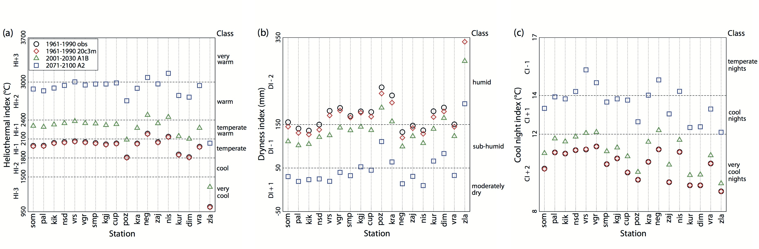
Research and Development
Climate Change (continued)
Impact on viticulture in Serbia – more can be found here:
Ruml M., Vukovic A., Vujadinovic M., Djurdjevic V., Rankovic-Vasic Z., Atanackovic Z., Sivcev B., Markovic N., Matijasevic S., Petrovic N., 2012, ”On the use of regional climate models: Implications of climate change for viticulture in Serbia”, Agricultural and Forest Meteorology, 158, 53-62
Operational Functions
Long range forecast
Monthly Forecast
Climate Monitoring
Dust Forecast
NCEP/NMMB Global Forecast
Research and Development
Earth Modeling System
Model Coupling
Hydrology modeling
Minerals in Soils
Case Studies
Climate Change
Future Plans
General conclusions:
warming and drying of Serbian vineyards
appropriate climate conditions for vine growing
shift to higher altitudes (~1000m altitude)
higher risk of spring frost,
extended growing season
early ripening, possible double ripening,
higher concentration of sugar due to extended
dry periods during growing season
disturbance in preparation for rest period

Slide 20
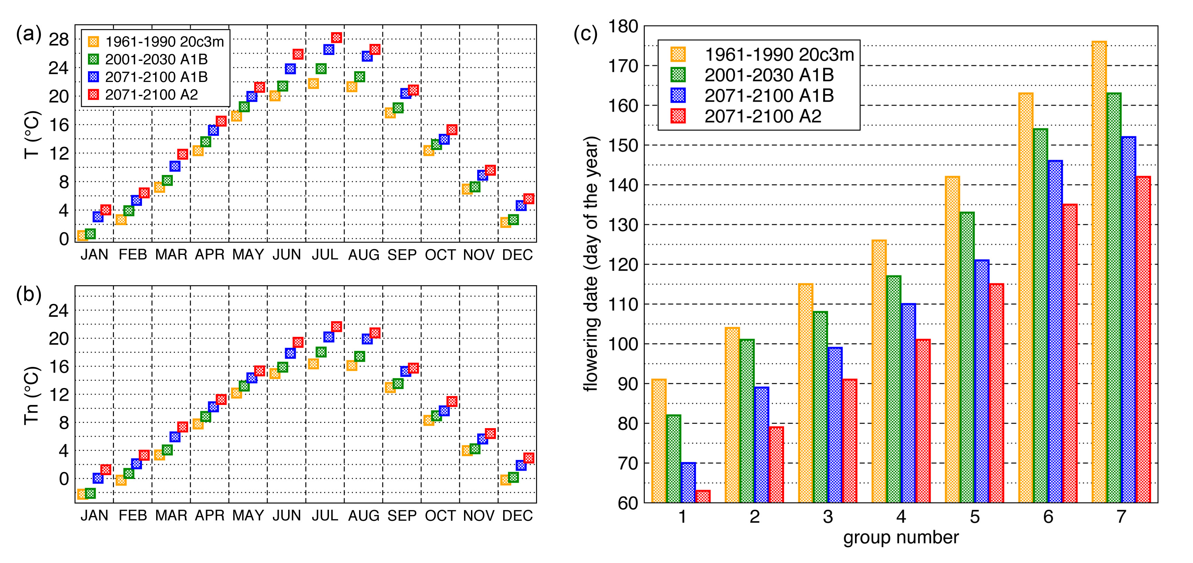
Research and Development
Climate Change (continued)
Impact on forestry in Serbia
Research is based on the flowering observations of about 100 woody taxa widely inhabited in Serbia.
Flowering in mainly driven by the minimum temperature:
Considerable shift in flowering date
High risk of spring frost
Advanced flowering – dispersion of allergenic pollen
Disturbance of the other phenophase stages
Disorders in generative propagations – affect survival of certain species
Stojicic, Dj., Vukovic., A., Vujadinovic, M., Djurdjevic, V., Obratov-Petkovic, D., 2012. The study of the climate change impact on woody taxa from Magnoliophyta group in the urban environment of Belgrade, Serbia. Submitted.
Operational Functions
Long range forecast
Monthly Forecast
Climate Monitoring
Dust Forecast
NCEP/NMMB Global Forecast
Research and Development
Earth Modeling System
Model Coupling
Hydrology modeling
Minerals in Soils
Case Studies
Climate Change
Future Plans

Slide 21
Future Plans
Switch to NCEP/NMMB as the main atmospheric model
Coupling of NCEP/NMMB with other Earth System components toward making of Earth Modeling System
Dynamical downscaling of ECMWF monthly forecast
Hindcast for LRF
Improvement of statistical downscaling of monthly and LRF
…..
Operational Functions
Long range forecast
Monthly Forecast
Climate Monitoring
Dust Forecast
NCEP/NMMB Global Forecast
Research and Development
Earth Modeling System
Model Coupling
Hydrology modeling
Minerals in Soils
Case Studies
Climate Change
Future Plans

Slide 22

www.hidmet.rs
www.seevccc.rs

