Slide 1
GLOBAL
SAND AND DUST STORMS
SOURCE BASE MAP
6 September 2019
COP14, New Delhi

Slide 2
TECHICAL INFORMATION
Work on Global Sand and Dust Storms Source Base Map is done under consultancy engagement with UNCCD.
Consultant:
Ana Vuković, Faculty of Agriculture, University of Belgrade, Serbia
anavuk@agrif.bg.ac.rs ; pazisadana@gmail.com
UNCCD coordinator of the work:
Utchang Kang, ukang@unccd.int
Acknowledgement: in this work to the consultant helped Bojan Cvetković (Faculty of Physics, University of Belgrade); work was supported with discussions during the 9th International Workshop on Sand/Dust storms and Associated Dustfall (Tenerife), UN Environment’s Sand and Dust Storms Technical Scoping Meeting, WMO, April 2019 (Geneva), Sand and Dust Storms Technical Workshops, WMO, October 2018, (Geneva)
Goal: to assess globally the capacity of soil surfaces to produce sand and dust storms in case of favorable wind conditions
More details will be available in the Report on the Development of Global Sand and Dust Storms Base Map.
UNCCD COP14, 6 September 2019, New Delhi

Slide 3
SDS SOURCES: DEFINITIONS
SDS source is bare topsoil surface susceptible to wind erosion or any surface capable to emit soil particles in favorable wind conditions.
Areas that include SDS sources have fine soil texture and bare or sparsely vegetated surfaces, which can experience not-frozen and low soil moisture conditions.
SDS source intensity is capacity of soil surface to emit soil particles under favorable wind conditions.
SDS source activity depends on frequency of high wind.
SDS sources may be distinguished according to their change in intensity:
permanent SDS sources
surfaces that have capacity to emit soil particles annually
dynamical SDS sources
surfaces that have capacity to emit soil particles seasonally or occasionally (during extreme events)
UNCCD COP14, 6 September 2019, New Delhi

Slide 4
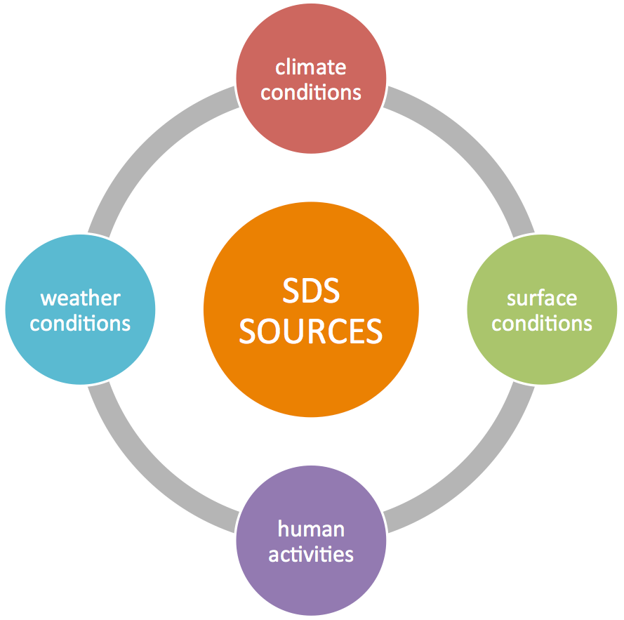
SDS SOURCES: DRIVERS
Drivers that impact SDS sources intensity and activity:
Climate conditions
aridity, seasonal weather,…
Weather conditions
extreme wind, drought, …
Surface conditions
Soil texture, soil moisture, temperature, land cover,…
Human activities
direct and indirect human impact
Drivers are in mutual interaction.
UNCCD COP14, 6 September 2019, New Delhi

Slide 5
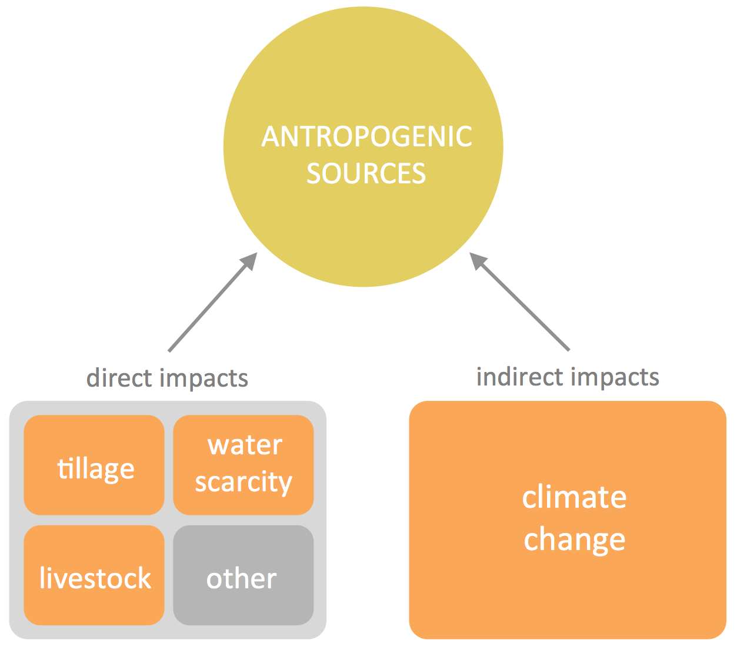
SDS SOURCES: ANTHROPOGENIC
When human activities are predominating driver for SDS sources intensity, these SDS productive areas can be called
anthropogenic sources.
Direct human impacts
land cover changes, disturbance of the topsoil and loss of soil structure (agriculture: tillage and livestock breeding),
use of water for irrigation, hygienic needs (especially for large urban areas) and industry,
other factors: deforestation, fires, mining, etc.
Indirect human impacts
climate change
UNCCD COP14, 6 September 2019, New Delhi

Slide 6
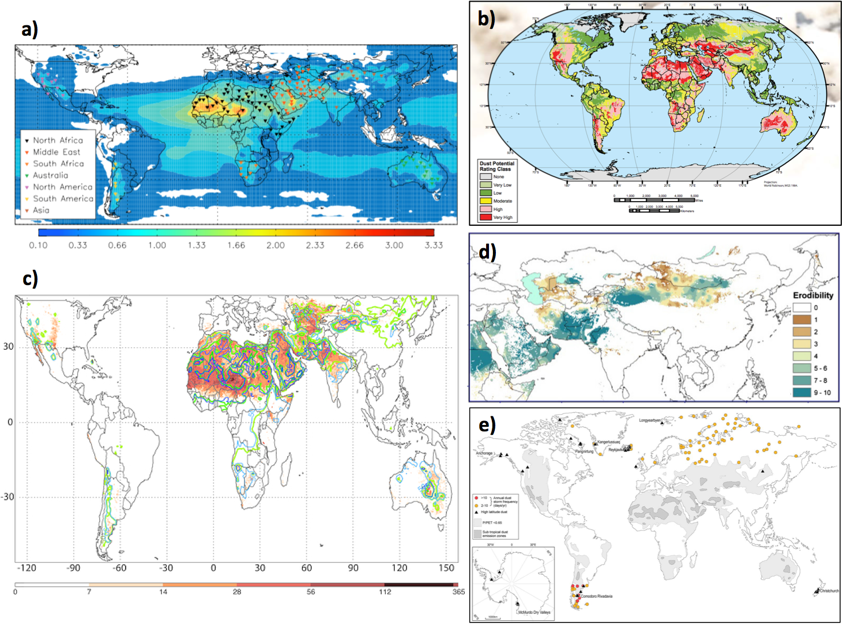
SDS SOURCES: STUDIES
131 hot spots and TOMS AI
(Engelstaedter and Washington 2007)
global dust potential map (DTF 2013)
potential dust sources (Shao et al. 2011)
global observations of
high-latitude dust
(Bullard et al. 2016)
annual mean frequency of DOD >0.2 and TOMS and OMI AI ≥0.5 (Ginoux et al. 2012)
UNCCD COP14, 6 September 2019, New Delhi

Slide 7
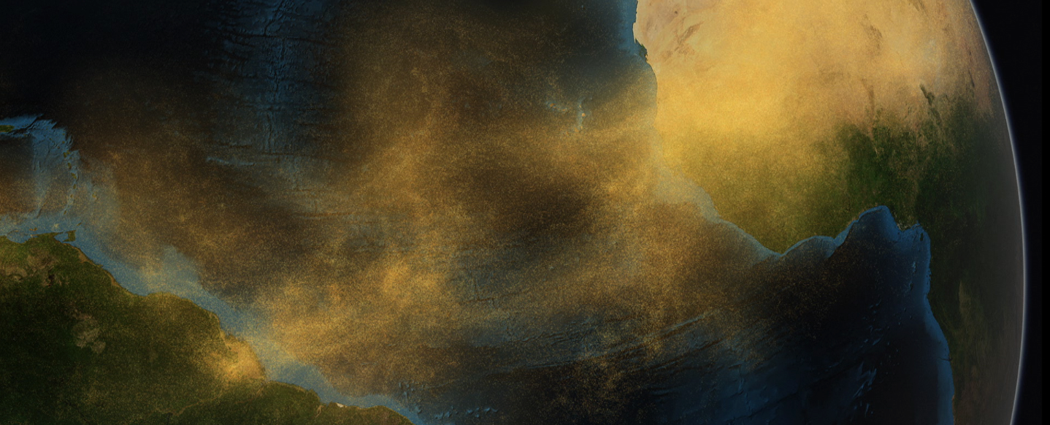
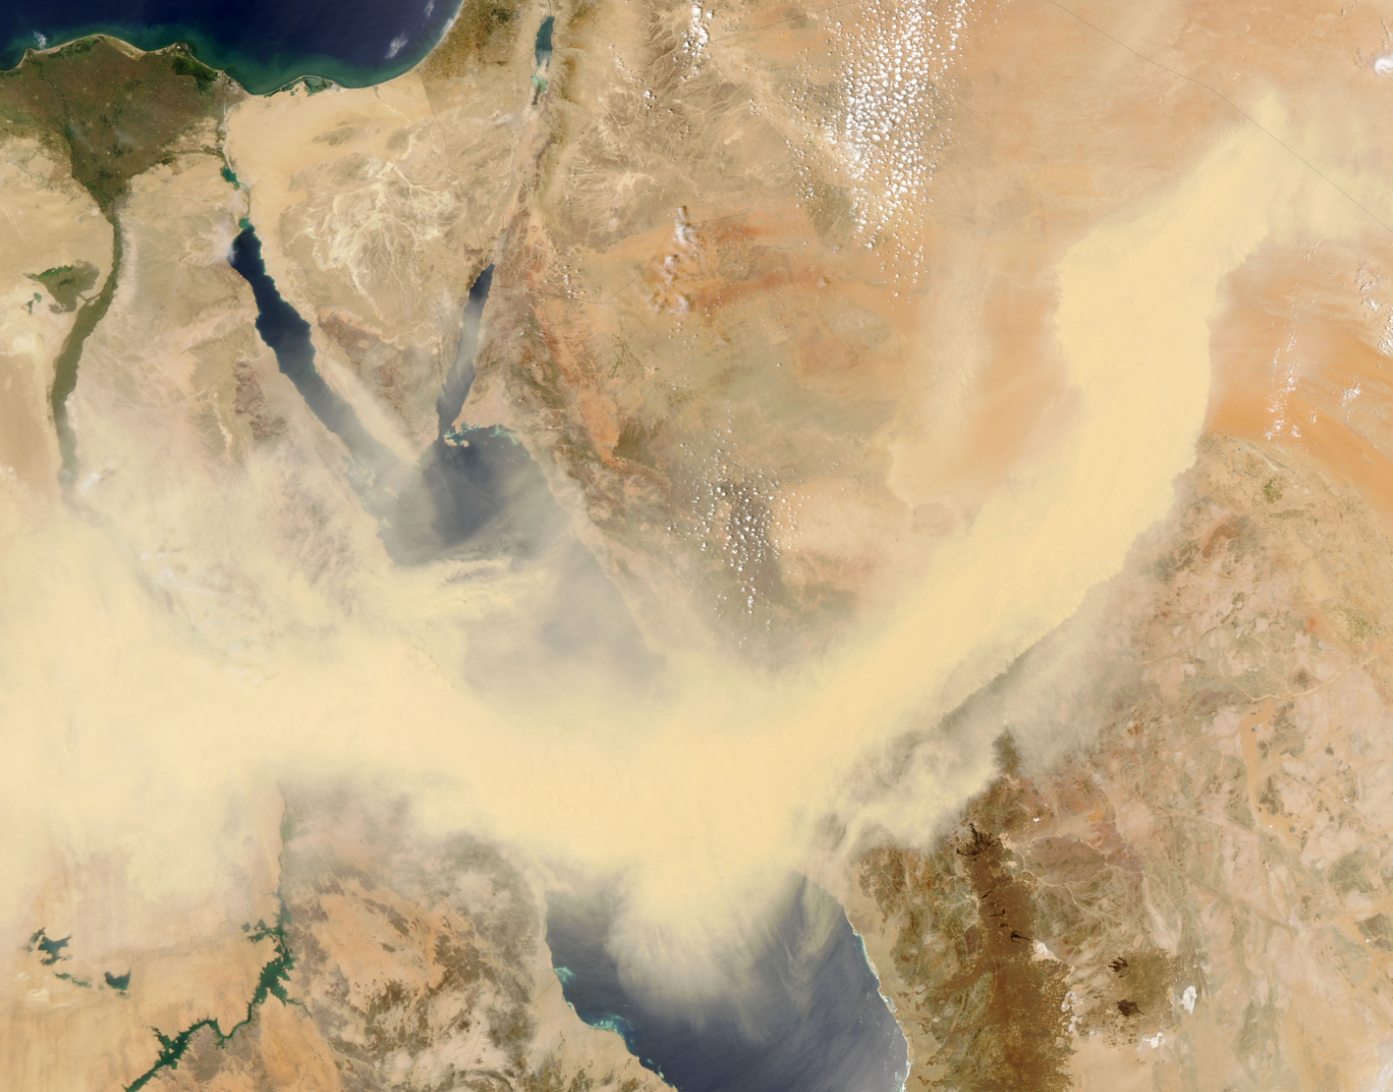
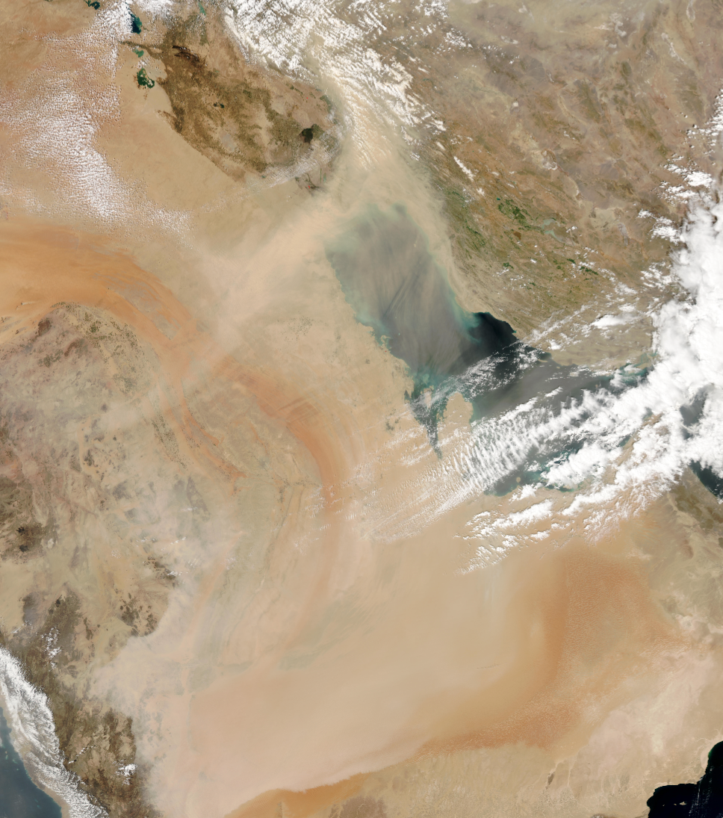
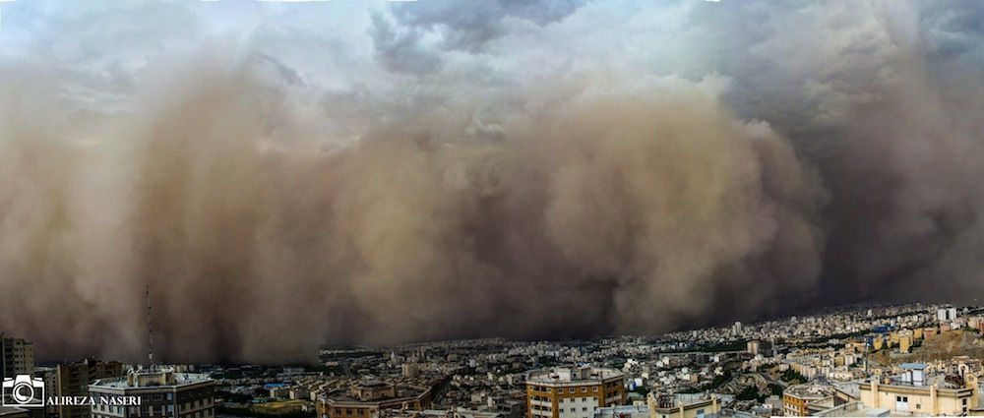
SDS SOURCES: SDS EVENTS
SDS sources contribute to wide range of spatial and temporal scales of SDS (or dust only) events and global dust cycle in general:
global – circle the globe and create global dust cycle which interacts with energy, water and carbon global cycles (cross continents and oceans)
regional – large scale, cross country boundaries and neighbor continents
local – relatively near SDS source
GLOBAL
REGIONAL
LOCAL
UNCCD COP14, 6 September 2019, New Delhi

Slide 8
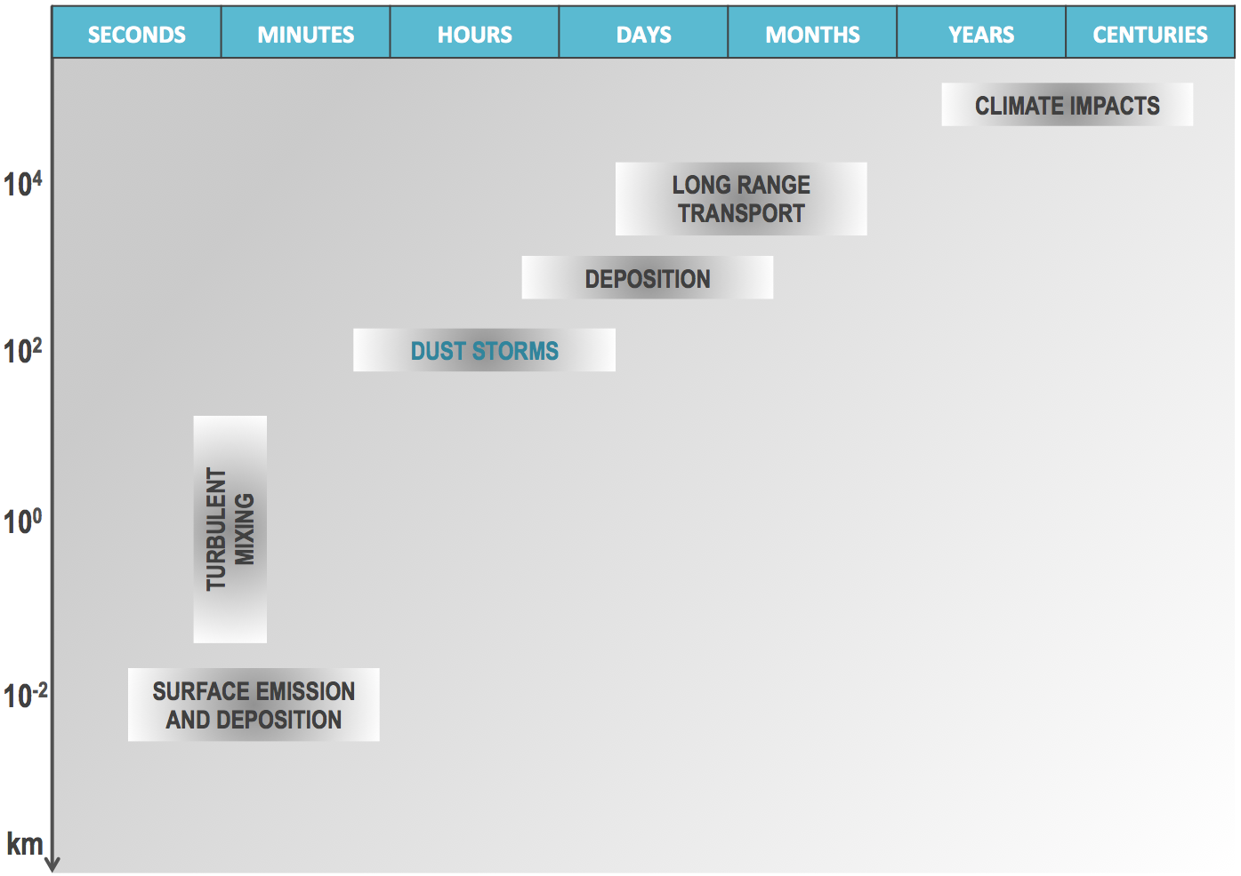
SDS SOURCES: SDS AND SDS SOURCES SCALES
regional
regional to global
local to regional
large spectrum of scalaes of
SDS productive areas
large spectrum of SDS and dust transport scales
UNCCD COP14, 6 September 2019, New Delhi

Slide 9
SDS SOURCES: MAPPING METHODOLOGIES
Methodologies for SDS source mapping can be distinguished in two groups:
 | Data | Advantages | Disadvantages
SDS source mapping from data on SDS occurrence | Observations of SDS (satellite and ground) | good representation (high confidence) of synoptic overview of major and frequently active SDS source areas (permanent and seasonal); recognize global and regional sources that dominate in SDS generation | spatial and temporal coverage of observations is not continuous; lower resolution than mapping resolutions of other soil related parameters; not able to recognize/delineate small scale and occasionally active SDS events; climatological approach (averaging of long term data) gives advantage to natural (permanent and seasonal) and/or larger scale SDS sources; underestimate SDS sources which are small scale and/or not frequently active.
SDS source mapping from data on surface conditions | Soil and surface data | contains data on soil characteristics and land use, can provide high resolution SDS source patterns, can detect/delineate small scale sources and distinguish SDS source hot spots, include surfaces with high potential for SDS generation in extreme weather conditions even if they have low activity. | require relatively complex combination of information from different sources of data; because of high spatial variability and not sufficient soil sampling, quality on soil information may be low which requires implementation of additional information; does not include information on frequency of SDS generation
UNCCD COP14, 6 September 2019, New Delhi

Slide 10
SDS SOURCES: MEANING OF RESULTS
Results obtained with different methodologies can have different meaning:
 | Meaning | Advantages | Disadvantages
SDS source mapping from data on SDS occurrence | Map represents frequency of SDS, assuming that areas with highest frequency are the strongest sources of SDS | Indirectly includes impact of high wind frequency | Does not include surface properties; placement of SDS sources may be biased (dislocated); low resolution
SDS source mapping from data on surface conditions | Map represents SDS sources intensity (capacity of soil surface to emit particles) in case of high wind occurrence | High resolution, gives location SDS sources with different intensity | Does not include high wind frequency, meaning that frequency of real activation of SDS sources is not included
Combined surface conditions and atmospheric data | Includes SDS sources intensity based on surface data and activity of sources based on real wind impacts on SDS sources with defined intensity | Gives high resolution information about SDS sources distribution including their intensity and activity | Global high resolution quality wind data, including local extreme high velocity episodes, does not exist; in climate changing world constant update is needed, because increased frequency of high wind velocity storms
!
UNCCD COP14, 6 September 2019, New Delhi

Slide 11
SDS SOURCES: CHOICE OF METHODOLOGY
Chosen methodology is SDS source mapping from data on surface conditions.
Why this choice of methodology?
Gives information about specific location of land surfaces that have capacity to emit soil particles in case of high wind conditions
Gives detail information on SDS sources intensity – distinguish soil surfaces with higher and lesser capacity to contribute to SDS formation
Can recognize local hot spots – surfaces with high resolution local maximums of SDS sources intensity
Why real wind data are of secondary importance for SDS source mapping?
High wind episodes will happen everywhere in world and if surface with some SDS source intensity exists – it will emit particles
Inclusion of wind impact may reduce importance of SDS source hot-spots
No global high resolution wind data (with wind gusts) exists
UNCCD COP14, 6 September 2019, New Delhi

Slide 12
SDS SOURCES: EXAMPLE
MAPS
SDS source mapping from data on SDS occurrence
LAND SURFACE
more frequent
high wind
hot-spot
sources
less frequent
high wind
SDS plumes
urban
SDS source mapping from data on surface conditions
UNCCD COP14, 6 September 2019, New Delhi

Slide 13
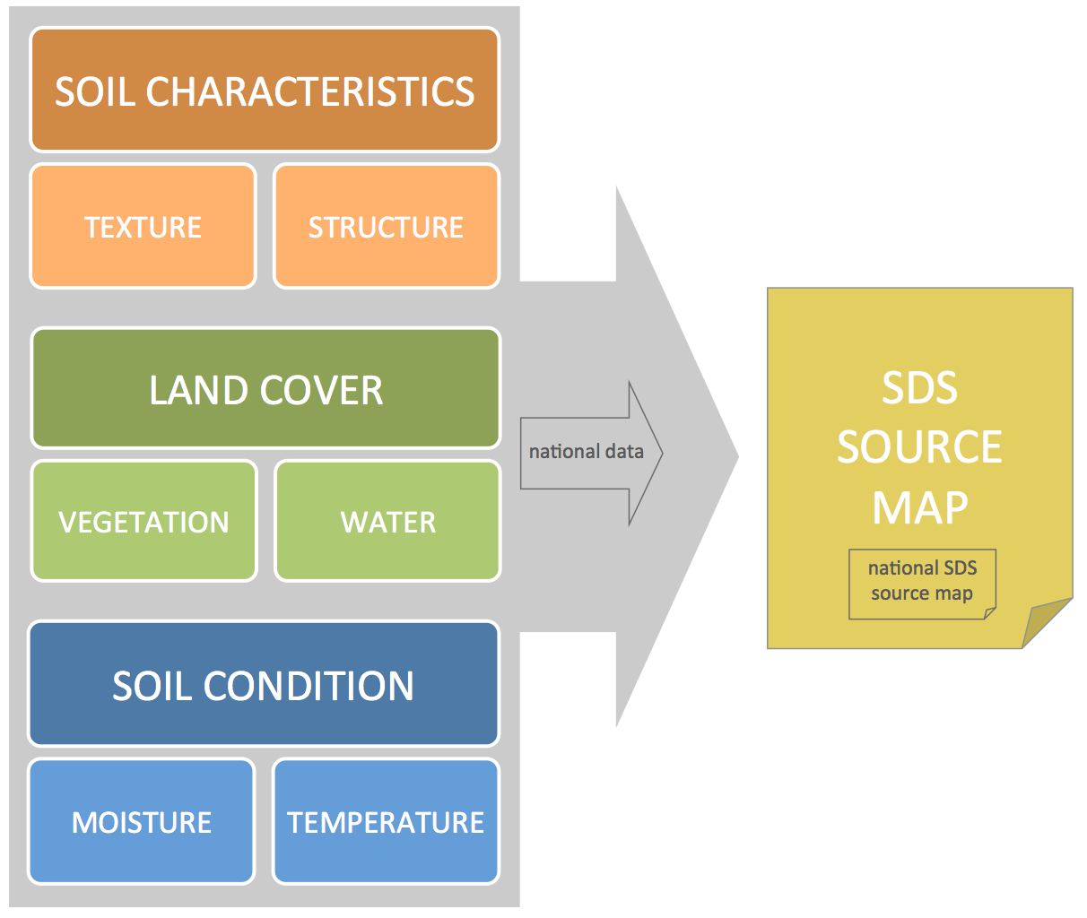
SDS SOURCES: CLUSTER OF DATA
Datasets for mapping:
soil characteristics
susceptibility of soil surface particles to wind erosion
(fixed soil properties, but can be variable under stress from direct human impact)
land cover
surface exposure to wind erosion
(fixed and variable land cover properties)
soil condition
moisture and temperature
(variable soil properties)
Implementation of better quality and more information from national data can improve resolution and accuracy of SDS source map and knowledge on their origin ➔ national SDS source map
UNCCD COP14, 6 September 2019, New Delhi

Slide 14
G-SDS-SBM: INTRODUCTION
Basic information:
Global sand and dust storms source base map (G-SDS-SBM) represents gridded (geo-referenced) information on the distribution, intensity and variability of sand and dust storms (SDS) sources developed from publically available global datasets.
The map shows maximum potential of the surfaces obtained from the data from the last 5 years (2014-2018) to produce SDS in case favorable wind conditions occur.
Values of the G-SDS-SBM are from 0 to 1 – SDS sources intensity, where 0 represents that surface has no potential (capacity) to produce SDS, and 1 represents highest SDS source intensity, meaning most productive SDS surfaces in case of high wind conditions.
Resolution of the map is 30 arcsec (about 1km at the Equator) in regular lat-lon grid, projection WGS84.
G-SDS-SBM is based on development of four monthly maps:
January, as a month with lowest temperatures and minimum vegetation for northern hemisphere and with opposite conditions on southern hemisphere;
April, as a month when vegetation starts to develop (beginning of the growing season) on the northern hemisphere and when vegetation cover decrease and vanish on southern hemisphere;
July, as a month with highest temperatures and developed vegetation for northern hemisphere and with opposite conditions on southern hemisphere;
October, as a month when seasonal vegetation decreases and vanishes on the northern hemisphere and when vegetation cover starts to develop on southern hemisphere.
UNCCD COP14, 6 September 2019, New Delhi

Slide 15
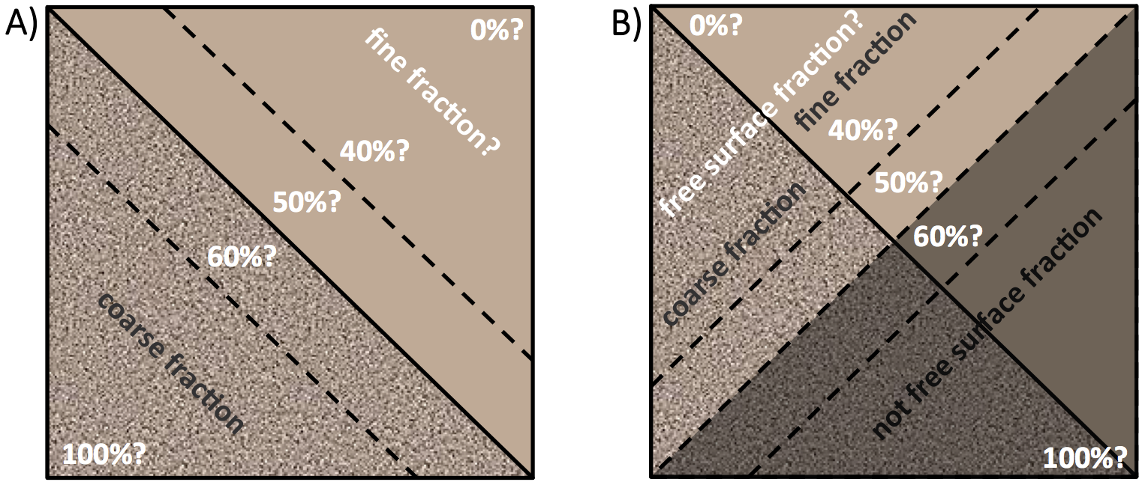
G-SDS-SBM: MAPPING AND MAJOR CONCERNS
Priority in detecting SDS sources
soil texture information
free surface % (without vegetation, snow/ice cover, water bodies and non frozen soil)
Challenge in soil texture information (picture A)
Soil texture data can be of low quality on global level, because not enough measurements or quality national data were not included in global datasets
Challenge in definition of free surfaces (picture B)
High variability of vegetation and snow cover, soil temperature and water bodies extent
Requires implementation of information on seasonal variability of free surfaces
Need to related percentage of free surface with satellite data!
UNCCD COP14, 6 September 2019, New Delhi

Slide 16
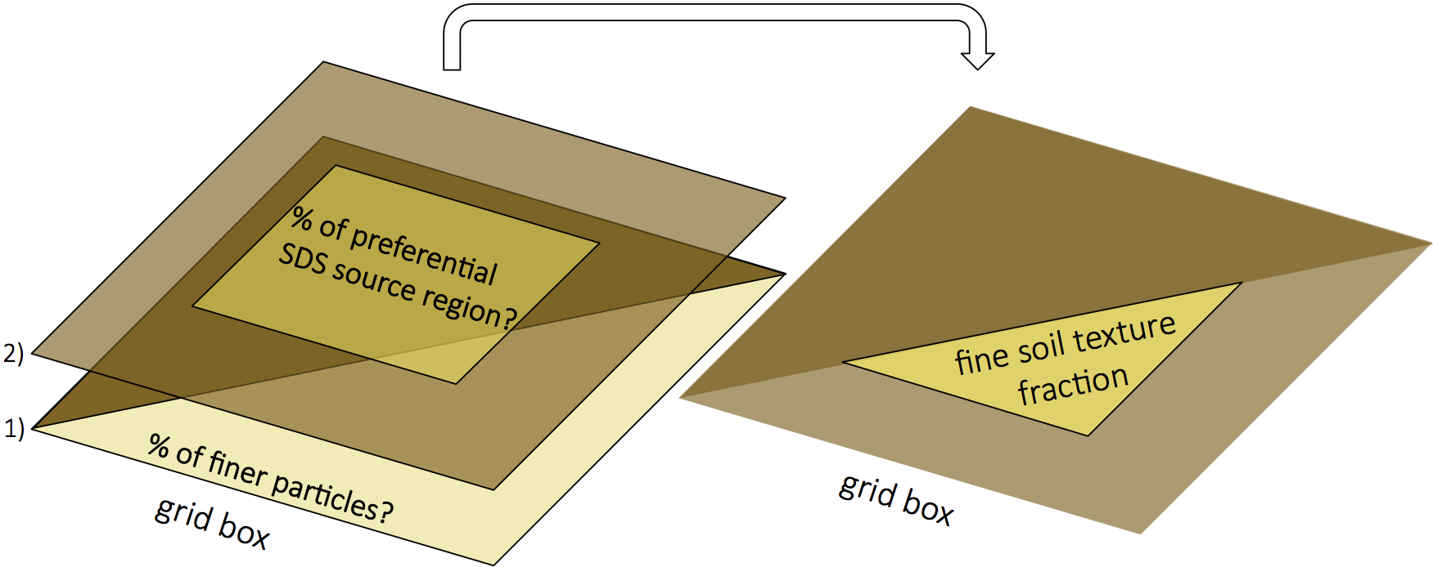
G-SDS-SBM: SOIL TEXTURE (1)
estimate from soil texture data amount of finer particles (layer 1);
increase fine texture content in areas with high probability for high alluvium content, and reduce in areas with low probability (layer 2)
topsoil fraction of soil texture that is susceptible to wind erosion
soil texture correction factor
UNCCD COP14, 6 September 2019, New Delhi

Slide 17
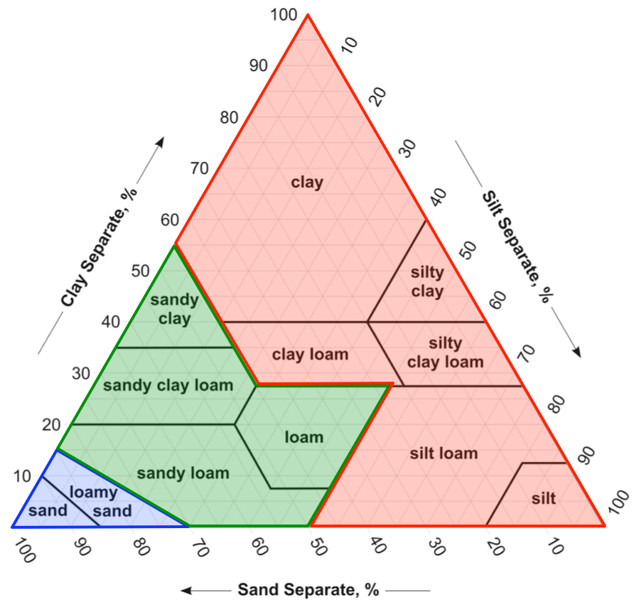
G-SDS-SBM: SOIL TEXTURE (2)
VAERAGE of two databases for soil texture were used:
ISRIC (International Soil Reference and Information Centre) World soil Information database that provides SoilGrids (soil global gridded information), at 30 arcsec resolution provides global sets for mass fraction of clay, silt and sand (%)
STATSGO-FAO (Natural Resources Conservation Service US General Soil Map – Food and Agriculture Organization) database of USDA soil texture types; combination of US 30arcsec and for the rest of the world FAO 2 arcmin USDA soil database that is usually used in numerical modeling of weather and climate.
NOTE: USDA soil texture types in STATSGO-FAO are translated to fraction of clay, silt and sand in %, using ISRIC database and changing by minimum percent of soil texture fraction to correspond to USDA soil texture type in STATSGO-FAO map in case the criteria is not already met.
UNCCD COP14, 6 September 2019, New Delhi

Slide 18
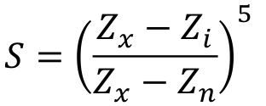
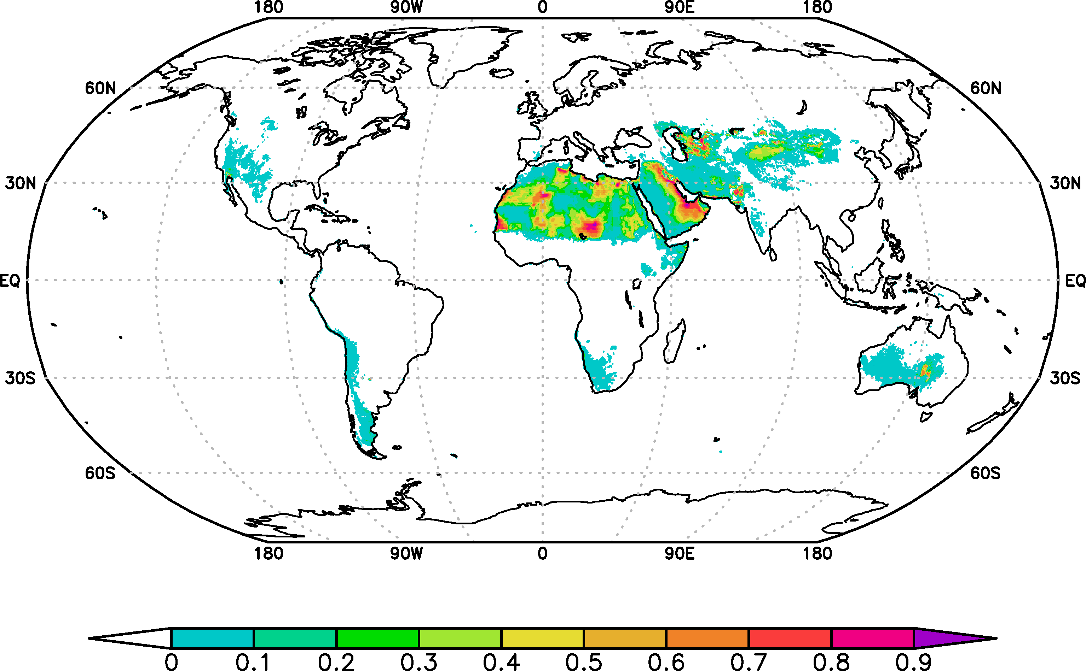
G-SDS-SBM: SOIL TEXTURE (3)
S-function according to Ginoux et al. (2001)
Z_{x} is maximum value in the box
Z_{n} is minimum value in the box
Z_{i} is value in ×
S has values from 0 to 1, and higher values distinguish topographical pits (have high probability to contain alluvium)
BOX
S-function (Ginoux et al. 2001) masked with low annual precipitation threshold - proved to correspond well with satellite data
Original S-function in Ginoux et al. (2001) is derived on 1° resolution, with box size of 10°x10° for calculation of S-function.
×
grid point
UNCCD COP14, 6 September 2019, New Delhi

Slide 19
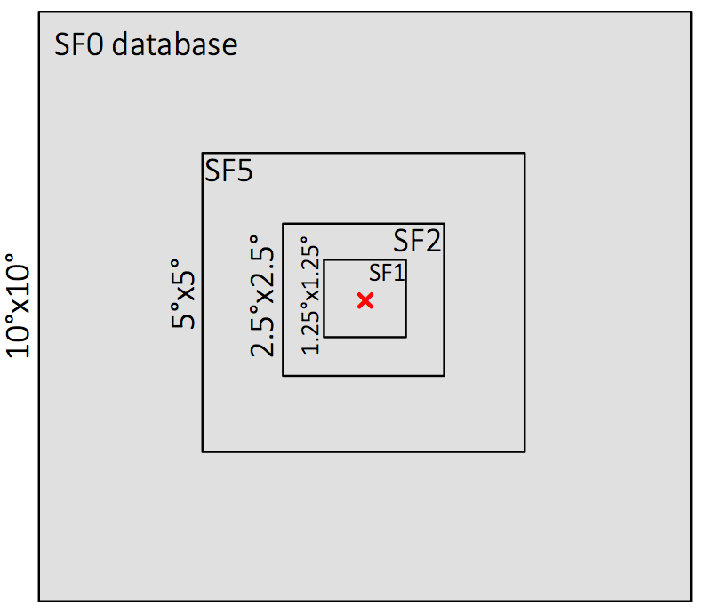
G-SDS-SBM: SOIL TEXTURE (4)
Development of soil texture correction factor according to Ginoux et al. (2001)
On global level ensemble of four S-function datasets are calculated on 1/120° (30 arcsec) resolution:
SF0 (box = 10°x10°)
SF5 (box = 5°x5°)
SF2 (box = 2.5°x2.5°)
SF1 (box = 1.25°x1.25°)
Results from different box sizes (large to small) can recognize different scales of topographical lows (large to small).
Average of 4 values is used as final S-function value, which is used for definition of correction factor: SF = (SF0+SF5+SF2+SF1) / 4
UNCCD COP14, 6 September 2019, New Delhi

Slide 20
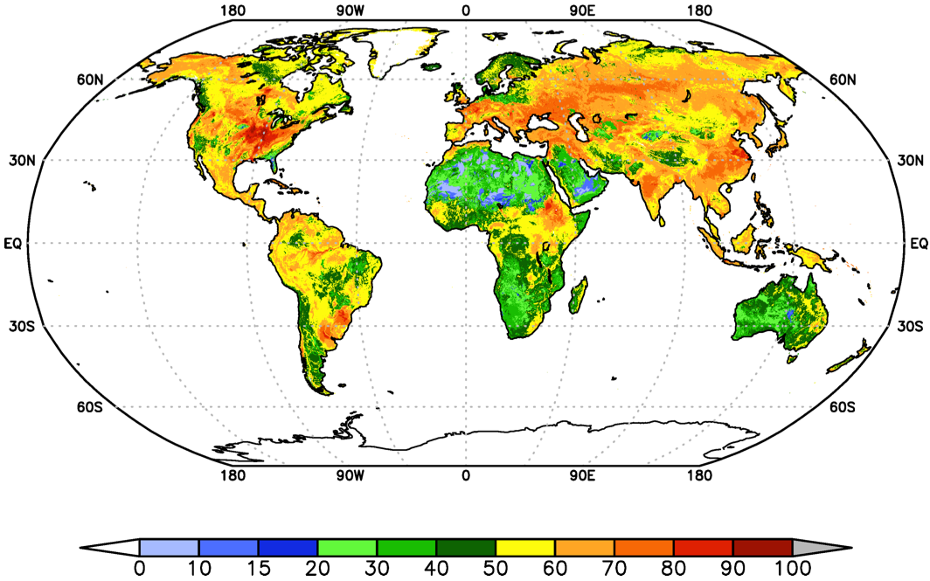
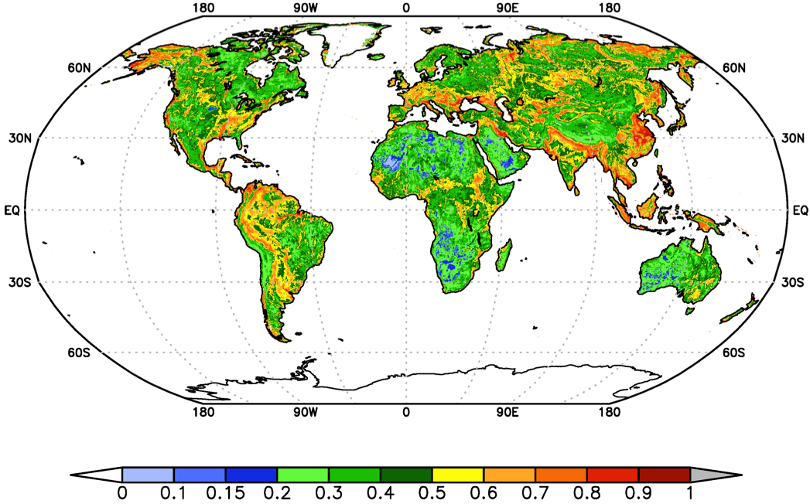
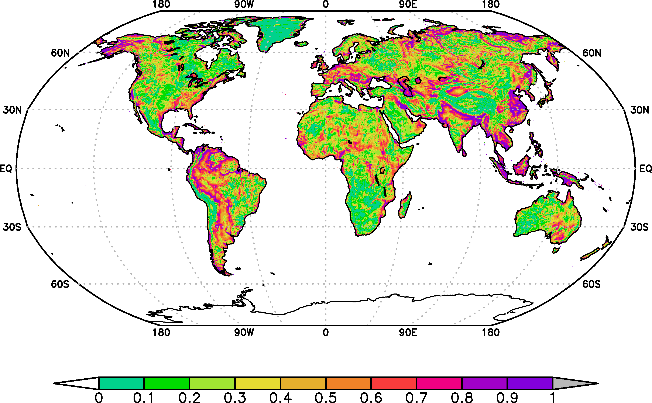
G-SDS-SBM: SOIL TEXTURE (5)
soil texture (clay+silt)%
final soil texture (clay+silt)%
after soil texture correction function is applied
SF = average S-function
UNCCD COP14, 6 September 2019, New Delhi

Slide 21
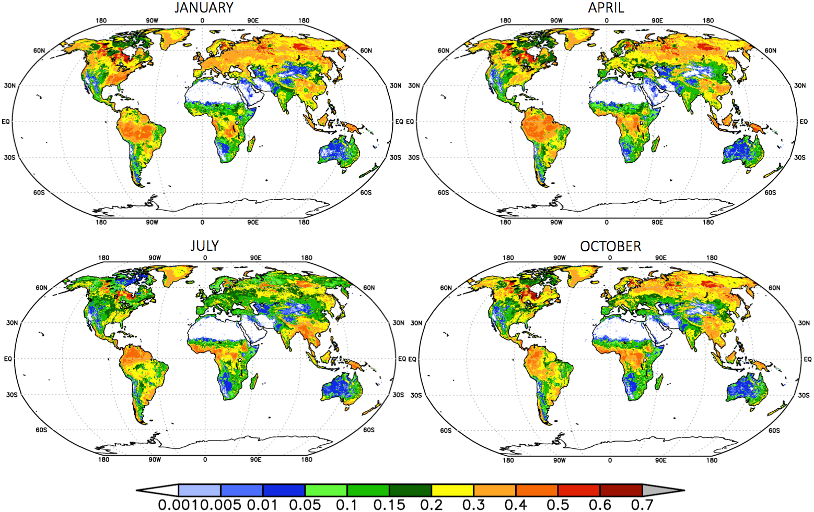
G-SDS-SBM: SOIL MOISTURE
ECMWF analysis on 0.25° resolution, for each day for 00 and 12 UTC for January, April, July and October for the period 2014-2018 for the top soil layer.
For each month from this 5-years period is derived minimum value.
Using minimum soil moisture content instead of average can represent maximum possible dryness for each grid point that may happen in present and probably near future climate.
UNCCD COP14, 6 September 2019, New Delhi

Slide 22
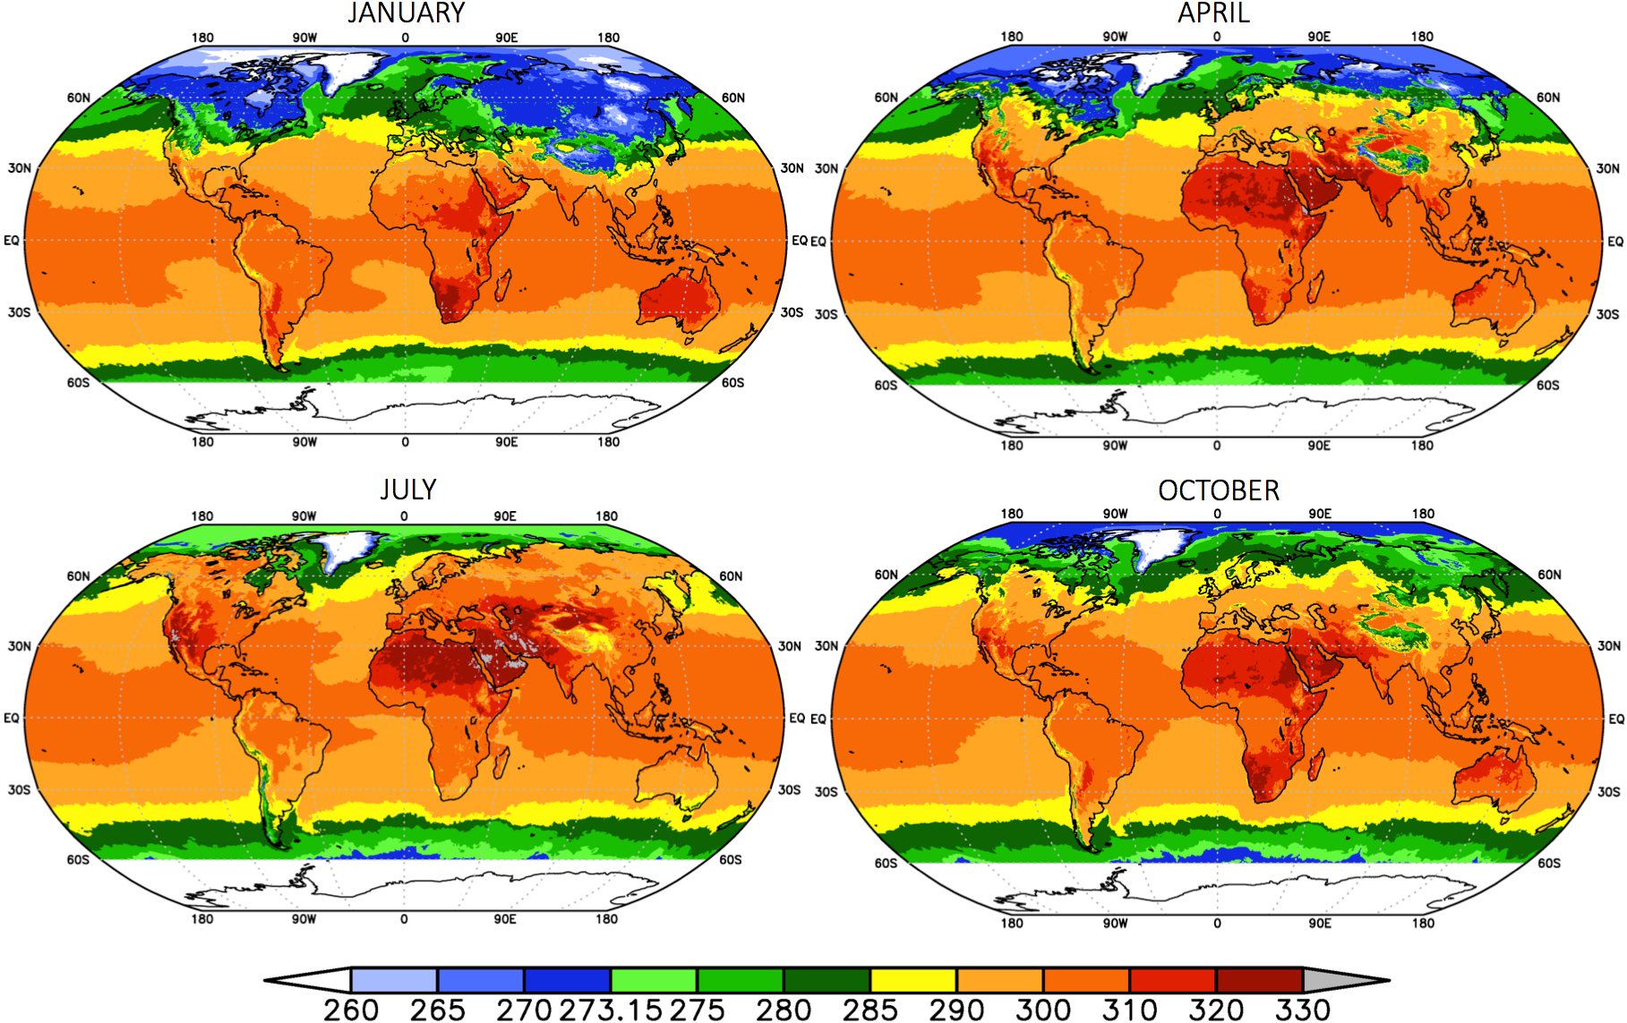
G-SDS-SBM: SOIL TEMPERATURE
ECMWF analysis on 0.25° resolution, for each day for 00 and 12 UTC for January, April, July and October for the period 2014-2018 for the top soil layer.
For each month from this 5-years period is derived maximum value.
Using maximum soil temperature instead of average can represent maximum possible not-frozen conditions for each grid point that may happen in present and probably near future climate.
UNCCD COP14, 6 September 2019, New Delhi

Slide 23
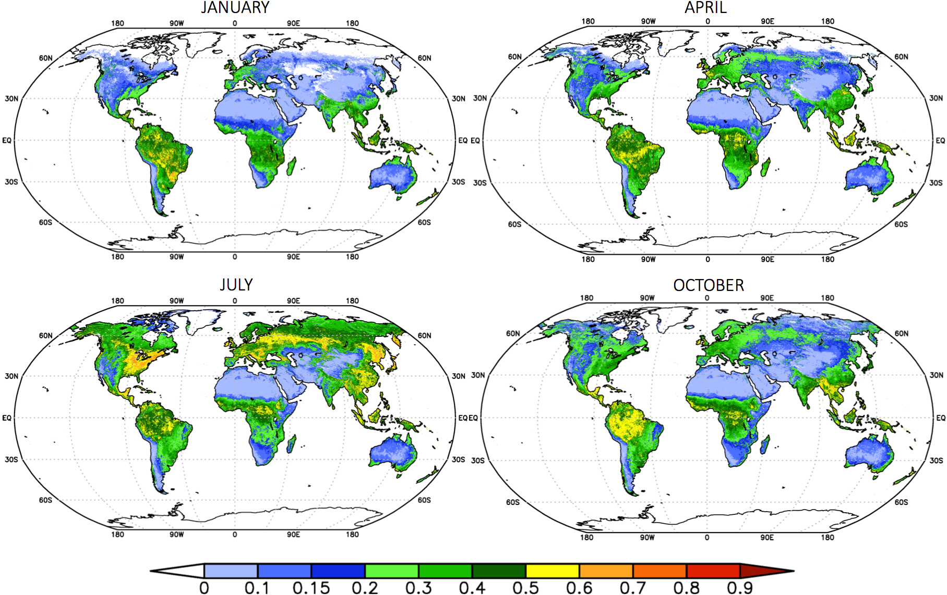
G-SDS-SBM: BARE LAND FRACTION (1)
MODIS EVI data are derived for months January, April, July and October for every year in the period 2014-2018.
Data are from MOD13A3 dataset on 1km resolution.
For each month from this 5-years period is derived minimum positive value.
Bare land fraction is defined from EVI_{min} for each month.
Using minimum positive value instead of average can represent maximum possible bale land fraction for each grid point that may happen in present and probably near future climate.
UNCCD COP14, 6 September 2019, New Delhi

Slide 24
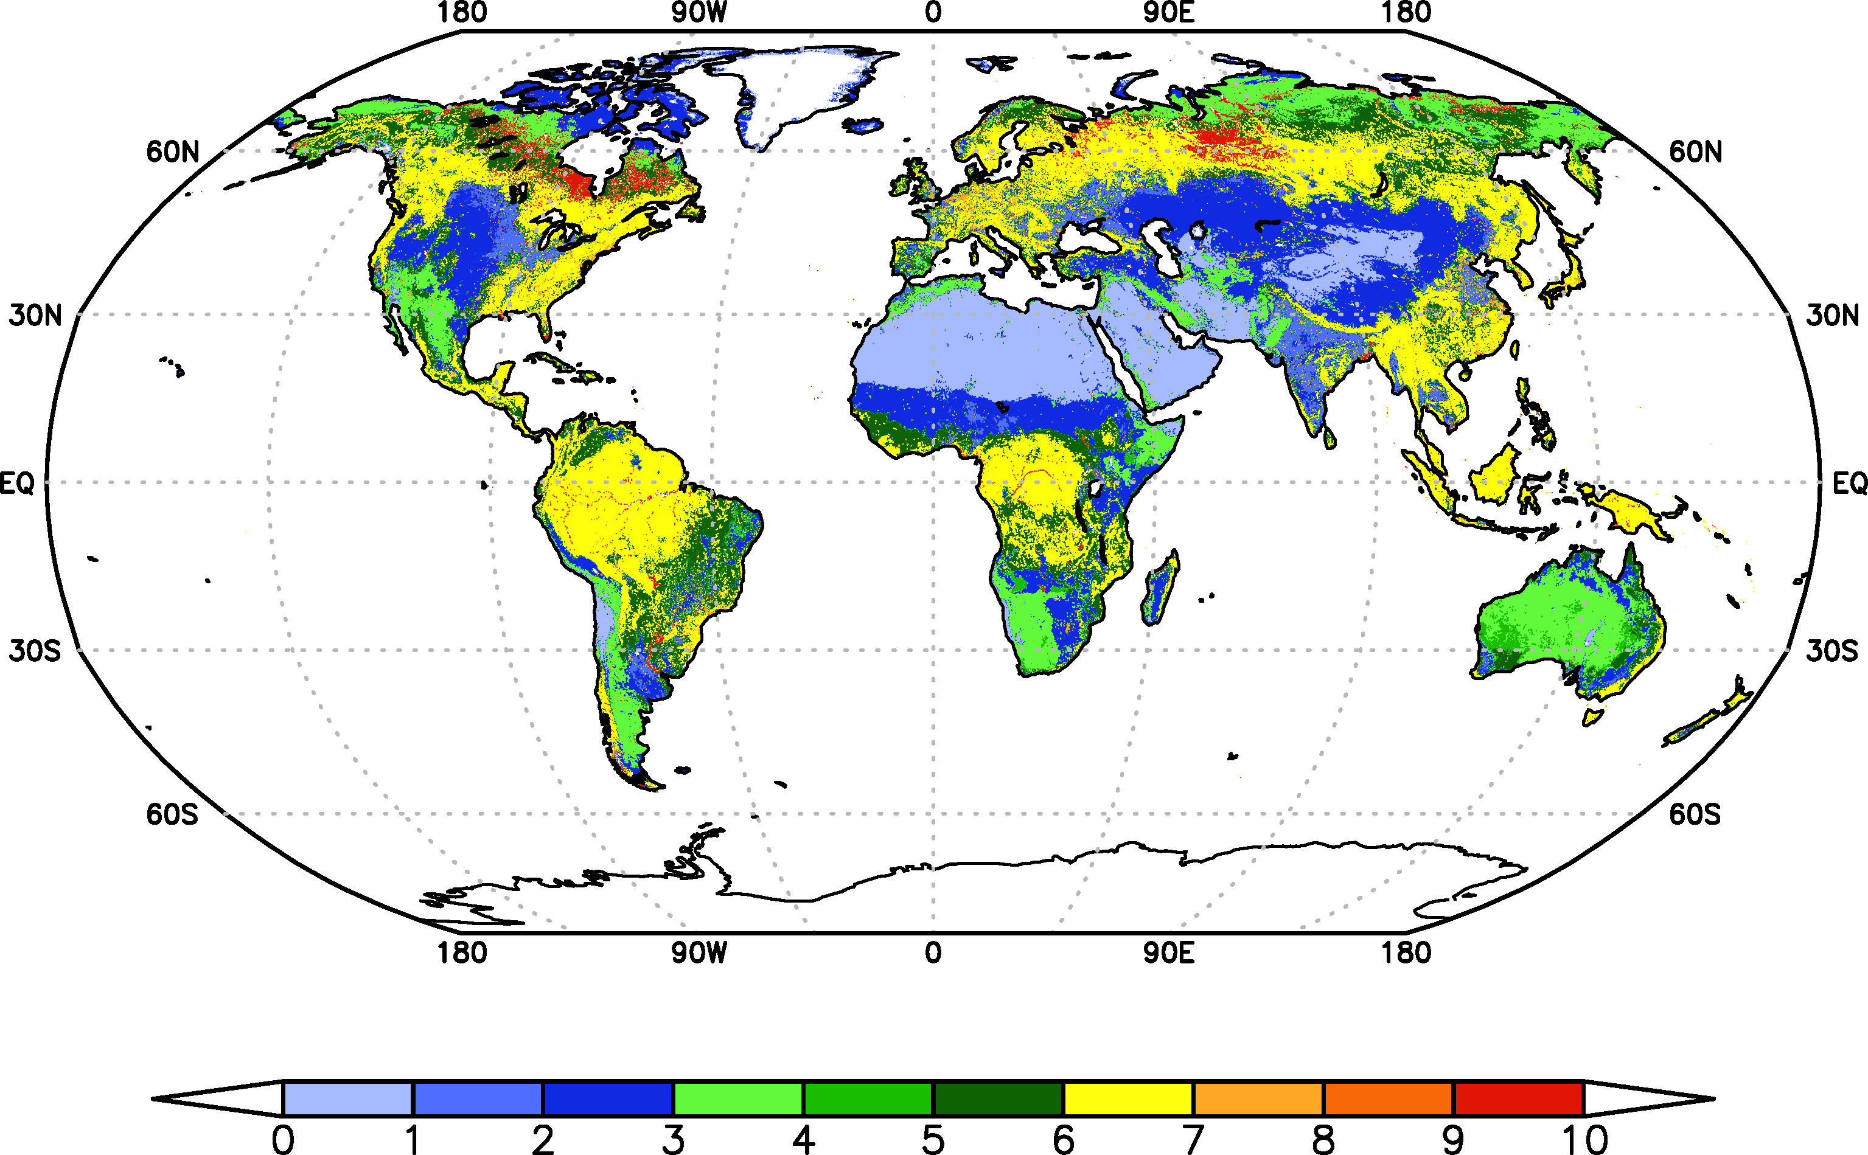
G-SDS-SBM: BARE LAND FRACTION (2)
MODIS land cover data product MCD12Q1 Version 6, variable LC-Type1 – IGBP classification
Annual dataset on 1km resolution; not yet available until 2018; used data for 2012-2016
Used for recognition of type of sources and to support EVI parameterization of bare land fraction
MODIS land cover types, simplified map obtained from data 2012-2016:
1) barren or sparsely vegetated, 2) cropland and cropland / natural vegetation mosaic,
3) grasslands, 4) open shrublands, 5) closed shrublands, 6) woody savannas and savannas,
7) forests, 8) urban and built-up, 9) water, 10) permanent wetlands.
Land cover types 1) - 4) can be SDS productive.
UNCCD COP14, 6 September 2019, New Delhi

Slide 25
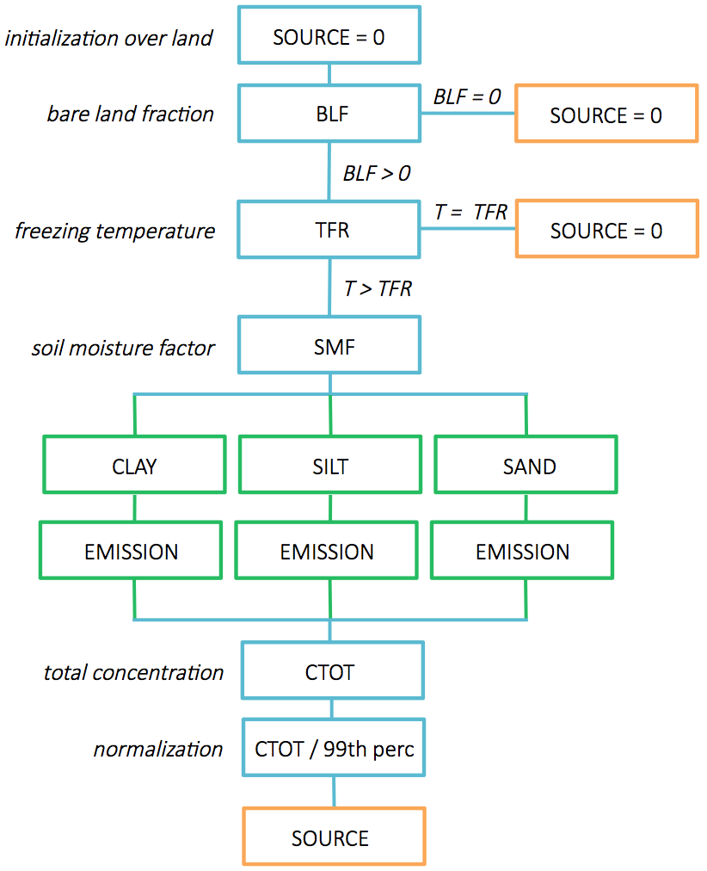
G-SDS-SBM: ALGORITHM
definition of bare land fraction
definition of soil freezing temperature depending on the soil moisture
definition of soil moisture factor for emission reduction outside arid and semi-arid areas
for each grid point and for each month
assumption: strong wind that can produce SDS can happen everywhere: run emission scheme for each particle size category under assumption that friction velocity is 1m/s, including impact of soil moisture depending on the clay content (Fecan et al. 1999)
calculate total emitted concentration (clay+silt+sand)
calculate 99th percentile of all values and scale with it
(for results above 1 is assigned value 1)
final result: SOURCE = SDS source intensity
UNCCD COP14, 6 September 2019, New Delhi

Slide 26
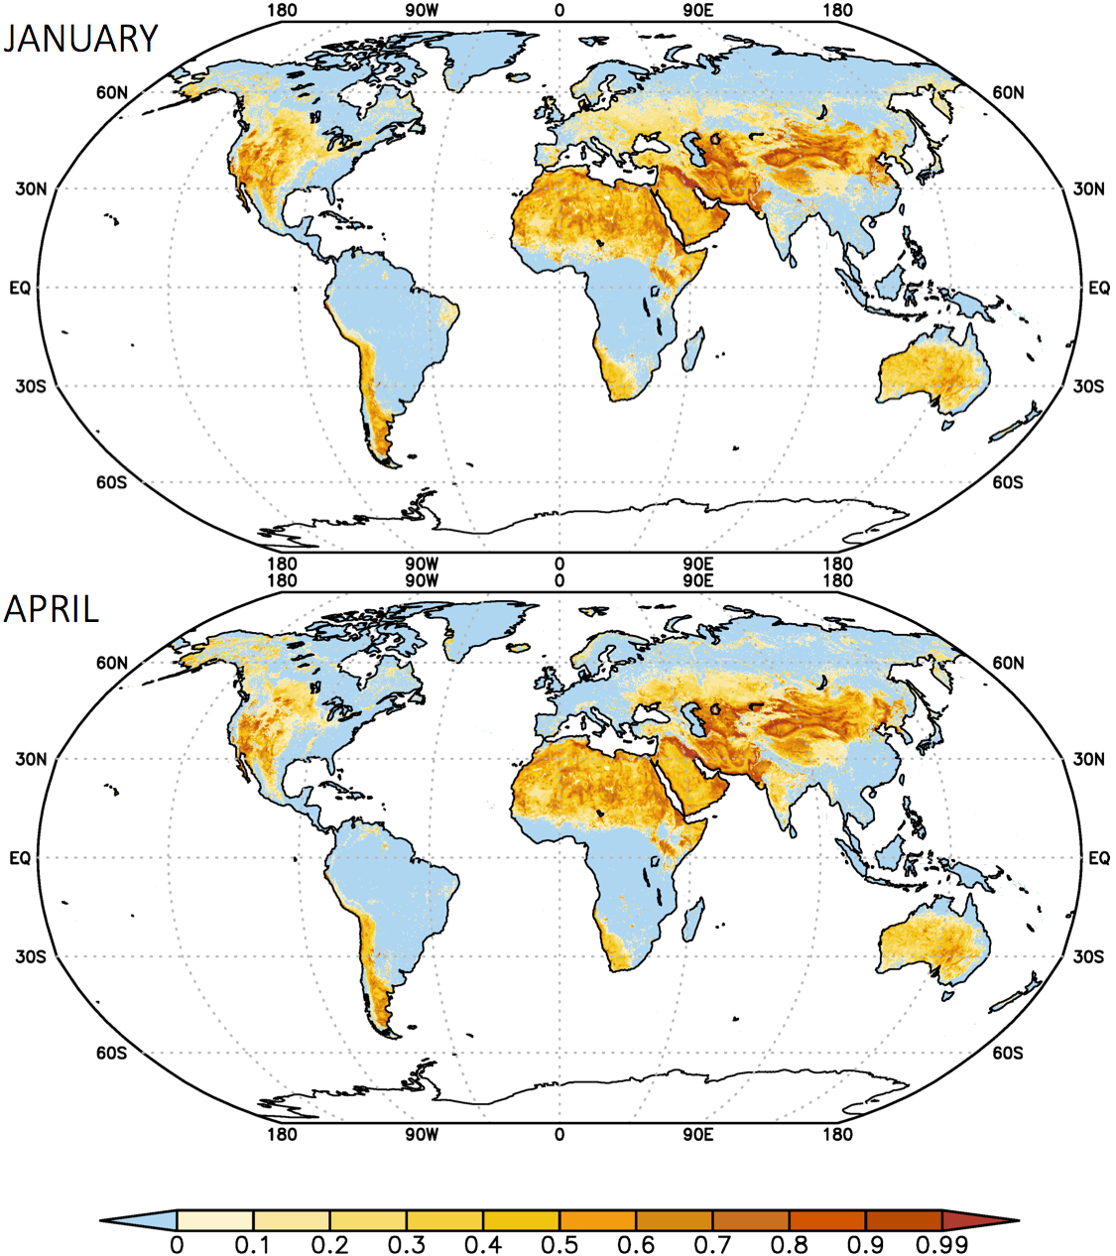
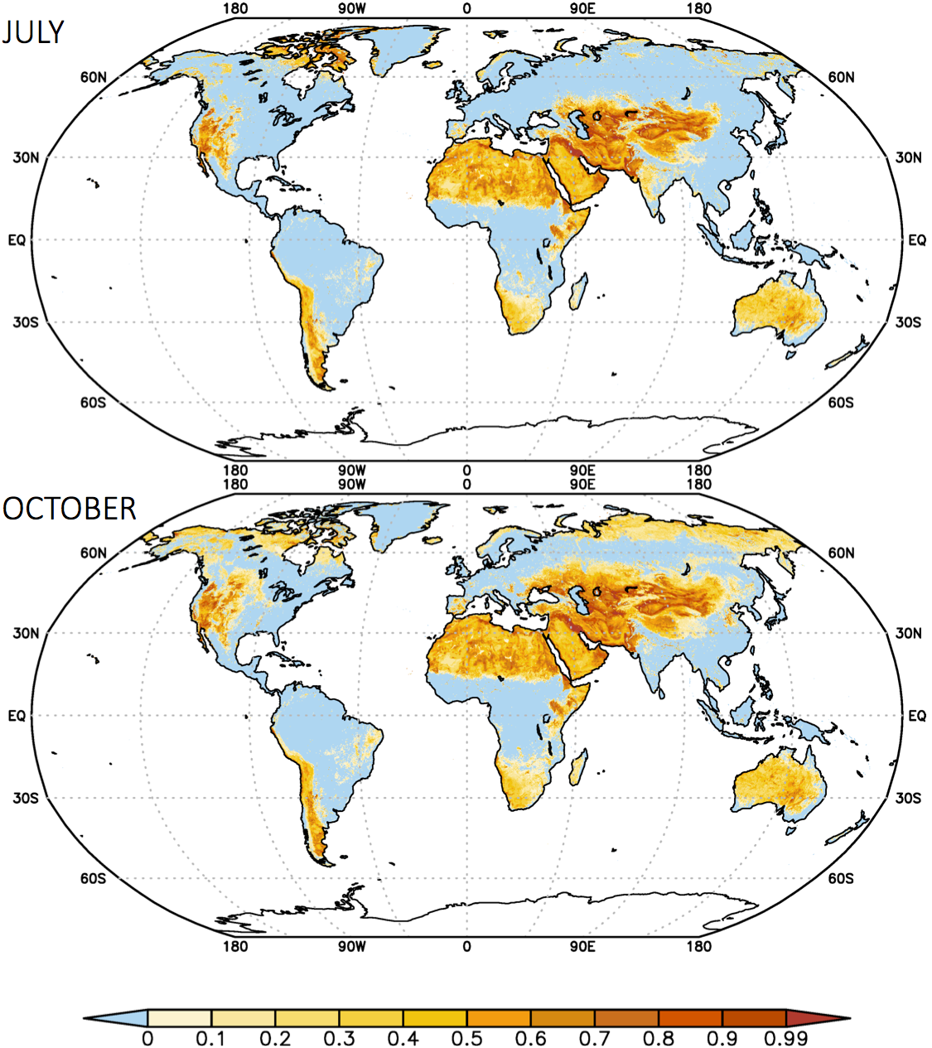
G-SDS-SBM: MONTHLY
These are basic results of SDS source mapping,
other maps are derived from these data.
UNCCD COP14, 6 September 2019, New Delhi

Slide 27
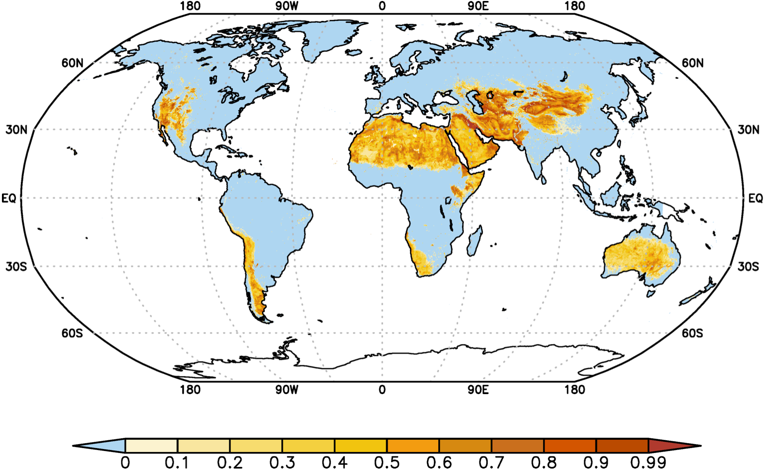
G-SDS-SBM: ANNUAL
Annual average global SDS source base map for permanent SDS sources.
UNCCD COP14, 6 September 2019, New Delhi

Slide 28
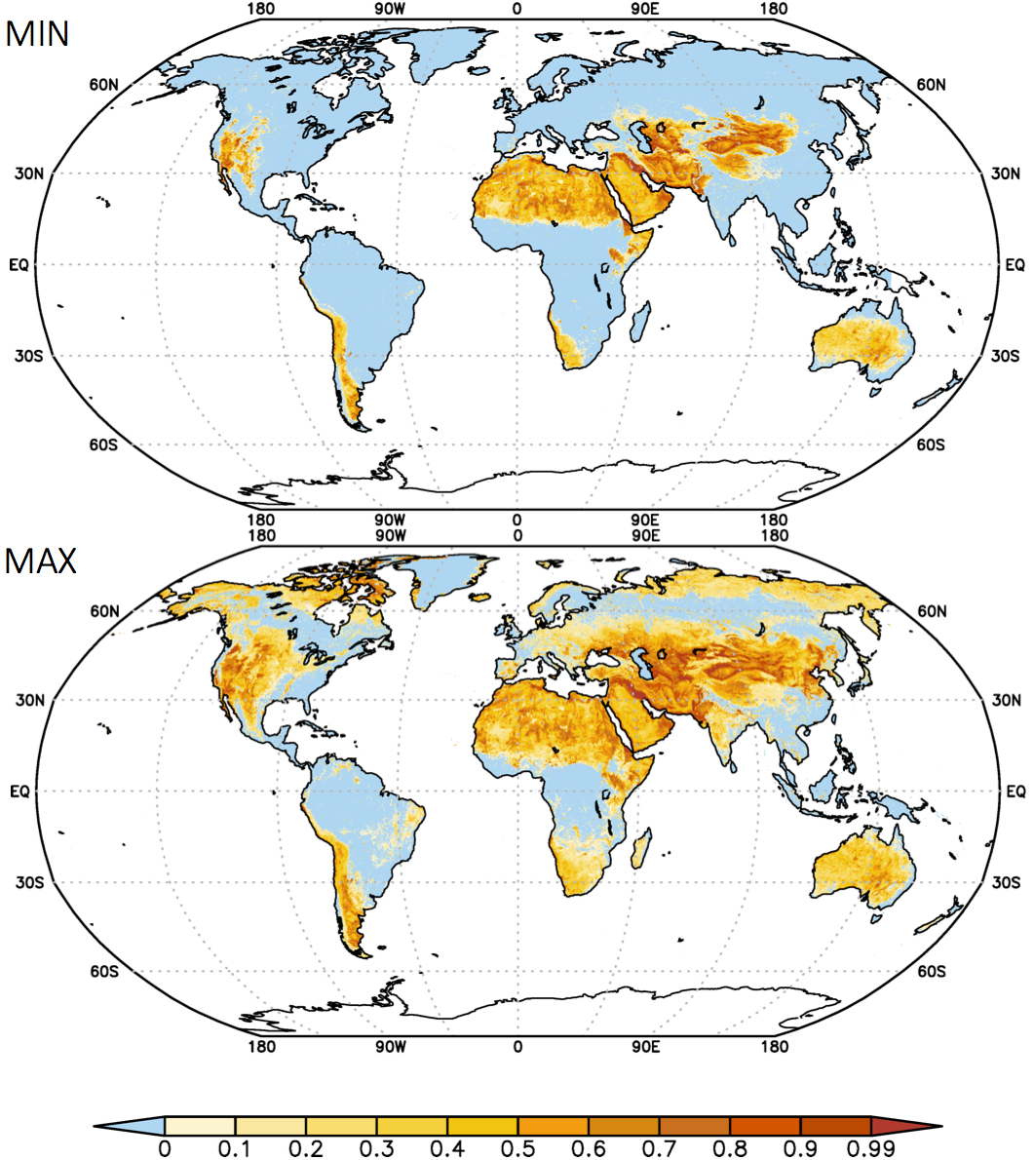
G-SDS-SBM: MAXIMUM AND MINIMUM
Minimum and maximum values for SDS sources intensity derived from monthly data.
Show variability of SDS sources intensity related to change of weather conditions and, consequently, change of bare land fraction.
UNCCD COP14, 6 September 2019, New Delhi

Slide 29
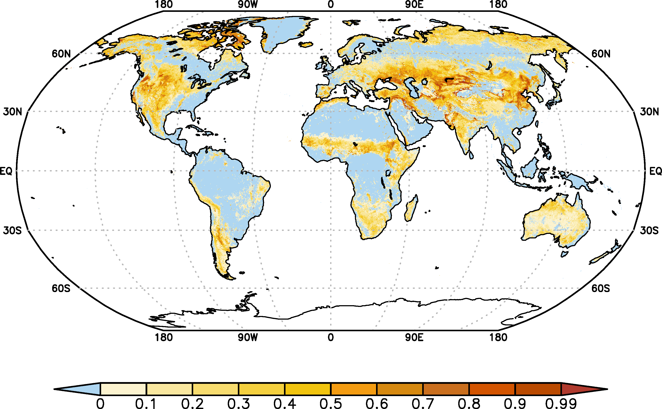
G-SDS-SBM: DYNAMICAL SOURCES
Difference of maximum and minimum SDS source intensity values
shows dynamical sources (seasonal and occasional) – change intensity during the year.
UNCCD COP14, 6 September 2019, New Delhi

Slide 30
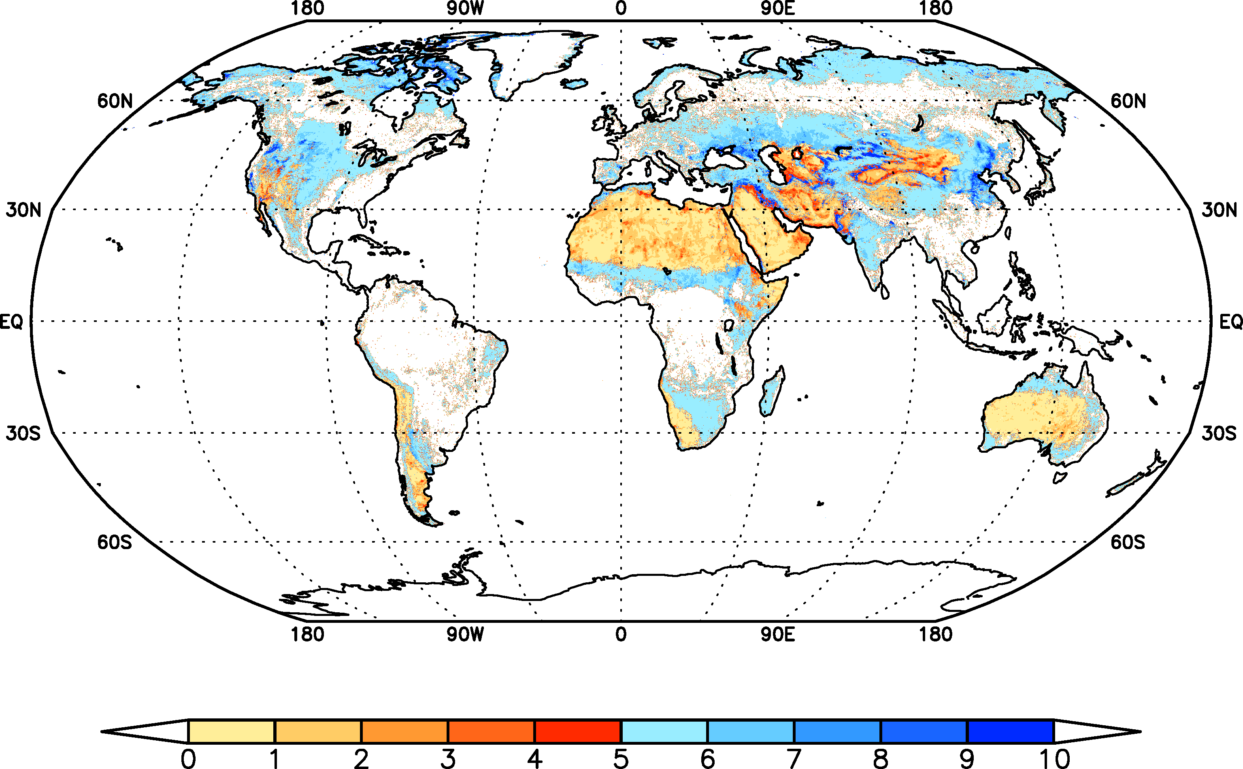
G-SDS-SBM: OVERVIEW
Distinguished permanent and dynamical sources,
with focus on sources with higher SDS source intensity (higher than 0.5).
higher intensity
DYNAMICAL
higher intensity
UNCCD COP14, 6 September 2019, New Delhi
PERMANENT

Slide 31
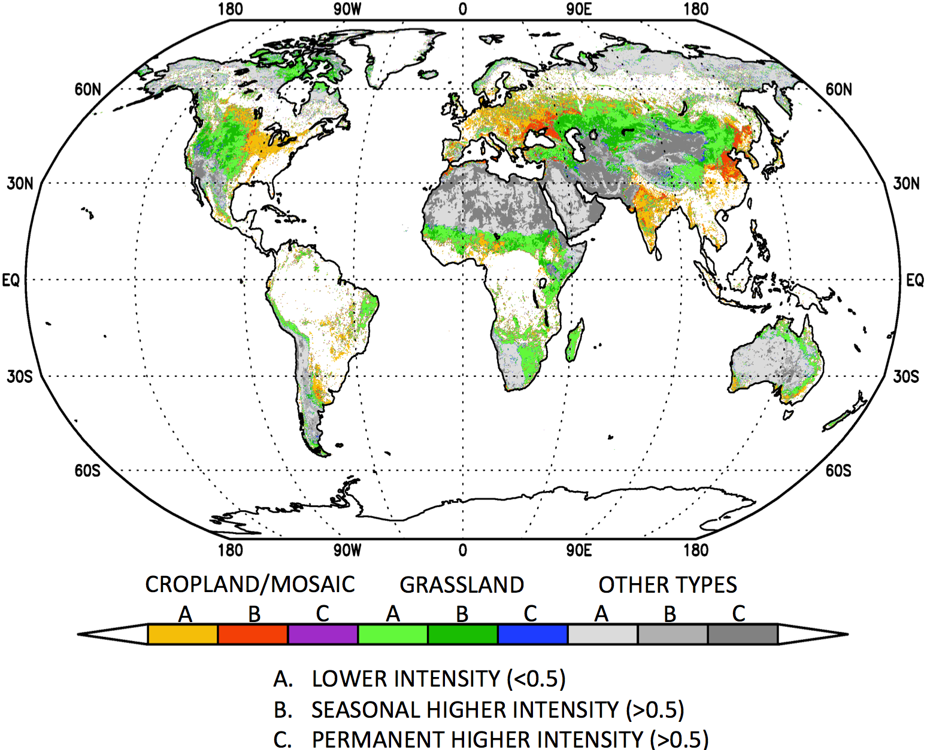
G-SDS-SBM: SIMPLE
SIMPLE map:
simple representation od SDS sources intensity (divided in 2 types: lower and higher intensity)
distinguish permanent and dynamical SDS sources
show type of sources (cropland, grassland and other barren of sparsely vegetated surfaces)
First guess where degradation is possible because of negative human impacts
UNCCD COP14, 6 September 2019, New Delhi

Slide 32
G-SDS-SBM: FEW ADDITIONAL NOTES
Quality of global SDS source base map depends on quality and availability of global input data and current knowledge that provided parameterizations used in algorithm
G-SDS-SBM includes climate change impact: methodology enabled recognition of soil surfaces that may have capacity to act as SDS sources under extreme weather conditions, which are increasing in climate changing world
Largest uncertainty in results if for SDS sources with low intensity
Spatial inconsistency of data appears because of resolution of input data and numerical approaches
For SDS source risk assessment is needed to include information on exposure of population downwind of SDS sources, negative human impacts, etc.
Improve on nation level: using national data and information, including additional observations and field studies, and high resolution coupled atmospheric-SDS modeling is possible to derive more accurate SDS sources map, assessment of their frequency of activation and impact area.
UNCCD COP14, 6 September 2019, New Delhi

