Slide 1
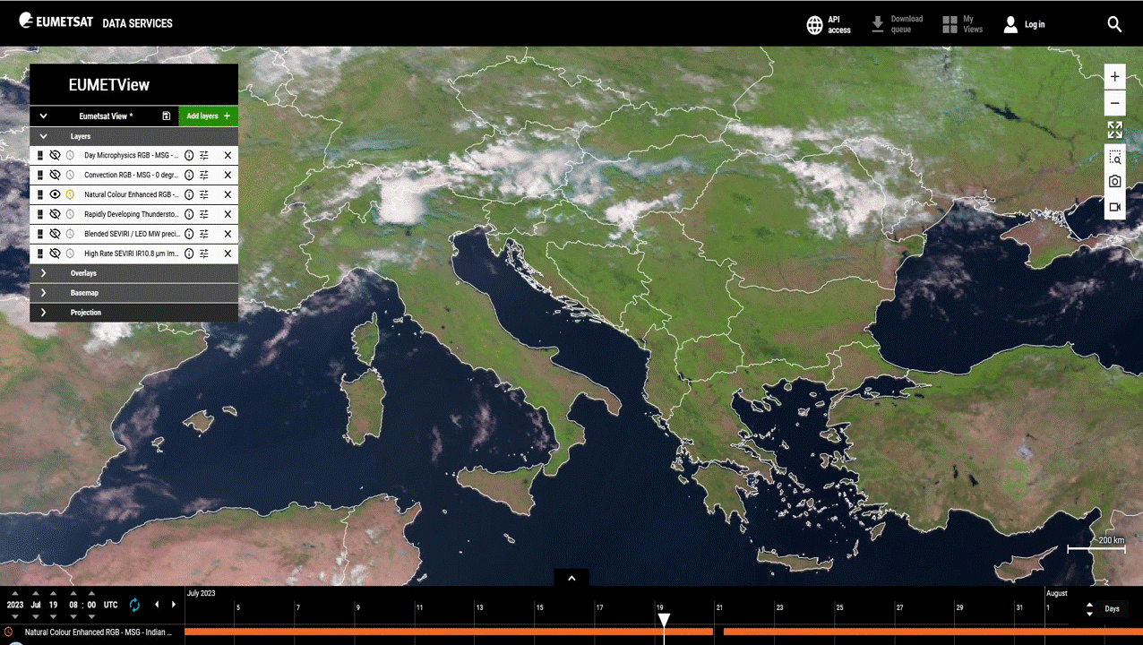
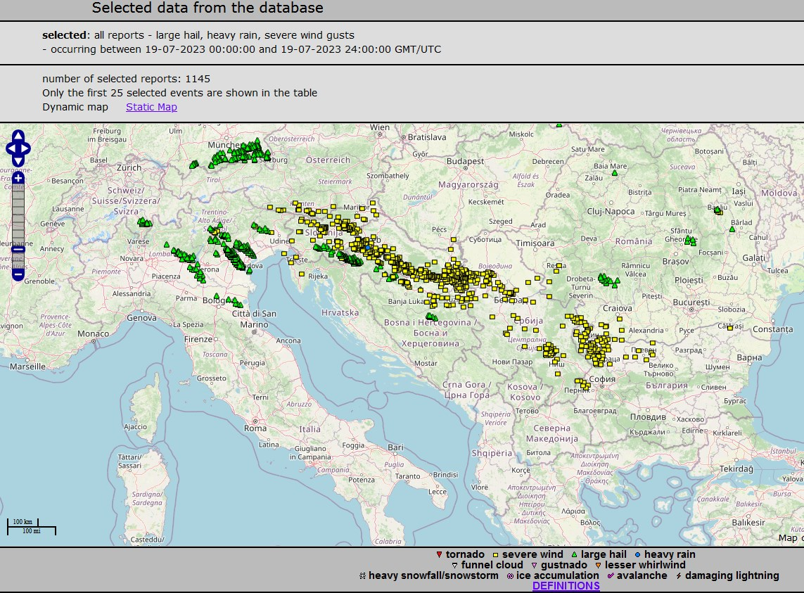
Република Србија - РЕПУБЛИЧКИ ХИДРОМЕТЕОРОЛОШКИ ЗАВОД
Republic Hydrometeorological Service of Serbia
Supercell storm – 19 Jul 2023 – Severe winds, large hail, moderate precipitation
True color satellite animation
European Severe Weather Database
selected: all reports - large hail, heavy rain, severe wind gusts
https://view.eumetsat.int/productviewer?v=default#
https://eswd.eu/cgi-bin/eswd.cgi

Slide 2
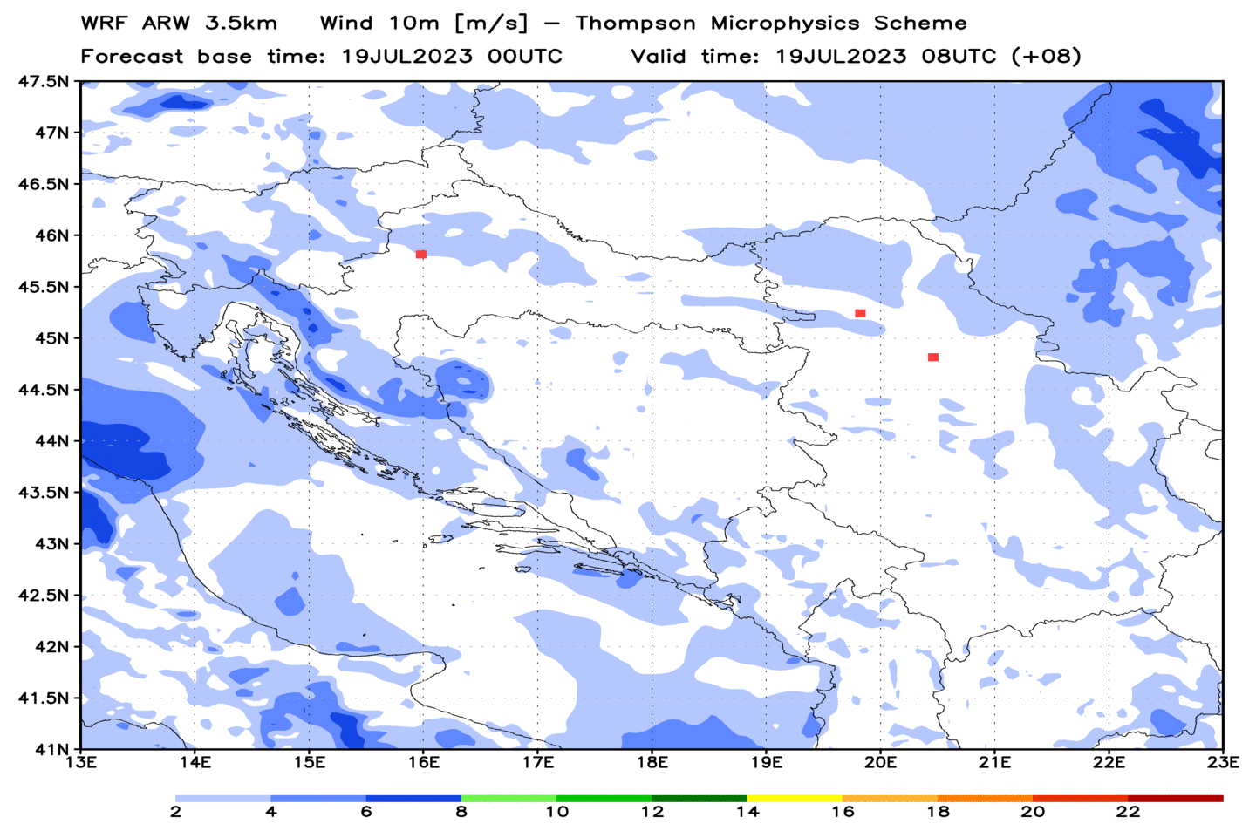
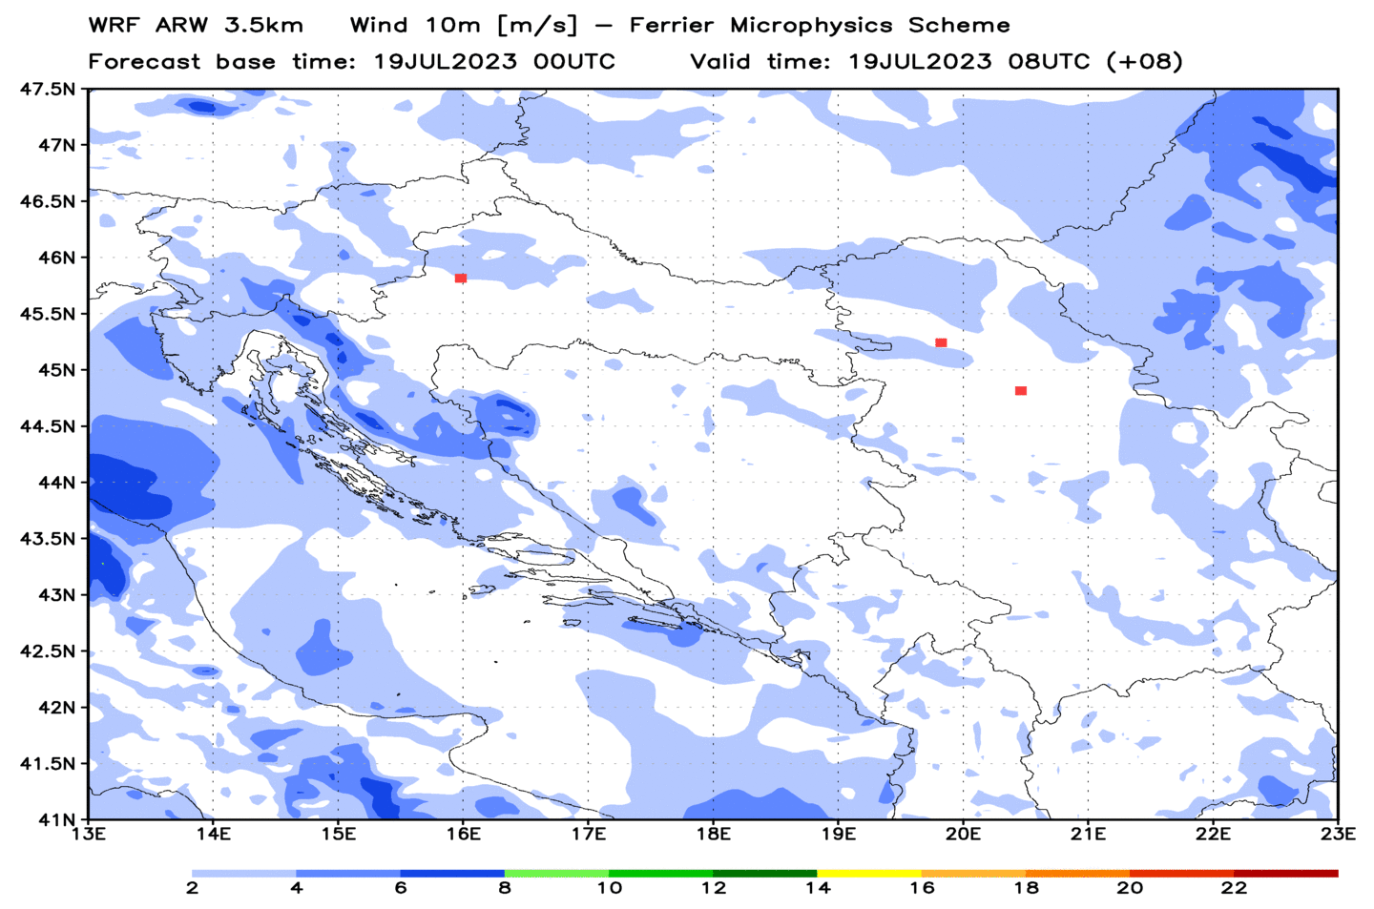
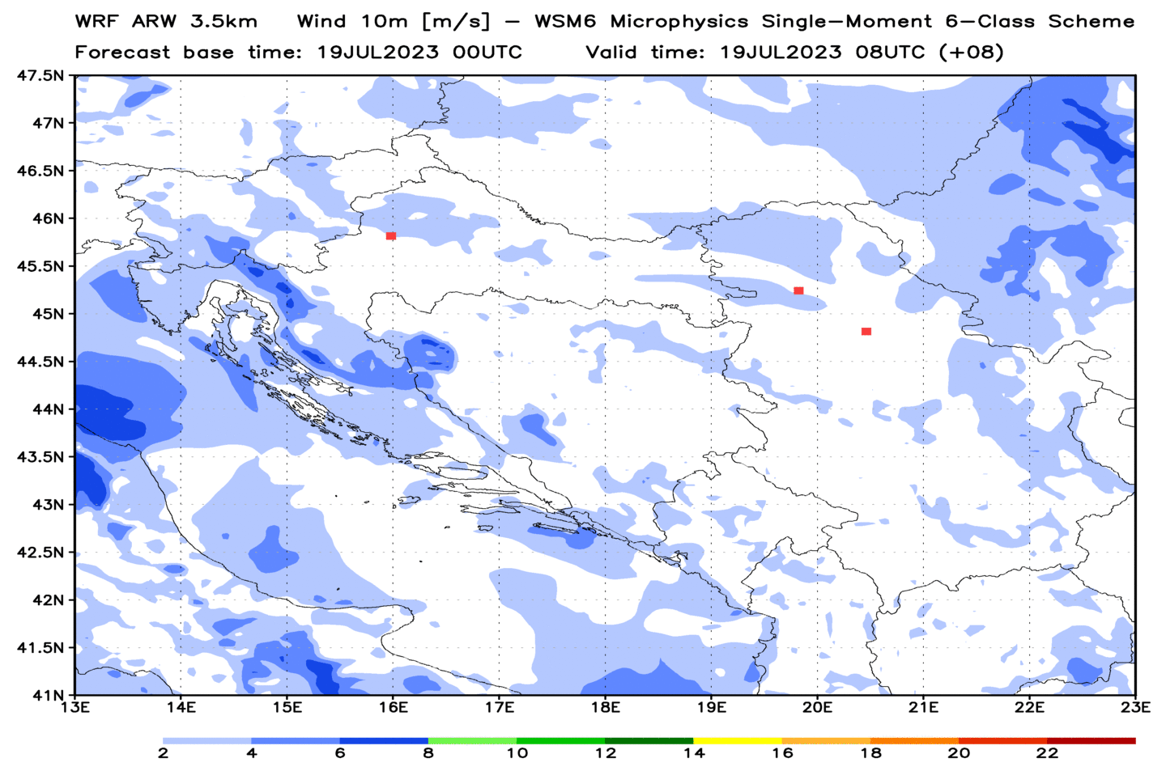
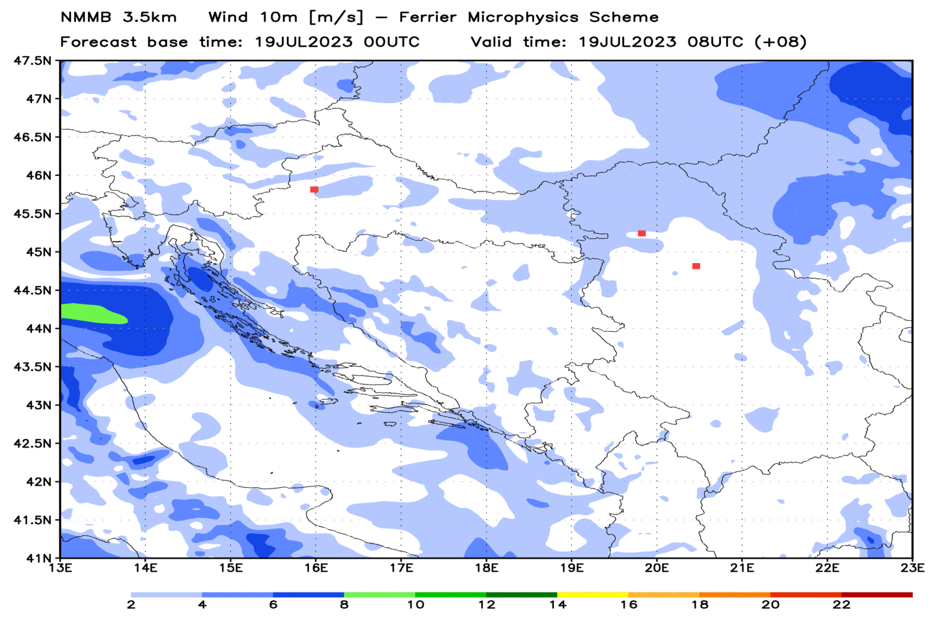
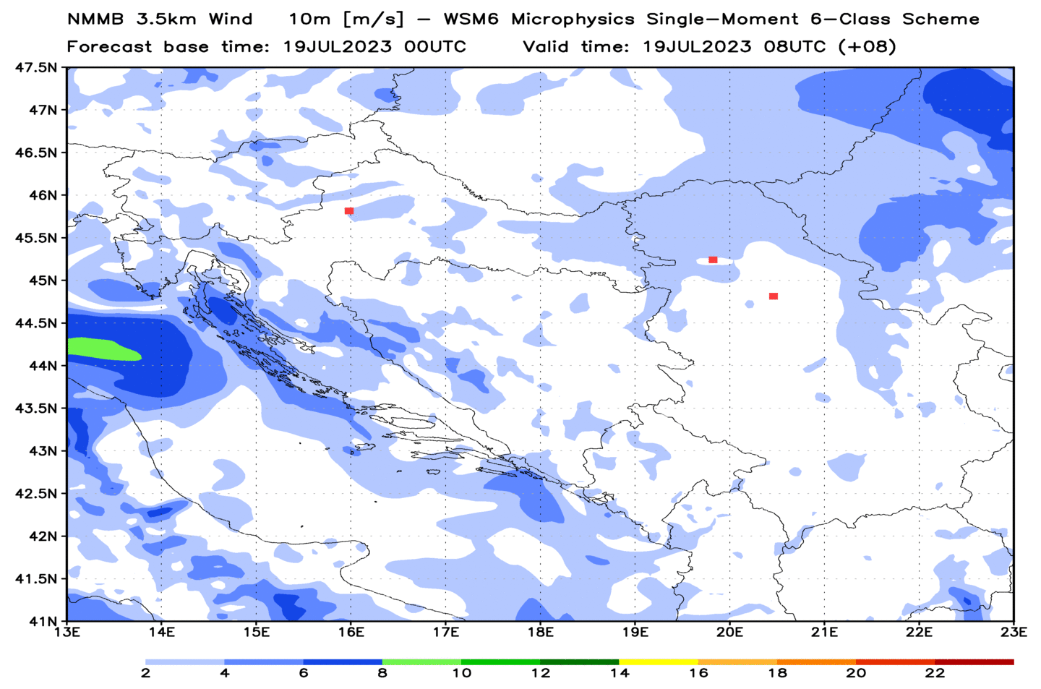
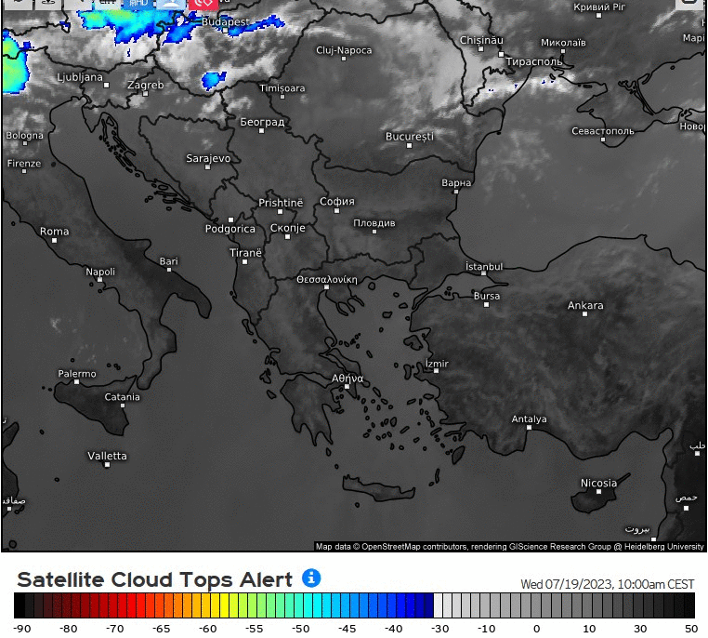
Република Србија - РЕПУБЛИЧКИ ХИДРОМЕТЕОРОЛОШКИ ЗАВОД
Republic Hydrometeorological Service of Serbia
WRF ARW Wind 10m – 3 Microphysics schemes - Upper row
NMMB Wind 10m – 2 Microphysics schemes - Lower row
Satellite animation of supercell path

Slide 3
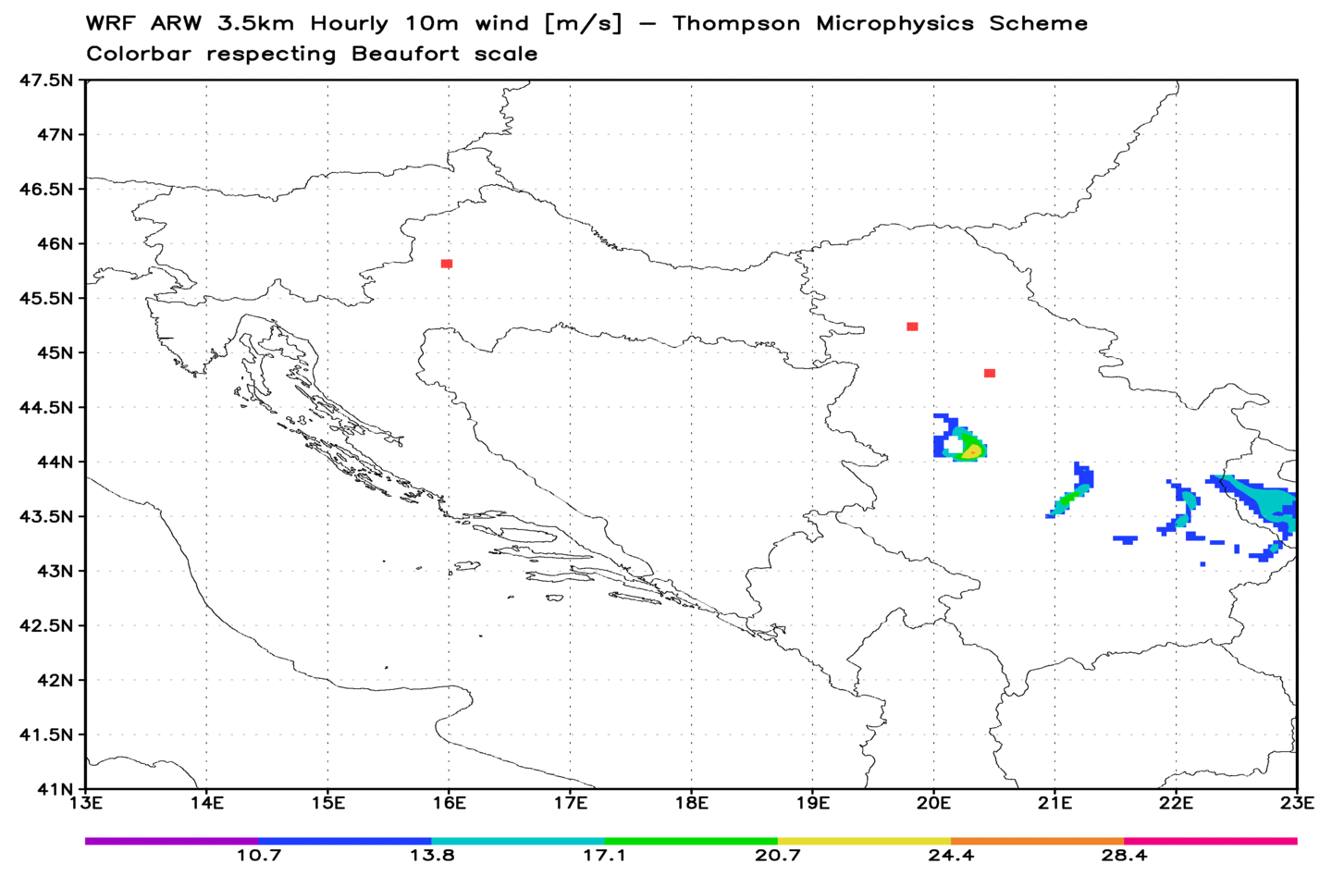
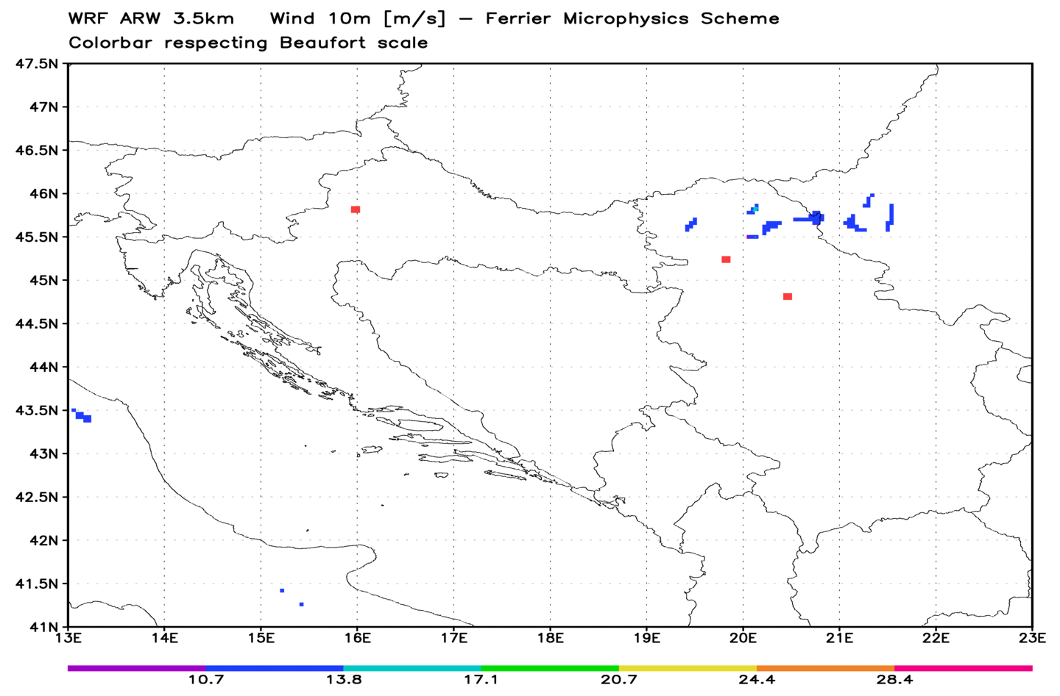
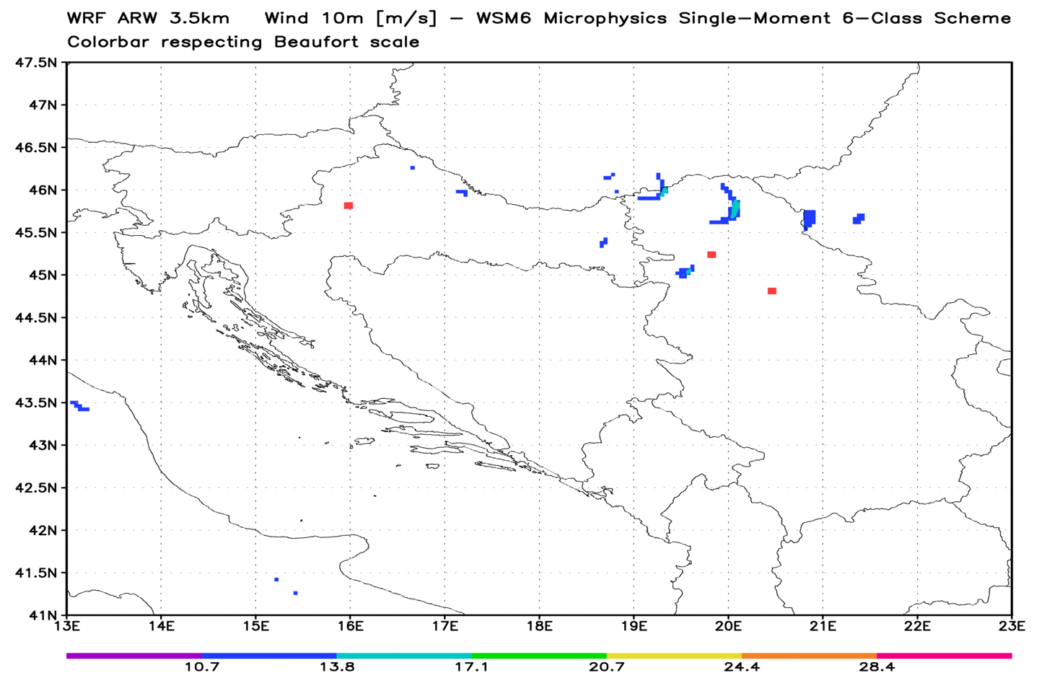
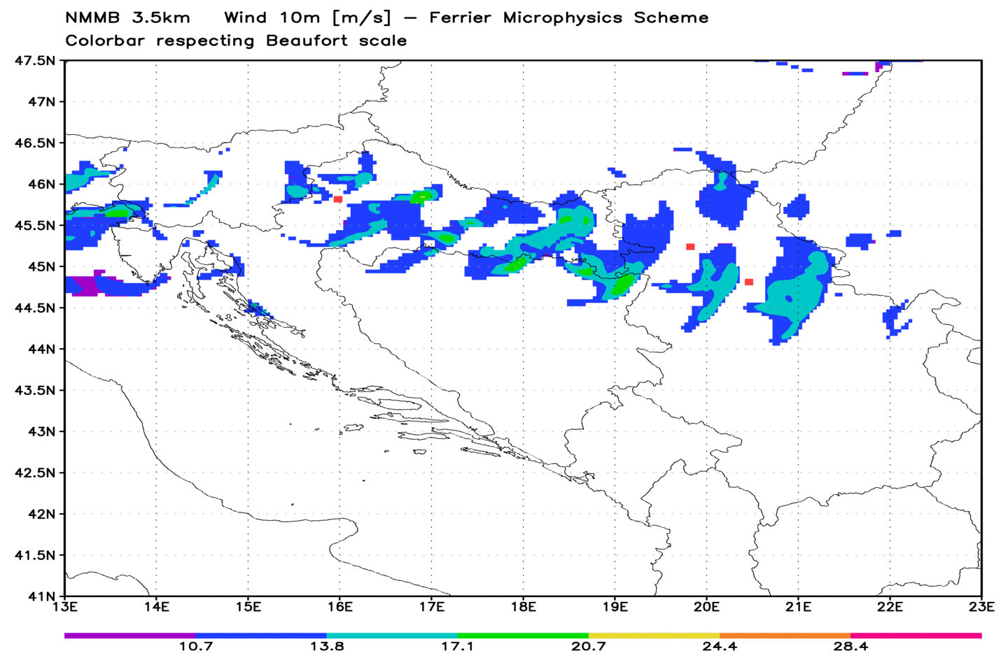
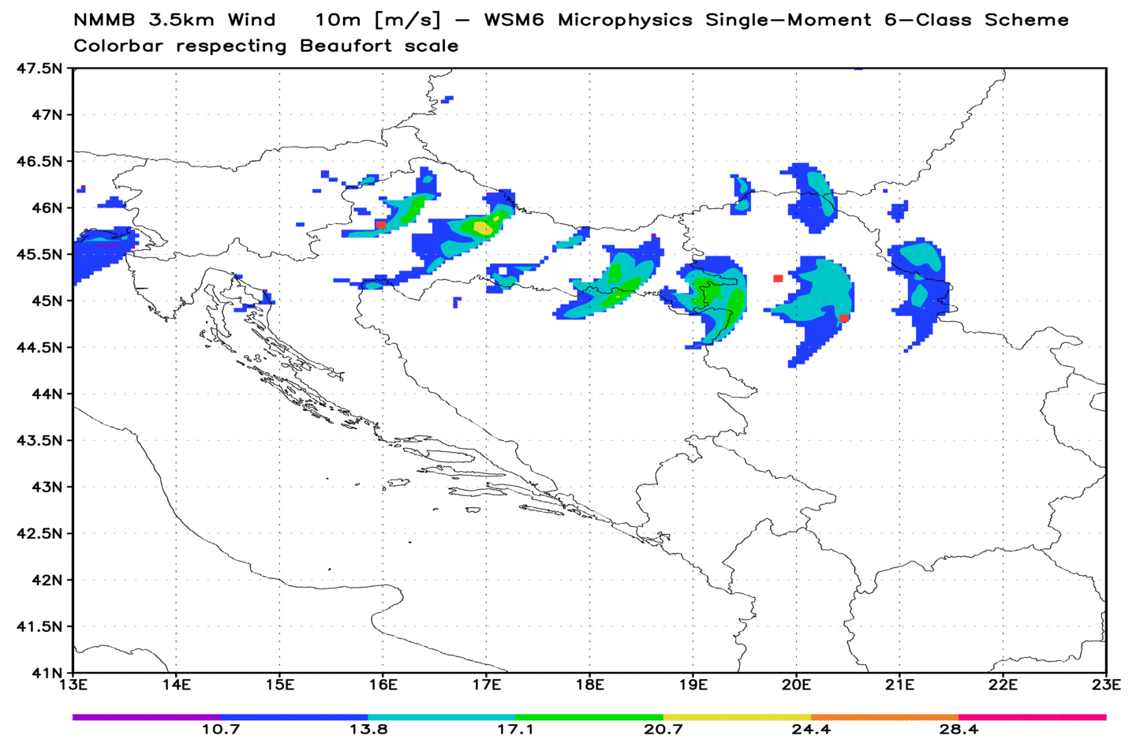
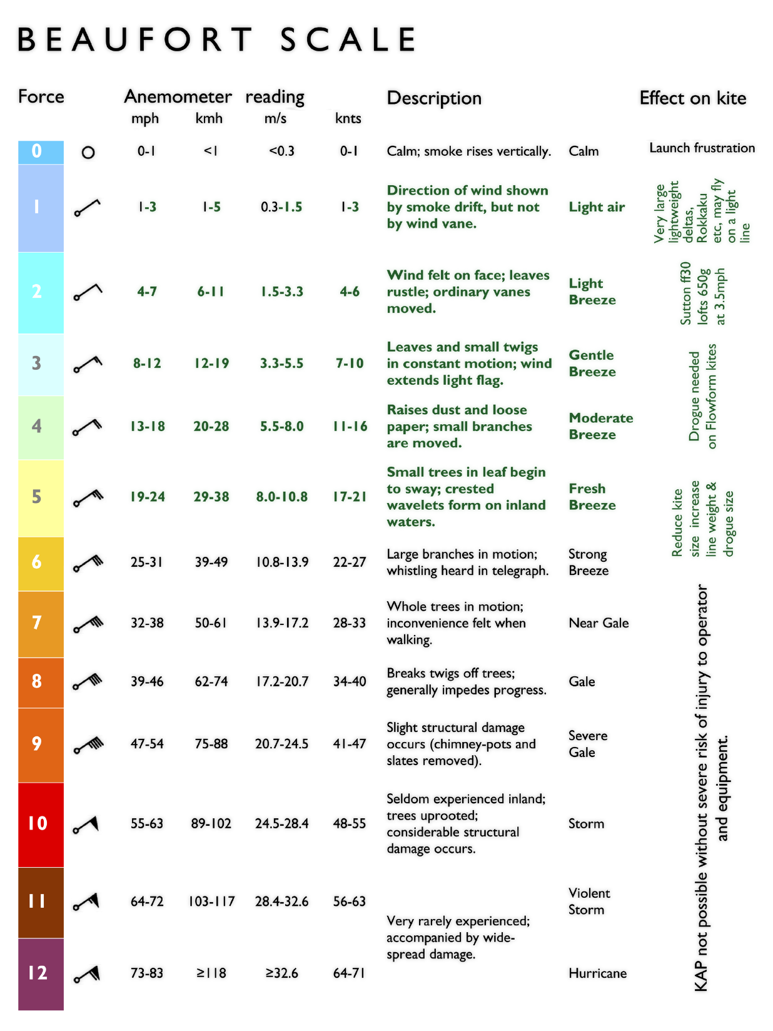
Република Србија - РЕПУБЛИЧКИ ХИДРОМЕТЕОРОЛОШКИ ЗАВОД
Republic Hydrometeorological Service of Serbia
WRF ARW Wind 10m – 3 Microphysics schemes - Upper row
NMMB Wind 10m – 2 Microphysics schemes - Lower row

Slide 4
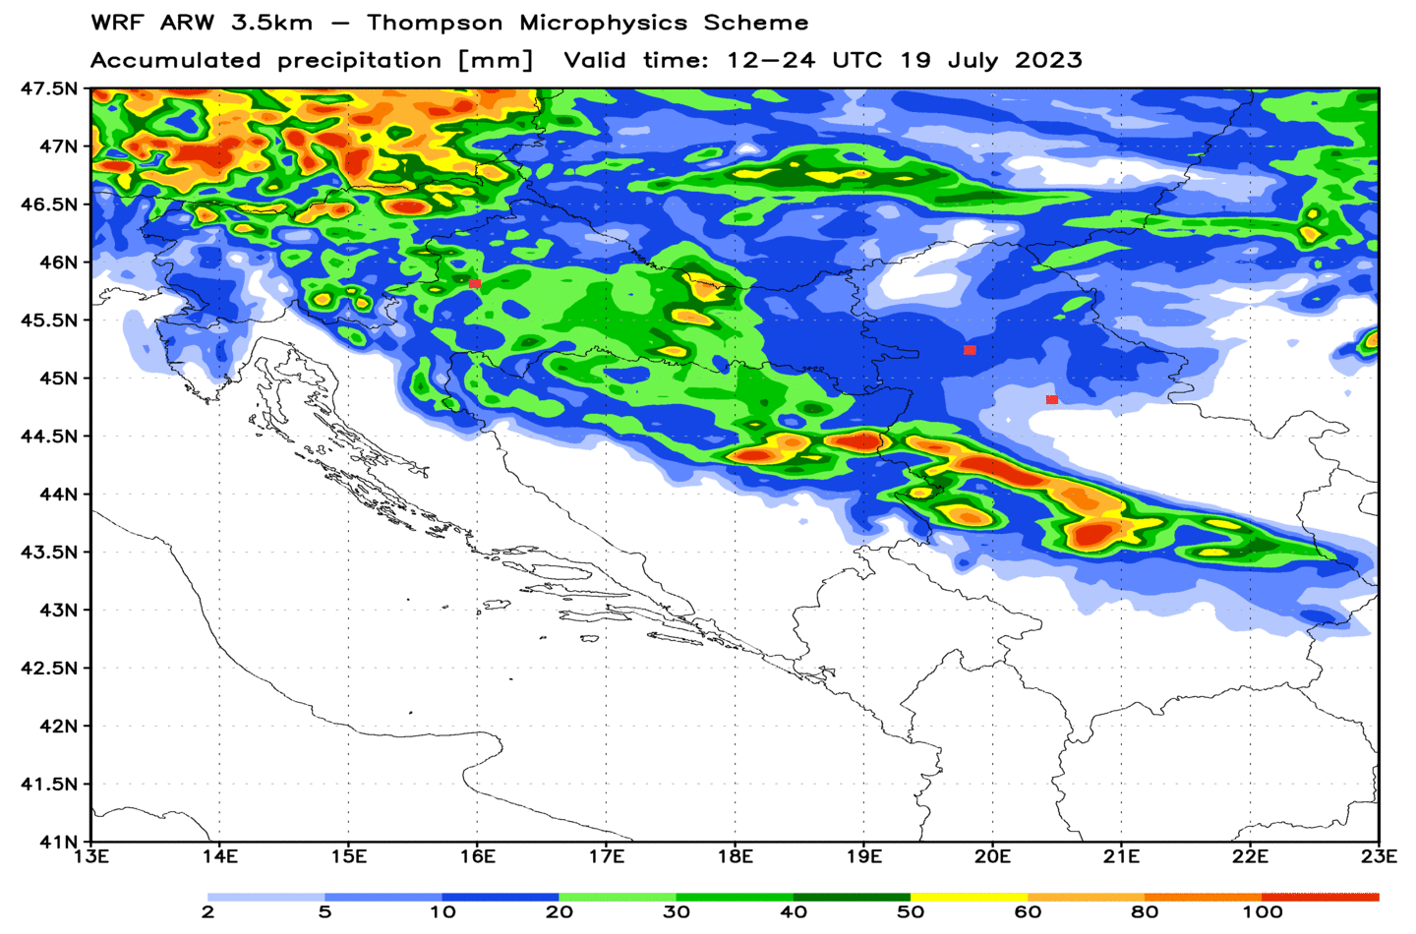
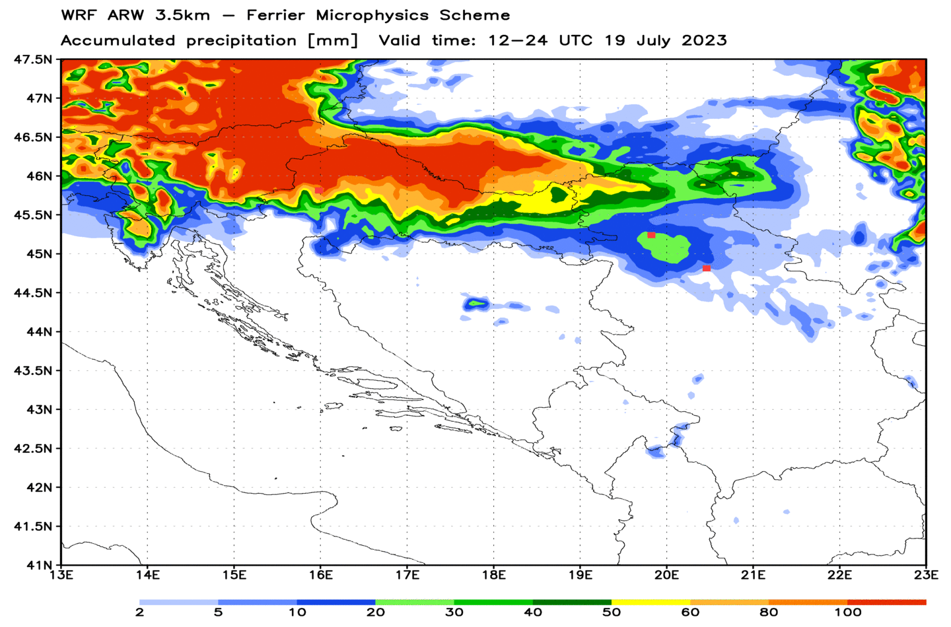
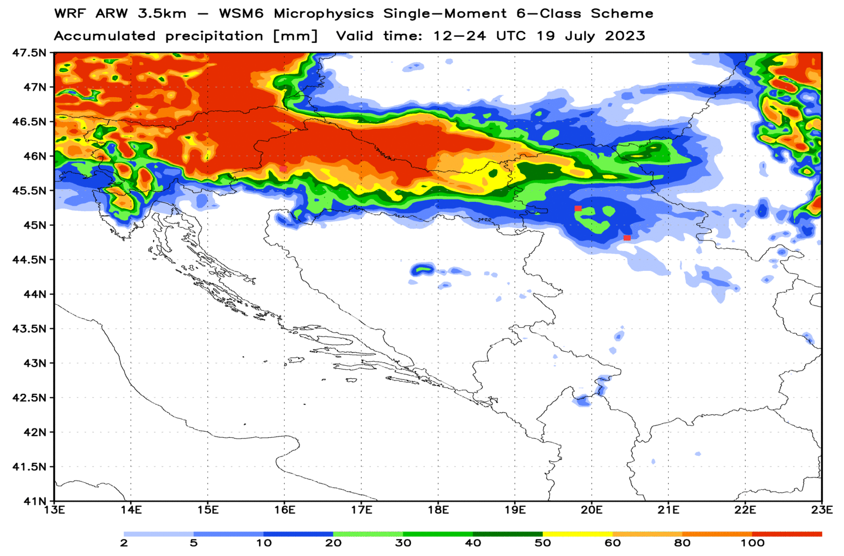
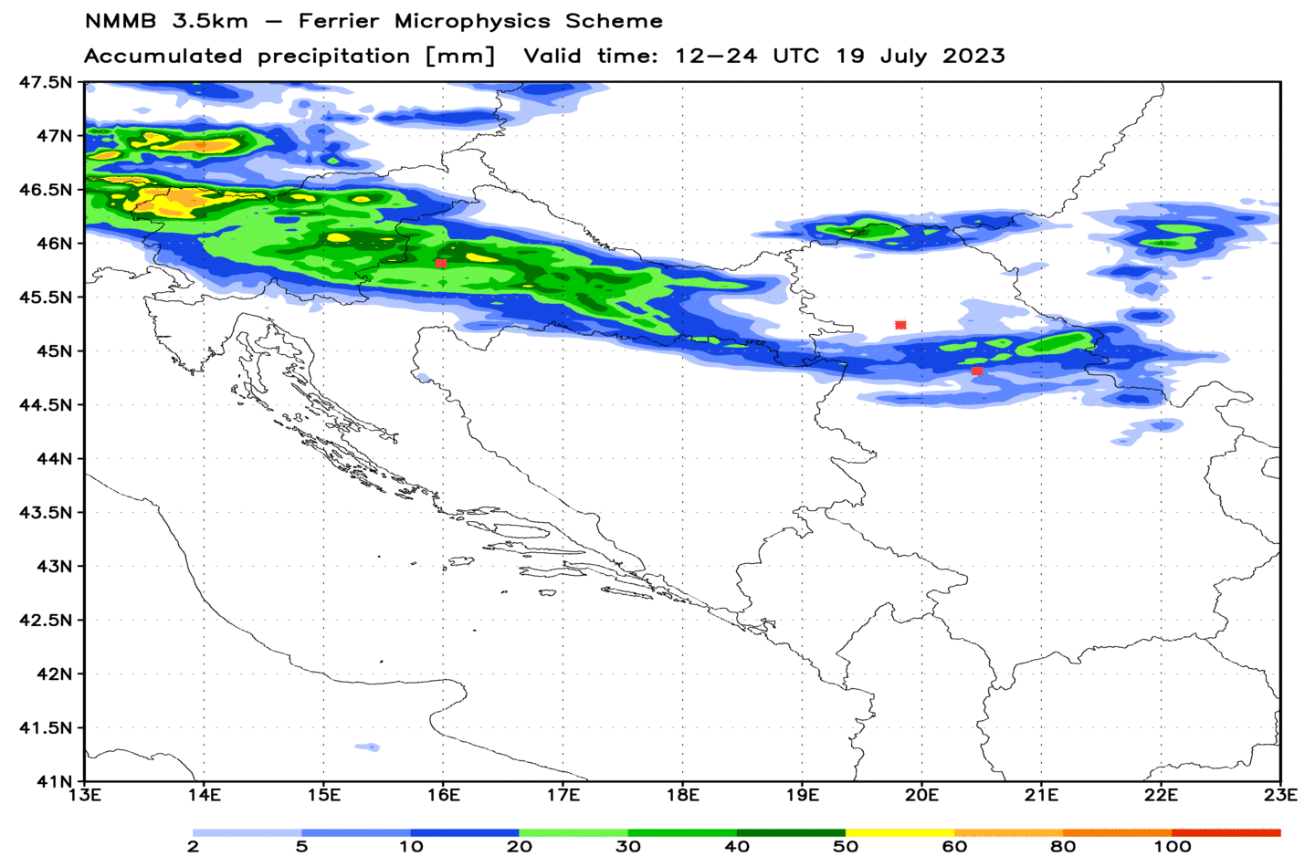
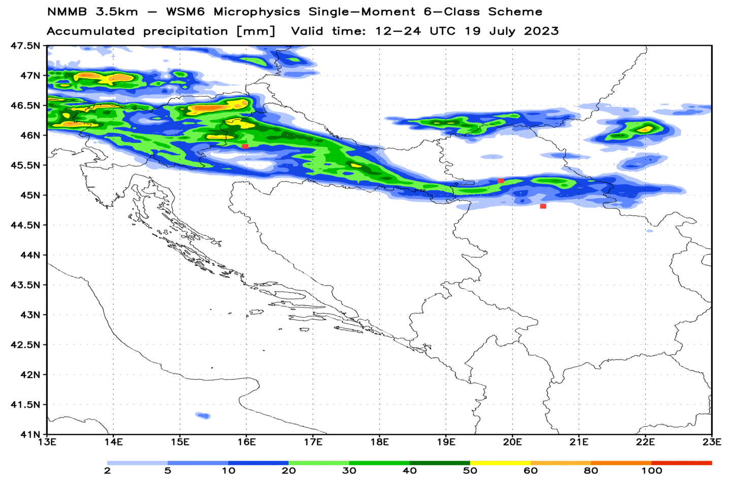
Република Србија - РЕПУБЛИЧКИ ХИДРОМЕТЕОРОЛОШКИ ЗАВОД
Republic Hydrometeorological Service of Serbia
WRF ARW Accumulated precipitation 12-24 UTC 19 Jul 2023 – 3 Microphysics schemes - Upper row
NMMB Accumulated precipitation 12-24 UTC 19 Jul 2023 – 2 Microphysics schemes - Upper row
European Severe Weather Database
selected: all reports - large hail, heavy rain, severe wind gusts

Slide 5
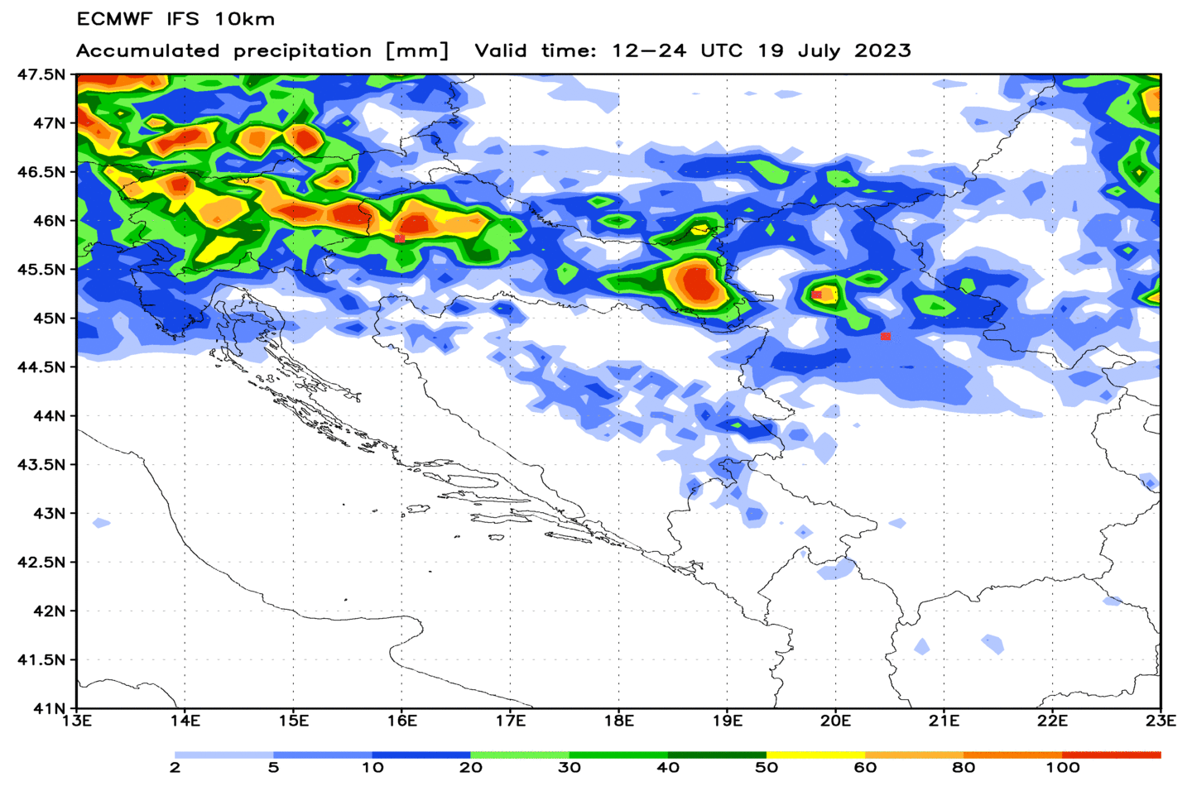
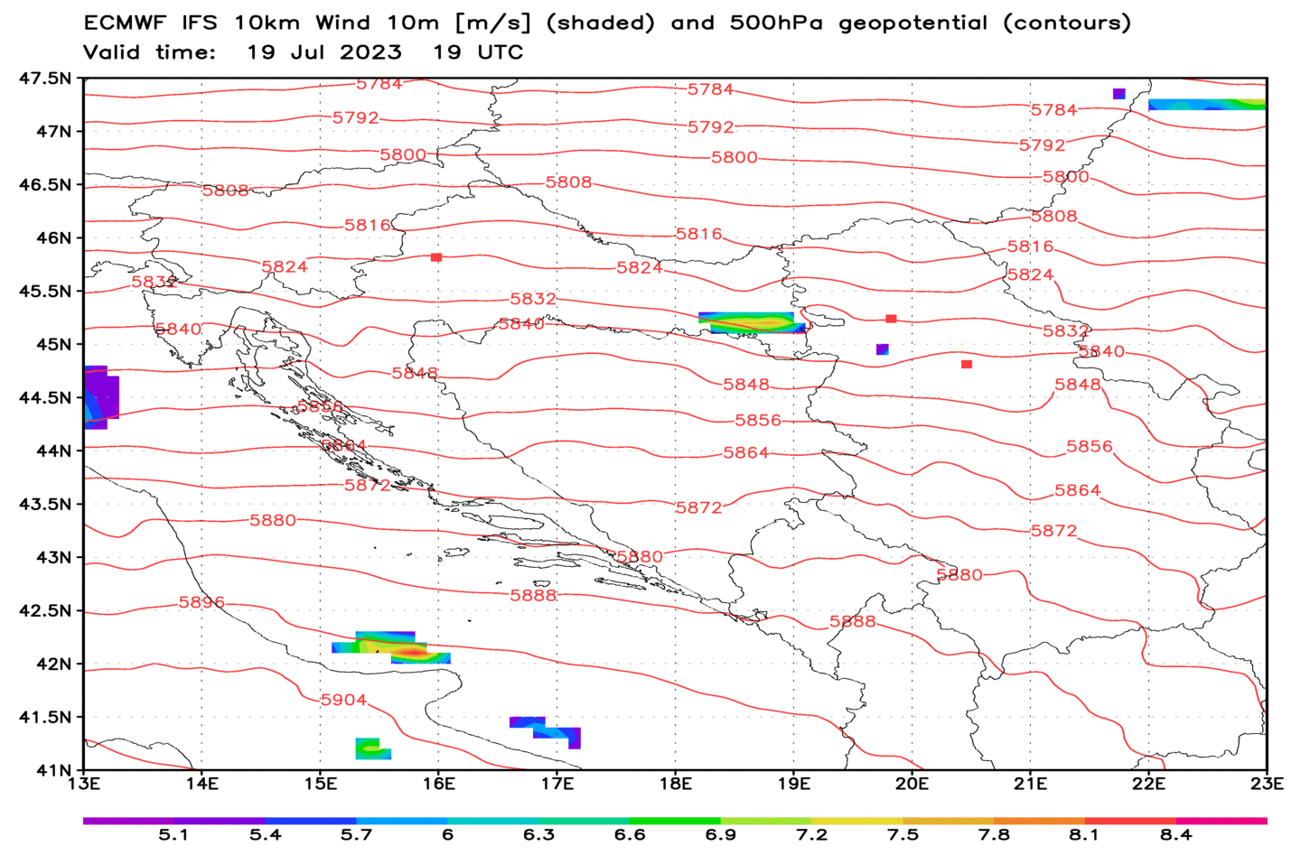
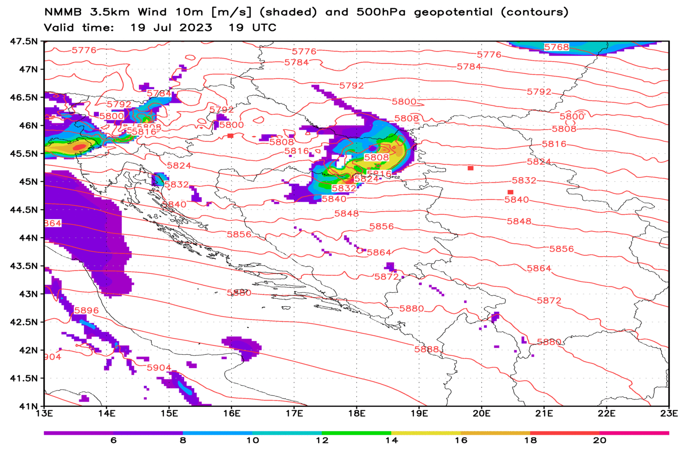
Република Србија - РЕПУБЛИЧКИ ХИДРОМЕТЕОРОЛОШКИ ЗАВОД
Republic Hydrometeorological Service of Serbia
Accumulated precipitation during storm
ECMWF 10km VS NMMB 3.5
Wind 10m and 500hPa geopotential
ECMWF 10km VS NMMB 3.5

Slide 6
Република Србија - РЕПУБЛИЧКИ ХИДРОМЕТЕОРОЛОШКИ ЗАВОД
Republic Hydrometeorological Service of Serbia

