Slide 1


Flash flood warning system based on fully dynamic hydrology modelling
G. Pejanovic, S. Petkovic, B. Cvetkovic
and S. Nickovic
Republic Hydrometeorological Service
Belgrade, Serbia
(South-East European Virtual Climate Change Center - SEEVCCC)

Slide 2
Numerical hydrologic modeling
Hydrology modelling – one of most important component in goobal climate models to appropriatelly represent
  hydrological cycle
  energy fluxes in the Earth's atmosphere and at the surface
Significant room for further impeovements
limited success in the past due to lack of adequate input data
More recent improvements:
  More accurrate and high-resolution data on
    topography, river routing, and soil types
    Precipitation observations/predictions
More recent improvements:
  variety of hydrology modeling approaches:
  simplifiedconceptual
  kinematic methods
  complex dynamic methods

Slide 3
The most complex models include full dynamic governing equations
  momentum equations, along with the equation of mass continuity, are used in their full extent.
  Such approach
    permits representation of hydrology scales ranging from flash floods to flows of large slow river watersheds.
    do not need model callibration
    could be unstable for vanishing surface water hight if not appropriatly numerically treated

Slide 4


Kinematic approximation: the the most used method
in hydrology modelling
  Continuity equation - prognostic
  Momentum equations – diagnostic
    Manning velocities calculates from the balance between the gradient
    and the friction slope forces
    Advantage: no numerical instability
    Disadvantage: simplified governing equations

Slide 5
Full dynamics (FD) vs. kinematics (KN)
FD model more accurate
FD: friction slope term requires special treatment (Froude number <2)
KN: simplifications avoids problem but simplifies the equations (Froude number >2)
Most watershed models adapt KN approach
KN cannot accurately represent large-scale, more inert processes

Slide 6
Kinematic flow
Drag force (D)
Inertia force (I)
Gradient force (G)
steep topography
Gradient force dominant over inertia force (advection)
→ Fr < 1
kinematic approximation D ~ (I+G)
inappropriate for slow flows

Slide 7
Full dynamic flow
Acceleration (A)
Gradient force (G)
Drag force (D)
Inertia force (I)
weak topography slope
Inertia force (advection) dominant over gradient force
→ Fr > 1
kinematic approximation A~ (I+G) - D
appropriate for both fast and slow flows

Slide 8
HYPROM ^{(*)} approach
Aim: to avoid a kinematic or other restrictive approximation
Dynamics based on the Saint-Venant equations
Both momentum and continuity equations are prognostic
^{(*)}Nickovic, S., G. Pejanovic, V. Djurdjevic, J. Roskar, and M. Vujadinovic (2010), HYPROM hydrology surface-runoff prognostic model, Water Resour. Res., 46, W11506, doi:10.1029/2010WR009195

Slide 9
  HYPROM - Full dynamic (FD) equation concept
Friction slope terms
Kinematic approximation
neglects inertia forces !! which
we want to avoid

Slide 10
Kinematic approx
Not appropriate for basins with slow flows
Acceptable for flesh floods
(where friction and gradient forces are in approx. balance)
➔Full dynamic system
to be used

Slide 11
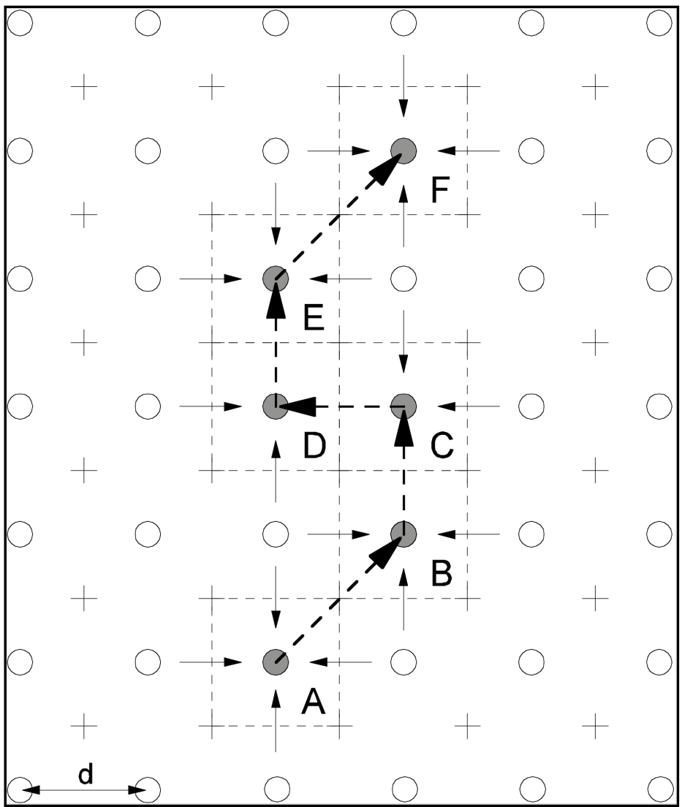
HYPROM governing equations:
h - points
u,v -points
A-B-C-D-E-F river points
river routing
Novel components in HYPROM
NO approximation in the governing eq-s
numerically stabile numerics
new numerical technique for
preventing grid decoupling noise
suitable for scales ranging from local (flash floods) to climate (large rivers, e.g. Danube)
computationally very efficient

Slide 12
Full Dynamics approach requires completely different numerical approach to resolve the Instability due to vanishing water heights!
Friction slope
Potential source of
model instability when
Fiedler and Ramirez (2002) suppress the instability by imposing an artificial threshold for the minimum water depth h_{c} = 10⁻¹⁰ m

Slide 13
  Friction slope numerics – HYPROM approach
Implicit time scheme applied
Unconditionally stable method
Convergent for
More info in Nickovic et al (2010)

Slide 14
  Friction slope numerics in HYPROM

Slide 15
River routing
  s – river direction
  River – a water collector from surrounding points
  Same numerics as for non-river points
  River path:
  A-B-C-D-E-F

Slide 16
  A numerical method proposed for the source term: averaging method which redistributes water mass to neighbouring points and avoids two-grid interval noise in the E or B horizontal grids
Nickovic et al (2011): Method for efficient prevention of gravity wave decoupling on rectangular semi-staggered grids”. Journal of Computational Physics, 230(5), 1865-1875

Slide 17
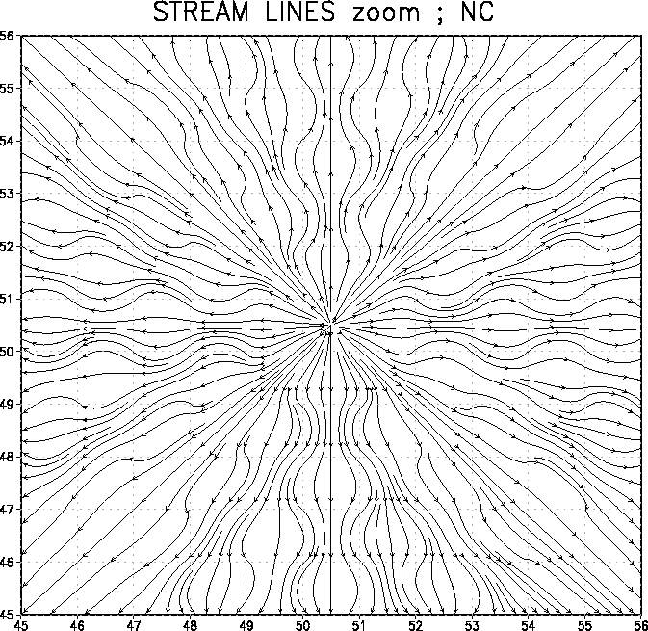
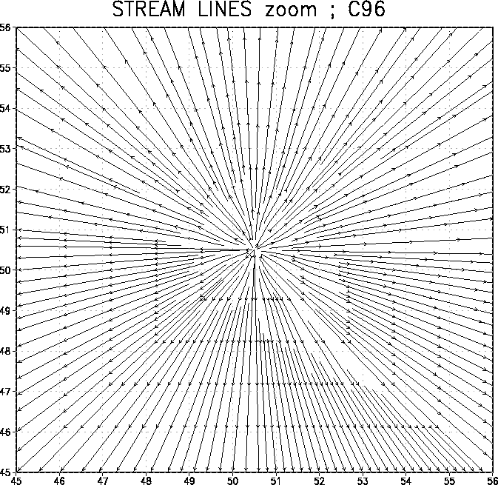
  Synthetic experiment with HYPROM
  (1pt source forcing)
  Without modification
  With modification

Slide 18
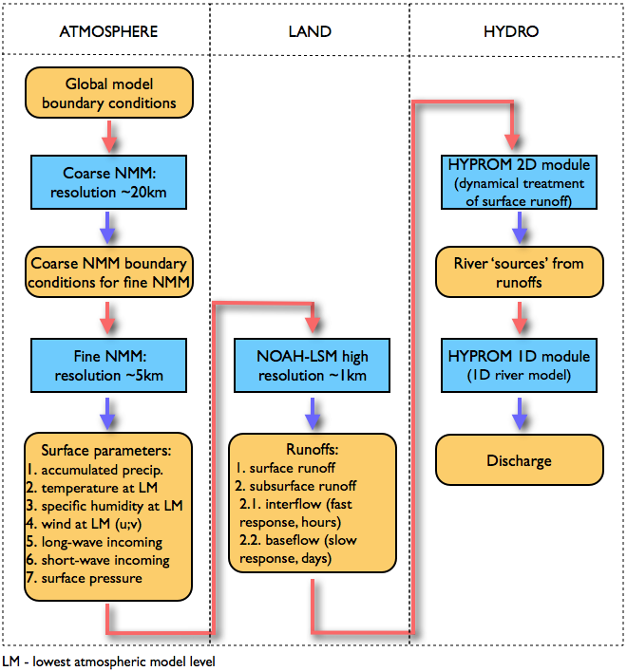
HYPROM integrated with the NCEP/NMM atmospheric model
Notes:
18

Slide 19
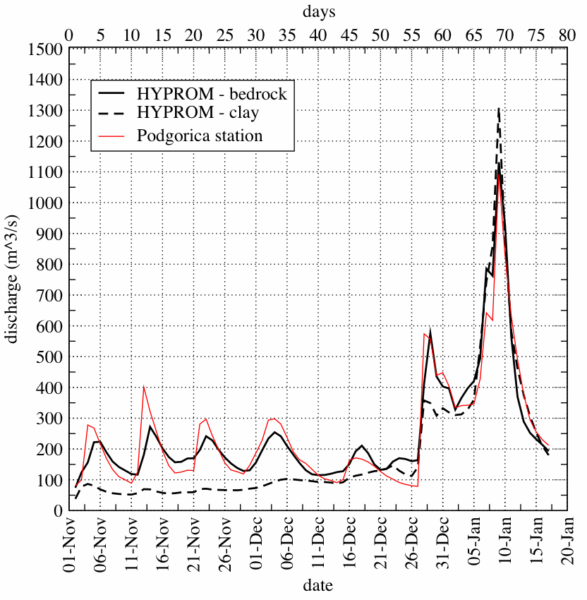
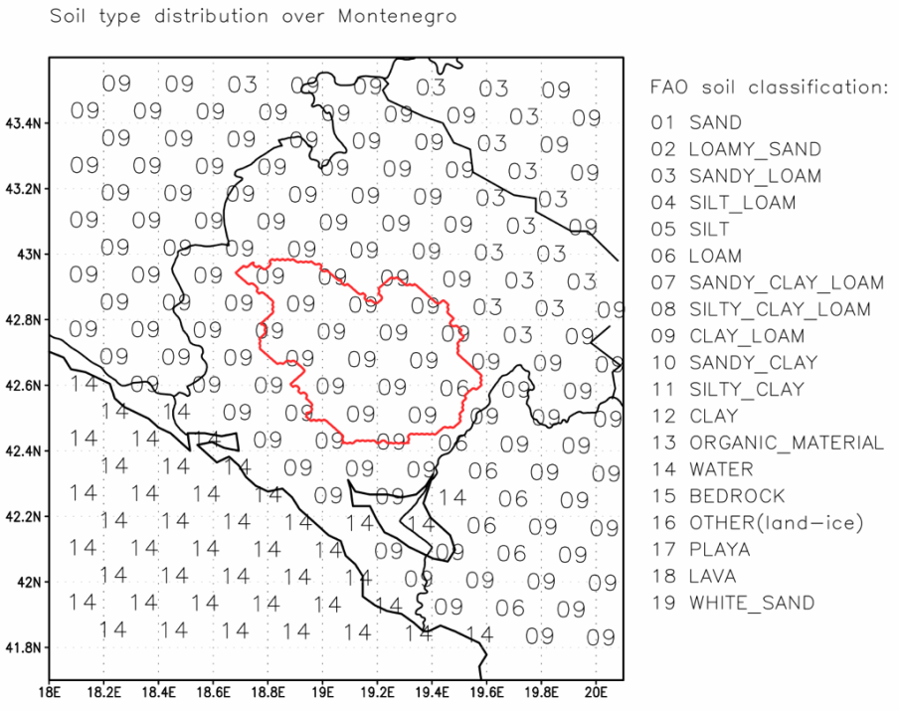
Moraca river - Sensitivity to soil type
  Small catchment case
parameter | Clay Loam (09) | Bedrock (15)
sat. diffusivity | 0.113 x 10⁻⁴ | 0.136 x 10⁻³
sat. conductivity | 2.45 x 10⁻⁶ | 1.41 x 10⁻⁴
porosity | 0.465 | 0.20
CH constant | 8.17 | 2.79

Slide 20
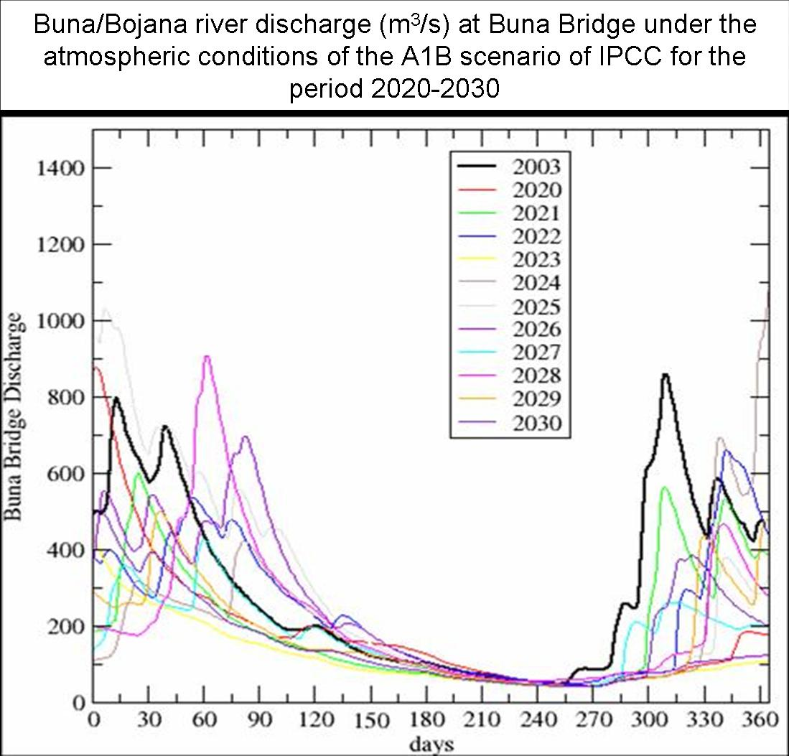
HYPROM and climate/seasonal assessments
Djurdjevic et al, 2011

Slide 21
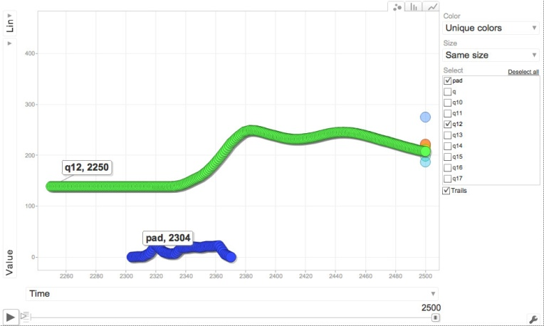
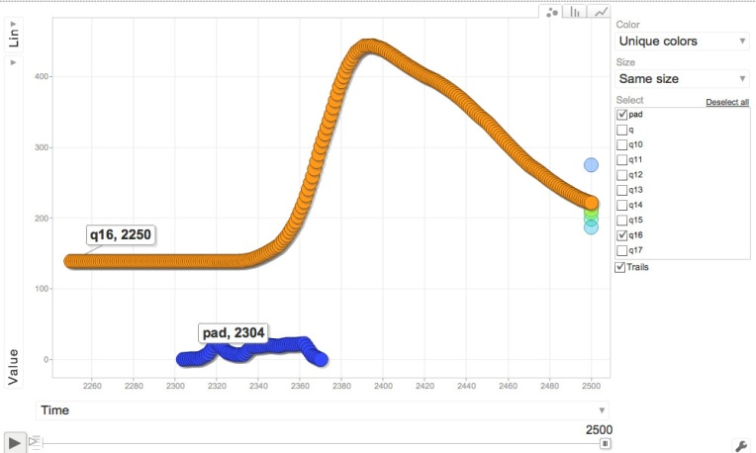
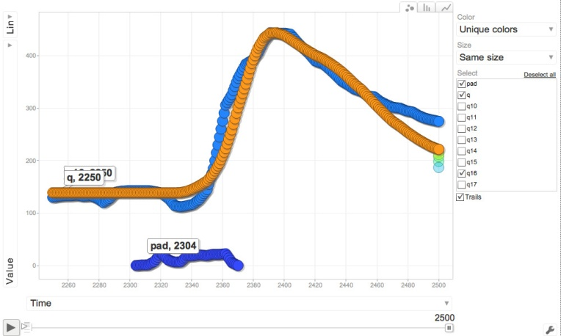
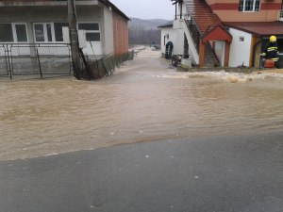
23 UTC
12UTC
14UTC
16UTC
S. Morava River flash flood case
23 Jan 2015
disasterous consequences
HYPROM run
Driven by radar precipitation
Predicted correctly the max discharge 7 hours in advance
Observed Q
Predicted Q
Radar P

Slide 22
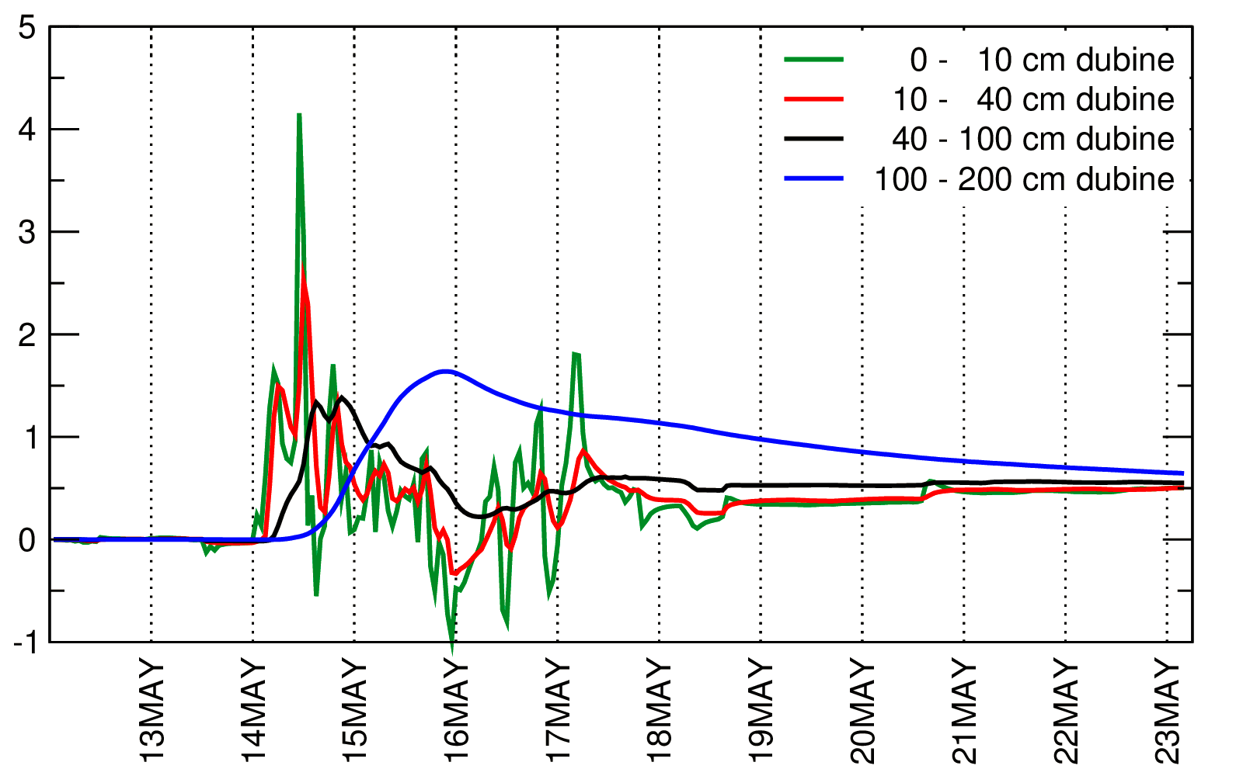
Most recent developments
HYPROM dynamics has been fully coupled with the NCEP/NMMB non-hydrostatic atmospheric model
a two-way interaction (atmosphere-hydrology feedbacks) (Vujadinovic-Mandic, 2015; PhD Thesis)
Volumetric soil moisture difference
ctrl-feedback exp at 4 model soil levels

