Slide 1


Cold cloud formation due to dust Implications for aviation
Bojan Cvetkovic ¹, Slobodan Nickovic ¹, Ana Vukovic ^{2,1}, Goran Pejanovic ¹,
Slavko Petkovic ¹ and Jugoslav Nikolic¹
¹ Republic Hydrometeorological Service of Serbia – South East European Climate Change Center, Belgrade, Serbia (bojan.cvetkovic@hidmet.gov.rs)
² Faculty of Agriculture, University of Belgrade, Belgrade, Serbia

Slide 2

ATMOSPHERIC DUST MODELLING
Depending on the research goals, considering nowadays computer resources, dust models evolution is divided in:
(1) modelling of the long range transport (global with resolutions ~100km)
(2) modelling of the intense dust storms (regional of several tens of km)
LONG RANGE TRANSPORT:
Global and regional models
Coarse resolution (several 10km to ~100km)
SHORT RANGE TRANSPORT:
Nonhydrostatic regional models
High resolution (several km)
Forecast of the dust storms
GLOBAL MODELS
REGIONAL MODELS
NONHYDROSTATIC MODELS

Slide 3
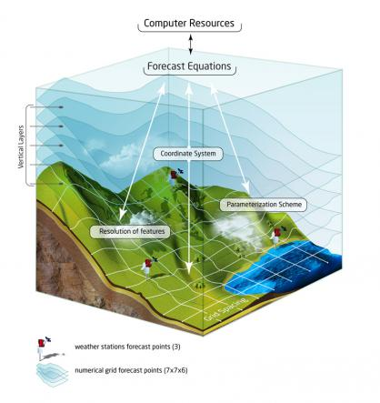
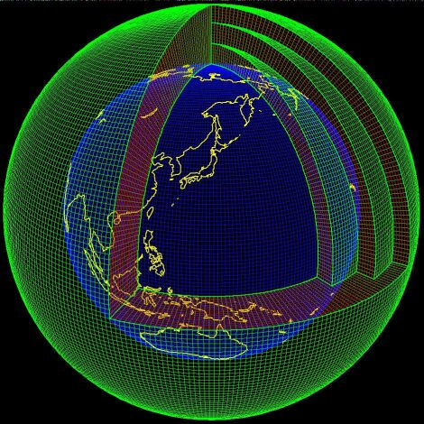
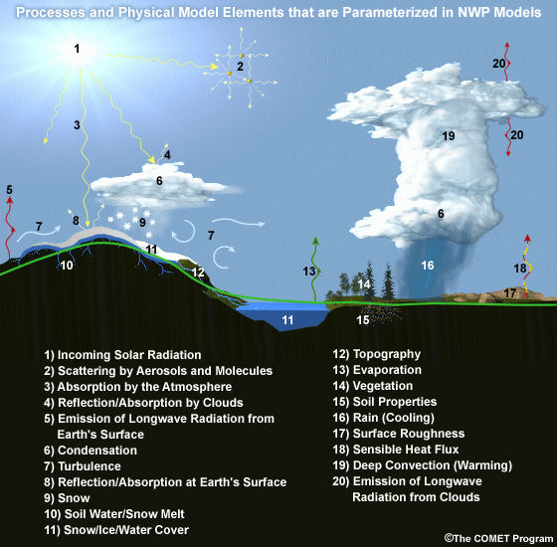
Coupled Numerical Weather Prediction (NMME) with DUST model (DREAM) concept
Numerically solve equations that describes physical processes in the atmosphere/land (fluid dynamics and thermodynamics) + atmospheric dust cycle processes
Separate numerical models for simulation of atmosphere/land/ocean/dust system components and processes within integrated in one system, where they exchange data during every model simulation timestep.
Actual atmosphere, ocean and land conditions + math. representation of physical laws ➔ calculate future state of the atmosphere and 3D dust concentration

Slide 4
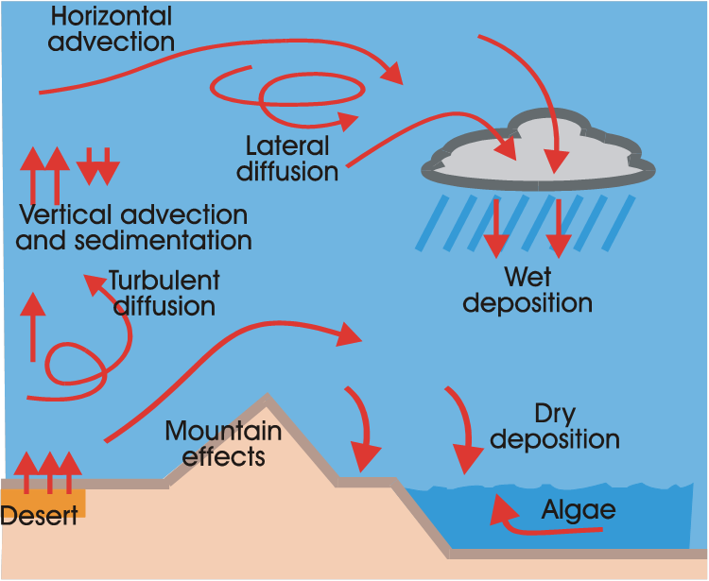
Dust Regional Atmospheric Model (DREAM)
Driven by the non-hydrostatic atmospheric model NCEP NMME
Simulates all major processes
of the atmospheric dust cycle
Includes 8 different dust particle bins
Includes different dust mineral fractions
Simulates ice nuclei concentration
To understand and model dust aerosol transport, processes ranged from micro to global scales must be considered, which explains complexity of the problem.

Slide 5
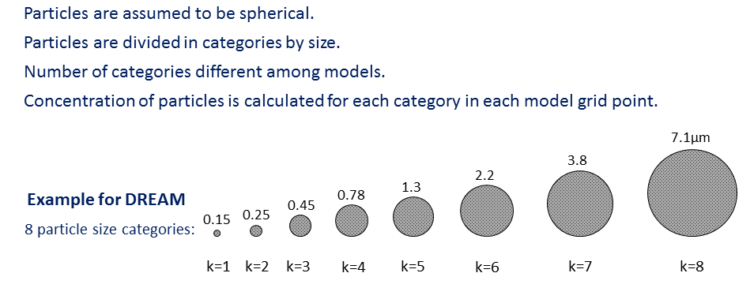
Dust Regional Atmospheric Model (DREAM) workflow
Dust model is coupled with atmospheric model (Eta, NMME, NMMB…)
Preprocessing: Very important is to define dust sources using land cover and soil texture data bases or other source of information, depending on area of interest ➔ prepare dust mask on model grid
Kernel of dust modeling – to solve equation:
horizontal
turbulent
mixing
vertical
turbulent
mixing
horizontal
advection
vertical
advection
source
sink
update of dust concentration in every model time step and in every model point and level
(same as atmospheric parameters)
using updated values of soil moisture and friction velocity calculate dust emission
for each of 8 bins
(Nickovic et al., 2001)
loss through dry (gravitational settling) and wet (washed down by precipitation) deposition
C is calculated for each particle size category C_{k}(k=1,…,8) at each model grid point in every time step!

Slide 6
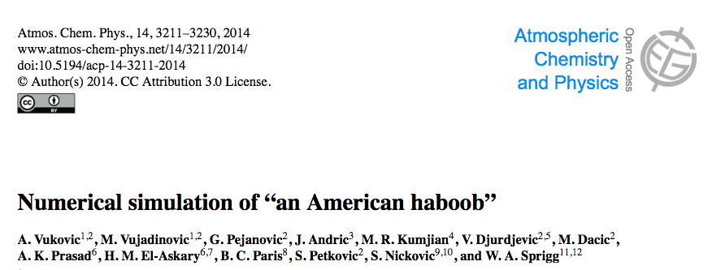
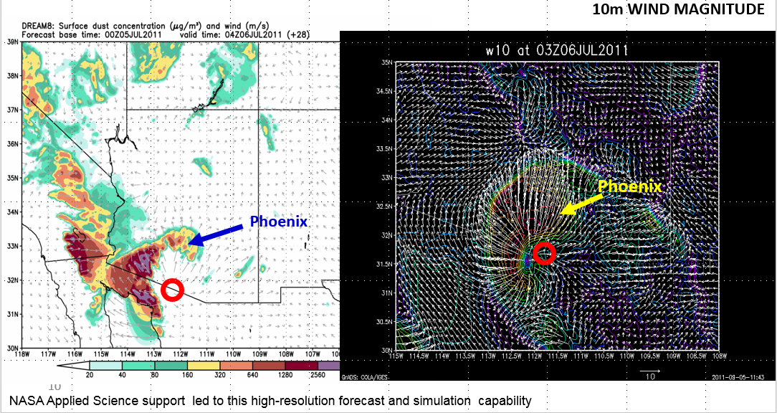
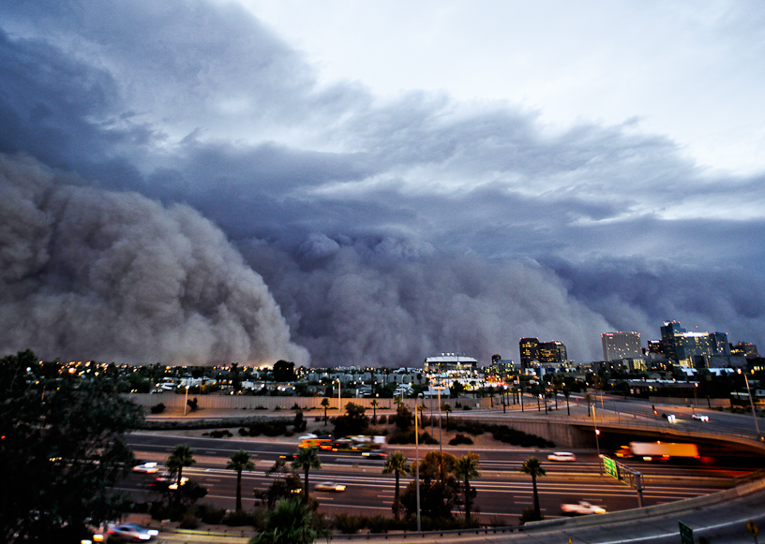
Dust storm forecast: Nonhydrostatic high resolution simulation of intense dust event
(Vukovic et al. 2014)
Haboob: cold downdraft from supercell clouds forms strong surface winds, intensive dust uplift, forms wall of dust
Study case: 5 JULY 2011 Phoenix (Arizona) model simulation 4km resolution
FRONT
Tucson – Phoenix; Front wide ~150km; travelled distance ~250km; Dust wall height ~1500-2000m
02UTC 6. JULY reached SE Phoenix; 02-04 UTC cross over Phoenix
cold
downdraft
dust
strong wind

Slide 7
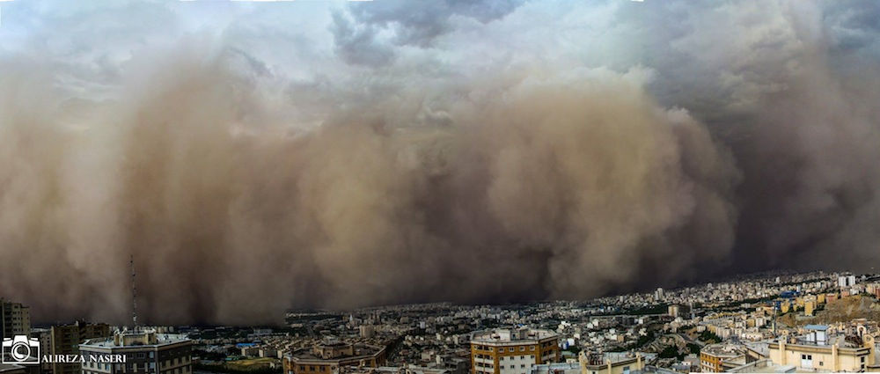
STUDY CASE: TEHRAN DUST STORM 2ND JUNE 2014
Simulation of small scale (local; several 100km), intense (several 1000ug/m3 PM10) & short lived (few hours) dust storms

Slide 8
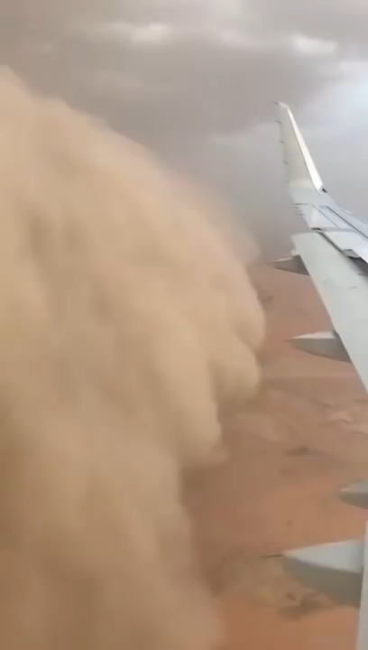
KUWAIT April 2018 HABOOB - DUST STORM

Slide 9
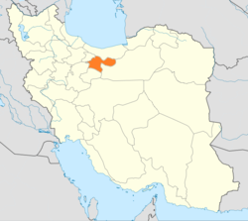
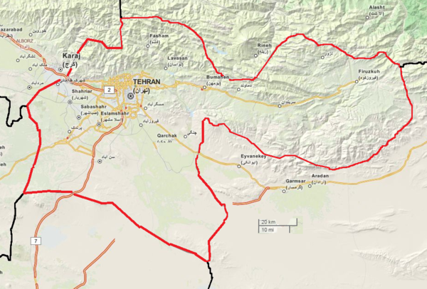
Information from reports
reached city at 04:50 p.m. local time;
passing of the sand storm over the fixed site lasted about 15min;
storm duration less than 2h;
reduction of visibility to ~10m; wind velocity reached 110 km/h;
temperature dropped from 33C to 18C in several min;
at least 5 deaths, 82 injured; multiple vehicle collision;
50 000 residential units lost power.
FRONT
cold
downdraft
dust
strong wind
Theory
Intensive cold downbursts from convective cells produced high velocity surface wind, creating cold front which was lifting, mixing and pushing dust towards the city;
Expected: high wind speed, drop in temperature, rise in humidity, rise in pressure, reduction of visibility.
Location of METAR data
OIII
13:00UTC – visibility reduction
30km
OIIE
12:30UTC – visibility reduction

Slide 10
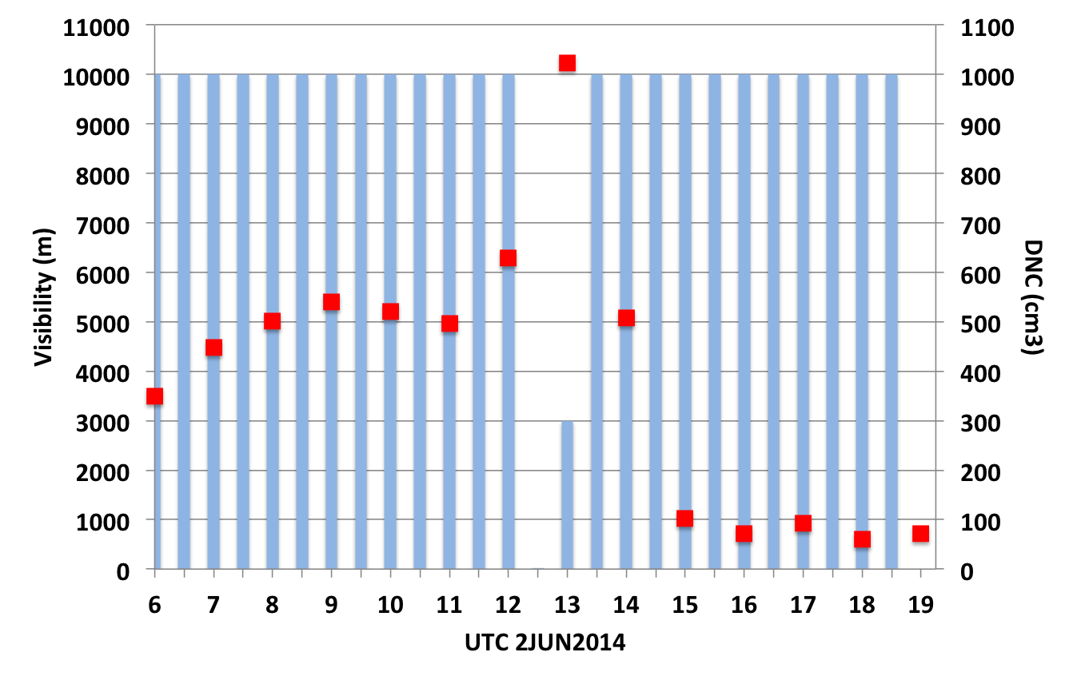
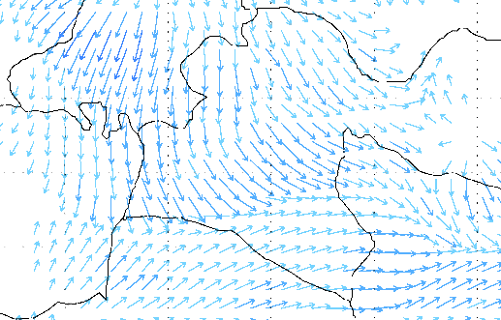
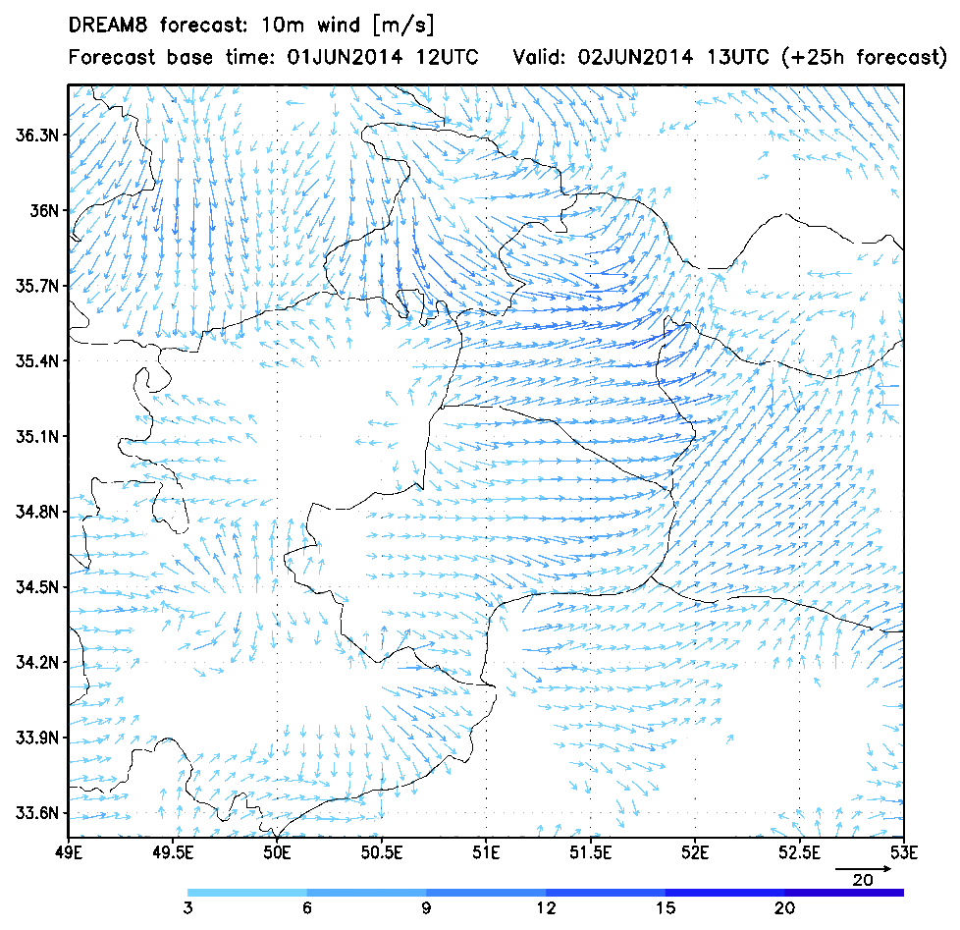
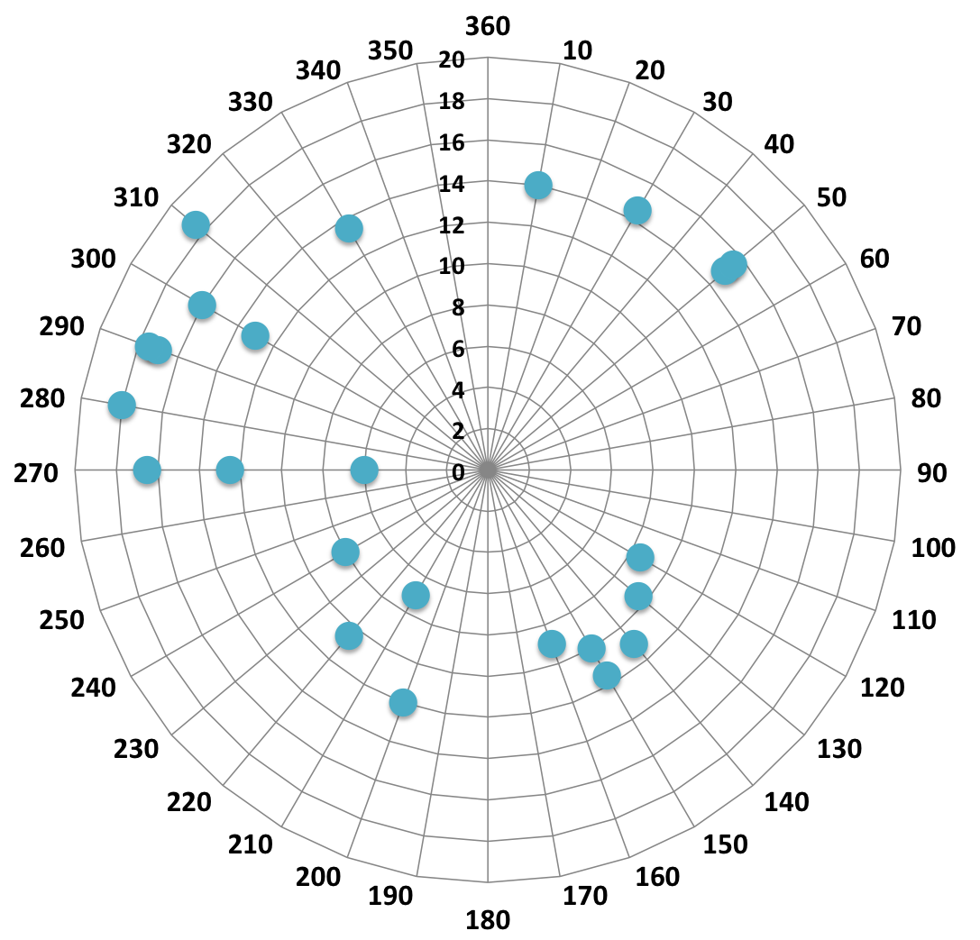
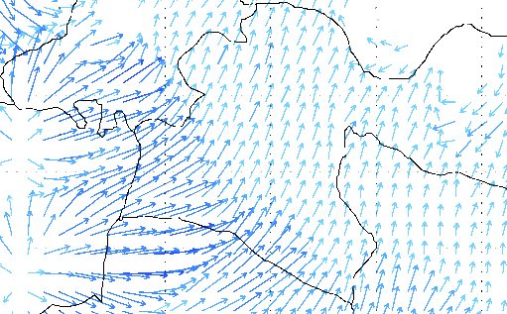
Imam Khomeini airport
OIIE
14UTC
Observed visibility & model DNC
Visibility reduced to 20m at 12:30UTC.
Model output data available on 1h.
13UTC
14
14:30
13:30
15
13
15:30
after 16h
Observed wind direction & model wind
12:30
until 12UTC
12UTC
12

Slide 11
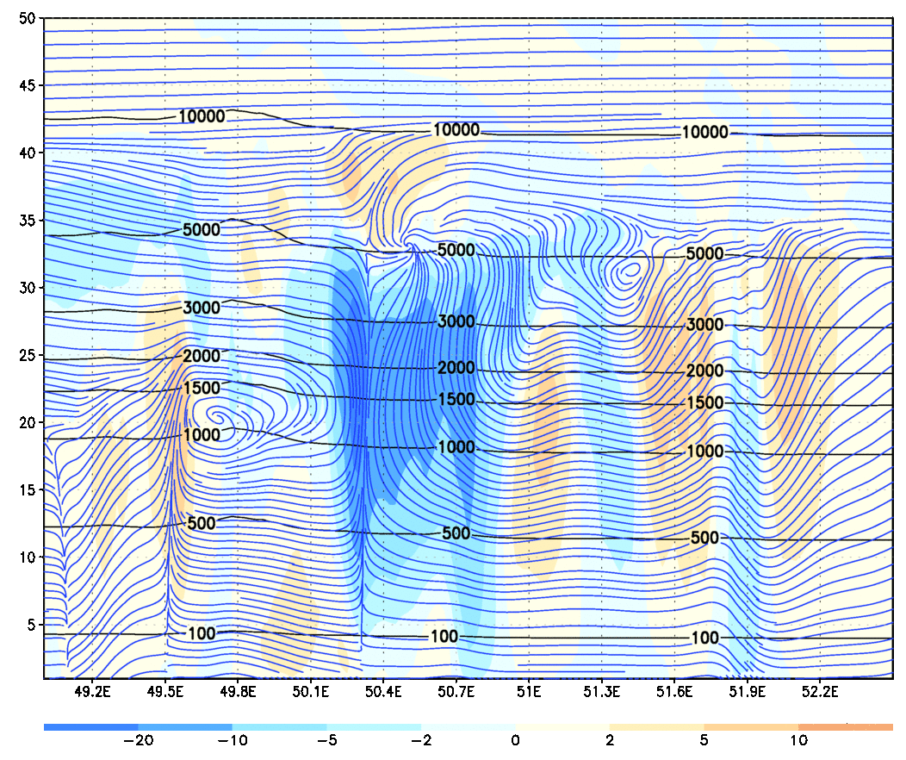
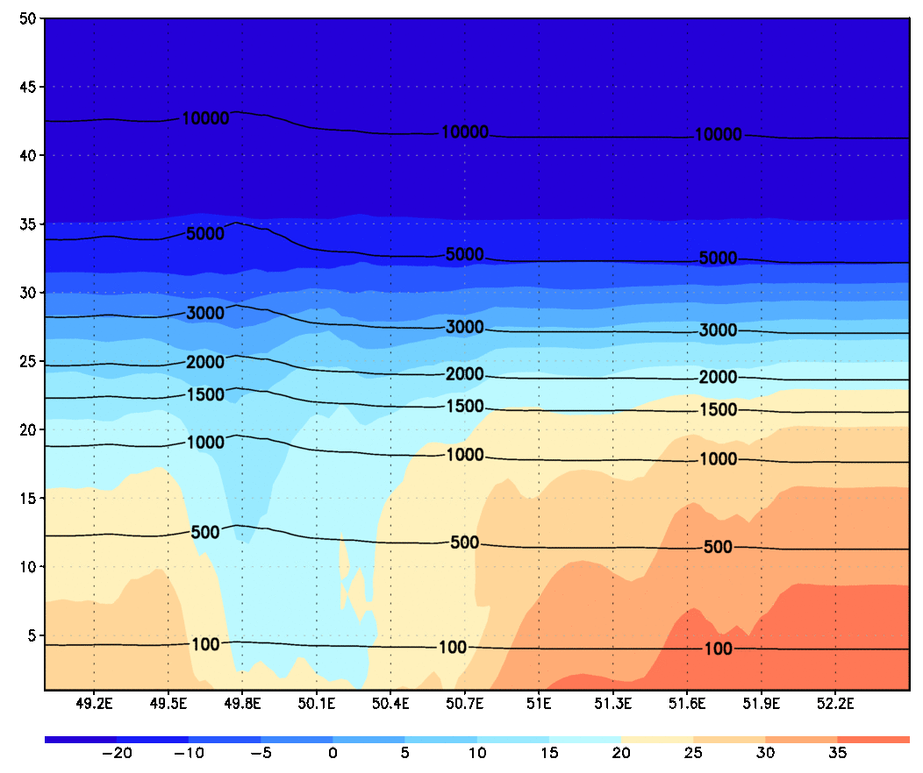
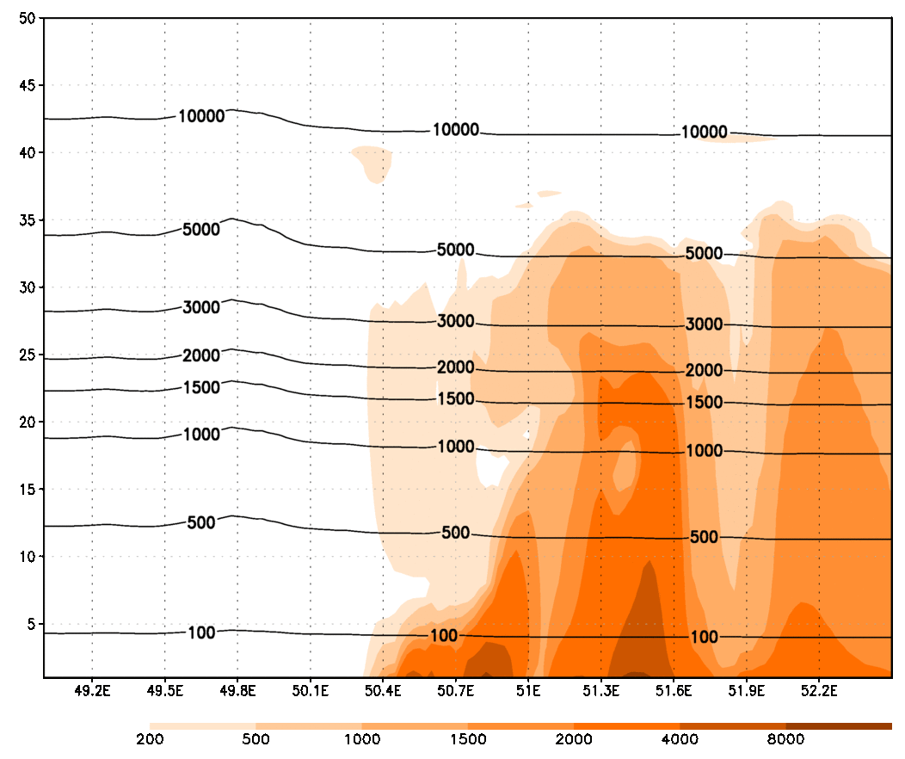
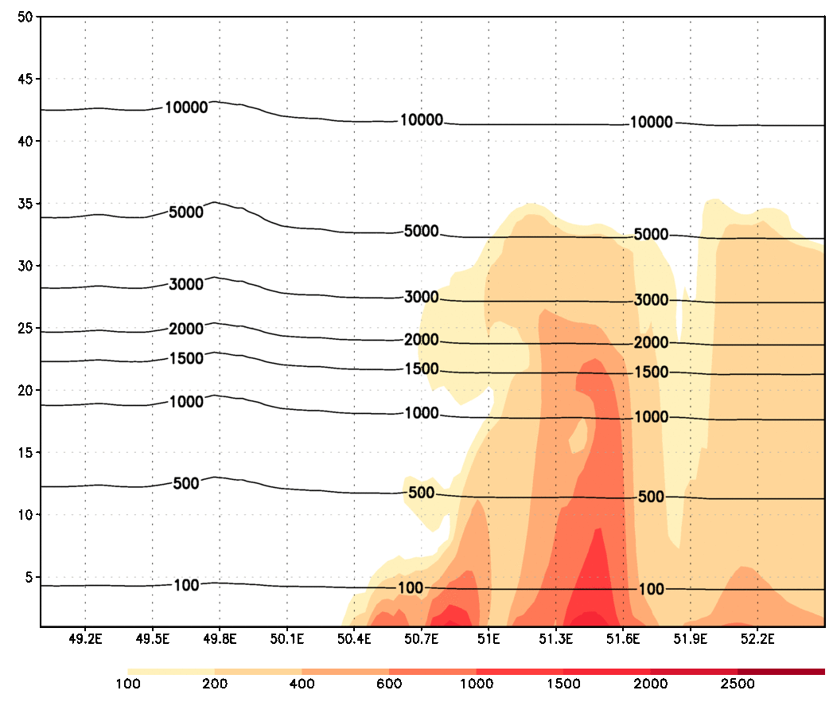
Vertical cross section along 35N
Values are on model levels, altitude of model levels are in black lines.
Streamlines (u,w) and vertical wind velocity
Temperature
Dust PM10 concentration
DNC – dust number concentration

Slide 12
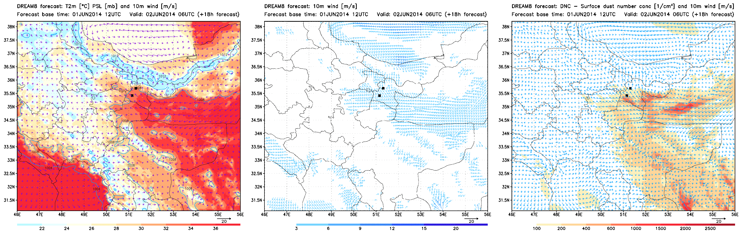
NMME-DREAM (SEEVCCC) simulation results for the period June 2nd 2014 06-20 UTC

Slide 13
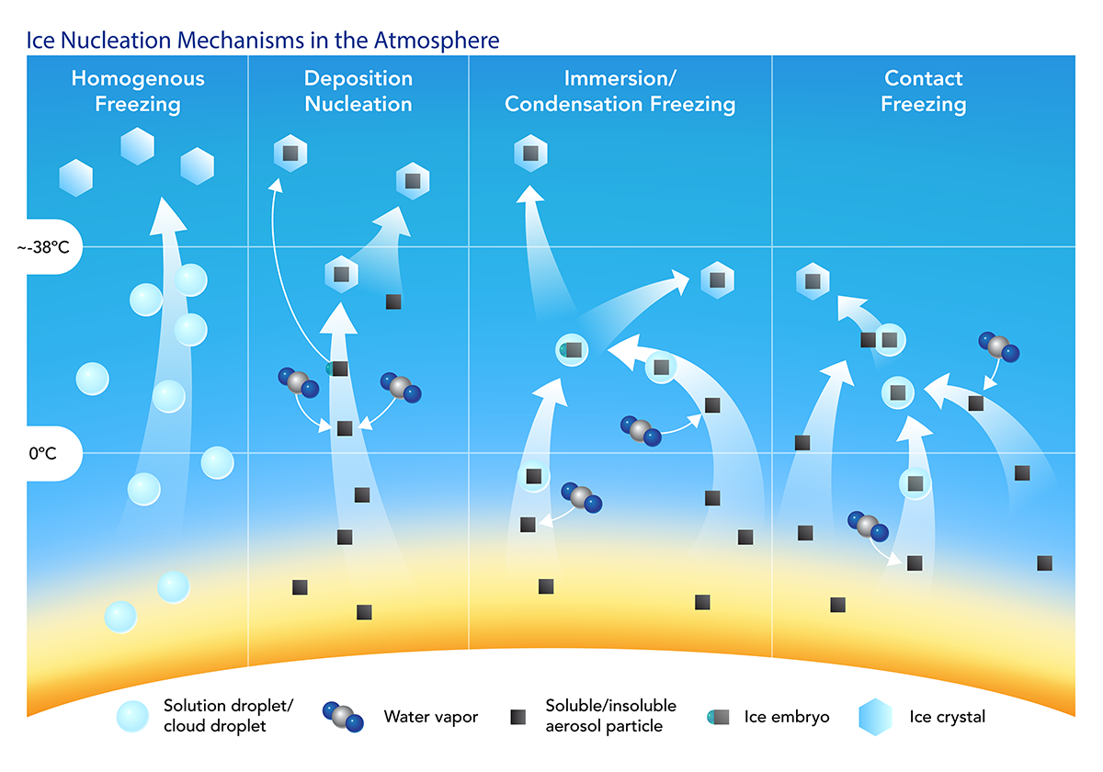
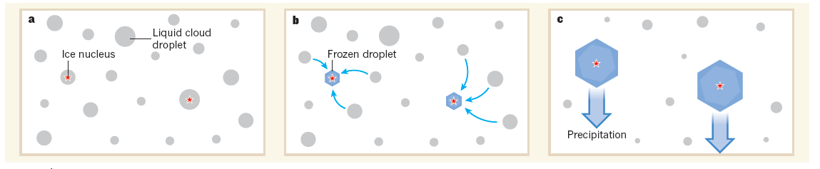
Heterogeneous cold clouds formation
Mineral dust particles act as efficient heterogeneous ice nuclei in the tropospheric cold and mixed-phase clouds
Dust particles lifted to the cold cloud layer effectively glaciate supercooled cloud water
Ice formation and precipitation
Koop and Mahowald, Nature, 2013

Slide 14
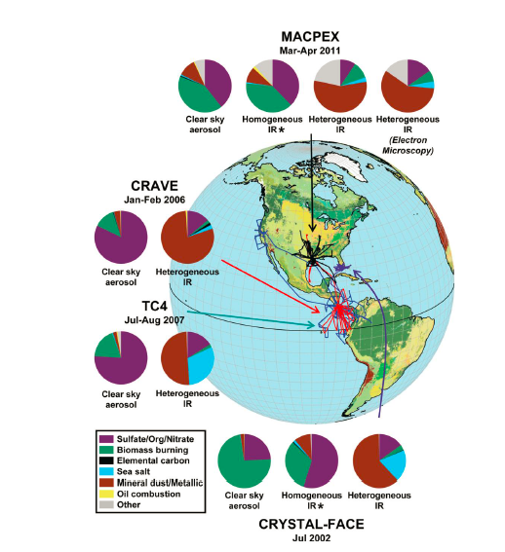
Recent findings from observations
(Ice Nuclei in ice crystals)
Cziczo at al., Science (2013)
  2/3 of residues in ice crystals from high clouds are dust+dust metallic oxides particles
  Small dust concentration needed to trigger the process
  Heterogeneous freezing is dominant process
  Minimal surface coating (no dust aging observed)
  Dust as ice nuclei found far from any of major desert sources (Asian, Saharan) !
Flight tracks of ice cloud residual measurements for four aircraft campaigns spanning a range of geographic regions and seasons

Slide 15
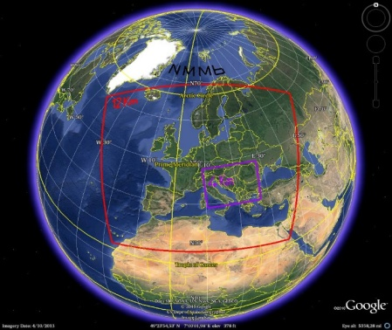
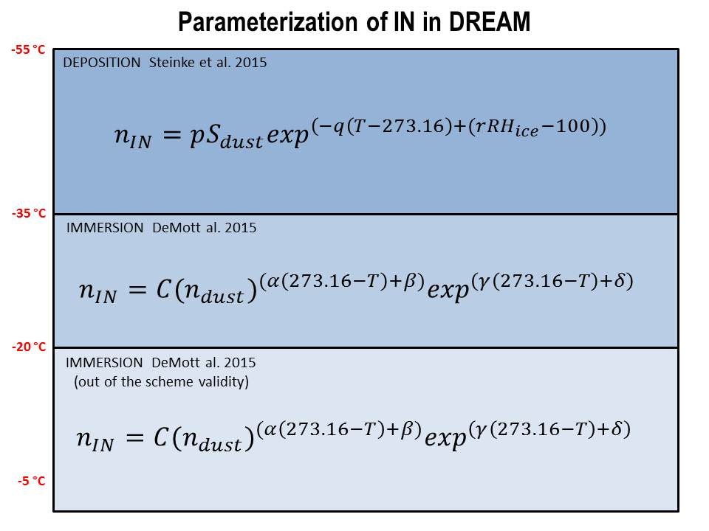
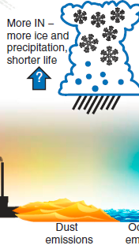
Improving precipitation forecast
‘Cooking’ cold clouds: our recipe
Dust C
T, RH
DREAM model
NMM model
Empirical parameterizations for immersion and deposition ice nucleation, which include dust concentration as a dependent variable for cloud glaciation process, are implemented in NMM/DREAM. Ice nucleation concentration is calculated as a prognostic parameter depending on dust and atmospheric thermodynamic conditions.
Instead of a predefined IN typically used in cloud mycrophysics we predict IN
NOTE: IN is fraction of aerosol capable to glaciate cloud water!
NMMB Thompson dust-friendly cold cloud micrphysics
Nickovic et al, 2016, Atmos. Chem. Phys., 16, 11367–11378

Slide 16
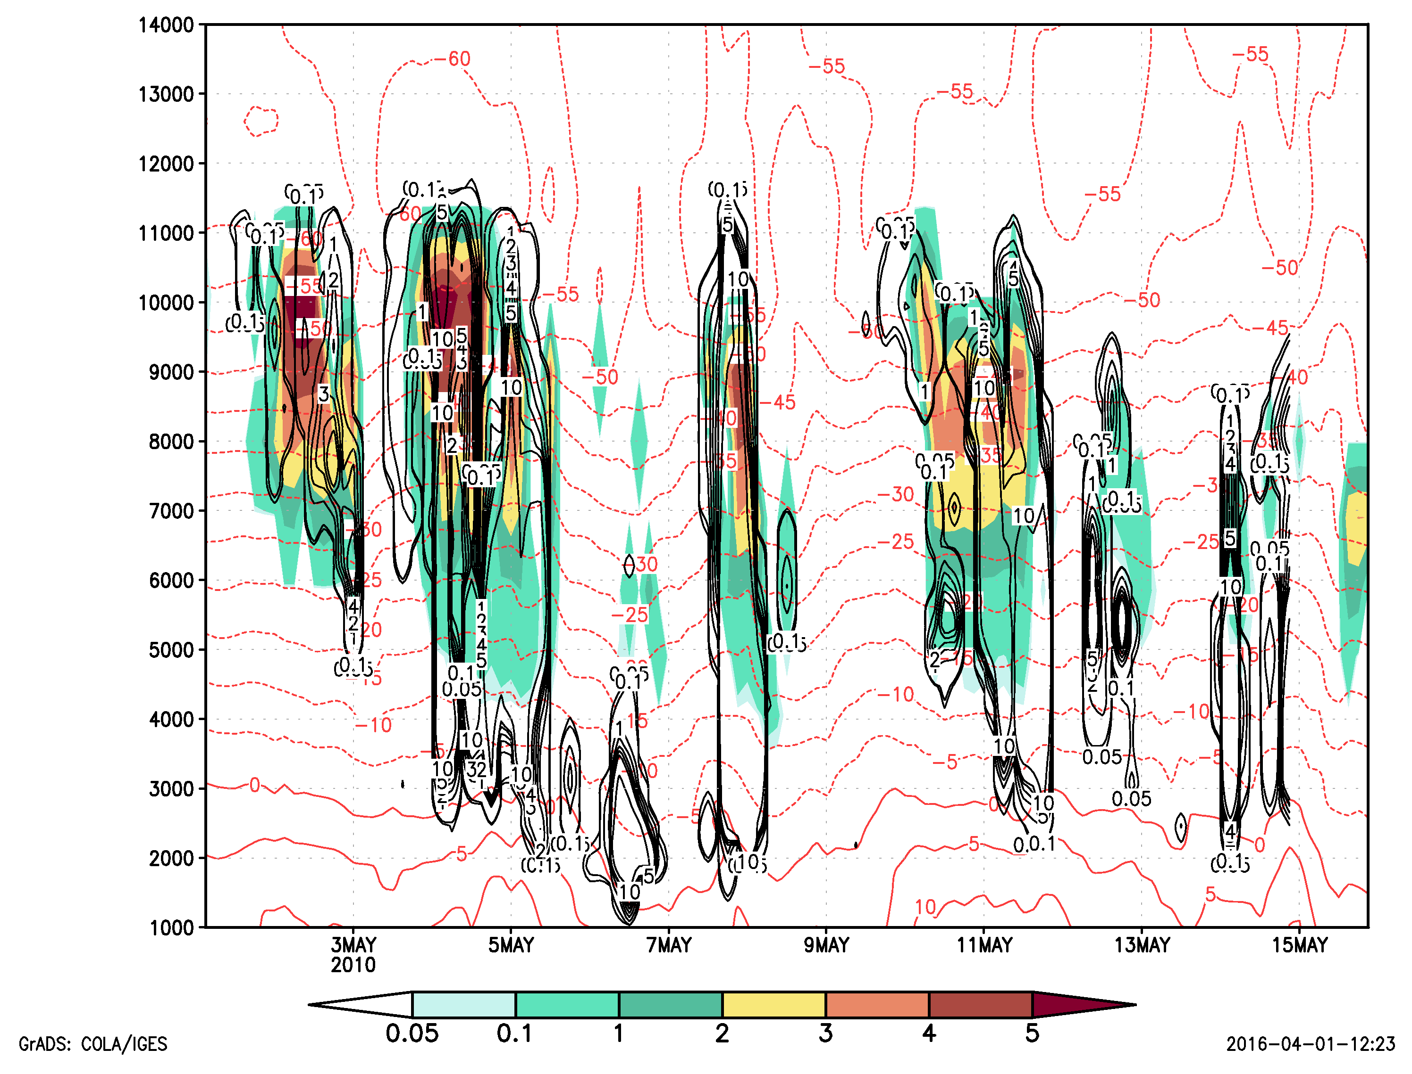
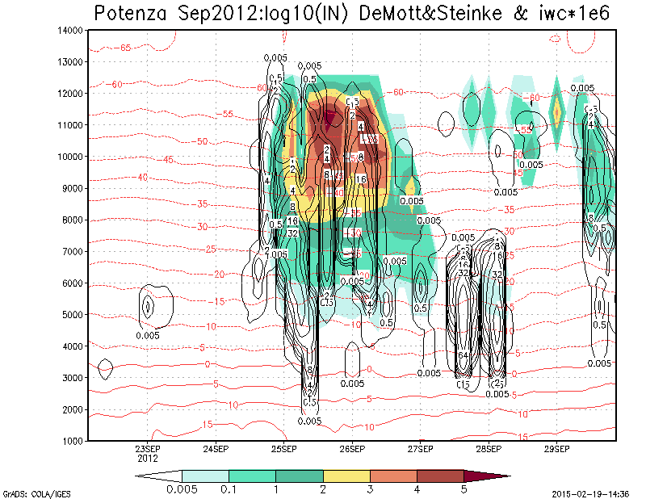
Model well reproduced timing, duration and position of #IN
1-15 May 2010
Vertical distribution
Data for model validation:
Lidar and cloud radar
CNR-IMAA Atmospheric
Observatory CIAO, Potenza, Italy
H(m)
- Model #IN (shaded)
- MIRA55 Ice Cloud Water
(black contours)
20-29 Sep 2012
H(m)
Daily averaged vertical loads
Potenza , May 2010 & Sep 2012
days

Slide 17
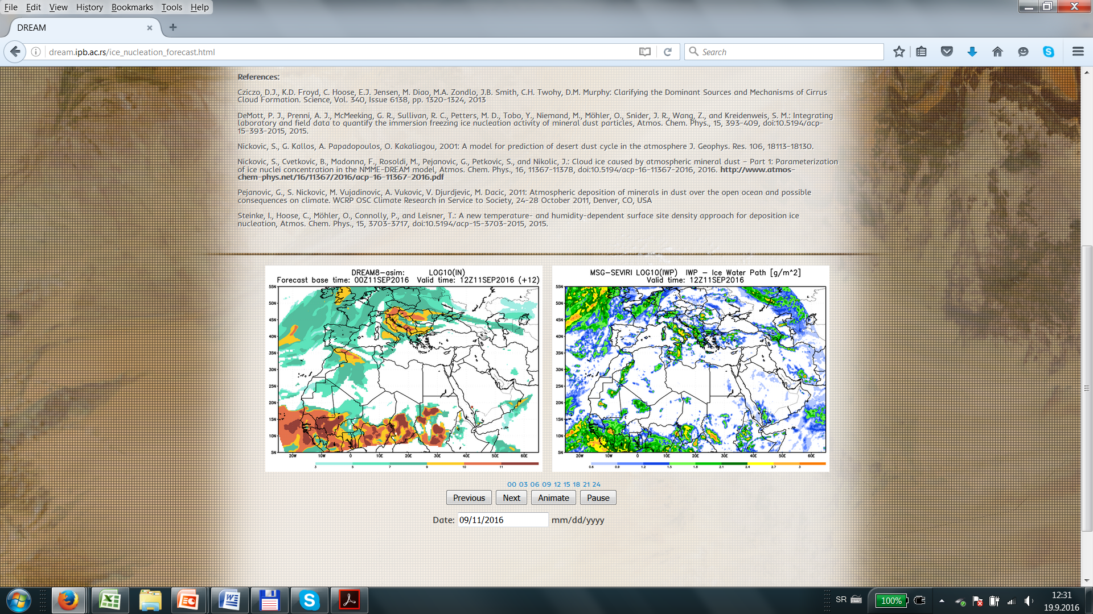
Daily IN maps
http://www.seevccc.rs/?p=8
http://dream.ipb.ac.rs/ice_nucleation_forecast.html
NWP groups interested to use daily #IN forecasts will soon have it available through the WMO SDS-WAS (dust) project

Slide 18
AIR FRANCE AF477
AIR CRASH HYPOTHESYS
INTENSE ICE NUCLEATION DUE TO SUDDEN UPDRAFT OF DUST PARTICLES INTO SUPERCOOLED CLOUD LAYER
1st June 2009
Airbus A330-203 operated by Air France
flight AF 447 Rio de Janeiro - Paris

Slide 19
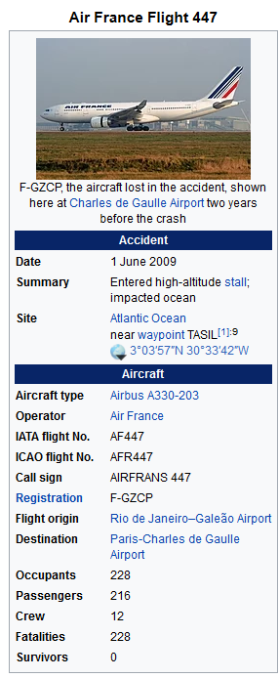
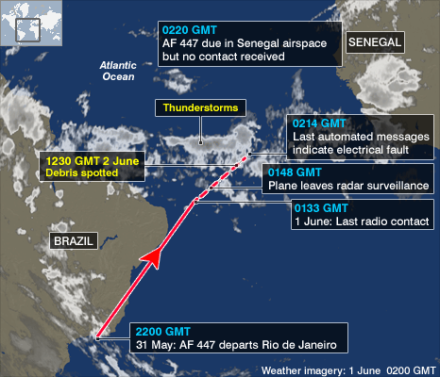

Slide 20
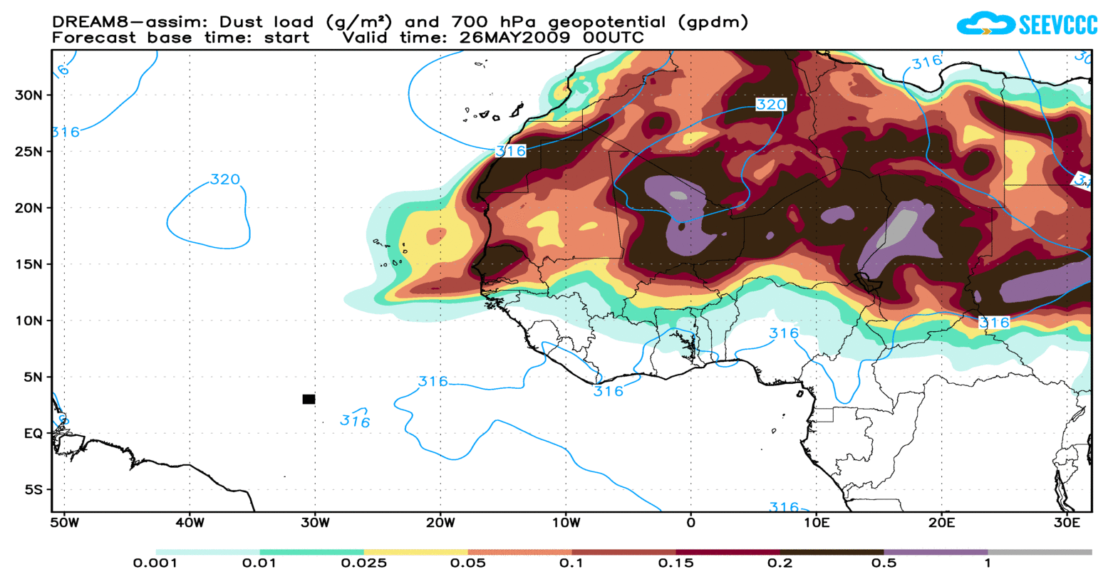
INTENSIVE LONG-RANGE TRANSPORT OF AFRICAN DUST TOWARDS EQUATORIAL MID-ATLANTIC REGION

Slide 21

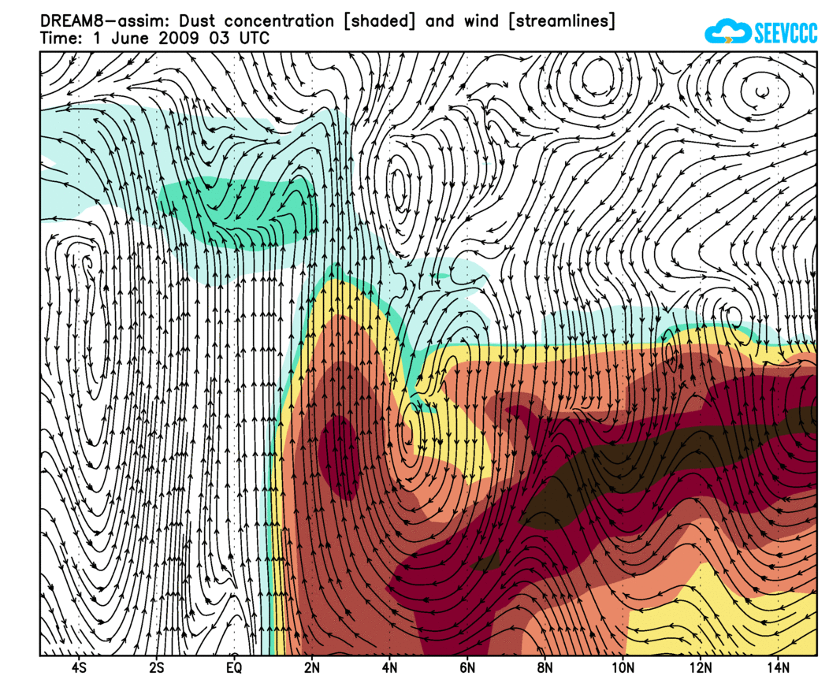
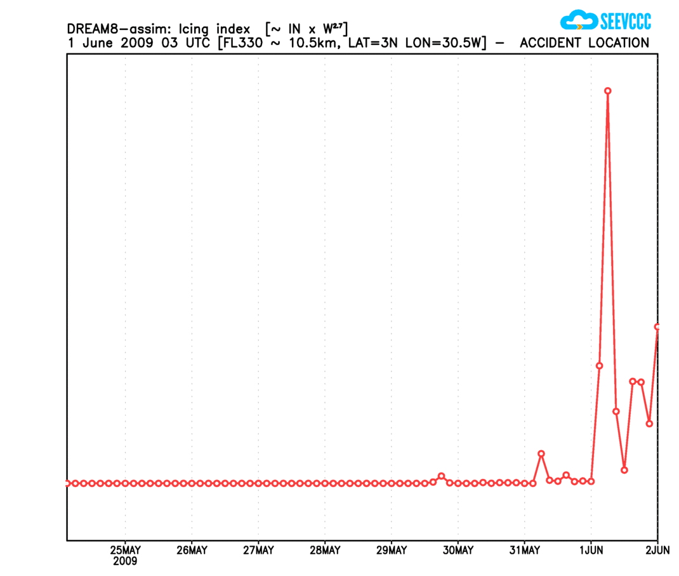
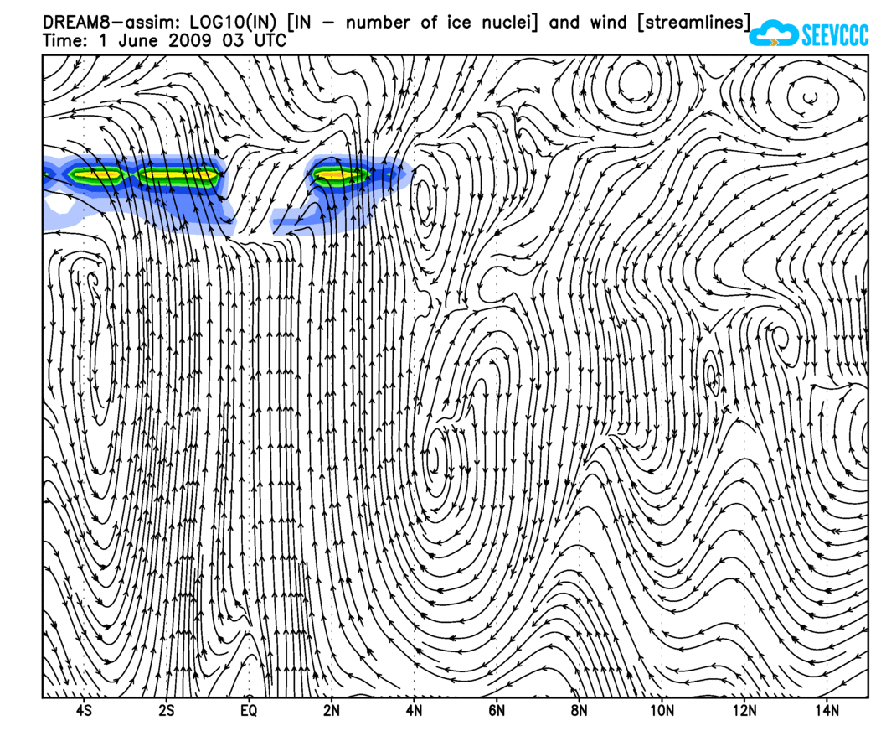
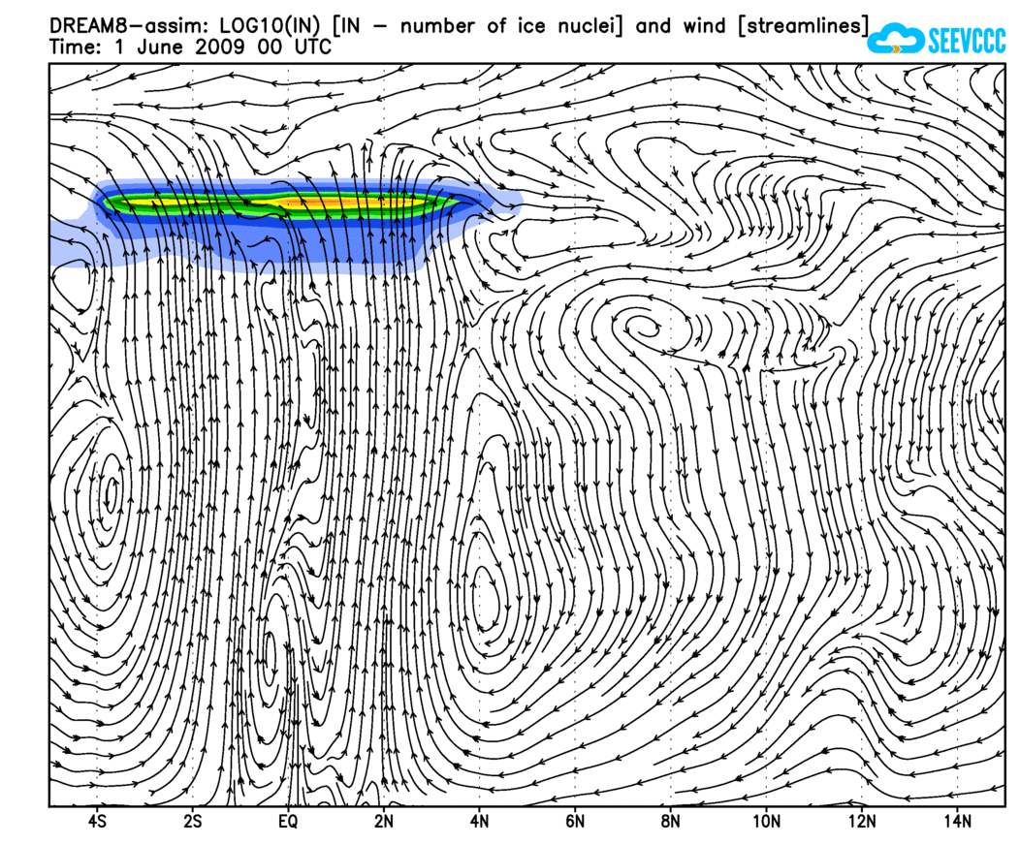
Cross at LON 30W; LAT 5S-15N, FL330

Slide 22
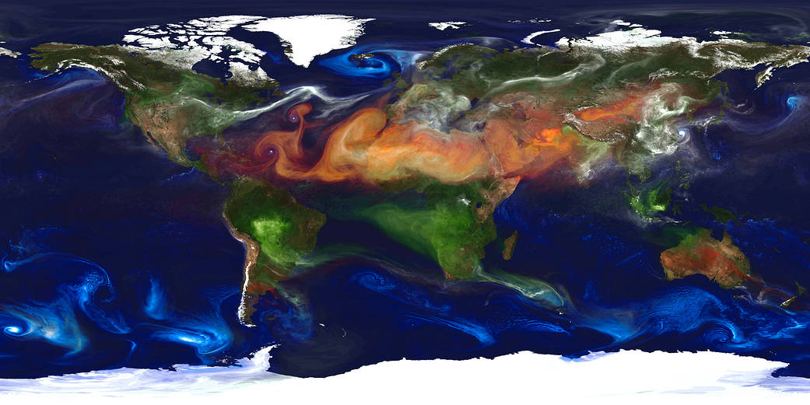
Sources and transport of atmospheric aerosols
Aerosol optical thickness of black and organic carbon (green), dust (red-orange), sulfates (white), and sea salt (blue) from a 10 km resolution GEOS-5 using the GOCART model - The Goddard Chemistry Aerosol Radiation and Transport (GOCART)
Dust picked up by winds from the Sahara and other North African deserts is often carried to the Caribbean Sea and the Americas. In fact, dust events deliver about 40 million tons of dust each year from the Sahara to the Amazon River Basin alone. Research has shown that part of the reason the Amazon region is so fertile is because of the vast mineral nutrients carried on the winds from Africa.

Slide 23
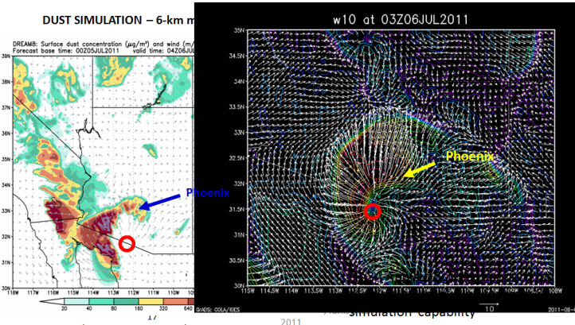
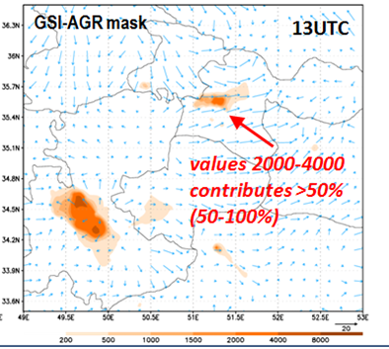
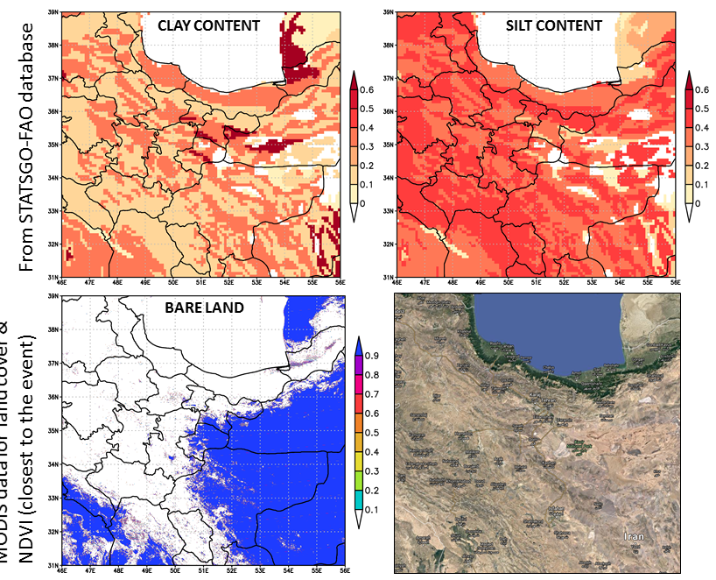
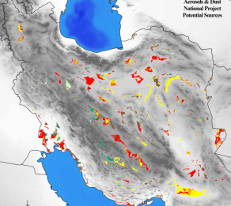
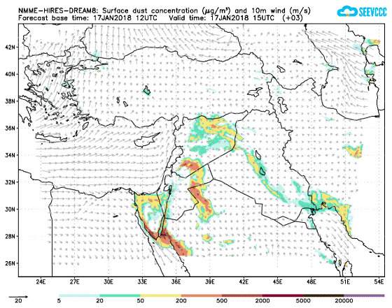
DREAM examples with haboob-like storms – High Resolution Modelling
Downscaling the model to at least 3-5 km horiz. resolution
Convective systems resolved
Non-hydrostatic effects included (high vertical velocities)
DREAM tests for selected haboobs
  Phoenix 2011;
  Tehran 2014;
  Turkey 2018
New approach to consider small-scale hot-spot dust sources :
  land cover (static) and NDVI (dynamic)
  Re-definition of the Ginoux source function for vary-small scales
  Local data on
    clay/silt fractions, land/surface properties
    identified sources not existing in other data bases (agricultural sources, etc...)
Phoenix 2011
Tehran 2014
Turkey 2018

Slide 24
Thank you kindly for your attention!

Slide 25
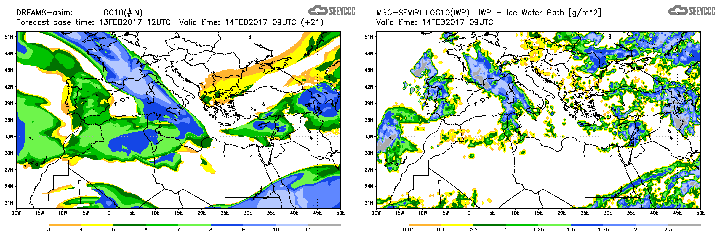
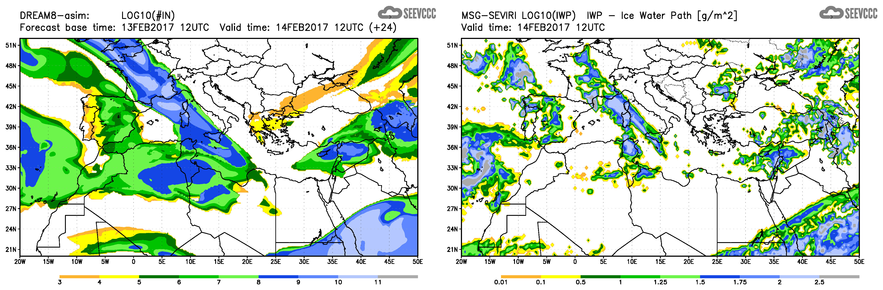
Model number of Ice nuclei load (left) vs MSG-SEVIRI satellite Ice water path (right)

