Slide 1

Overview of on-going work on NMMB HPC performance at BSC
George S. Markomanolis, Oriol Jorba, Kim Serradell
Belgrade, 26 September 2014

Slide 2

Outline
Introduction to OmpSs programming model
Experiences with OmpSs
Future work
2

Slide 3
NMMB/BSC-CTM
More than 100.000 lines of Fortran code for the main core
NMMB/BSC-CTM is used operationally for the dust forecast center in Barcelona
  NMMB is the operational model of NCEP
The general purpose is to improve its scalability and the simulation resolution
3

Slide 4
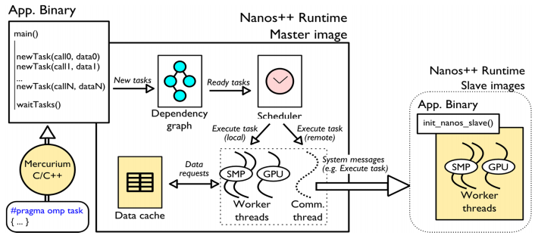
OmpSs Introduction
Parallel Programming Model
- Build on existing standard: OpenMP
- Directive based to keep a serial version
- Targeting: SMP, clusters, and accelerator devices
- Developed in Barcelona Supercomputing Center (BSC)
Mercurium source-to-source compiler
Nanos++ runtime system
https://pm.bsc.es/ompss

Slide 5
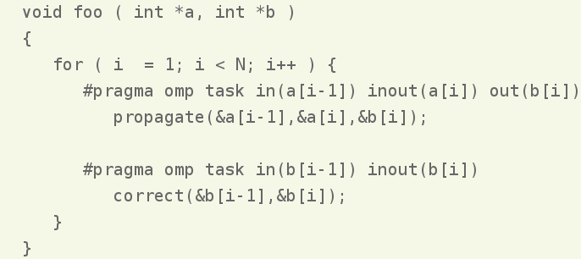
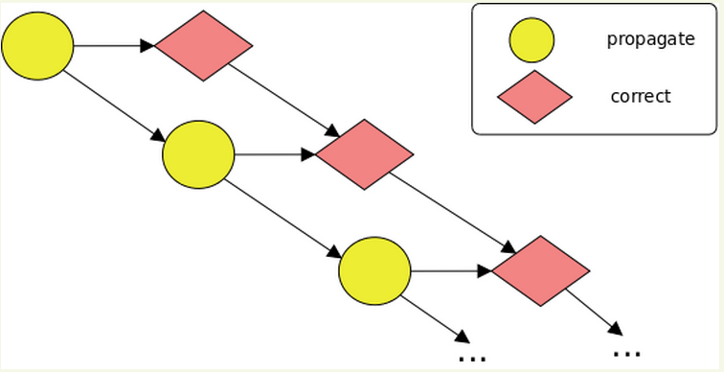
OmpSs Example

Slide 6
Roadmap to OmpSs
NMMB is based on the Earth System Modelling Framework (ESMF)
The current ESMF release (v3.1) is not supporting threads
However, the development version of NMMB uses ESMF v6.3
Post-process broke because of some other issues (which will be fixed)
The new version of NMMB with OmpSs support has been compiled on MareNostrum and MinoTauro
6

Slide 7
Performance Analysis of NMMB/BSC-CTM Model

Slide 8
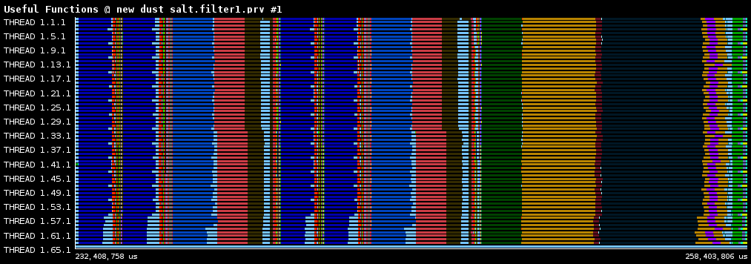
Zoom between EBI solvers
The useful functions call between two EBI solvers
The first two dark blue areas are horizontal diffusion calls and the light dark is advection chemistry.
8

Slide 9
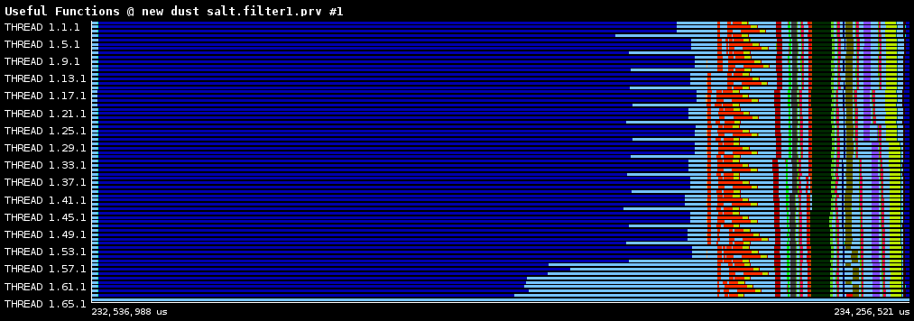
Horizontal diffusion
We zoom on horizontal diffusion and the calls that follow
Horizontal diffusion (blue colour) has load imbalance
9

Slide 10
Experiences with OmpSs

Slide 11
Objectives
Trying to apply OmpSs on a real application
Applying incremental methodology
Identify opportunities
Exploring difficulties
11

Slide 12
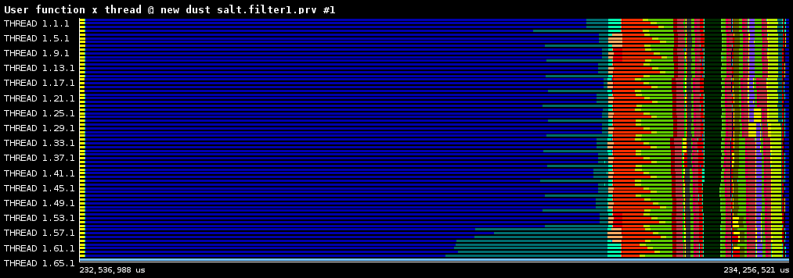
Horizontal diffusion + communication
The horizontal diffusion has some load imbalance
There is some computation about packing/unpacking data for the communication buffers (red area)
Gather (green colour) and scatter for the FFTs
12

Slide 13
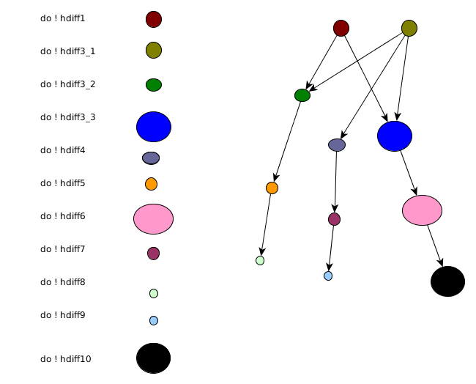
Horizontal diffusion skeleton code
The hdiff subroutine has the following loops and dependencies
13

Slide 14
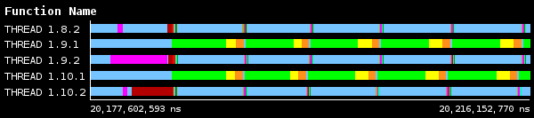
Local optimizations
Study the hdiff tasks with 2 threads
Loop hdiff3_3 needs 4.7 ms (green colour)
Code of hdiff3_3 loop
do j=jts_b1,jte_h2 do i=its_b1,ite_h2 hkfx=hkx(i,j)*fmlx(i,j) hkfy=hky(i,j)*fmly(i,j) if(num_tracers_chem>0.and.diff_chem)then do ks=1,num_tracers_chem sx (i,j,ks)=(s (i,j,l,ks)-s (i-1,j,l,ks))*hkfx sy (i,j,ks)=(s (i,j,l,ks)-s (i,j-1,l,ks))*hkfy enddo endif enddo enddo
14

Slide 15
Local optimizations
Study the hdiff tasks with 2 threads
Loop hdiff3_3 needs 4.7 ms (green colour)
Code of hdiff3_3 loop
do j=jts_b1,jte_h2 do i=its_b1,ite_h2 hkfx=hkx(i,j)*fmlx(i,j) hkfy=hky(i,j)*fmly(i,j) if(num_tracers_chem>0.and.diff_chem)then do ks=1,num_tracers_chem sx (i,j,ks)=(s (i,j,l,ks)-s (i-1,j,l,ks))*hkfx sy (i,j,ks)=(s (i,j,l,ks)-s (i,j-1,l,ks))*hkfy enddo endif enddo enddo
New code if(num_tracers_chem>0.and.diff_chem)then do ks=1,num_tracers_chem do j=jts_b1,jte_h2 do i=its_b1,ite_h2 hkfx=hkx(i,j)*fmlx(i,j) hkfy=hky(i,j)*fmly(i,j) sx (i,j,ks)=(s (i,j,l,ks)-s (i-1,j,l,ks))*hkfx sy (i,j,ks)=(s (i,j,l,ks)-s (i,j-1,l,ks))*hkfy enddo endif enddo enddo
15

Slide 16
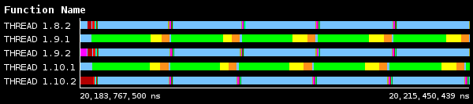
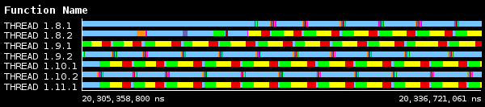
Local optimizations
Study the hdiff tasks with 2 threads
Loop hdiff3_3 needs 4.7 ms (green colour)
Paraver trace with the code modification
Now the hdiff3_3 needs 0.7 ms, a speedup of 6.7 times!
16

Slide 17
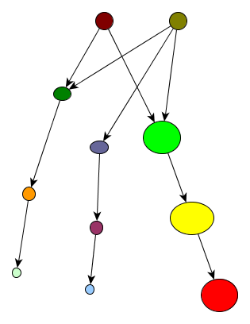
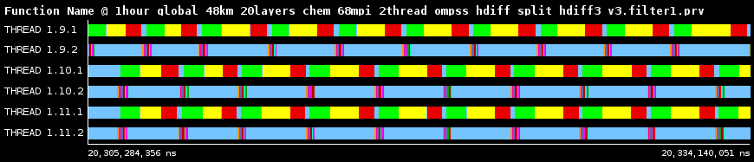
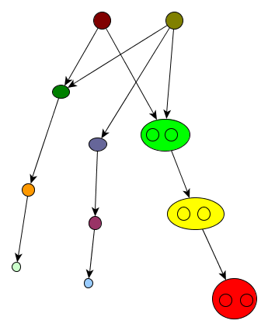
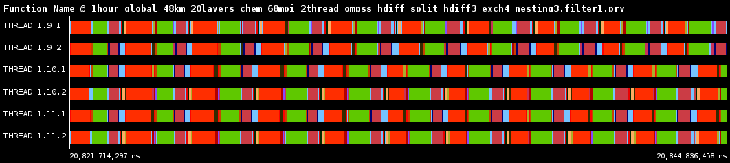
Parallelizing loops
Part of hdiff with 2 threads
Parallelizing the most important loops
We have a speedup of 1.3 by using
worksharing
17

Slide 18
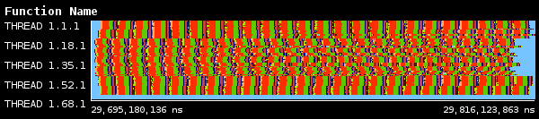
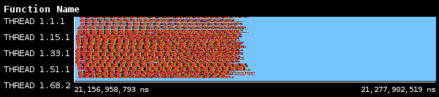
Comparison
The execution of hdiff subroutine with 1 thread takes 120 ms
The execution of hdiff subroutine with 2 threads takes 56 ms, the speedup is 2.14
Overal for 1 hour simulation from 17.37 seconds (average value) to 9.37 seconds, improvement of 46%.
18

Slide 19
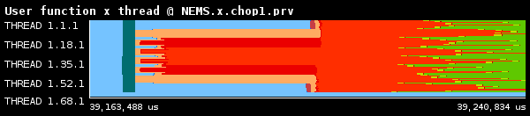
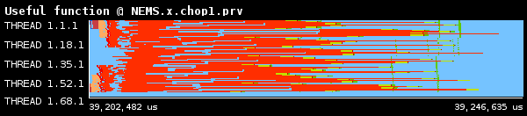
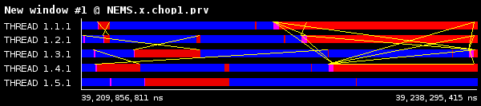
Issues related to communication
We study the exch4 subroutine (red colour)
The useful function of exch4 has some computation
The communication creates a pattern and the duration of the MPI_Wait calls can vary
19

Slide 20
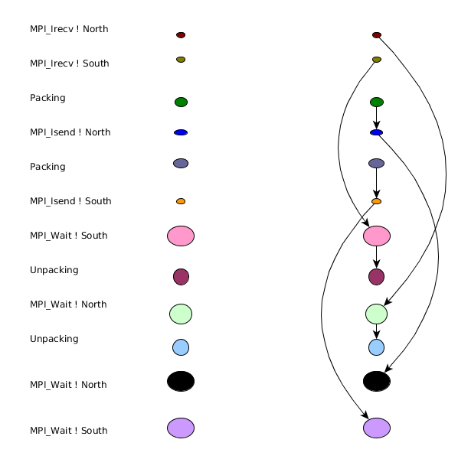
Issues related to communication
Big load imbalance because message order
There is also some computation
20

Slide 21
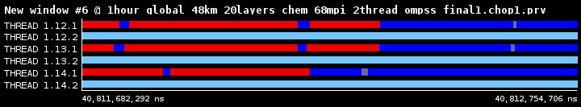
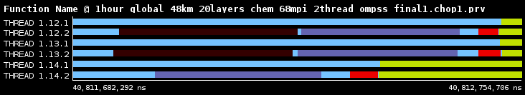
Taskify subroutine exch4
We observe the MPI_Wait calls in the first thread
In the same moment the second thread does the necessary computation and overlaps the communication
21

Slide 22
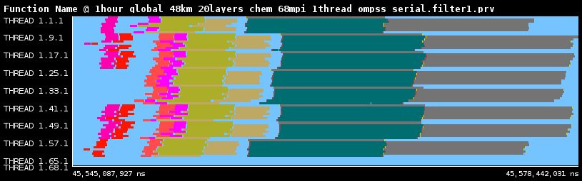
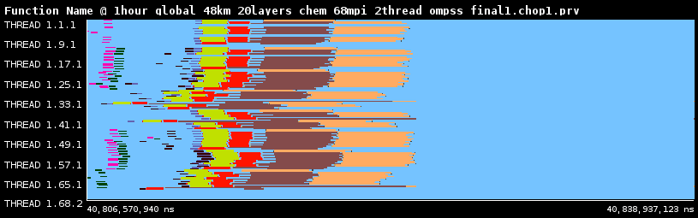
Taskify subroutine exch4
The total execution of exch4 subrouting with 1 thread
The total execution of exch4 subrouting with 2 threads
With 2 threads the speedup is 88% (more improvements have been identified)
22

Slide 23
Incremental methodology with OmpSs
Taskify the loops
Start with 1 thread, use if(0) for serializing tasks
Test that dependencies are correct (usually trial and error)
Imagine an application crashing after adding 20+ new pragmas (true story)
Do not parallelize loops that do not contain significant computation
23

Slide 24
Remarks
The incremental methodology is important for less overhead in the application
OmpSs can be applied on a real application but is not straightforward
It can achieve pretty good speedup, depending on the case
Overlapping communication with computation is a really interesting topic
We are still in the beginning but OmpSs seems promising
24

Slide 25
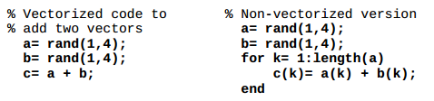
Code vectorization

Slide 26
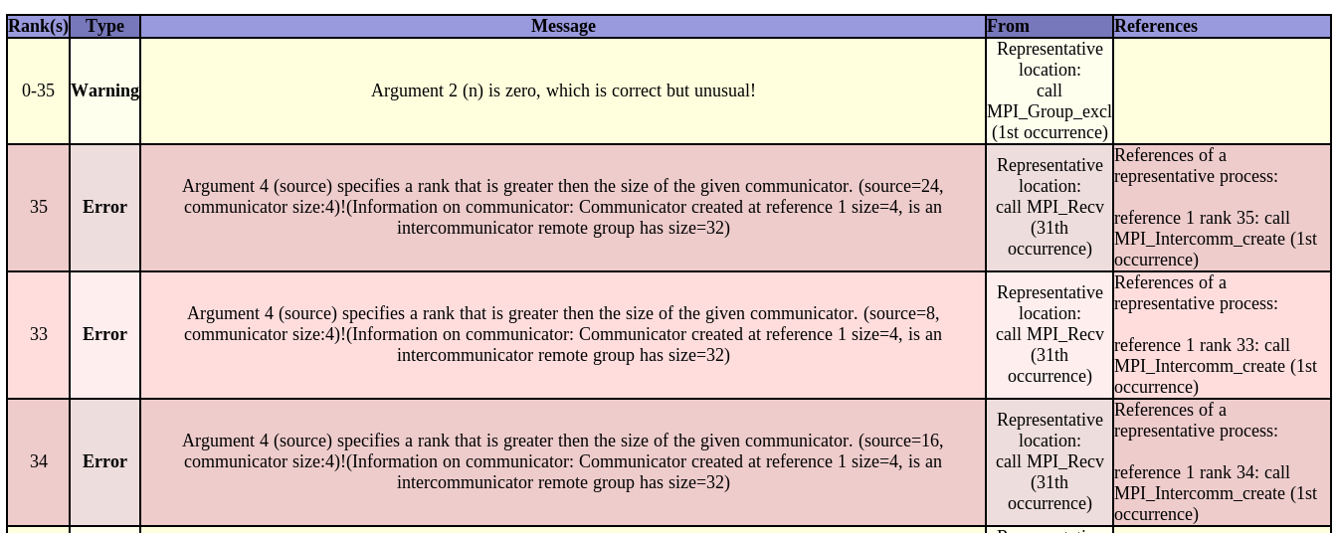
MUST - MPI run time error detection

Slide 27
2. Experimental performance analysis tool

Slide 28
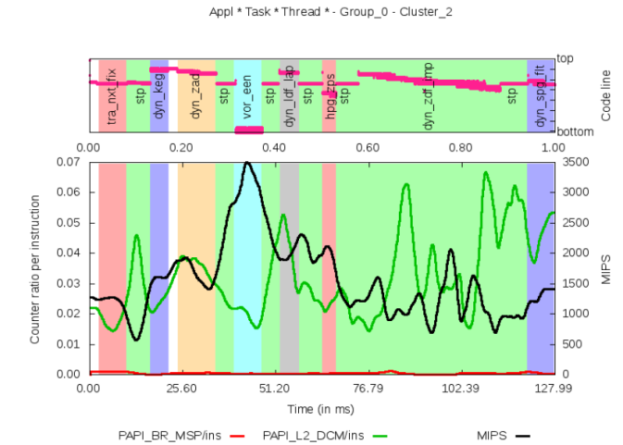
NEMO – Performance analysis with experimental tool
Study of the poor performance:
Lines 238-243 of tranxt.f90 (tra_nxt_fix), lines 229-236 of step.f90 (stp), and lines 196, 209, 234-238, 267, 282 of dynzdf_imp.f90 (dyn_zdf_imp)
Credits: Harald Servat
28

Slide 29
3. Exploring directions

Slide 30
Future directions
Collaborate with database experts at BSC
Rethink big, roadmap for European technologies in hardware and networking for big data
Exascale IO
30

Slide 31
Future Work

Slide 32
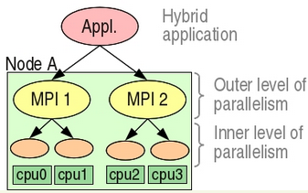
Future improvements
One of the main functions of the application is the EBI solver (run_ebi). There is a problem with global variables that make the function not reentrant. Refactoring of the code is needed.
Porting more code to OmpSs and investigate MPI calls as tasks
Some computation is independent to the model's layers or to tracers. OpenCL kernels are going to be developed to test the performance on accelerators
Testing versioning scheduler
The dynamic load balancing library should be studied further (http://pm.bsc.es/dlb)
More info at ECMWF HPC workshop 2014
32

Slide 33
PRACE schools
PATC Course: Parallel Programming Workshop, 13-17 October 2014 (BSC)
PATC Course: Earth Sciences Simulation Environments, 11-12 December 2014 (BSC)
Google for “PATC PRACE”
33

Slide 34
Thank you!
Questions?
Acknowledgements:
Jesus Labarta, Rosa M. Badia, Judit Gimenez, Roger Ferrer Ibáñez, Victor López, Xavier Teruel, Harald Servat,
BSC support
34

