Slide 1
NMMB in an HPC environment: strengths and bottlenecks on Marenostrum Supercomputer
George S. Markomanolis, Oriol Jorba, Kim Serradell
Belgrade, 25 September 2014

Slide 2

Outline
Introduction
  SO Applications
  NMMB/BSC-CTM
  Global high-res application
Collaboration projects with CS
COMPSs on Fix-Vrbl tasks
Performance NMMB/BSC-CTM
Future work
2

Slide 3
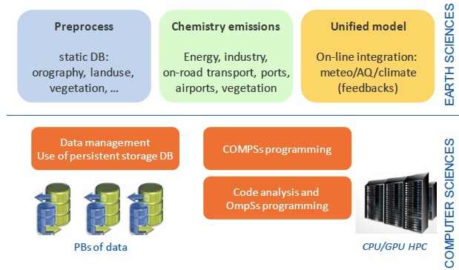



Severo-Ochoa Earth Sciences Application
Development of a Unified Meteorology/Air Quality/Climate model
  Towards a global high-resolution system for global to local assessments
Extending NMMB/BSC-CTM from coarse regional scales to global high-resolution configurations
Coupling with a Data Assimilation System for Aerosols
International collaborations:
Meteorology
Climate
Global aerosols
Air Quality
National Centers for
Environmental Predictions
Goddard Institute Space Studies
Uni. of California Irvine
3
Notes:
Under all this context, the Earth Sciences Department is working in the development of a High Resolution unified Meteorology/Air Quality/Climate modelling system
This unified system will be a powerful tool to strength the research in atmospheric sciences on air quality, interactions between meteorology and atmospheric chemistry, and climate
The goal of the Severo-Ochoa project is to set-up the model at global scale with high-horizontal resolution (15 to 1km). The application will produce PBs of data and will exploit hundreds of thousands of cores
Four main collaborations with the Computer Sciences department are established: workflows with CompSs, porting Unified model code to ompSs, integration of persistent objects in modelling system databases, trace analysis of the executions.
Establishment of several international collaborations with:
National Centers for Environmental Predictions (USA) – collaboration on meteorological modelling
NASA-Goddard Institute for Space Studies (USA) – collaboration on implementation of aerosols and climate application
University of California Irvine (USA) – collaboration on air quality and the study of secondary aerosols on a global scale
3

Slide 4
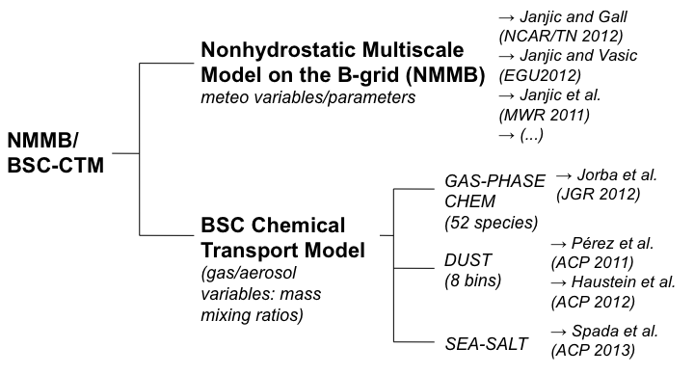
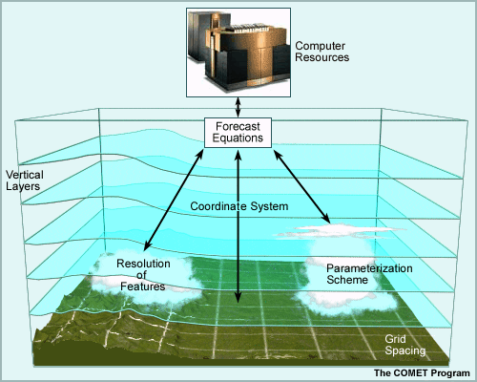
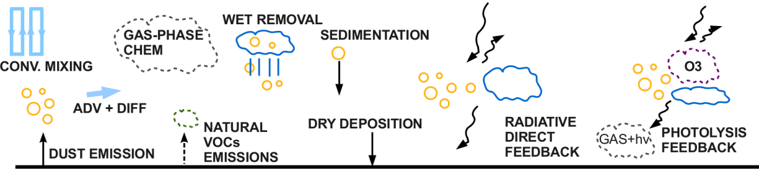
NMMB/BSC-Chemical Transport Model (Overview)
Global aerosols
Secondary aerosols
Ocean model
Notes:
In summary, the NMMB/BSC-CTM is developed based on the NMMB.
The gas-phase chemistry, the mineral dust and sea salt aerosols has already been implemented.
In the framework of the Severo-Ochoa, the model will be configured at global very high –resolution, and the secondary aerosols and an ocean model will be coupled with the system.
Thus, the range of application of the model will be extended from short- to climate applications.

Slide 5
Collaborations with Computer Sciences
Use of CompSS:
  Porting Model pre-processing to CompSs
  Test of the application at low and high resolution
  Limitations on the approach when dealing with high-resolution configurations
Performance analysis:
  Definition of model configurations
  Initial extraction of traces – problems when using instrumented functions
Issues on the operational cluster
5

Slide 6
1. Use of COMPSs

Slide 7
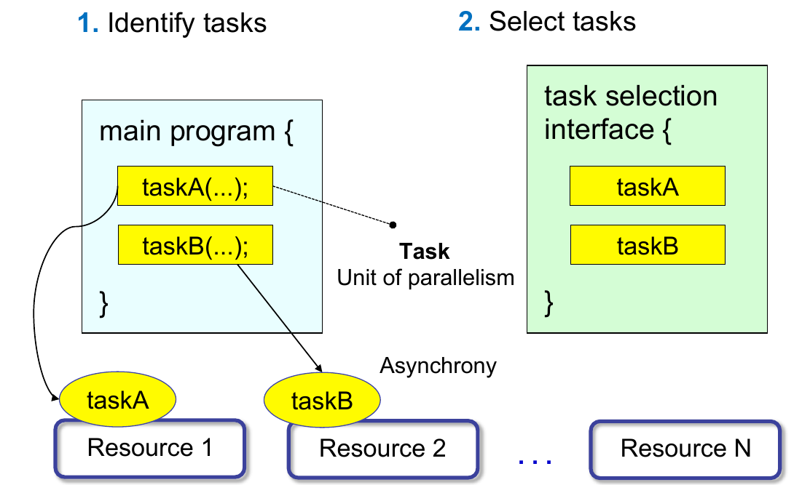
Programming Model: Steps
Source: COMPSs Tutorial, July 2013, Barcelona

Slide 8
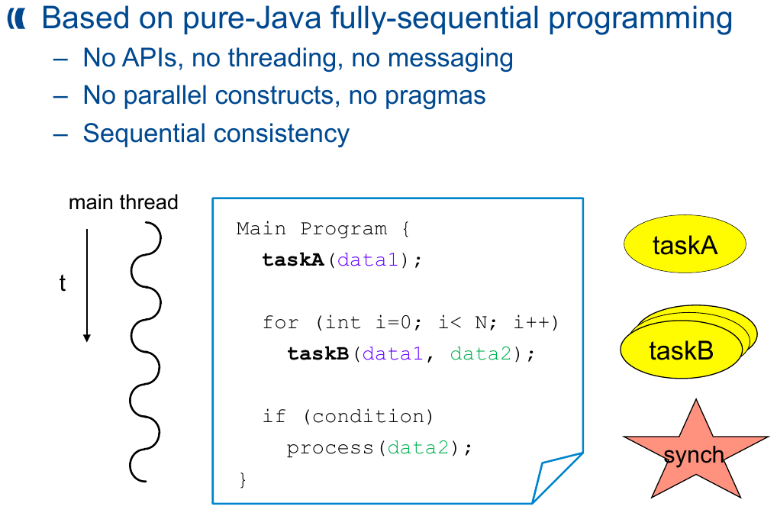
Programming Model: Proeprties
Source: COMPSs Tutorial, July 2013, Barcelona

Slide 9
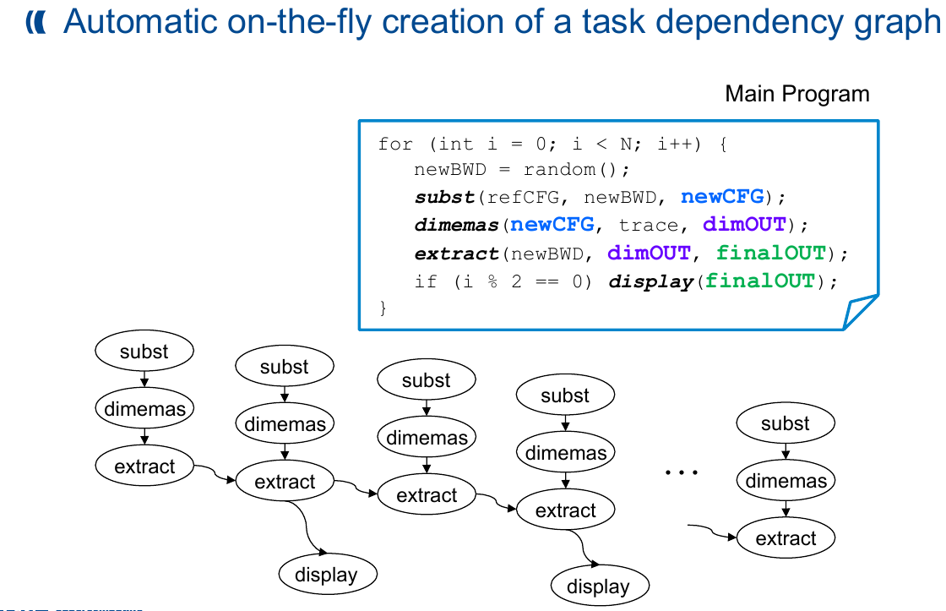
Programming Model: Dependency detection
Source: COMPSs Tutorial, July 2013, Barcelona

Slide 10
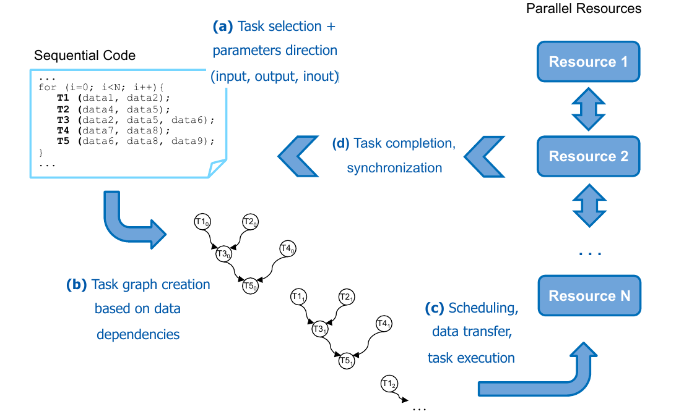
Programming Model: Summary
Source: COMPSs Tutorial, July 2013, Barcelona

Slide 11
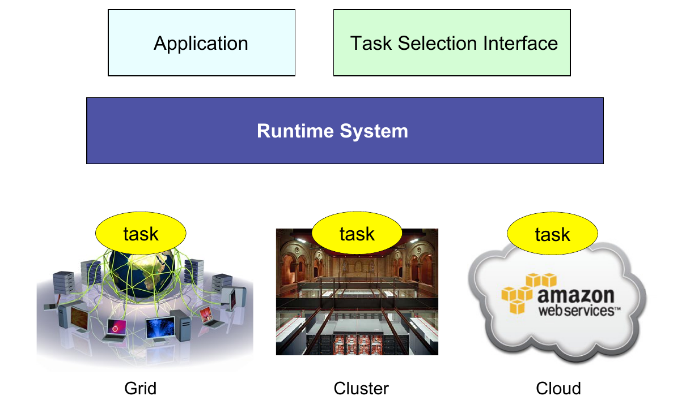
Runtime System
Source: COMPSs Tutorial, July 2013, Barcelona

Slide 12
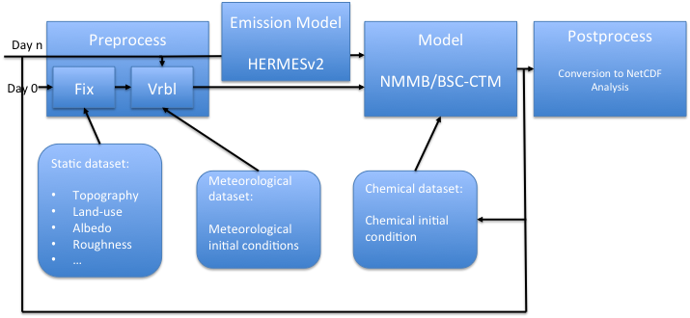
Execution diagram: Focus on the Preprocessor
Tested in two cases: Global domain 1ºx1.4º resolution
Global domain 12km x 12km

Slide 13
Original Preprocess
Preprocess is divided in two main tasks:
  Fixed: which is only done once, when configuring the model
  Variable: is done each run, as takes daily meteorological and surface sea temperature inputs.
  Fixed and Variable are now run separately.
Totally sequential, synchronous, ignore data dependencies between subprocesses.
#FIXED
./exe/smmount.x
./exe/landuse.x
./exe/landusenew.x
./exe/topo.x
./exe/stdh.x
./exe/envelope.x
./exe/topsoiltype.x
./exe/botsoiltype.x
./exe/toposeamask.x
./exe/stdhtopo.x
./exe/deeptemperature.x
./exe/snowalbedo.x
./exe/vcgenerator.x
./exe/roughness.x
./exe/gfdlco2.x
./exe/lookup_aerosol.x
#VARIABLE
ln -s ../meteo_data/wafs.00.0P5DEG.13042400.grib1 ../output/gfs.t00z.pgrb2f00
ln -s ../meteo_data/sst2dvar_grb_0.5.13042400.grib1 ../output/sst2dvar_grb_0.5
./degribgfs_generic_05.sh 00 00 03 pgrb2f ../output
./exe/gfs2model_rrtm.exe 00
./exe/inc_rrtm.x
./exe/cnv_rrtm.x
./exe/degribsst.x
./exe/albedo.x
./exe/albedorrtm1deg.x
./exe/vegfrac.x
./exe/z0vegustar.x
./exe/allprep_rrtm.x
./exe/read_paul_source.x
./exe/dust_start.x
13

Slide 14
Original Performance
The executions are done in MareNostrum3.
Compiled with ifort compiler,
  FFLAGS=“-mcmodel=large -shared-intel -convert big_endian -traceback -assume byterecl -O3 -fp-model precise -fp-stack-check”
9.3 Gb statical data required (geodata and GTOPO30 databases)
Runtime for the global operational domain:
  Fixed: 7m30s
  Variable: 0m32s
14

Slide 15
Porting to COMPSs (I)
Preprocess is a collection of Fortran codes.
In order to port to COMPSs, we need to modify sources to manage files as arguments instead of being hardcoded.
Example:
  smmount creates two files, seamaskDEM and heightDEM.
  With COMPSs, smmount is executed with files as arguments
    ./smmount ../output/seamaskDEM ../output/heightDEM
Fortran source code is modified to handle arguments.
Each executable is wrapped in a Java method and selected as a task.
This method is not hard to code, but allprep executable in variable, manages more than 44 files !!!
15

Slide 16
Porting to COMPSs (II)
Then, three files are written in JAVA:
  Fixed.java: main program of the application, contains task calls.
  FixedBinaries.java: implementation of each task with the call to the executable.
  FixedItf.java: selection of tasks, providing the necessary metadata about their parameters.
The same files are written for Variable.
16

Slide 17
Execution
We implemented a Fortran/MPI application only for the Fixed preprocess, using 5 cores of one node based on the dependency graph acquired from CompSs.
Runtime for the global domain, 24 km:
  Fixed: 2m30s.
17

Slide 18
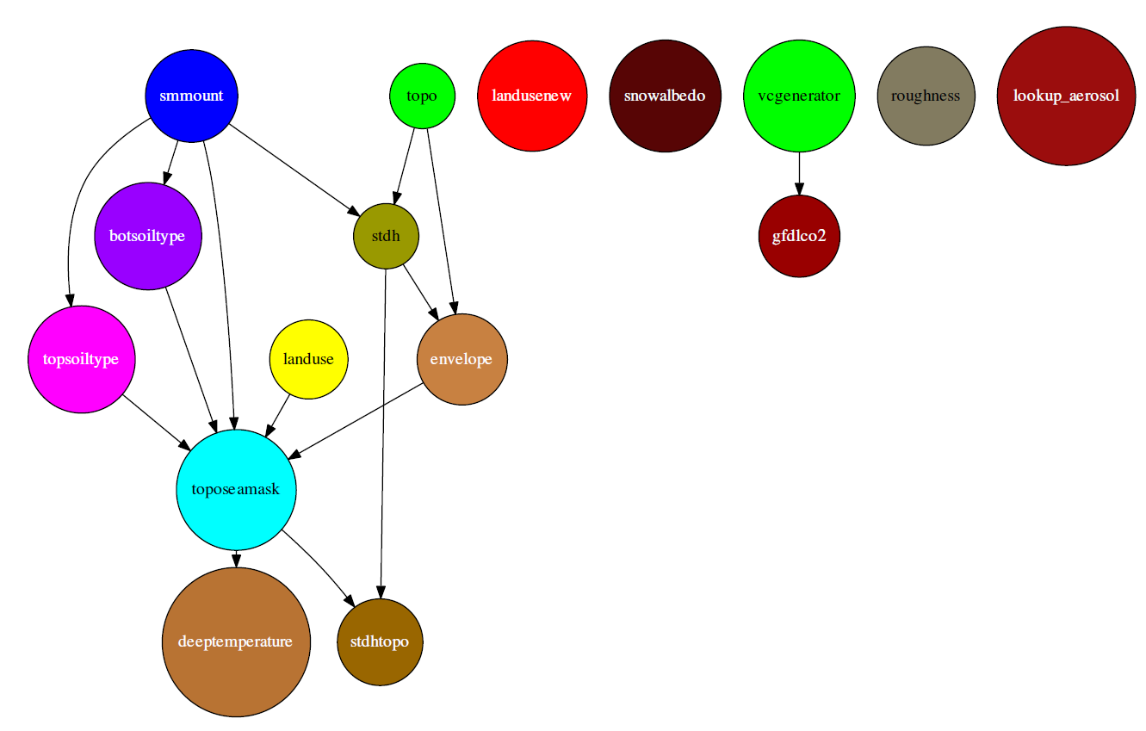
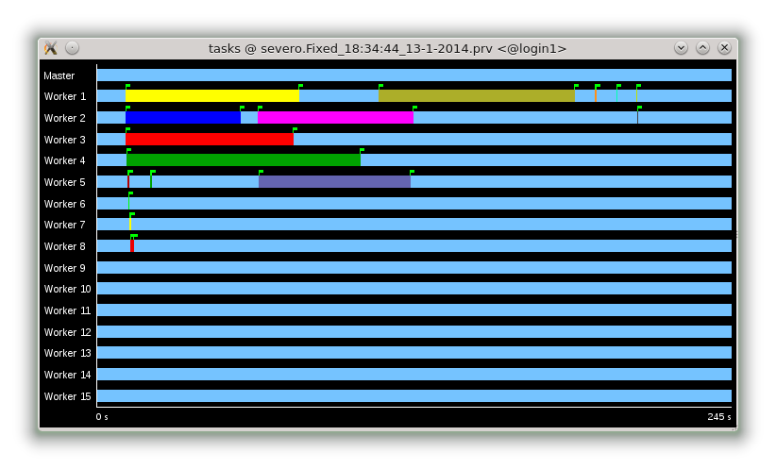
Preprocessor Step 1 – COMPSs
  We used 5 cores and achieved a speedup of 2.7 times!
18

Slide 19
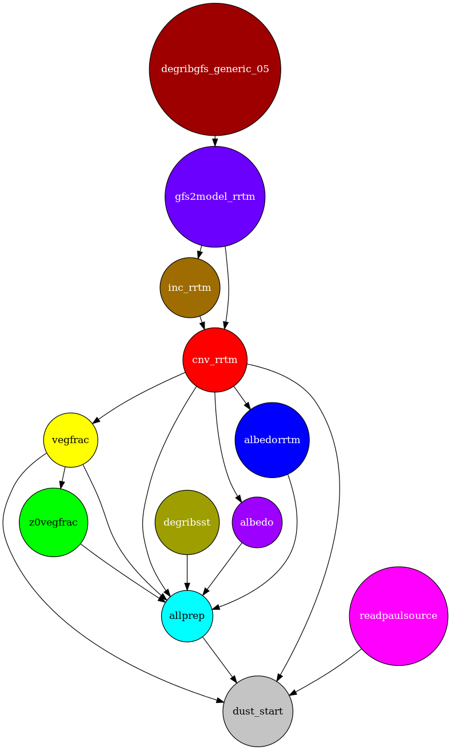
Preprocessor Step 2 – COMPSs
The serial part allprep consumes a lot of time, we should investigate a hybrid solution because of memory issues
Need to be improved for higher resolution forecasts
19

Slide 20
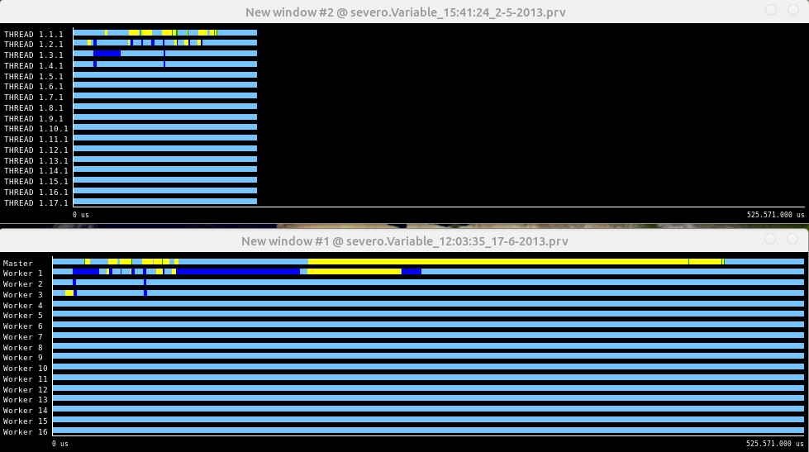
Test on a bigger case
We applied this method to generate 12km global resolution input files (more than
6GB output files)

Slide 21
2. Performance analysis of NMMB/BSC-CTM

Slide 22
Outline
Performance Analysis of NMMB/BSC-CTM
  Configuration domains
  MPI processes mapping
  Processor affinity
  Decomposition
  Hardware counters
  Load imbalance issues
  Serialization
  Polar filters
  I/O
  Scalability
Conclusions and Future work
22

Slide 23
Execution diagram – Focus on the Model
Study domain: Global domain 24km x 24km resolution

Slide 24
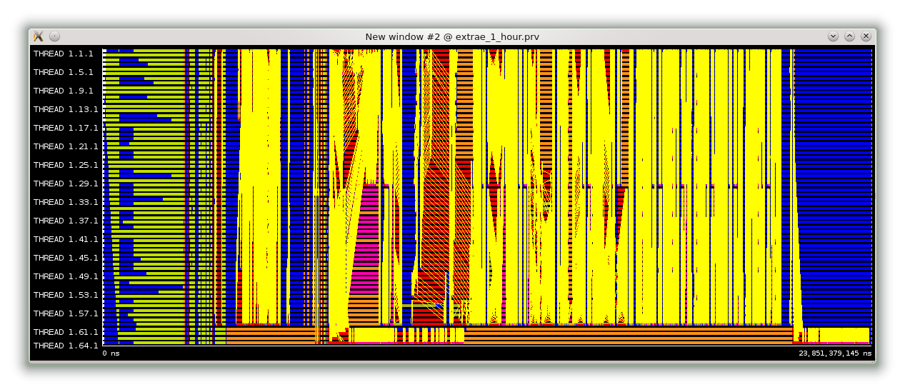
Paraver
One hour simulation of NMMB
Last four processes are used for I/O
MPI_Isend (pink area) needs significant time
24

Slide 25
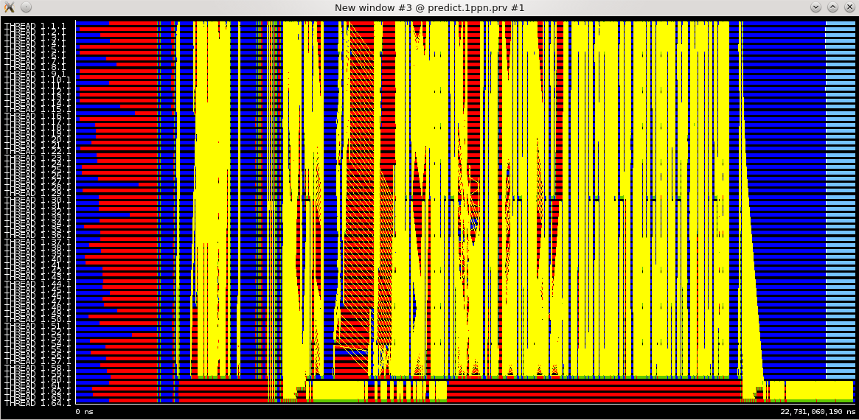
Dimemas simulator
One hour simulation of NMMB (Dimemas)
Dimemas shows that MPI_Isend should not spend a lot of time
25

Slide 26
Dimemas simulator
One hour simulation of NMMB (Dimemas)
We observed that the default OpenMPI (v1.5.4) eager threshold is 12 KB on infiniband networks and we modified it to 64KB
26

Slide 27
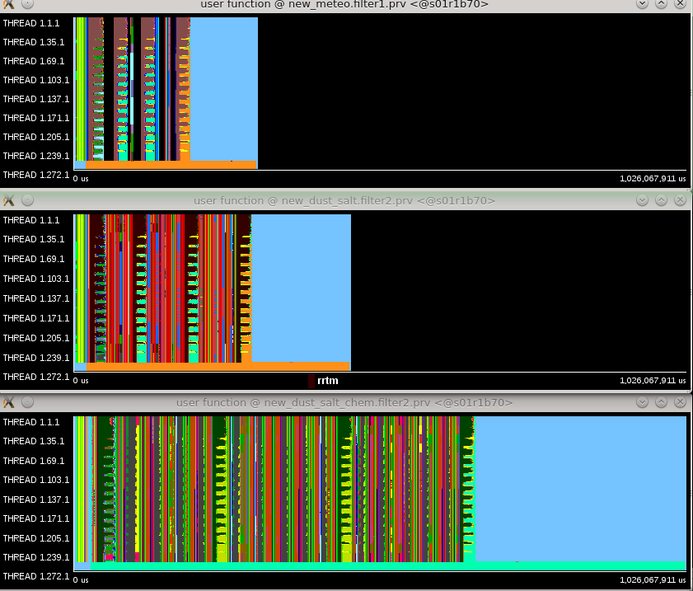
Configuration domains - Paraver
One hour simulation of NMMB/BSC-CTM, global, 24km, 64 layers
meteo: 9 tracers
meteo + aerosols:
9 + 16 tracers
meteo + aerosols + gases: 9 + 16 + 53
27
Notes:
Explain configurations
Explain Paraver
Synchronized windows to explain the black area
Mention the time that I/O consumes

Slide 28
Issue with the last binary file
Last binary is written with delay.
Example regional 11km resolution
4778176548 Dec 15 09:25 nmmb_hst_01_bin_0000h_00m_00.00s
4778176548 Dec 15 09:28 nmmb_hst_01_bin_0001h_00m_00.00s
4778176548 Dec 15 09:31 nmmb_hst_01_bin_0002h_00m_00.00s
4778176548 Dec 15 09:34 nmmb_hst_01_bin_0003h_00m_00.00s
4778176548 Dec 15 09:38 nmmb_hst_01_bin_0004h_00m_00.00s
4778176548 Dec 15 09:41 nmmb_hst_01_bin_0005h_00m_00.00s
4778176548 Dec 15 10:42 nmmb_hst_01_bin_0006h_00m_00.00s
28

Slide 29
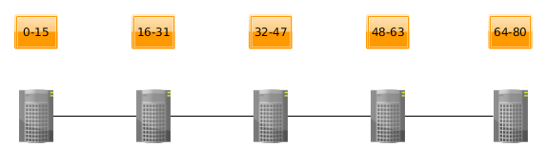
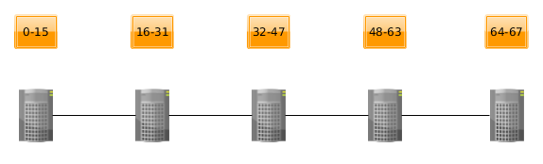
Mapping
Initial mapping, 76 computation cores and 4 cores for I/O
New mapping, 64 computation cores and 4 cores for I/O (I/O processes on separate node)
29
Notes:
Explain configurations
Explain Paraver
Synchronized windows to explain the black area
Mention the time that I/O consumes

Slide 30
Issue with the last binary file solved
The instrumented execution has no issue…
4778176548 Dec 15 11:14 nmmb_hst_01_bin_0000h_00m_00.00s
4778176548 Dec 15 11:17 nmmb_hst_01_bin_0001h_00m_00.00s
4778176548 Dec 15 11:21 nmmb_hst_01_bin_0002h_00m_00.00s
4778176548 Dec 15 11:24 nmmb_hst_01_bin_0003h_00m_00.00s
4778176548 Dec 15 11:27 nmmb_hst_01_bin_0004h_00m_00.00s
4778176548 Dec 15 11:30 nmmb_hst_01_bin_0005h_00m_00.00s
4778176548 Dec 15 11:33 nmmb_hst_01_bin_0006h_00m_00.00s
30

Slide 31
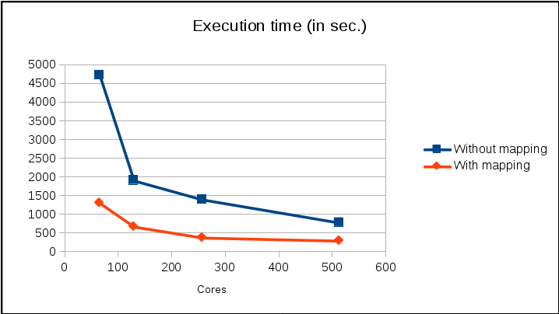
Performance of different mapping and more I/O servers
The new mapping improved the execution time between 2.56 and 3.6 times
31

Slide 32
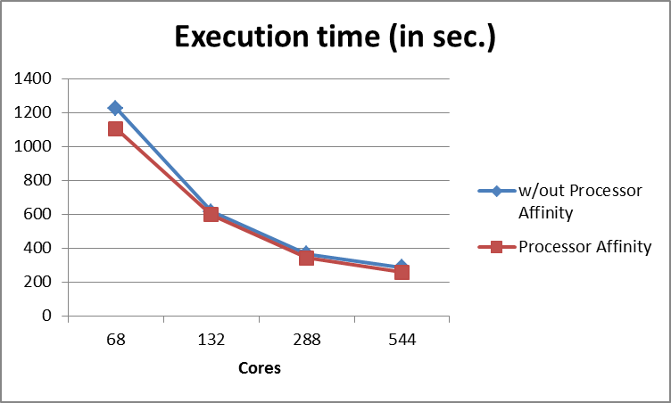
Processor affinity
The MPI process is not allowed to migrate to another core
Improvement between 2.8% till 10%
OpenMPI option --bind-to-core
32

Slide 33
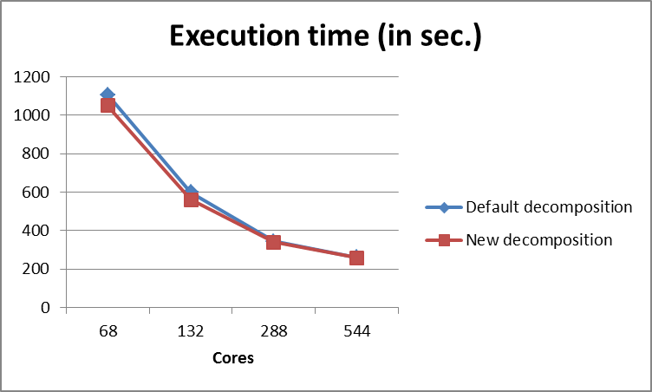
Decomposition
Improvement till 6.5%. For 64 computation cores we use a decomposition of 2x32 instead of 8x8.
33

Slide 34
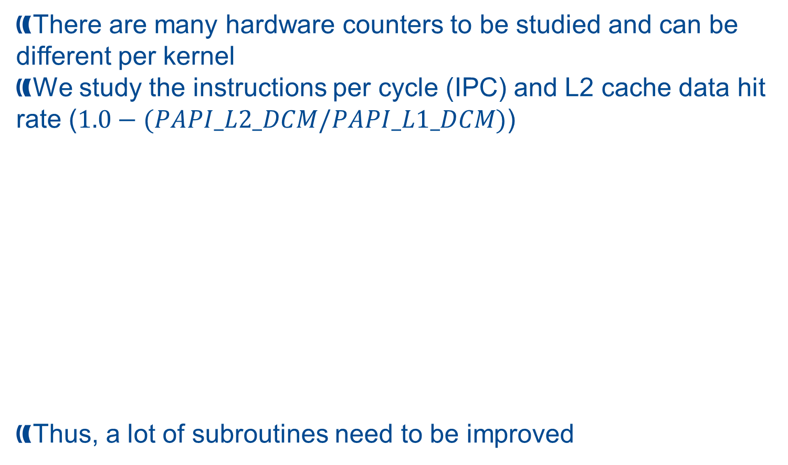
Hardware counters
There are many hardware counters to be studied and can be different per kernel
We study the instructions per cycle (IPC) and L2 cache data hit rate ($1.0−(PAPI_L2_DCM/PAPI_L1_DCM)$)
Thus, a lot of subroutines need to be improved
Function | IPC | L2 cache data hit rate
PBL turbulence | 0.22 | 0.3
Turbulence | 0.27 | 0.26
ODE solver | 0.67 | 0.6
Horizontal diffusion | 0.62 | 0.78
Advection chemistry | 0.56 | 0.7
34

Slide 35

Load imbalance issues
In our field we have dynamic load imbalance issues that are not easy to be solved
One hour of simulation, global, 24km, meteo configuration 20 July 2005
35

Slide 36
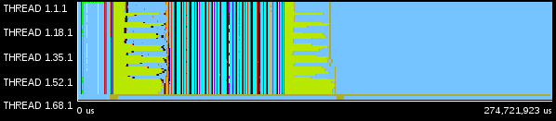
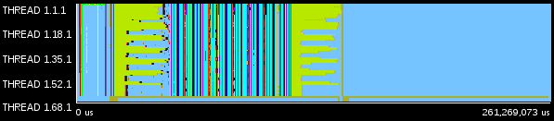
Load imbalancing issues
In our field we have dynamic load imbalance issues that are not easy to be solved
One hour of simulation, global, 24km, meteo configuration 20 July 2005, useful functions
One hour of simulation, global, 24km, meteo configuration 20 December 2005, useful functions
36

Slide 37
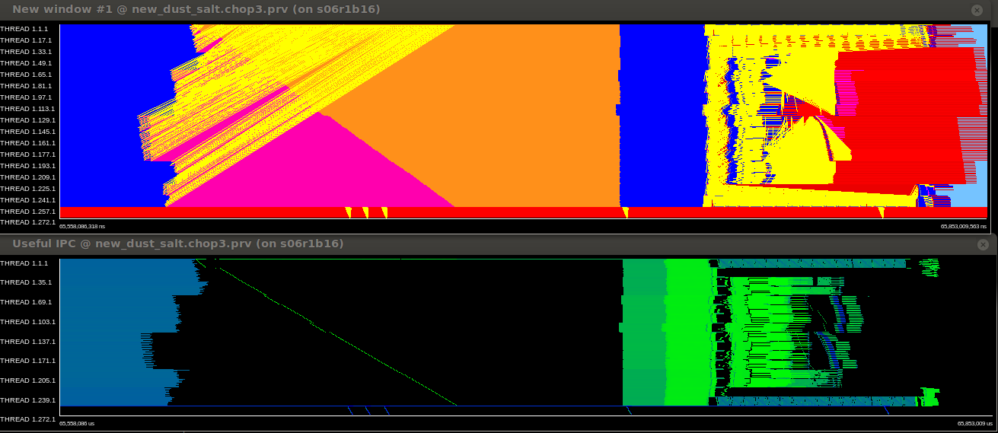
Serialization
Serializations are serious bottlenecks that should be avoided for scaling purposes
No useful IPC (black area) during the main part of monotonization
37

Slide 38
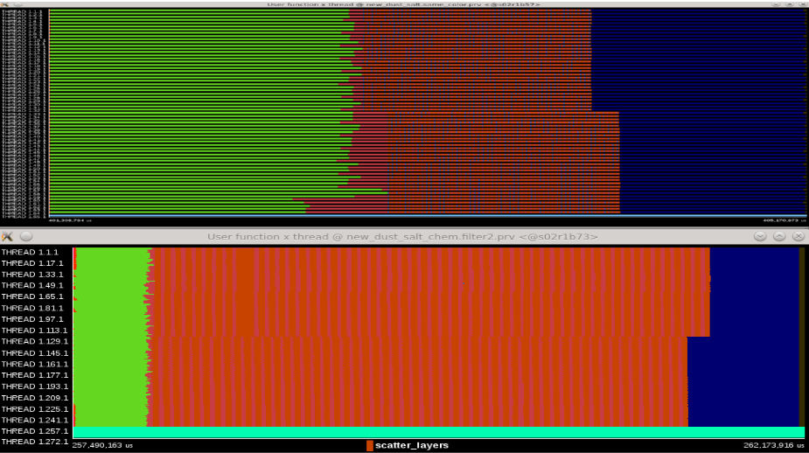
Polar Filters
The procedure is constituted by a gathering of the necessary data to participated nodes, execution of a serial FFT and scattering the data back to the nodes
Compare the execution with 64 and 256 computation cores
Lower number of cores improve the communication performance
Does not occur always
38

Slide 39
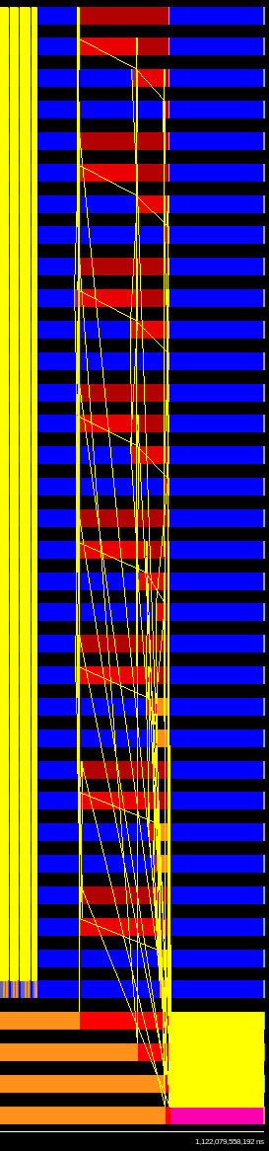
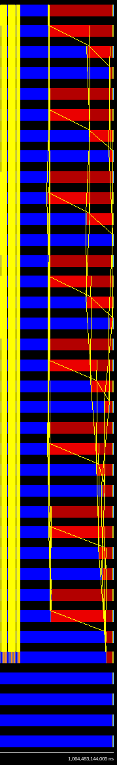
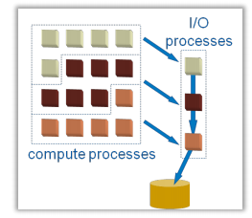
Issue with I/O
Last hour
With I/O Without I/O
There is no parallel I/O implemented!
39

Slide 40
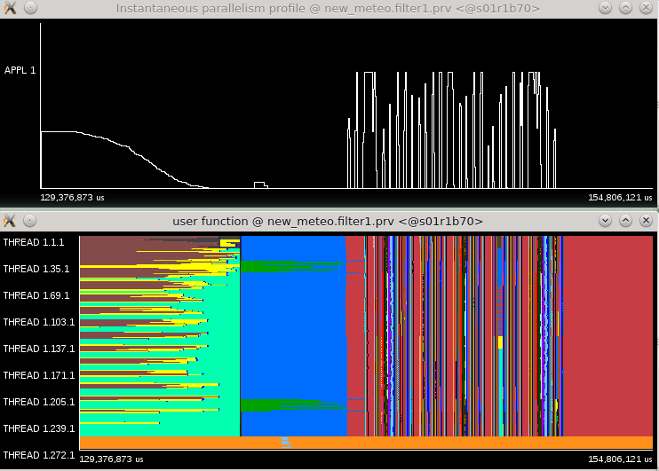
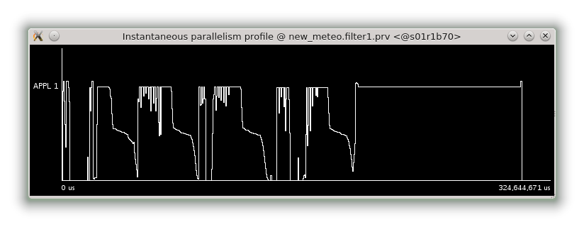
Paraver – Useful computation - Meteo
40

Slide 41
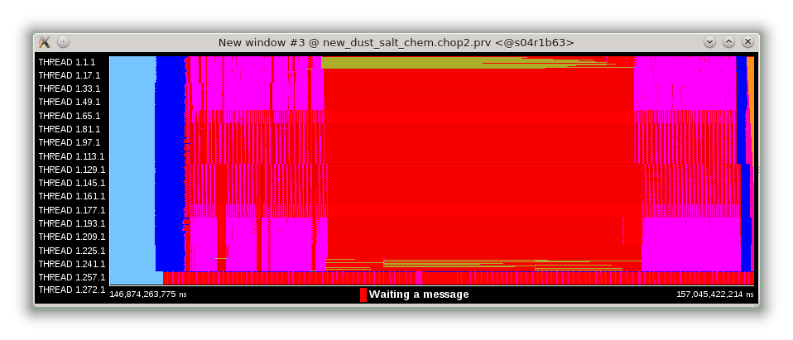
Paraver - Information about functions
Three hours simulation of NMMB, global 24km
 | Meteo
Functions | Percentage | IPC
rrtm | 13.7% - 52% (31.3%) | 2.18 - 2.38
gather_ layers | 8.26% - 13.7% (11.1%) | X
scatter_ layers | 10.6% - 14.1% (12.1%) | X
 | Meteo + aerosols + chemistry
Functions | Percentage | IPC
run_ebi | 14% - 20.3% (16.55%) | 0.71-1.11
rrtm | 3.97% - 15.07% (9.05%) | 2.17 – 2.37
gather_ layers | 12.37% - 24.55% (16.93%) | X
scatter_ layers | 14.65% - 26.58% (19%) | X
 | Meteo + aerosols
Functions | Percentage | IPC
rrtm | 8.8% - 33.4% (20.33%) | 2.2 – 2.4
gather_layers | 11.9% - 22% (17.4%) | x
scatter_layers | 14.4% - 26.6% (19.5%) | X
41

Slide 42
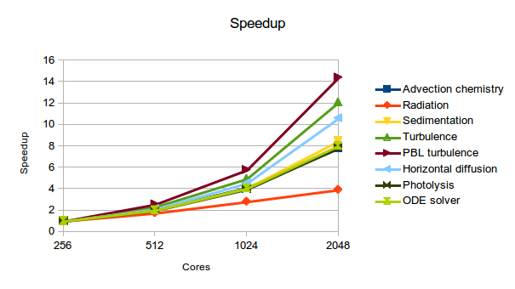
Speedup
Here is presented the speedup per subroutine (the main ones)
For some of them we have super linear behavior because of better cache handling as we decrease the workload per core
42

Slide 43
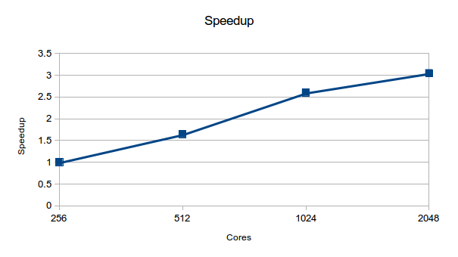
Scalability
Speedup for the whole application
The total speedup is not efficient and more work needs to be done as we described
43

Slide 44
3. Issues on the operational cluster

Slide 45
Issues on the operational cluster
Up to 4.4x times variation of the execution time on 169 cores
Using -O2 optimization flag
Using IBM MPI without efficient mapping
Using IBM MPI parameters
Issues with the filesystem
45

Slide 46
Variation of the execution time
Four faulty nodes influence the performance of the cluster
Including all the nodes the execution time was between 75 and 330 seconds
Exclude the following nodes
#BSUB –R “select[hname!=100]”
#BSUB –R “select[hname!=102]”
#BSUB –R “select[hname!=104]”
#BSUB –R “select[hname!=105]”
The execution time without the above nodes is around to 75-90 seconds. The reboot of the nodes seems to solved the problem.
46

Slide 47
Using -O2 optimization flag
Using -O2 optimization flag
Using -O2 optimization flag
The usage of –O3 was crashing the model.
We added the –fp-model strict flag to take care the floating point operations and disable optimizations that can influence the results.
47

Slide 48
Using IBM MPI without efficient mapping
FIX
48

Slide 49
Issues with the filesystem
In some cases no binary files are created with the output of the model
Error: failed.LSF error (res): Stale NFS file handle
Think about automatic submit of failed jobs?
49

Slide 50
Conclusions
The performance analysis of an application is a long and sometimes difficult task
We used Extrae/Paraver to analyze our model
Demonstration of the importance of processor affinity, mapping, and decomposition of the domain
Hardware counters are important to study the computation phases
Load imbalance issues are well known to the community but need to be studied
We identified some serialization issues
I/O maybe is not the most important issue now but it will be a significant one
50

Slide 51
Conclusions
We identified issues on the operational cluster
We improved the performance
  Excluding faulty hardware
  Using better optimization flags
  Improving IBM MPI mapping
51

Slide 52
Thank you!
For further information please contact
Georgios.markomanolis@bsc.es

