Slide 1
Performance analysis Tools: a case study of NMMB on Marenostrum Supercomputer
George S. Markomanolis, Oriol Jorba, Kim Serradell
Belgrade, 25 September 2014

Slide 2

Outline
Introduction to Paraver
  Examples with NMMB/BSC-CTM
  Various Paraver views
Configuration of Extrae tool
Summary
2

Slide 3
Tools
Since 1991
Based on traces
Open source: http//:www.bsc.es/paraver
Core tools:
  Paraver
  Extrae
  Dimemas
3

Slide 4
Paraver
Every behavioral aspect/metric described as a function of time
Those functions of time can be rendered into a 2D image
Statistics can be computed for each possible value or range of values of that function of time
4

Slide 5
Extrae
BSC instrumentation package
When/Where
  Parallel programming model runtime
  Selected user functions
  Periodic samples
  User events
Additional information
  Counters
5

Slide 6
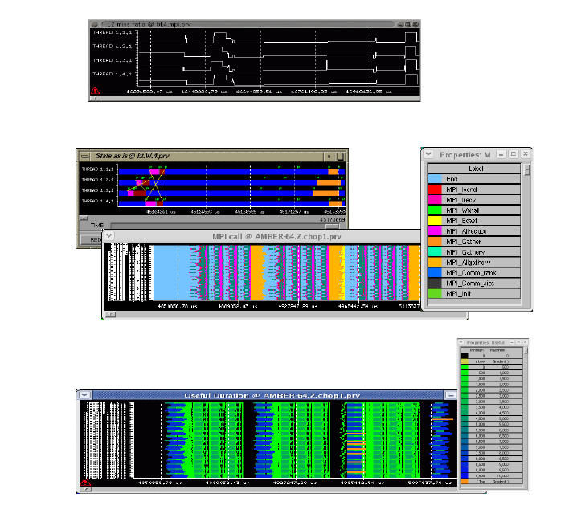
Timelines
Representation
  Function of time
  Colour encoding
6

Slide 7
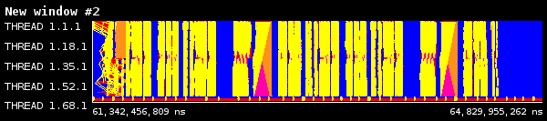
Paraver – Generic View
Part of the timeline
Colours for different events
Example for 68 MPI processes
1 hour global domain, 24km, 64 layers, meteo configuration
7

Slide 8
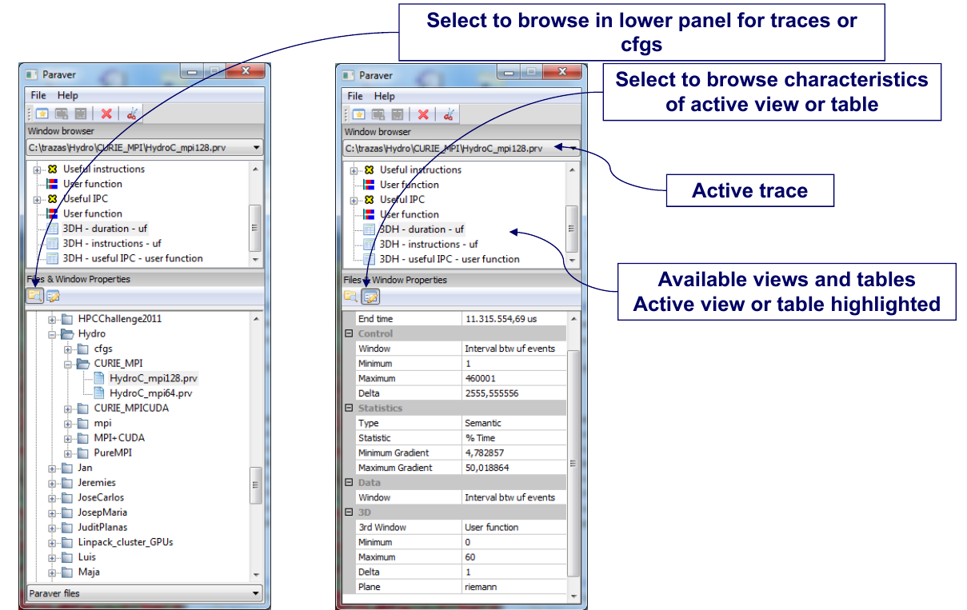
Paraver – Menu (from BSC Tools presentation)
8

Slide 9
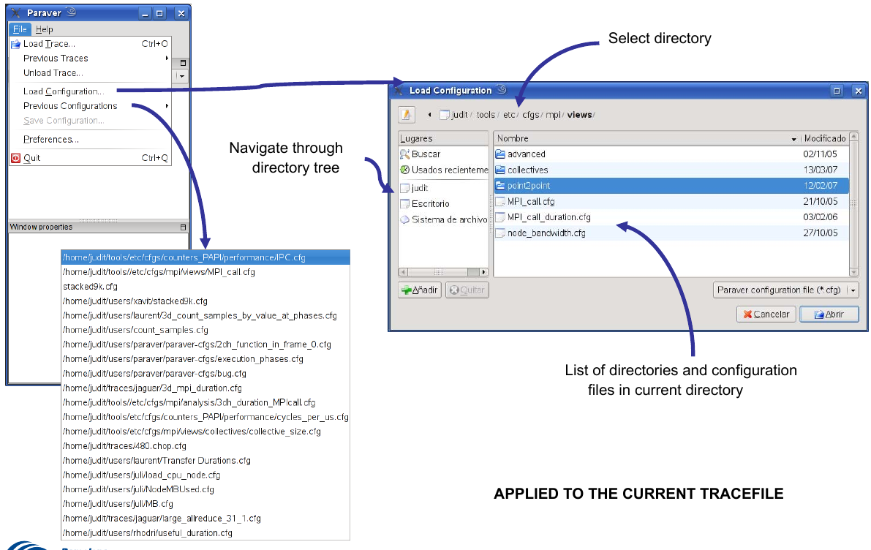
Paraver – Load configuration (from BSC Tools presentation)
9

Slide 10
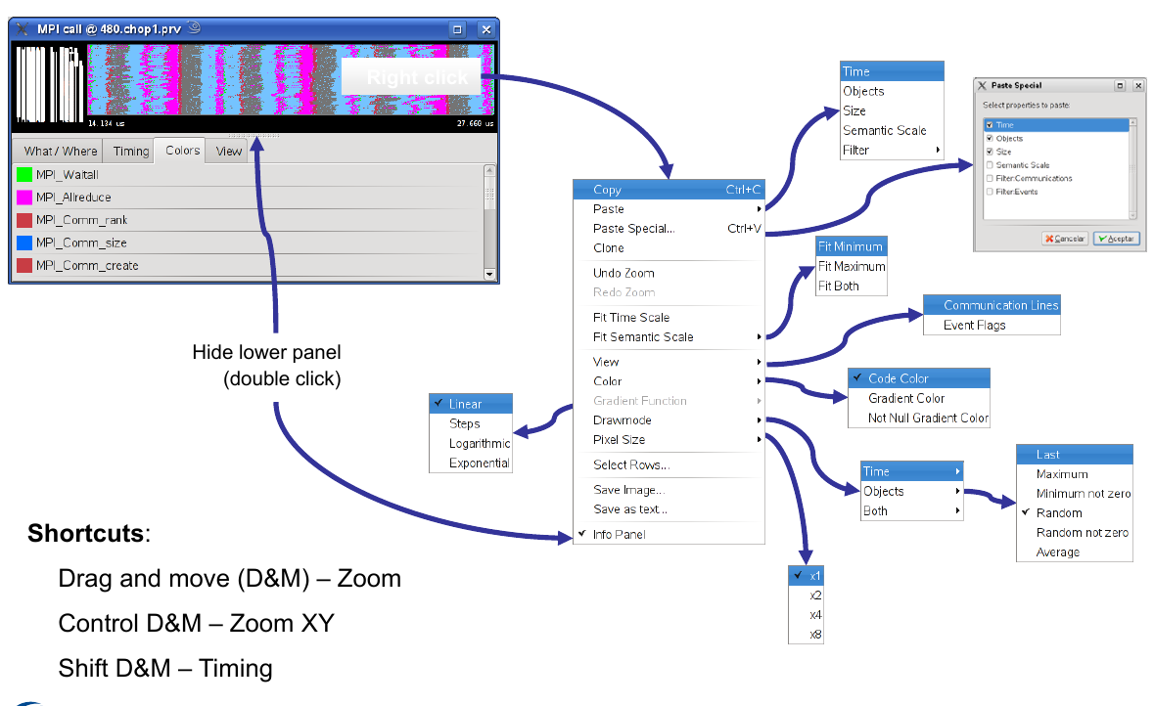
Paraver – Menu (from BSC Tools presentation)
10

Slide 11
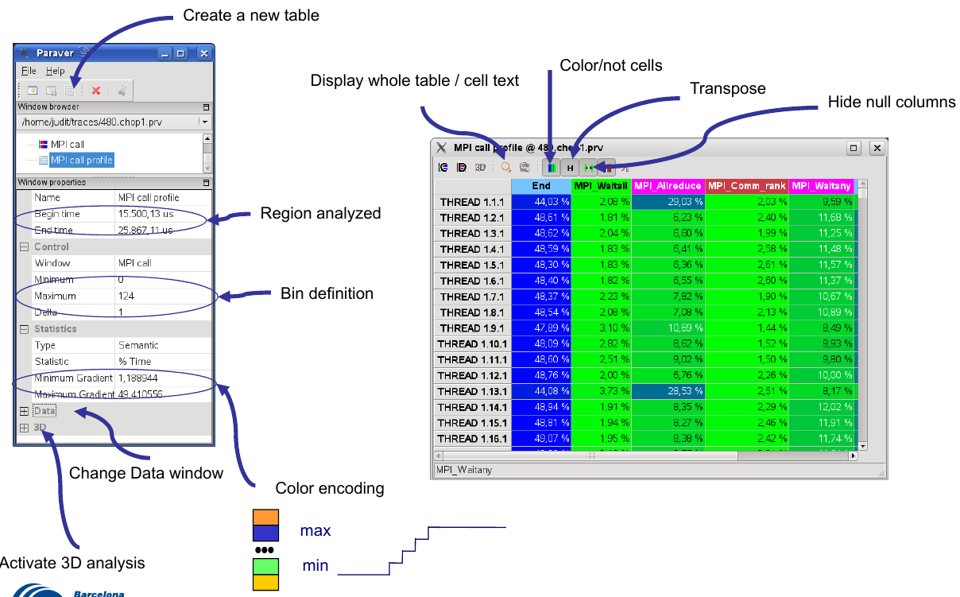
Paraver – Profiles (from BSC Tools presentation)
11

Slide 12
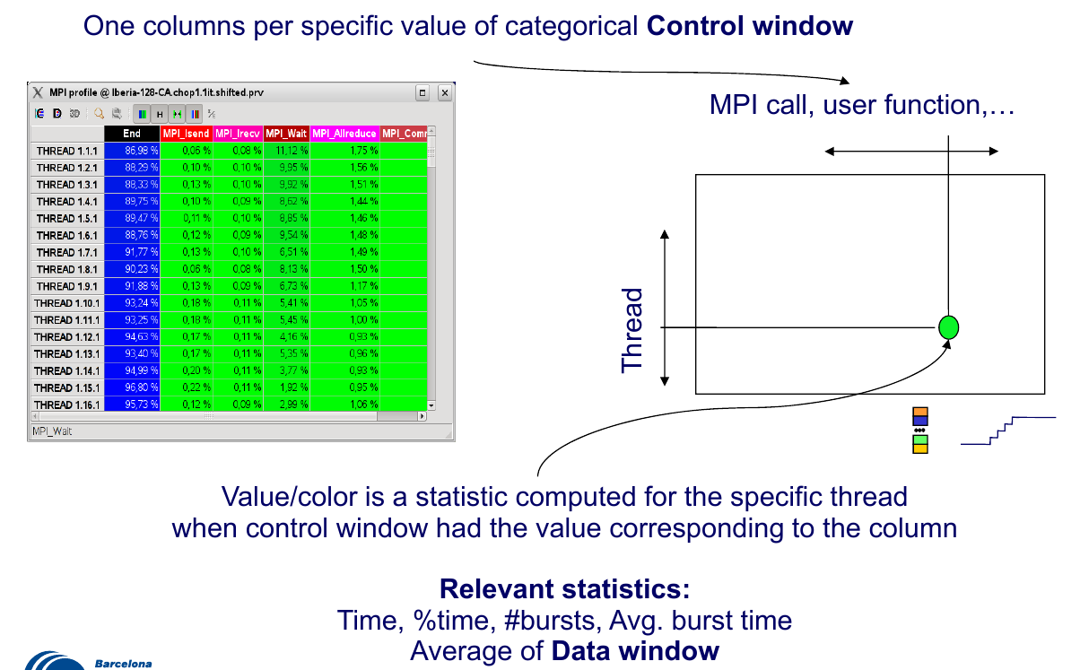
Paraver – Profiles (from BSC Tools presentation)
12

Slide 13
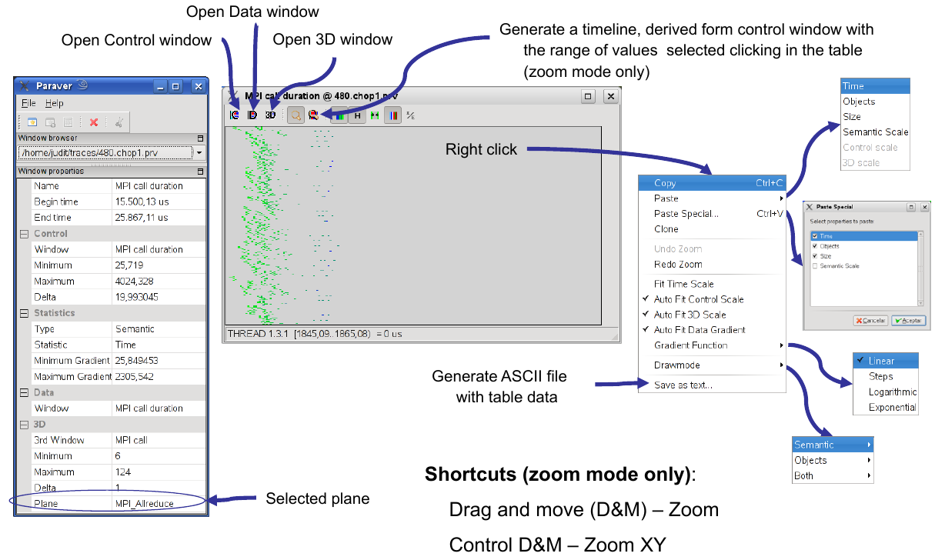
Paraver – Histograms (from BSC Tools presentation)
13

Slide 14
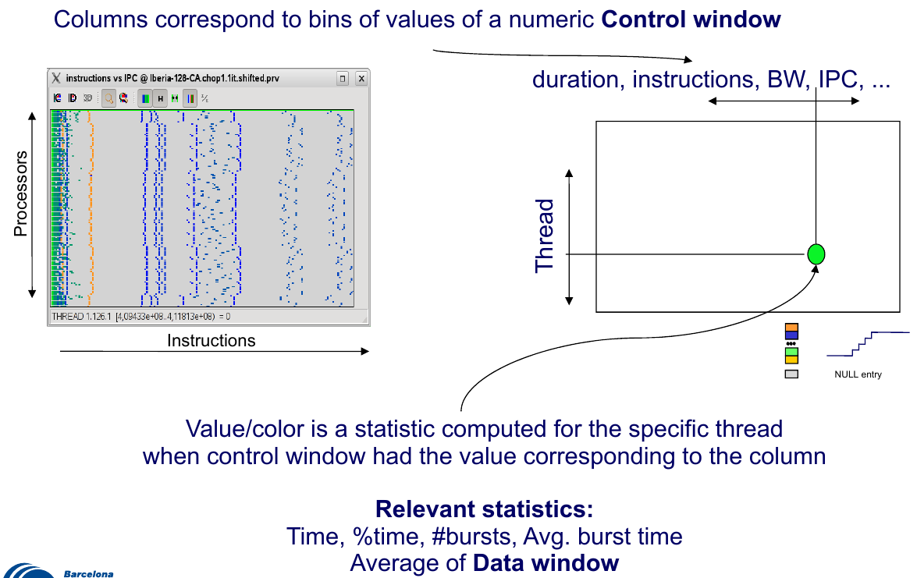
Paraver – Histograms (from BSC Tools presentation)
14

Slide 15
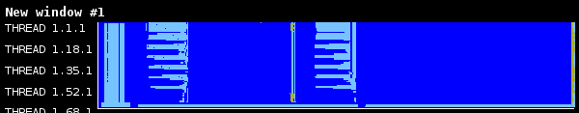
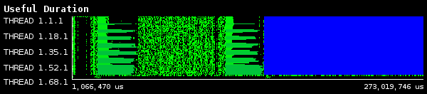
Paraver –View
Running and observing the events
Computation
15

Slide 16
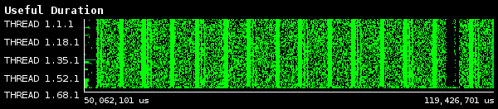
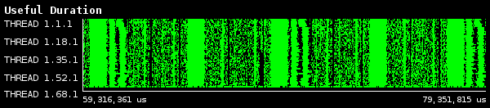
Paraver – Computation View
Create a profile view for the following part of the trace
16

Slide 17
Paraver – Profile View
Create a profile view for the following part of the trace
17

Slide 18
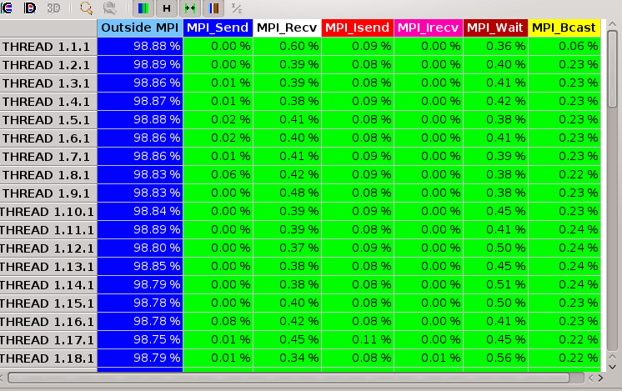
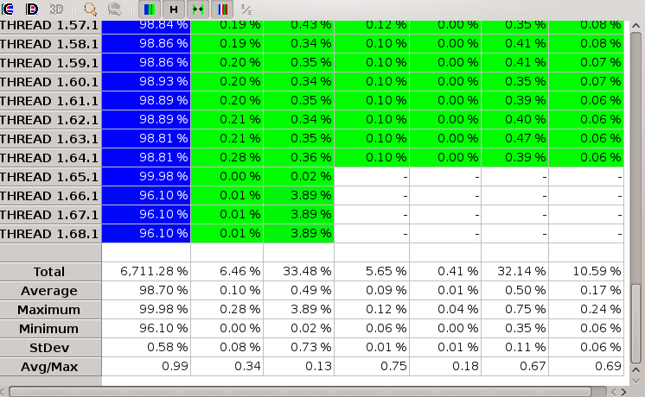
Paraver – Profile View
Percentage of MPI calls
Average=98.7% is the
parallel efficiency
Maximum = 99.98% is the
communication efficiency
Avg/max = 0.99 is perfect
load balanced only for this
part of the trace
18

Slide 19
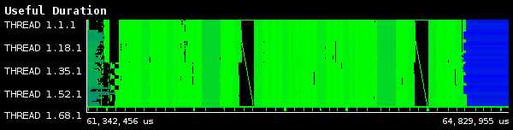
Paraver – Useful Duration
Part of the timeline
1 hour global domain, 24km, 64 layers, meteo configuration
Green low computation, blue significant computation (useful duration view)
19

Slide 20
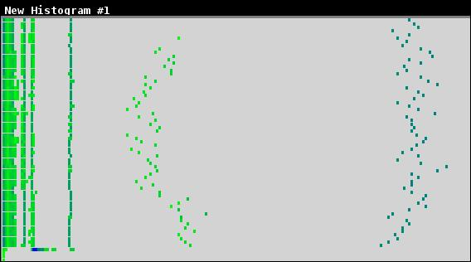
Paraver – Time histogram
For better load balancing is needed to have vertical lines
20

Slide 21
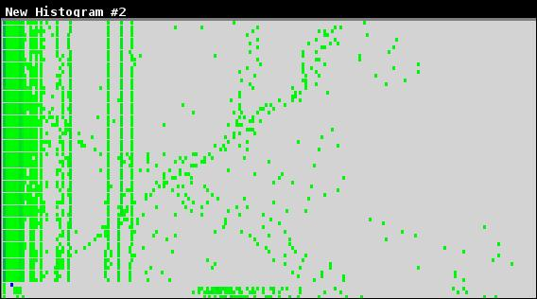
Paraver – Instructions histogram
The computation is not uniform
21

Slide 22
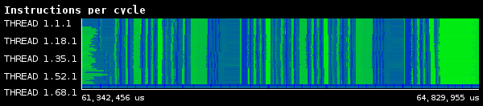
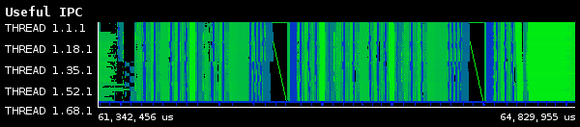
Paraver – Instructions per cycle (IPC)
Efficient computation
Useful efficient computation
22

Slide 23
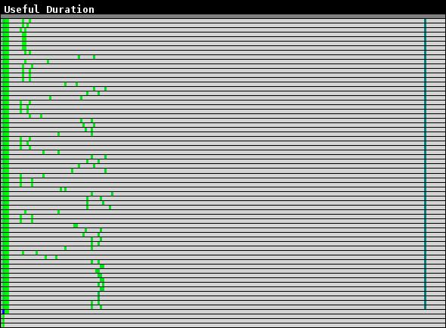
Paraver – Useful computation histogram
23

Slide 24
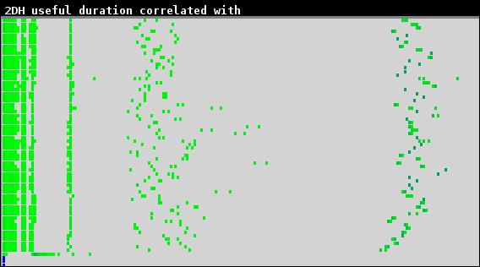
Paraver – Useful time histogram
24

Slide 25
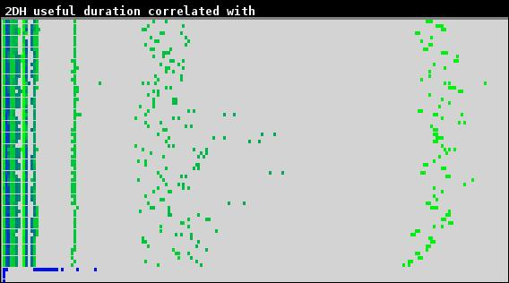
Paraver – Useful IPC histogram
25

Slide 26
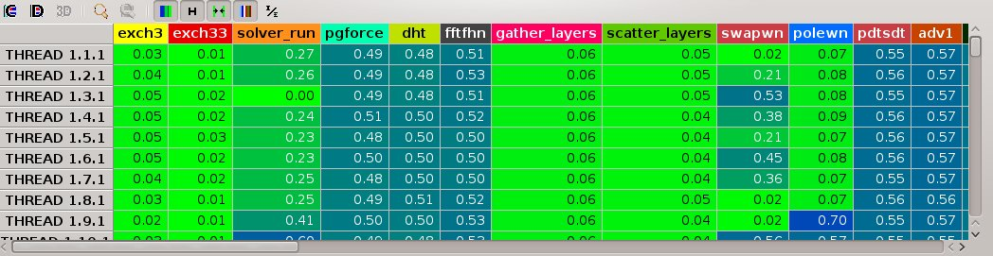
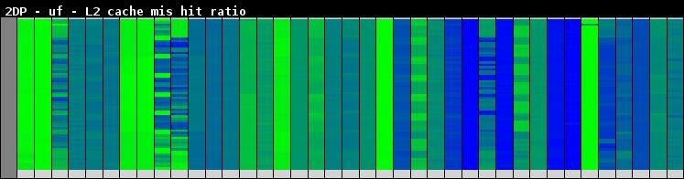
Paraver – Useful L2 cache miss hit ratio
Per user function
Table
26

Slide 27
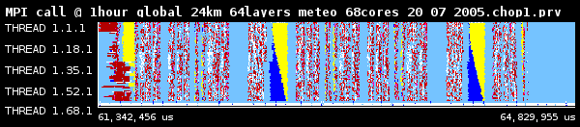
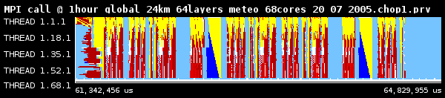
Paraver – MPI calls
MPI calls excluding computation
MPI calls with partial communication visualization
27

Slide 28
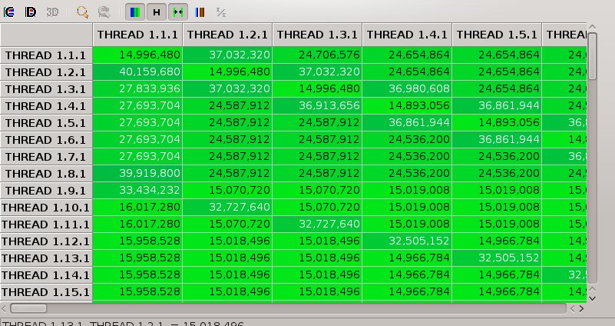
Paraver – Total bytes sent
28

Slide 29
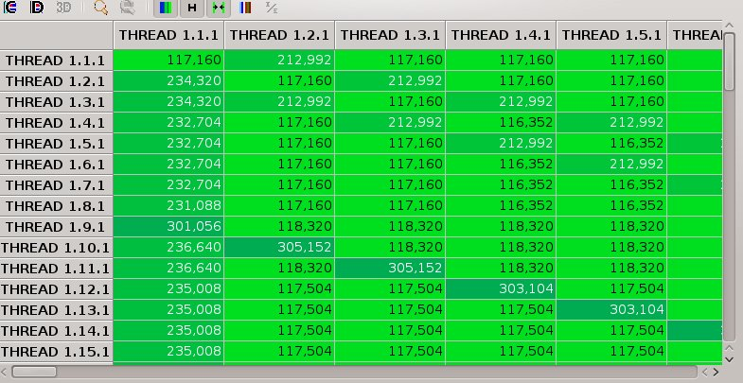
Paraver – Max bytes sent
29

Slide 30
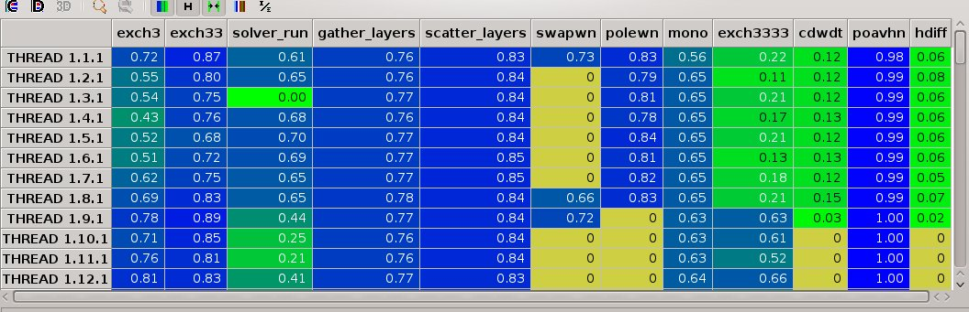
Paraver – Percentage of MPI time per user function
30

Slide 31
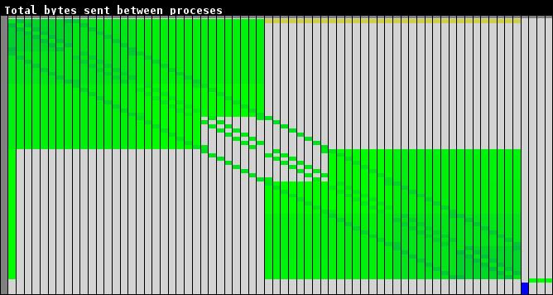
Paraver – Communication matrix
31

Slide 32
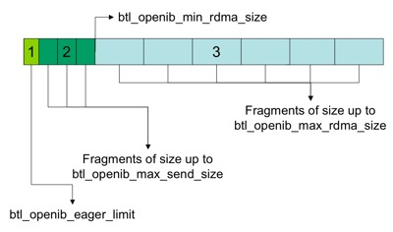
MPI – Send a message
32

Slide 33
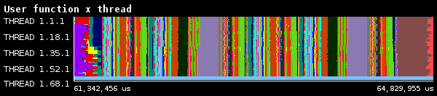
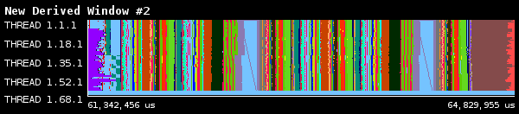
Paraver – User functions
User functions
Useful user functions
33

Slide 34
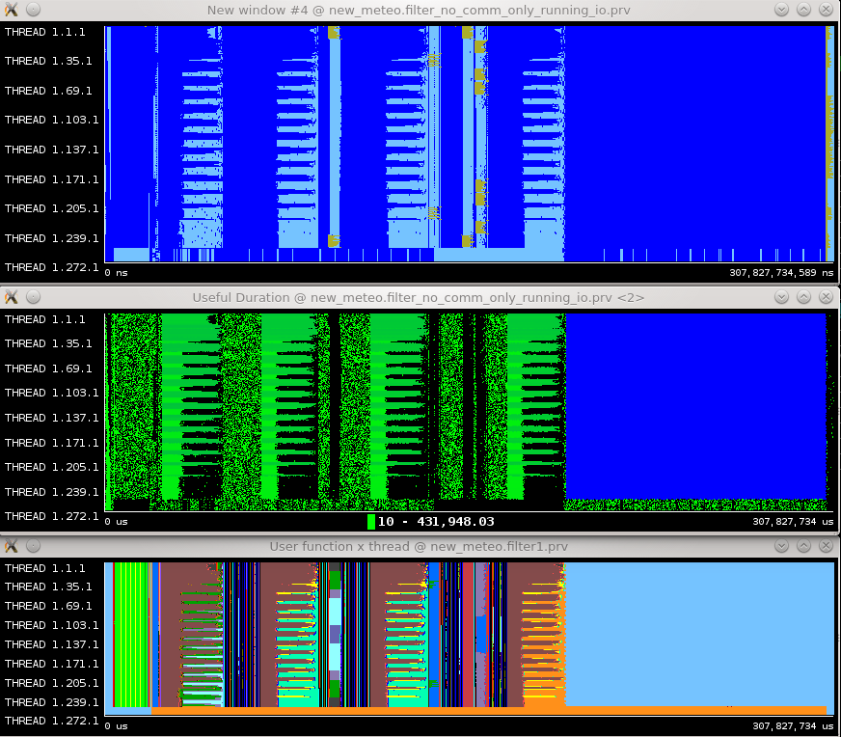
Paraver – Global – 24km - Meteo
Simulation: 02/12/2005

Slide 35
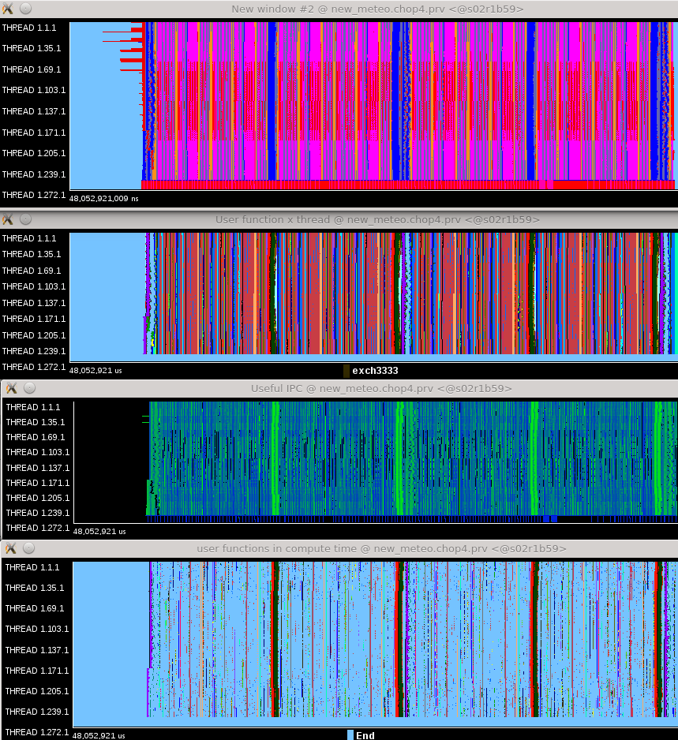
Paraver – Global – 24km – Meteo – between radiations

Slide 36
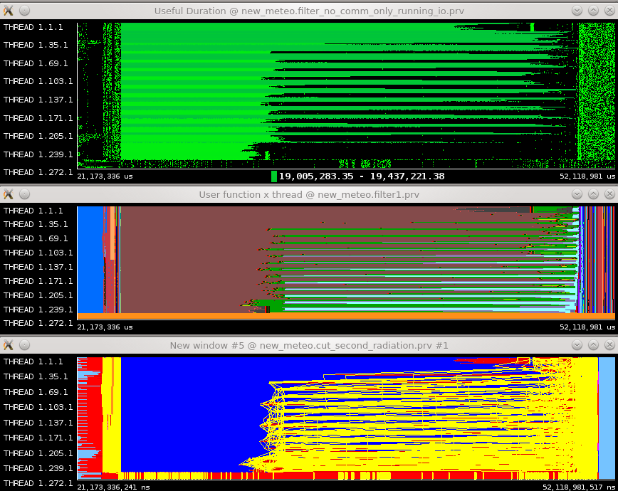
Paraver – Global – 24km – Meteo – radiation

Slide 37
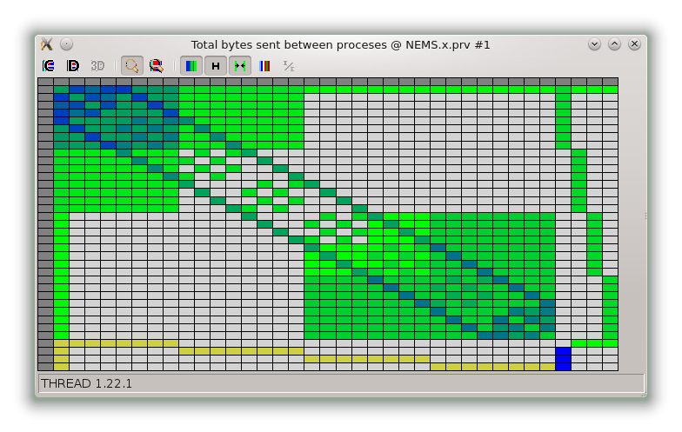
Communication matrix

Slide 38
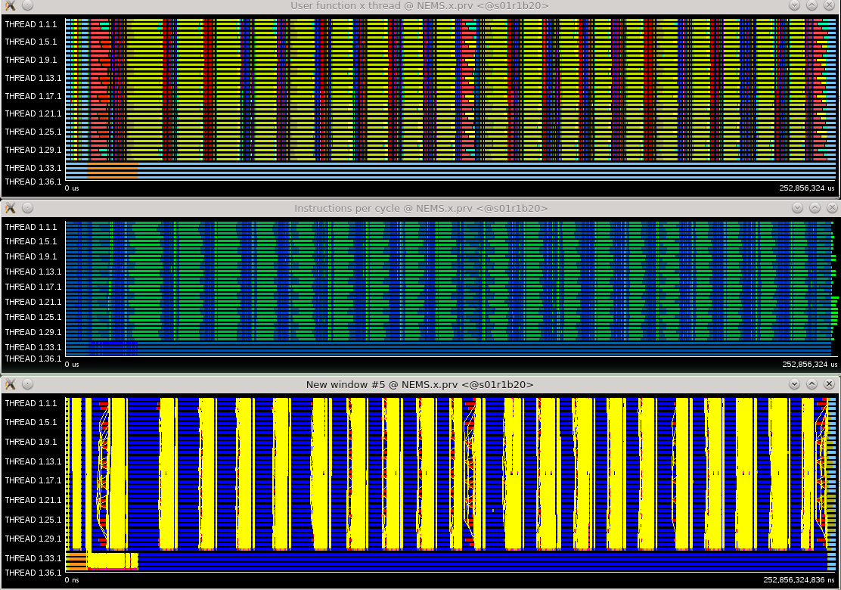
Paraver – Global – 24km – Meteo/Dust/Chem
Simulation:
21/05/2010

Slide 39
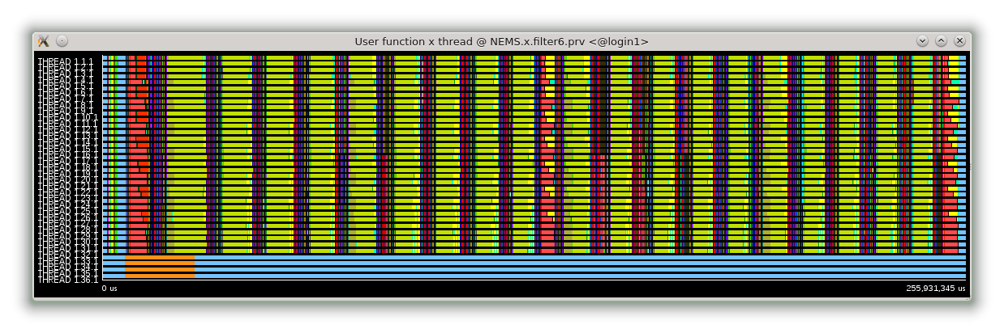
Paraver – Global – 24km – Meteo/Dust/Chem
Simulation:
21/09/2010

Slide 40
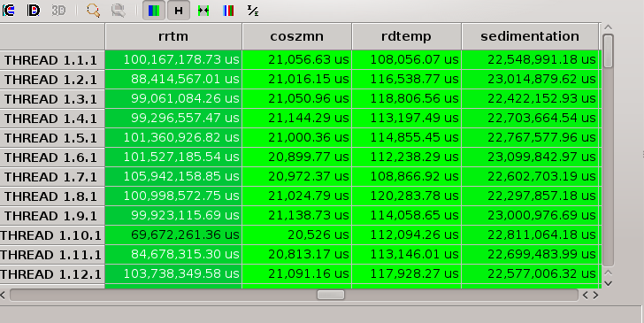
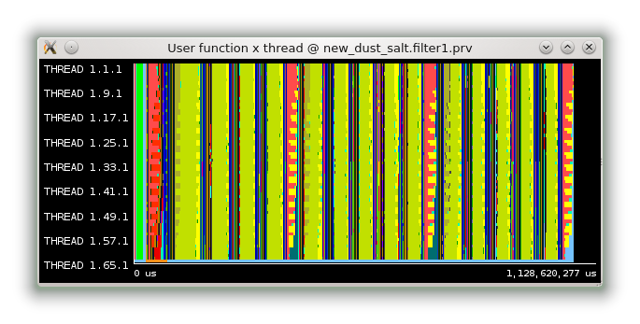
Paraver – (useful) user functions

Slide 41
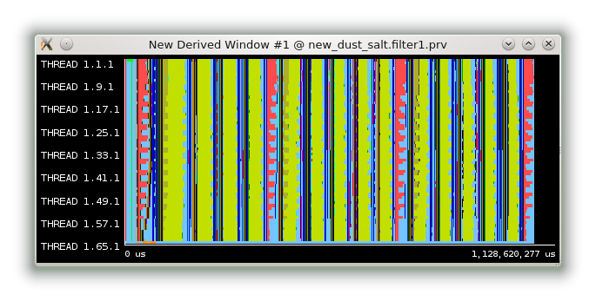
Paraver – (useful) user functions

Slide 42
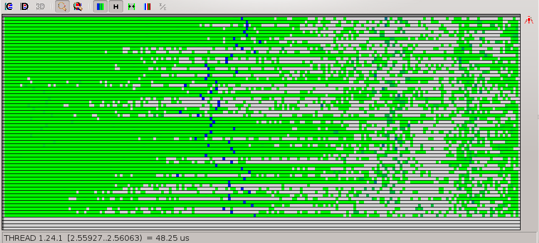
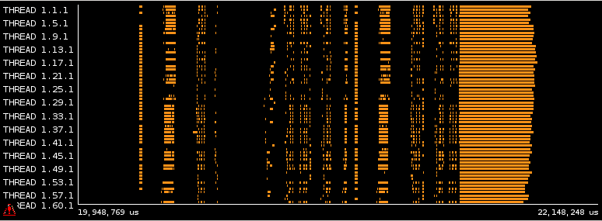
Computation load imbalance

Slide 43
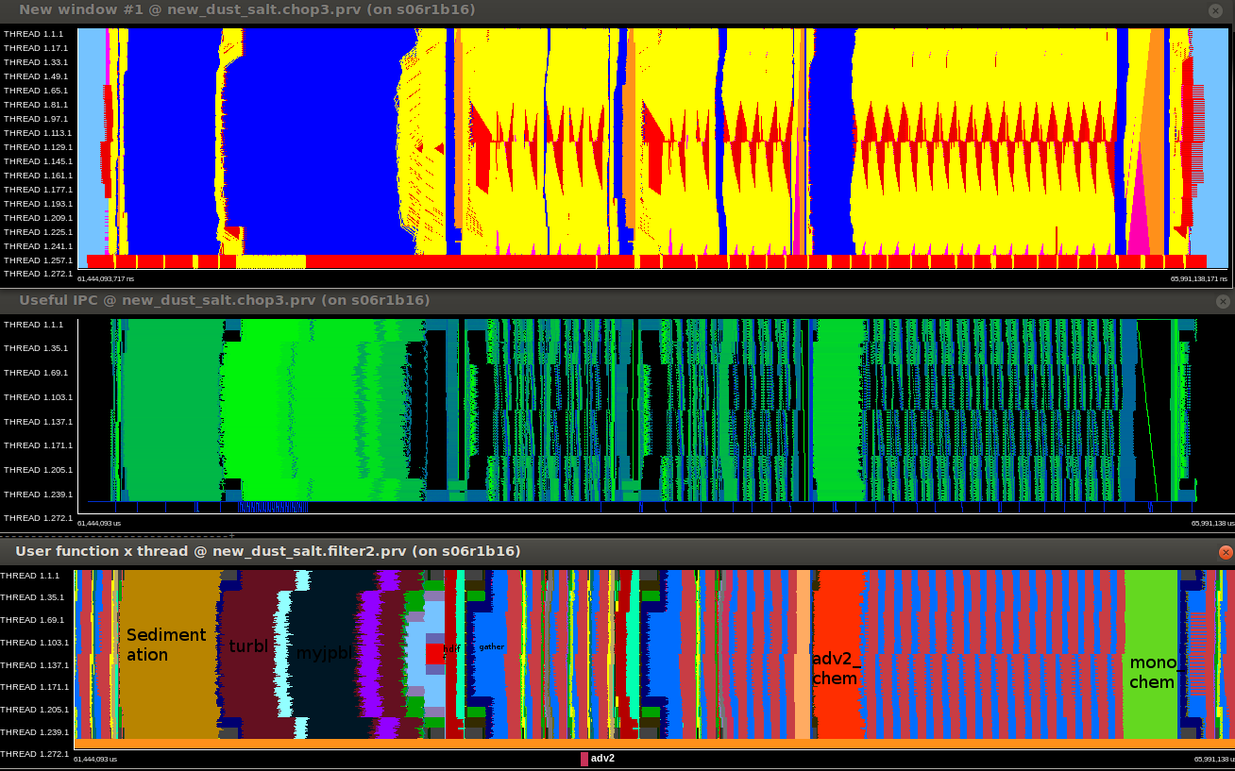
Zoom between radiation calls for dust/sea-salt

Slide 44
Extrae
How to use:
mpirun … wrapper.sh /path/umo.x
Contents of wrapper.sh file:
export EXTRAE_HOME=/installation_path/
export LD_PRELOAD=/installation_path/lib/libmpitrace.so
export LD_LIBRARY_PATH=$LD_LIBRARY_PATH:/installation_path/lib
source ${EXTRAE_HOME}/etc/extrae.sh
export EXTRAE_CONFIG_FILE=/path/extrae_config.xml
$*
44

Slide 45
Extrae – XML file
<?xml version=‘1.0’?>
</trace enabled=“yes”
…
<mpi enabled=“yes”>
<counters enabled=“no”/>
</mpi>
<user-functions enabled=“yes” list=“/path/fucntions_list.txt”>
<counters enabled=“yes”/>
<user-functions>
<counters enabled=“yes”>
<cpu enabled=“yes” starting-set-distribution=“1”>
<set enabled=“yes” domain=“user” changeat-globalops=“0”>
PAPI_TOT_INS,PAPI_TOT_CYC
</set>
</cpu>
<buffer enabled=“yes”>
<size enabled=“yes”> 1000000</size>
<circular enabled=“no”>
</buffer>
…
<merge enabled=“yes”
…
>
$TRACE_NAME$
</merge>
</trace>
45

Slide 46
Summary
The performance analysis of an application is a long and sometimes difficult task
We used Extrae/Paraver to analyze our model
Performance tools are needed more and more!
Hardware counters are important to study the computation phases
Load imbalance issues are well known to the community but need to be studied
We identified some serialization issues
Extrae needs to be properly configured
46

Slide 47
Thank you!
Questions?

