Slide 1
Introduction to an HPC environment
George S. Markomanolis, Oriol Jorba, Kim Serradell
Belgrade, 24 September 2014

Slide 2
Objectives
Overview of an HPC environnement
Present some High Performance Computing topics
Describe tools, options and techniques to get better performance in your simulations
Feel free to ask whenever you want…

Slide 3
Why HPC?
HPC: High Performance Computing
Definition: High-performance computing (HPC) is the use of parallel processing for running advanced application programs efficiently, reliably and quickly.*
We need HPC to calculate the operations inside the models
* http://searchenterpriselinux.techtarget.com/definition/high-performance-computing

Slide 4
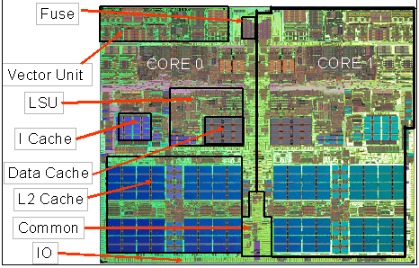
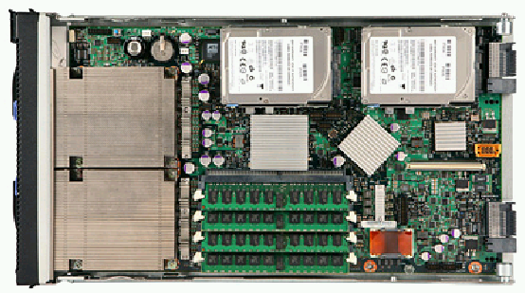
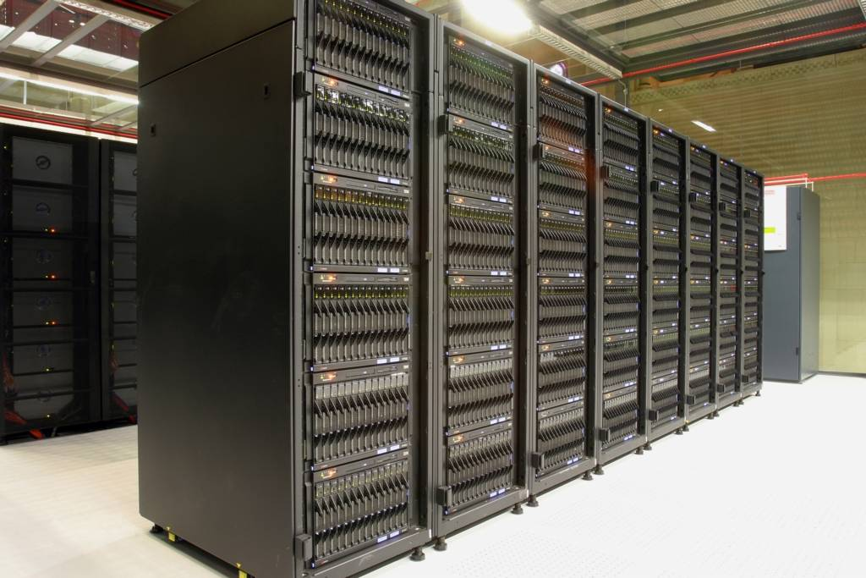
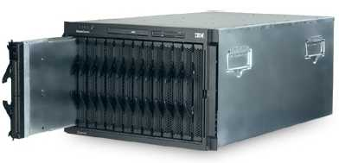
What is it a Supercomputer
Processors, Blades, BladeCenters and Racks & network
CORE
PROCCESSOR
BLADE
BLADE
CENTER
RACKS

Slide 5
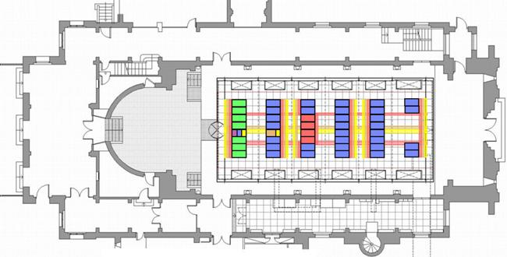
Mare Nostrum layout

Slide 6
Mare Nostrum 3 Hardware

Slide 7
Networks
In Mare Nostrum 3, there are three different connection network in each compute rack:
Infiniband: high speed interconnection network via fibre optic cables connection the compute nodes.
Using a “Fat Tree” topology
Ethernet for Management
Ethernet for GPFS disk

Slide 8
Working in HPC
Constraints
Many users
Many jobs
Limited ressources
We need a job sumitter and scheduler
Distributes jobs through machine
Gives priority
Each job has an id
Makes a waiting queue
The user submits the jobs and waits for the result.
User need to learn commands to communicate with queue

Slide 9
Working in HPC

Slide 10
Queue and Scheduling
In Mare Nostrum 3, LSF 9.1.1 is the queue managing system
Distributes work through nodes
Balances load
Manages Jobs (id, status…)
Detects faulty nodes
Manages queues, reservations, downtimes…
Administration done by Operations Team at BSC
[bsc32359@login2 ~]$ bjobs
JOBID USER STAT QUEUE FROM_HOST EXEC_HOST JOB_NAME SUBMIT_TIME
649736 bsc3235 RUN bsc_es s16r2b45 s11 *AG_AND1km Dec 4 06:17
649782 bsc3235 RUN bsc_es s16r2b45 s16 IMAG_CAT Dec 4 07:30
649830 bsc3235 RUN xlarge login2 s10 WRF-TEST Dec 4 08:38
649831 bsc3235 RUN xlarge login2 s03 *-WRF-2013 Dec 4 08:39
649841 bsc3235 RUN bsc_es login2 s15 *GE-NETCDF Dec 4 08:56
649852 bsc3235 RUN bsc_es login1 s15 KRIGING_AM Dec 4 09:14
649850 bsc3235 RUN xlarge s10r1b29 s03 *OPE-CAN_t Dec 4 09:12
649854 bsc3235 RUN xlarge s03r1b15 s08 *LIOPE-CAN Dec 4 09:15
649858 bsc3235 RUN bsc_es s03r1b15 16*s16 NDOWN_IP Dec 4 09:17
16*s02

Slide 11
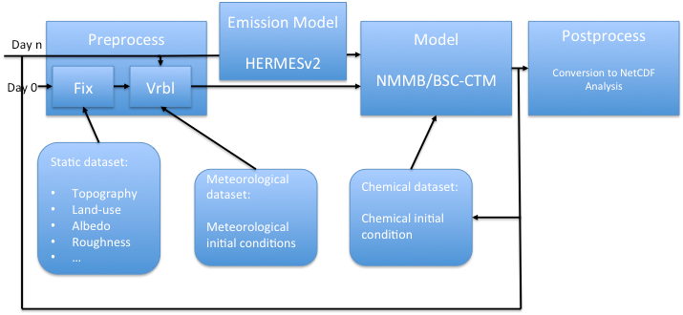
Workflow
Two ways to manage a workflow
Using a script language
Then waiting files, executions…
Using dependences in queues
With LSF: bsub -w ended(jobid) < job_command

Slide 12
NMMB/BSC Forecasts at Earth Sciences
Three operational and daily forecasts
Global (1.4ºx1º horizontal resolution) for 120h
GFS 00h
Meteo, Dust and Sea Salt
49 minutes for the model execution
Regional over NA-ME-E (0.33º x 0.33º) for 72h
GFS 12h
Meteo and Dust
71 minutes for the model execution
Regional over NA-ME-E (0.1ºx0.1º) for 72h
GFS 12h
Meteo and Dust
51 minutes for the model execution
Using a dedicated cluster on 16 cpu’s
Using 256 cpu’s in Mare Nostrum 3

Slide 13
Manage data
In Earth Sciences community, HUGE size of data can be generated.
We need different filesystems to work and store this data.
Immediate disk: disk in the supercomputer where the model is run. Very fast disk.
Medium term disk: one the data is generated, we need to work with the data to analyse it.
Long term storage: store the data, in case to reuse later. Usually tapes, speed is not a constraint.
Data storage costs money !!!
Before running a simulation, do an analysis about which variables you need later.

Slide 14
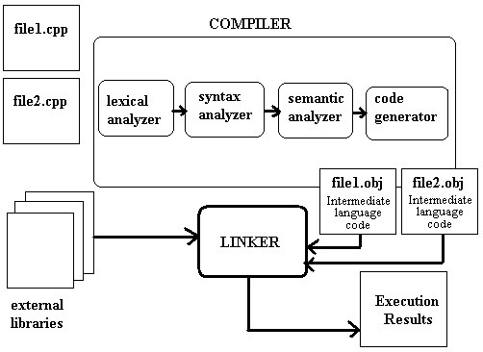
Compilers
We need to pass from codes written in languages that we understand (Fortran, C, C++,…)
In a code that the machine can understand.
Each final executable, will be different in each machine.
Sometimes compatible, sometimes not.

Slide 15
Compilers (II)
Differents compilers
GNU Compilers: gcc, gfortran
Licensed Compilers
Intel Compilers
PGI Compilers
Diferent results and behaviours !!!
Usually, Intel compilers perform much better tan others in Intel architectures.

Slide 16
Different Architectures
Distributed Memory
MPI, OpenMP
Shared Memory
OpenMP
GPU1
GPU1
GPU1
Accelerators
CUDA, OpenGL, Cell,
Xeon Phy...

Slide 17
Programming Models
Message Passing (MPI)
Shared Memory (OpenMP)
Partitioned Global Address Space Programming (PGAS) Languages
UPC, Coarray Fortran, Titanium
Next Generation Programming Languages and Models
Chapel, X10, Fortress, ompSs
Languages and Paradigm for Hardware Accelerators
CUDA, OpenCL
Hybrid: MPI + OpenMP + CUDA/OpenCL
New Xeon Phy Co-processors

Slide 18
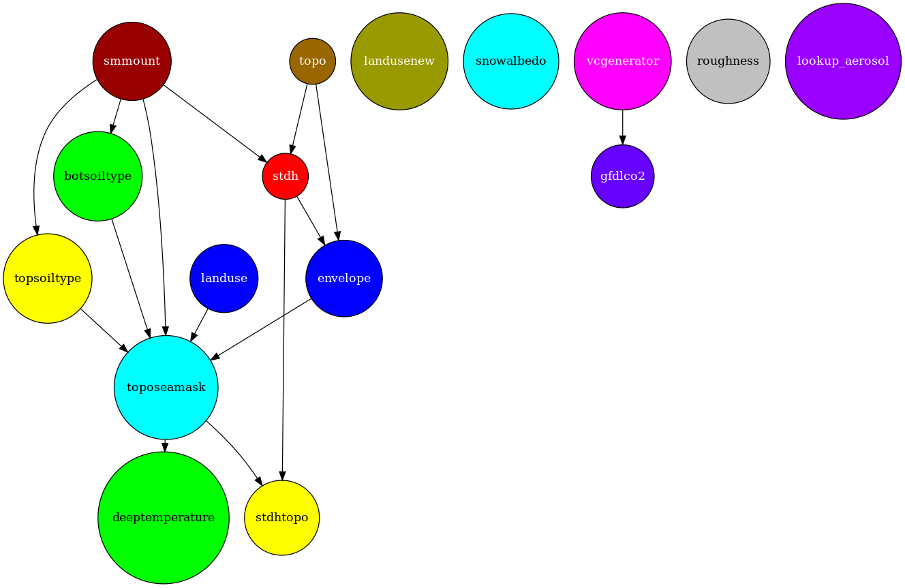
BSC Programming Model
OmpSs
Focused in extend OpenMP with new directives to support asynchronous parallelism and heterogeneity (devices like GPUs)
Exploit data dependencies
Heterogeneity
Make reduce the complexity on working with new devices and technologies.

Slide 19
Parallelizing Atmospheric Models
We need to be able to run this models in Multi-core architectures.
Model domain is decomposed in patches
Patch: portion of the model domain allocated to a distributed/shared memory node.
Patch
MPI/OpenMP Communication
with neighbours

Slide 20
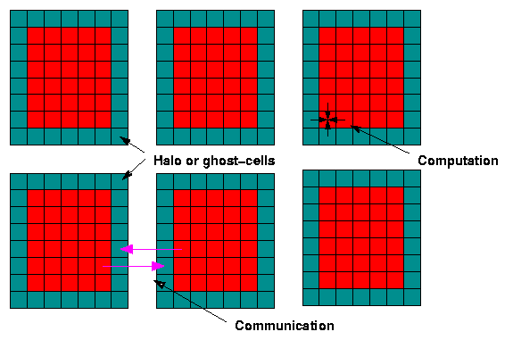
Parallelizing Atmospheric Models
Halo exchange

Slide 21
Parallelizing Atmospheric Models
X
Use a “smart” domain decomposition
Cores for X and Y axis
Try to follow Y > X
Ex: if we have 60 cores, X=6 and Y=10
We want to increase computation and reduce communication time
If the communication pattern is weak, the application will not perform well and will scale poorly.
Y

Slide 22
Optimizing your code
Optimizing the code
Getting better performances to run faster the models.
Many optimizations can be done
Take time to write/learn your code. Ask engineers.
In compilation time, ask for the usual compilations flags in your machine.
But be careful. Optimizations sometimes are no for free:
Compilation time is increased
It’s a tradeoff with precision.
Use tools to improve the analysis and get better performance

Slide 23
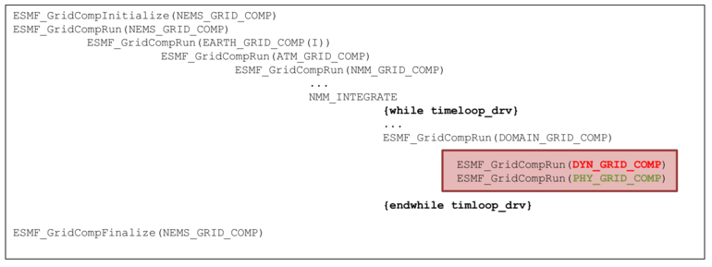
Analyze your code
Seems obvious, but it’s important to know the structure of your code
In NMMB,
Main Structure:

Slide 24
Analyze your code (II)

Slide 25
Optimization flags in Intel Fortran Compiler
Take a look to “Quick reference guide to optimization with Intel compilers version 13”
Step by step approach to optimize your code
Wide explanation about compiler options
General optimization options
-O0: No optimization. Used during the early stages of application development and debugging.
-O1: Optimize for size. Omits optimizations that tend to increase object size. Creates the smallest optimized code in most cases.
-O2: Maximize speed. Default setting. Enables many optimizations, including vectorization.
-O3: Enables -O2 optimizations, plus more aggressive loop and memory access optimizations.

Slide 26
Optimization flags in Intel Fortran Compiler (II)
Processor-Specific Optimization Options
-xtarget: Generates specialized code for any Intel processor that supports the instruction set specified by target.
-mtarget: Generates specialized code for any Intel processor or compatible, non-Intel processor that supports the instruction set specified by target.
Floating - Point Arithmetic Options
-fast=[1|2]: Allows more aggressive optimizations at a slight cost in accuracy or consistency. (fast=1 is the default) . This may include some additional optimizations that are performed on Intel microprocessors but not on non-Intel microprocessors.
-precise: Allows only value-safe optimizations on floating point code.
-double/extended/source: Intermediate results are computed in double, extended, or source precision Implies precise unless overridden.
-except: Enforces floating-point exception semantics.
-strict: Enables both the precise and except options, and does not assume the default floating-point environment.

Slide 27
Optimization flags in Intel Fortran Compiler (III)
Interprocedural Optimization
-ip: Single file interprocedural optimizations, including selective inlining, within the current source file.
-ipo: Permits inlining and other interprocedural optimizations among multiple source files. Long compilation time and for my experience, can fail uin building time.

Slide 28
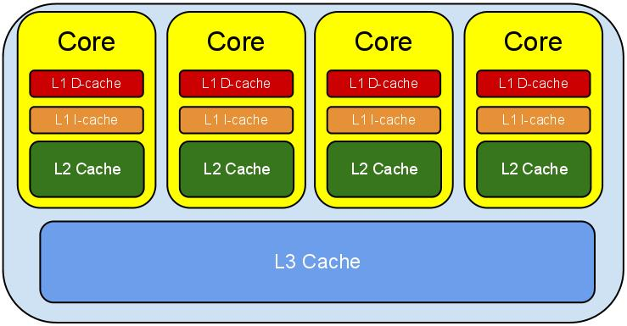
Optimization through Cache Hierarchy
Accessing data is an “expensive” operation
It takes more time to “move” data from memory than make an operation instruction
Take advantage of your cache hierarchy
+ TIME

Slide 29
Optimization through Cache Hierarchy (II)
How to do it ?
Make use of every word of every cache line.
Use a cache line intensively and then not return to it later.
Fortran stores matrices in column-major order (consecutive elements of a column are in consecutive memory locations).
Using this ordering, data is copied one column at a time.
This means copying adjacent memory locations in sequence.
All data in the same cache line are used, and each line needs to be loaded only once.

Slide 30
Scalability
How to decide how many cpus use in a job?
Depending on the scalability of the code.
Avoid wasting resources
If the code does not scale, giving twice cpu’s will no make your code twice faster !!!

Slide 31
Tools
Timing your application
/usr/bin/time
Profiling your application
Compile with debug and profile support
Using gprof tool to analize results
Focus on fuctions executed longer
real 49m54.536s
user 788m36.269s
sys 2m54.719s

Slide 32
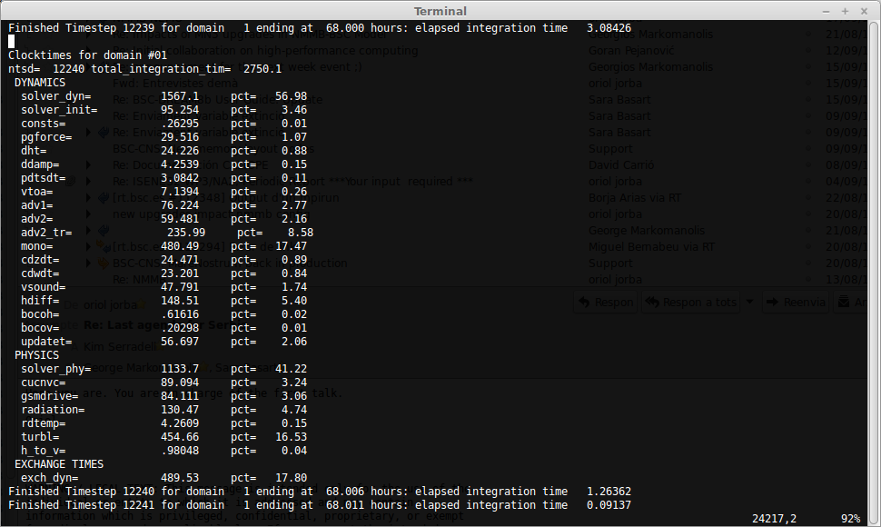
Tools (II)
In NMMB:
Internal timings

Slide 33
Tools - Paraver
Tools to analyse and visualize simulations
At BSC, we use Paraver
Paraver will extract information from an execution
CPU use
Memory consumption
Hardware counters
Communication pattern

Slide 34
Tools - Paraver

Slide 35
QUESTIONS
Хвала !

