Slide 1
Issues on the operational cluster
Up to 4.4x times variation of the execution time on 169 cores
Using -O2 optimization flag
Using IBM MPI without efficient mapping
Using IBM MPI parameters
Issues with the filesystem
I/O issues
1

Slide 2
Variation of the execution time
Four faulty nodes influence the performance of the cluster
Including all the nodes the execution time was between 75 and 330 seconds
Exclude the following nodes
#BSUB –R “select[hname!=100]”
#BSUB –R “select[hname!=102]”
#BSUB –R “select[hname!=104]”
#BSUB –R “select[hname!=105]”
The execution time without the above nodes is around to 75-90 seconds. The reboot of the nodes seems to solved the problem.
2

Slide 3
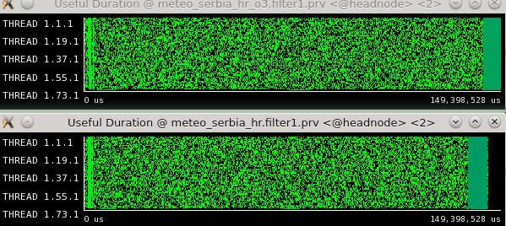
Using -O2 optimization flag
Using -O2 optimization flag
Using -O2 optimization flag
The usage of –O3 was crashing the model (without -g).
We added the –fp-model strict flag to take care the floating point operations and disable optimizations that can influence the results.
Not efficient results, but not trusted also
3

Slide 4
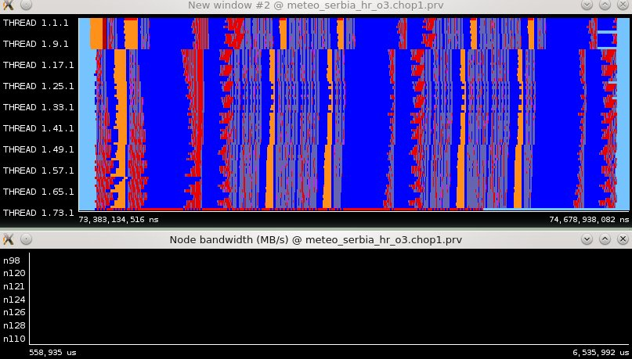
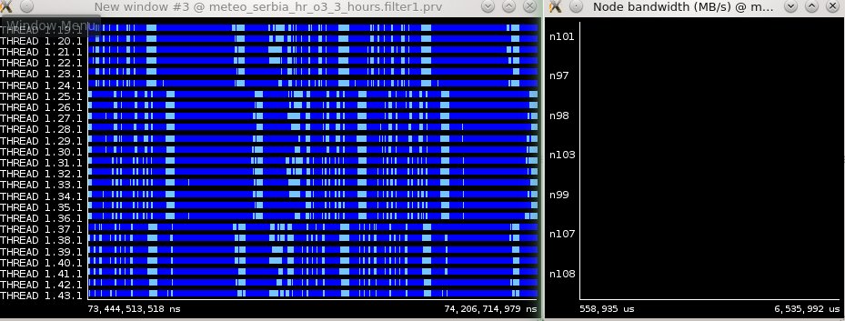
Issues with the hardware??
Issue with the node 98
4

Slide 5
Issues with the filesystem
In some cases no binary files are created with the output of the model
Error: failed.LSF error (res): Stale NFS file handle
Think about automatic submit of failed jobs?
5

Slide 6
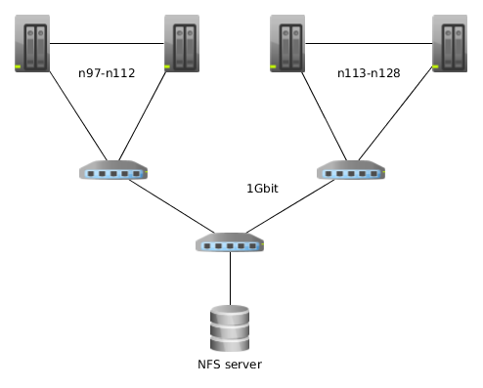
I/O issues
Machine GB M/sec (using only one node from the switch) n101 2 45.5
Machine GB M/sec (using two nodes from the switch) n101 2 29.0 n104 2 26.0
I/O bottlenecks easy to occur
with this network configuration
Using IBM MPI environment variables
6
6

Slide 7
Using IBM MPI environment variables
MP_EAGER_LIMIT=128K
MP_BINDPROC=yes
MP_TASK_AFFINITY=core
MP_RC_MAX_QP=4096
7

Slide 8
Remarks
Tested both NMMB versions with and without ESMF on the new machine
On operational ESMF NMMB, disable ESMF_Log calls
Synchronize the time across the nodes with NTP configuration
We suggest to do some more tests to run simulations with more balanced distribution of the nodes across the switches
8

